Slide 1
Why Developers Should Love PowerShell
Kurt Kroeker
EnergyCAP, Inc.

Slide 2
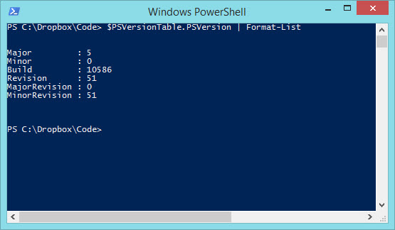
What is PowerShell?
This Photo by Unknown Author is licensed under CC BY-SA-NC

Slide 3



Slide 4

PowerShell and Me
File and folder manipulation
Running multiple programs with parameters
Database queries
REST API calls
Logging and emailing
Miami-Dade County

Slide 5
PowerShell and Me
Shortcuts to often-used directories
Library of personalized functions
Testing scripts
Build scripts
Automate manual, error-prone tasks

Slide 6

PowerShell and You!
It is POWERFUL
It is EVERYWHERE
It is FAMILIAR
Notes:
It is POWERFUL
Shell scripting faster than UI
One-liners for complex tasks
.NET, MS ecosystem fully integrated
It is EVERYWHERE
All desktop & server versions of Windows (XP+)
In your tools (Visual Studio, VS Code)
PowerShell Core supported for Mac OS, Linux
It is FAMILIAR
Aliases support commands from other systems
.NET and COM objects;
Build your own PS “Swiss army knife”

Slide 7
PowerShell Console Concepts
PowerShell Console
Commandlets
Aliases
Variables
Pipelines

Slide 8
PowerShell Script File Concepts
Script files
Functions
Operators
Error Handling
Param()
VS Code & ISE

Slide 9
PowerShell Working Tips
Get-Help, -Command, -Member
The tab key
Up/Down arrows & Ctrl + R
Your PowerShell Profile
Hash tables
Web API Interactions

Slide 10
PowerShell Gotchas
. Vs .\
Old code on the internet
Is it an array?
Calling programs with arguments
Working with strings

Slide 11
PowerShell Resources
PowerShell Core project
https://github.com/PowerShell/PowerShell
Microsoft PowerShell SDK Docs
https://docs.microsoft.com/en-us/powershell/scripting/developer/windows-powershell?view=powershell-6
PS Gallery
https://www.powershellgallery.com
PowerShell 6 Cheat Sheet
https://ilovepowershell.com/powershell-cheat-sheet/
Unit Testing PS with Pester
https://devblogs.microsoft.com/scripting/what-is-pester-and-why-should-i-care/
ExecutionPolicy Management
https://docs.microsoft.com/en-us/powershell/module/microsoft.powershell.security/set-executionpolicy?view=powershell-6

Slide 12
Conclusion
We covered…
What is PowerShell?
PowerShell is
Powerful
Everywhere
Familiar
PowerShell Console & Scripting Basics
PowerShell Working Tips & Gotchas
Any Questions?

Slide 13

Kurt Kroeker Sr. Software Engineer EnergyCAP, Inc.
Email: kurt.kroeker@energycap.com
Twitter: KurtKroeker

Slide 14
Subjects Not Covered
PSCustomObject creation
Add-Type to use DLLs
“Splatting” arguments
ExecutionPolicy

