Slide 1
Why Developers Should Love PowerShell
Kurt Kroeker
EnergyCAP, Inc.
Notes:
Introduce Myself
About This Talk/Agenda
Talking
What is PowerShell?
Kurt's PowerShell Background
Why should YOU care about PowerShell?
Demos
Introduction to PowerShell console and scripting basics
Tips working with PowerShell
PowerShell Gotchas
DISCLAIMER #1: I want to reiterate that this is a beginner thru intermediate entry into the world of PowerShell, so if you’re already an experienced PS user, you might not get much out of my talk.
Show of Hands: How many already using PowerShell cmdlets on a daily basis? Written your own functions?
DISCLAIMER #2: I have a lot to cover, so if you’re following along on your computer and have an issue with something you saw me do, please write down your questions for the end of the session and I’ll hang around afterward for a little bit, too.

Slide 2


Kurt Kroeker Sr. Integration Software Developer EnergyCAP, LLC
Email: kurt.kroeker@energycap.com
Notes:
sxa

Slide 3
PowerShell and Me
Shortcuts to often-used directories
Library of personalized functions
Testing scripts using Pester
Build scripts
Automate manual, error-prone tasks

Slide 4



Slide 5


Slide 6
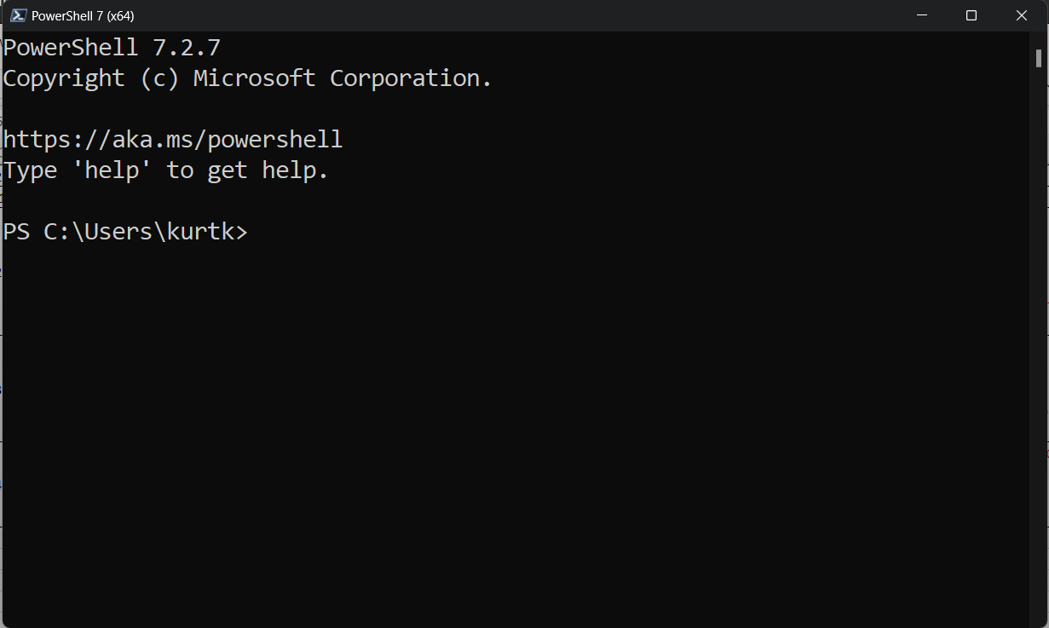
What is PowerShell?

Slide 7

PowerShell and You!
Powerful
Everywhere
Familiar

Slide 8
PowerShell Console Concepts
PowerShell Console
Commandlets + Parameters
Aliases
Variables
Pipelines

Slide 9
PowerShell Script File Concepts
Script files
Functions
Operators
Error Handling
Param()
VS Code & ISE

Slide 10
PowerShell Working Tips
Get-Help, -Command, -Member
The tab key
Up/Down arrows, Ctrl + R, Ctrl + C
Your PowerShell Profile
Web API Interactions
Notes:
Get-Help, -Command, -Member
Mention twice because it’s so useful
high discoverability of PowerShell functionality and leverage the power of comment-based help.
Get-Help works for your code, not just pre-packaged code; good practice to document using comment-based help. Keeps your PS documentation up to date along with your source code.
DEMO: demo_commentBasedHelp.ps1
Tab key
Use the tab key to autocompletes everything:
Commandlet/function/alias names
File/folder paths
Variable names
Variable values (enum)
Types
Up/Down arrows, Ctrl + R, Ctrl + C
Common to most CLIs; get your commands back by hitting the up/down arrows to navigate the previous command, even from session to session.
Ctrl + R is a reverse lookup within your previous commands based on search text (feature from bash brought into PowerShell)
Ctrl + C to cancel a long-running or botched command
Love your PowerShell profile
Keep common function available, by adding the functions you use the most to your Microsoft.PowerShell_profile.ps1 file.
Find it with $PROFILE
Keep it in source control?!
Love Invoke-RestMethod
- Web API interactions are easy with PowerShell
DEMO: demo_apiCalls.ps1

Slide 11
PowerShell Gotchas
Is it an array?
Calling programs with arguments
Working with strings
Notes:
Working with strings
Watch your quotes! PS allows both single and double quotes to be used for declaring strings
Only double quotes honor string interpolation
DEMO: Show single vs double quote example
Can usually choose single or double quotes when working with short strings, when you have to work with stringified JSON. Here-Strings are your friend
DEMO: Show multi-line Here-String (demo_hereString.json)
String interpolation with complex object; surround with $() : Get-ChildItem | ForEach-Item { “The length of this file is $_.length” }
Is it an array?
In scripting you may find that variables which you expected to be an array are not.
E.g. Get-ChildItem returns an array of files OR a single file (if there was only 1)
Scenarios like this expose themselves where you expect a loop to execute multiple times but they error! Get-Service also subject to this effect
Done on purpose to make console experience nicer
Save yourself using the array cast operator @()
Calling programs with arguments
Getting the syntax right was super frustrating when I wanted to execute an EXE with some arguments
It's easy to get confused by PowerShell's behavior when it comes to the syntax for passing arguments into EXEs
DEMO: demo_consoleArgs.ps1

Slide 12
Conclusion
We covered…
What is PowerShell?
PowerShell is
Powerful
Everywhere
Familiar
PowerShell Console & Scripting Basics
PowerShell Working Tips & Gotchas
Any Questions?
Notes:
Q & A
Q: Why should I use PowerShell Core vs. regular?
PSCore feature set is smaller b/c .NET Core is newer
Run PS-based automation in other OSs
PowerShell core is open source; see the guts
NOTE: can't use ISE in PSCore...use VSCode insteads
Q: Why should I use Visual Studio Code vs the ISE?
VS Code
Is much nicer for managing projects/workspaces
More customizable than the ISE (e.g. default terminals for PS or PSCore)
Debugging experience was prettier
However, integrated PS terminal was not as nice; quirks of text input, autocomplete not as nice; display experience a little lacking
Code snippet completion is a little annoying
ISE
Already installed everywhere
Decent debugging experience
ISE is not included as part of PowerShell Core; you'll have to use VS Code

Slide 13
PowerShell Resources
PowerShell Core in GitHub
https://github.com/PowerShell/PowerShell
PS Gallery
https://www.powershellgallery.com
Unit Testing PS with Pester
https://pester.dev/

Slide 14
Kurt Kroeker Sr. Integration Software Developer EnergyCAP, LLC
Email: kurt.kroeker@energycap.com
Download PowerPoint and demo files here:
Todo - LINK
Notes:
sxa

Slide 15
Subjects Not Covered
PSCustomObject creation
Add-Type to use DLLs
“Splatting” arguments
ExecutionPolicy

