Slide 1
DevOps Automated Testing
By: Kurt Leadley

Slide 2
The Importance of Automated Testing
It is important to keep your code base in a deployable state at all times.
Any code change to the system should be tested thoroughly. This ensures that if there is a problem, it is caught before multiple other changes to the system are made.
When an error is not immediately caught and fixed, other errors in newer code pushes can be introduced, creating a massive problem that is hard to fix.
These types of problems can be addressed with Automated Testing

Slide 3
Automated Testing
Automated testing is one of the many tools used for implementing continuous integration, which is the ability to constantly make changes without breaking the system.
To have continuous integration work, you need to be able to deploy code at all times.
Automated testing is used to find an error as soon as possible so that it can be fixed and the system can go back into a deployable state.
A deployable state is also known as a green state.
Automation Testing is generally split up into three categories
Unit Tests
Acceptance Tests
Integration Tests

Slide 4
Unit Tests
These tests are tests on small pieces of code
They tend to test a single function or method
They are easy to debug because you root cause is limited to a small block of code
They are the easiest and fastest type of automated test to create
They are the fastest type of test to run
They are not used in conjunction with a database or other external dependencies
Unit tests should run very fast—your whole suite, even for a large application, should be able to run in under ten minutes (Humble & Farley, 2011, p. 60)

Slide 5
Acceptance Tests
Generally is a test of the application
This is done to “provide assurance that a higher level of functionality operates as designed” (Kim, Debois, Willis, Humble, & Allspaw, 2017, p. 131)
A change to some code might have a negative impact on another aspect of the application that was not even being worked on. So it is good to test the entire application
These are not UI tests and are still automated tests
Acceptance tests take longer to run than a unit test
They are harder to debug than a unit test

Slide 6
Integration Tests
This is a step further than the Application Test
It tests the Application and also anything that is involved with the Application. An example could be a book ordering application inside of a website that has many other features than just ordering a book
This is the slowest type of testing
This is the hardest type of testing to debug
This testing often involves many different teams that may not even be involved with your code deploy
It is ideal to do any testing at the unit or application layer that you can
It is still a necessary test to conduct

Slide 7
Integration Tests Cont.
“It is essential to ensure that you don’t hit a real external system unless you are in production, or you have some way of telling the service that you are sending it dummy transactions for testing purposes.” (Humble & Farley, 2011, p. 96).
This is to prevent your tests from having any effect on the real system
Ideally external systems that you need to test in your integration tests also have a test environment
Many times, the external system does not have a reliable test environment and you have to try to create your own
This is why the integration test is the most time consuming and difficult type of test to write, conduct and debug

Slide 8
Testing Pyramid
This is a concept which states that Unit tests should be the first and most often used type of automated test
This is because Unit Tests can be written quickly, they run quickly and they are easier to debug
The ideal automation environment should find errors as soon as possible and also as cheaply as possible. There is not reason to run a 2 hour long acceptance test just to find out that a function that produces a random number was incorrectly written.
This means that unit tests should always run before acceptance and integration tests
This also means that any test that can be written as a unit test should be a unit test and not one of the other two types

Slide 9
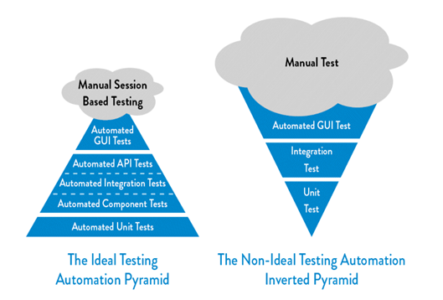
Ideal vs Non-Ideal Testing Pyramid
(Figure from The DevOps Handbook p. 133)

Slide 10
Resources
Kim, G., Debois, P., Willis, J., Humble, J., & Allspaw, J. (2017). The DevOps handbook: how to create world-class agility, reliability, and security in technology organizations. Portland, OR: IT Revolution Press, LLC.
Humble, J., & Farley, D. (2011). Continuous delivery. Upper Saddle River, NJ: Addison-Wesley.
Cohn, M., & Lister, T. R. (2015). Succeeding with agile: software development using Scrum. Chennai: Pearson.

