Slide 1
LeNet-style CNN
Input and feature shapes: height × width × channels
02 LeNet-style CNN
Stage | Operation | Output
Input | Grayscale image | 28 × 28 × 1
Features 1 | 5 × 5 conv, tanh, average pool | 14 × 14 × 6
Features 2 | 5 × 5 conv, tanh, average pool | 5 × 5 × 16
Classifier | Dense layers with tanh | 120, 84
Output | Linear layer | 10 logits
Implemented two convolution and average-pooling stages with tanh activations and a dense classifier. Padding adapts the first convolution to the original digit size.
First convolution: padding 2
Open notebook
Notes:
Sources: https://github.com/KurtMeehanPro/digit-recognizer/blob/main/notebooks/02_lenet_style_cnn.ipynb
Architecture: https://github.com/KurtMeehanPro/digit-recognizer/blob/main/scripts/model/digit_model_definitions.py
Shapes computed from the implemented LeNet layers.

Slide 2
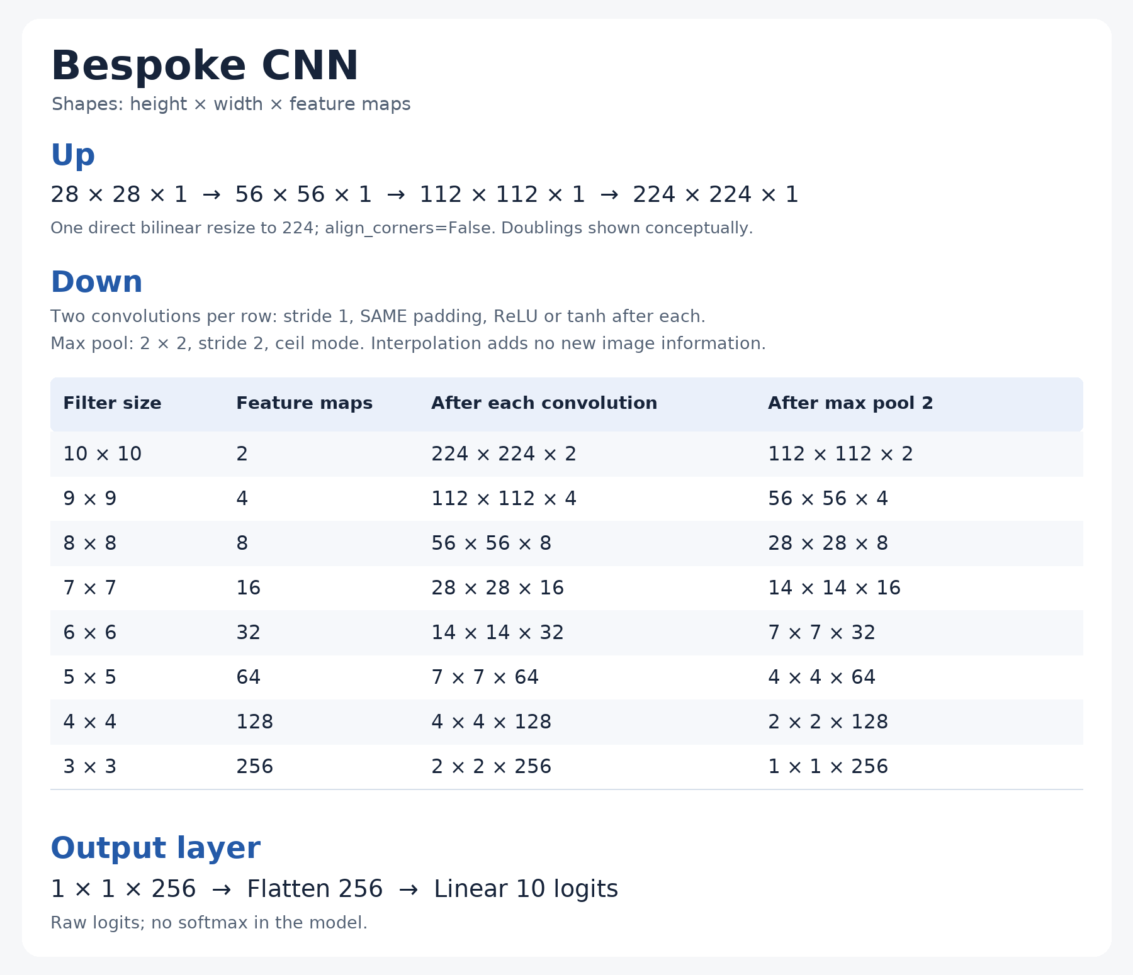
03 Bespoke
upsampling CNN
Resized each digit directly from 28 × 28 to 224 × 224, then applied eight two-convolution stages. Compared ReLU and tanh across learning rates. Interpolation adds no image information.
Open notebook
Notes:
Source notebook: https://github.com/KurtMeehanPro/digit-recognizer/blob/main/notebooks/03_bespoke_upsampling_cnn.ipynb
Original card: docs/evaluations/assets/bespoke-224-architecture.png
Architecture: scripts/model/digit_model_definitions.py

Slide 3
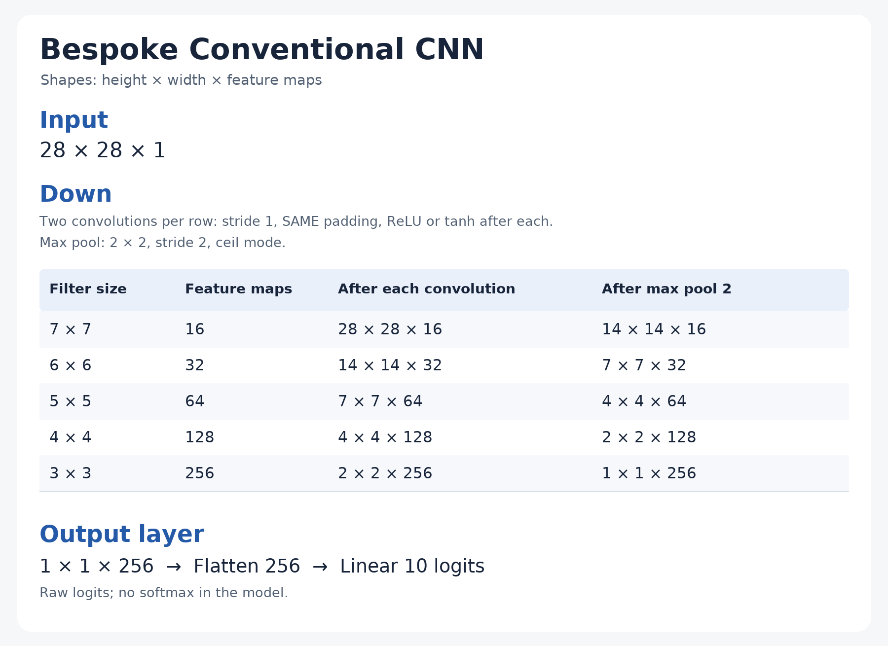
04 Bespoke
conventional CNN
Kept the original 28 × 28 input and used five two-convolution blocks. Compared ReLU and tanh across learning rates using the conventional architecture.
Open notebook
Notes:
Source notebook: https://github.com/KurtMeehanPro/digit-recognizer/blob/main/notebooks/04_bespoke_conventional_cnn.ipynb
Original card: docs/evaluations/assets/bespoke-conventional-architecture.png
Architecture: scripts/model/digit_model_definitions.py

Slide 4
Conventional CNN
Performance experiments
05 Conventional CNN
performance
Same five-block architecture
Fixed training rotations
Reused the conventional architecture and changed the training setup: fixed rotations, learning-rate searches, longer training from fresh initialization, and separate regularization trials. Validation stayed upright.
0°, ±5°, ±10°, ±22°, ±45°, ±90°
Optimization experiments
Activation, learning rate, and longer training
Regularization experiments
Explicit L2, decoupled weight decay, and both
Open notebook
Notes:
Source: https://github.com/KurtMeehanPro/digit-recognizer/blob/main/notebooks/05_bespoke_conventional_cnn_performance.ipynb
Configuration implementation: scripts/model/digit_model_experiments.py
Reuses BespokeCNN28 from notebook 04. The eleven-view augmentation and regularization trials belong to notebook 05.

Slide 5
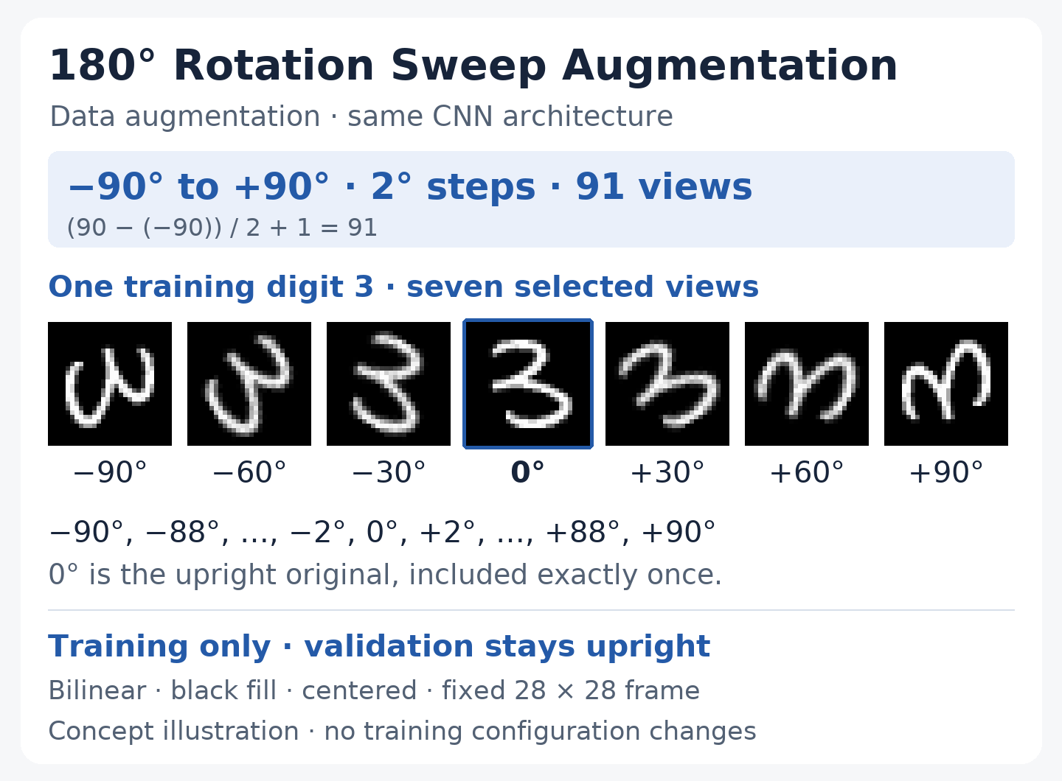
Scratch concept
91-view rotation sweep
A separate scratch concept for 91 fixed views per training digit, from −90° to +90° in 2° steps. The CNN stays unchanged and validation remains upright.
Repository
Notes:
Source card: docs/evaluations/assets/rotation-sweep-concept.png
Repository: https://github.com/KurtMeehanPro/digit-recognizer
Separate scratch concept, not a new numbered notebook. Original card retained unchanged.

Slide 6
References
https://github.com/KurtMeehanPro/digit-recognizer

