Slide 1
Investigating Return on Investment for NPS Graduate Degrees
Capt Quinn Harrison
MAJ Janet Karanja
LT Kurt Pasque
MAJ Ryan Kelton

Slide 2
Agenda
Purpose: To provide the results of the analysis, solicit feedback on our approach and dashboard, and discuss future research.
Agenda
Restatement of team problem, mission, and end state
Proposed Analysis to Convey NPS Value
Commander Survey
Thesis Data Analysis
Service Specific Analysis
Demo of Analytical Tool
Findings, contributions, and way ahead

Slide 3
Problem, Mission, End State
Problem: How do we measure the ROI of an NPS graduate degree for the Navy, joint services, and DOD, in terms that are meaningful to senior DOD leaders and sets it apart from other funded graduate programs.
Mission: The team develops a data collection plan and supporting infrastructure focused on a specific service and single department, to assess ROI and enable additional NPS research.
End state: The team has a data collection plan and supporting infrastructure that outlines survey questions, and specific data needed from and about NPS graduates. This information is scalable to additional departments and year groups and is provided to a future thesis student for follow on research.

Slide 4
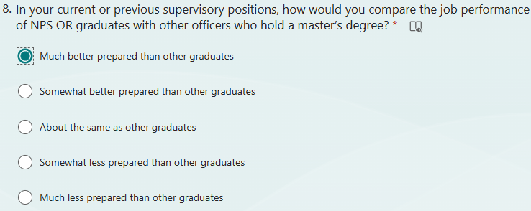
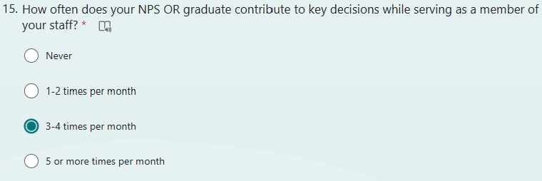
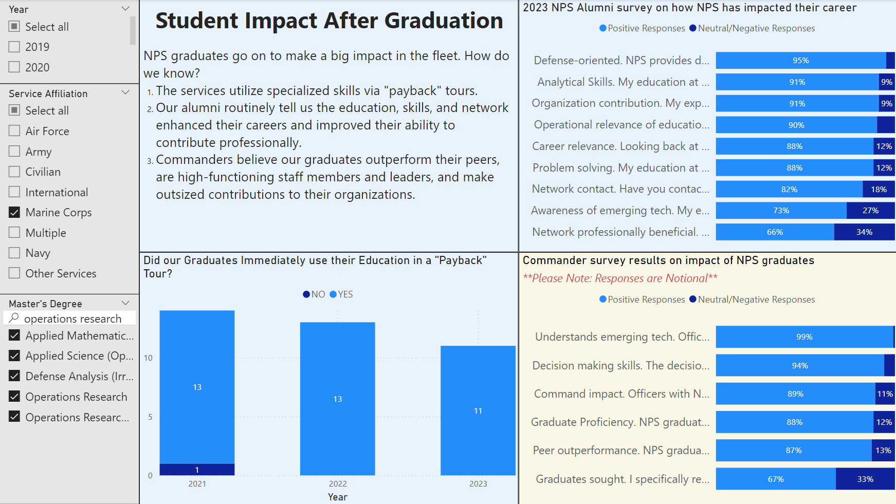
Commander Survey
Purpose of the Survey
Capture comprehensive feedback from senior leaders, gaining insight into fleet attitudes and perspectives on NPS and its graduates.
Identify strengths to communicate outward and areas for improvement within NPS.
Current State
Our current survey is iteration one, we hope to hand off as future work for development of a robust survey that ensures methodological rigor and reliable data collection.
Key Metrics and Impact
Extracting metrics on NPS graduate job performance, skills, and impact as viewed by senior leaders.
Initiate feedback loop that could affect NPS alignment with fleet needs.
Demonstrate to key stakeholders NPS’s value and impact to senior leadership should convey strong message of value.
This survey tool can be used to assess what Commanders in the fleet value about NPS graduates, and what skills they value in their commands.
Notes:
- Not going to review the whole survey itself during the outbrief, we'll send the survey to Laurel and let IE handle the survey itself
"We built a survey tool, and handed it out to Laurel and their team"
Include bumper sticker

Slide 5
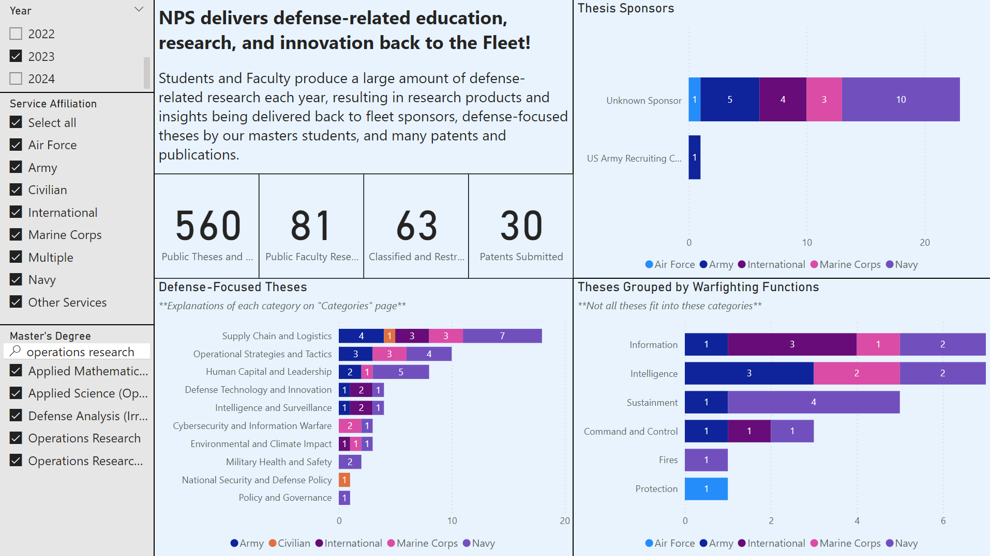
Thesis Data Analysis
Purpose of Analysis: Demonstrate how analysis of student research can be presented to show immediate impact of student theses on sponsor commands in critical, highly relevant topic areas.
Findings
Analysis can reveal research areas being focused on, conveying relevance in terms meaningful to senior leaders.
Categorizations can be in terms familiar to senior leaders like Joint Warfighting Functions or some other category depending on audience.
We can see what sponsoring commands were impacted by student research, showcasing impact of student research on the fleet to senior leaders.
Also helps illustrate gaps to NPS leadership, highlighting potential commands for engagement on how to plug into NPS ecosystem and benefit from student and faculty research.
Methods
Using ChatGPT’s API and tailored prompts to classify public abstracts.
Using text analysis tools learned in OR department.
Possible changes to how we collect thesis data could better highlight sponsored commands and research areas.
Notes:
Possible changes to how we collect thesis data could better highlight sponsored commands and research areas.
These are exemplars of how we should show the data, but we also want to know if this is useful for the leadership / answering questions
Could be displayed in a number of ways – who could be benefitted by this
Charts are OR, 2023, all services
Out of 3623 theses, only 220 showed a sponsor.

Slide 6
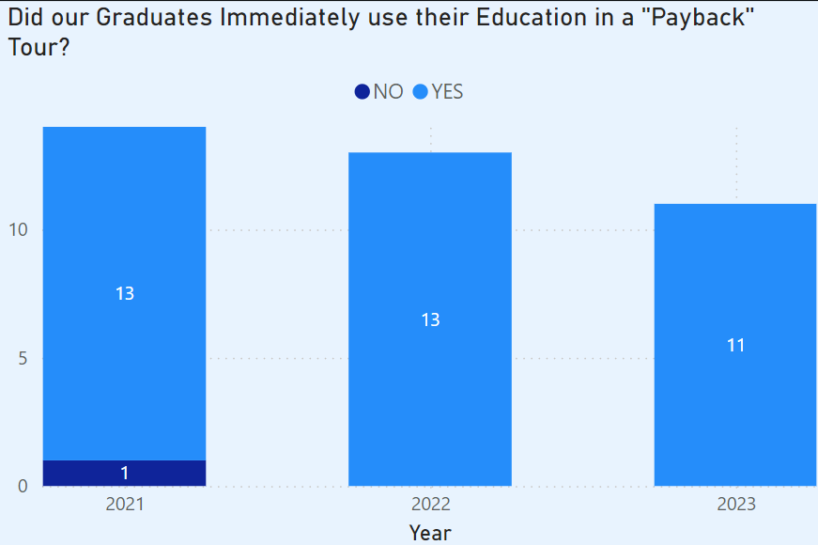
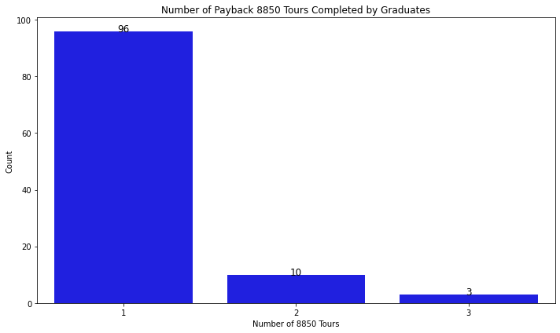
Service Specific Analysis
Purpose of Analysis: Develop metrics scalable to other services that reflect utilization of NPS graduates in relevant billets requiring their education.
Findings
Immediate utilization. Many degrees at NPS are relevant to specialized staff roles across the DOD. Immediate utilization reflects delivery of value back to the services.
Repeated utilization. Officers completing multiple utilization tours reflect a high degree of expertise earned in a particular specialty. This expertise is invaluable to the services and ensures critical human capital is built and retained within the ranks of our active duty forces.
Methods
This analysis requires connections to external, service-owned data, and a data matching effort with NPS data. The IR team currently fosters many relationships for this kind of data and this capstone helped facilitate a connection with the Marine Corps.
Service level utilization analysis can show immediate impact of NPS on specialized readiness needs and development of critical human capital.
Notes:
Go to a single color for the bottom bar chart
Developing/experimenting with different metrics to demonstrate ROI
Immediate utilization: how are degrees being used to fill billets?
Repeated utilization: are graduates continuing to give back to the force?
Methods: We can match data present at NPS (thesis data) with fleet provided data (orders written for specific communities) to create tools/metrics that help demonstrate ROI to the greater force

Slide 7
Power BI Dashboard Demo
Notes:
-have a good base that we pull up.
-then have a scripted few changes to demonstrate functionality
-DO NOT dazzle them too much
-mimic the backup slides for first presentation
-cdr survey data – make "notional data" in bold red letters

Slide 8
Outputs Directly from NPS
The goal is to communicate value from NPS by showing connection between students, commands, and strategic research areas.
Notes:
Include bumper sticker

Slide 9
Graduate Impact on Fleet
These graphics attempt to communicate NPS graduate impact by highlighting service, command, and career impacts.
Notes:
Stick in bumper sticker
"Metrics are scalable to the joint force"

Slide 10
Findings and Way Ahead
Findings
Storytelling through student theses. There is an opportunity to better aggregate and communicate the work of all students in metrics using the methods we proposed in addition to current anecdotal methods.
Sponsor data. This data is currently not tracked consistently. We recommend adding a required dropdown field for listing sponsors for all students submitting theses.
Problem framing. We recommend future research in developing a framework for the DOD senior leaders NPS must engage with to focus evangelism efforts and NPS responses to identified gaps. Example could be a spectrum, identifying ways to address moving leaders up ladder:
Key contributions of our project
Analytical tool that proposes how to highlight NPS value to DOD decision makers.
Text analysis of thesis metadata to highlight student research areas.
Introduction of commander survey that can create valuable senior leader feedback loop.
Service level analysis showing value delivered back to USMC.
Our efforts initiated a relationship between IR and USMC for future work.
Way Ahead
Phase 2: Pass all materials (dashboard, technical report, code, data) to next leg of research relay, Group Captain Pravin Dikshit.
Opponents | Critics | Neutrals | Supporters | Champions
Notes:
Include a way ahead: Power BI dashboard tool that will be passed on as thesis level work
-text analysis (as opposed to Chat-GPT we could use TRAC Monterey LLM)
-phase 1 was the captsone,
-way ahead is phase 2, Group CPT Pravin conducts thesis research

