Slide 1
Robust Tropical Neural Networks
Dr. Ruriko Yoshida, OR Department, NPS
Dr. Jefferson Huang, OR Department, NPS
Dr. Keiji Miura, Kwansei Gakuin University
Maj Christopher Teska, OR PhD Candidate, NPS
LT Kurt Pasque, OR Masters Student, NPS

Slide 2
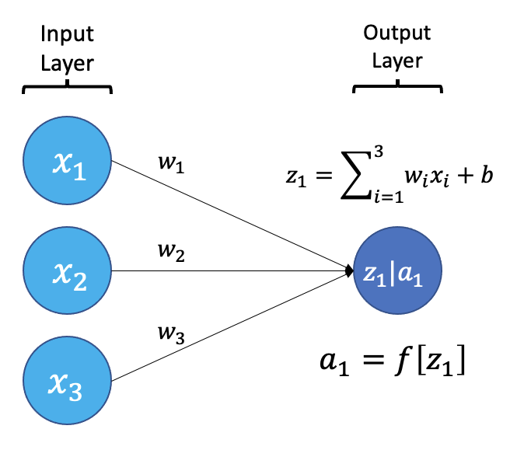

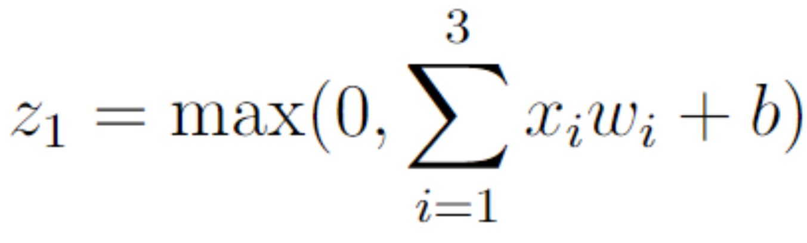
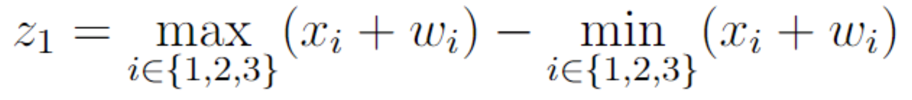
Tropical Layers
How ReLU Activated Neural Network Layers Work
How our Tropical Neural Network Layer Works
Notes:
Z_1 tropical norm, distance from tropical distance, projecting onto mod1 space

Slide 3
Tropical Layers
How our Tropical Neural Network Layer Works
How ReLU Activated Neural Network Layers Work
Notes:
Z_1 tropical norm, distance from tropical distance, projecting onto mod1 space

Slide 4
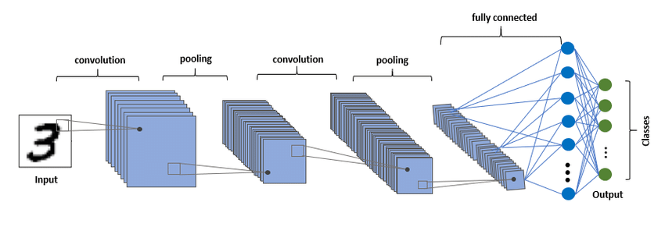


Experiment
EXPERIMENT
Train 2 identically structured models (1 w/ ReLU activations, 1 w/ LAST layer Tropically activated) on a training set.
Attack test set using projected gradient descent attack.
Evaluate model accuracy on test set pre/post attack.
Repeat for 3 open-source, benchmark datasets.
MODEL STRUCTURES
Similarities: Convolutional Neural Network (CNN) w/ 3 convolutions followed by 2 fully connected layers. ReLU activations for all layers except the last layer.
Differences: Last layer (that produces the logits) for tropical network uses tropical neurons.

Slide 5
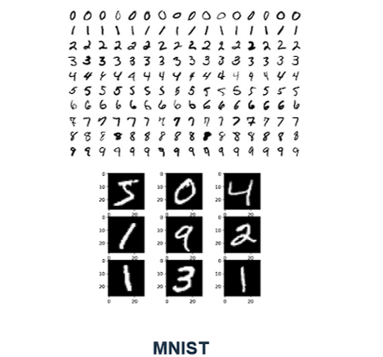

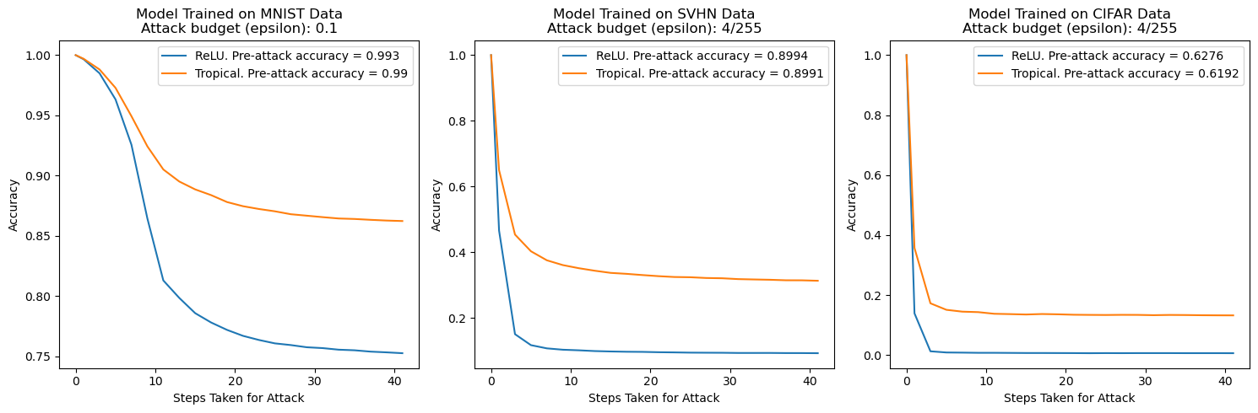
Data + Results
~0.11 delta
~0.22 delta
~0.13 delta

Slide 6

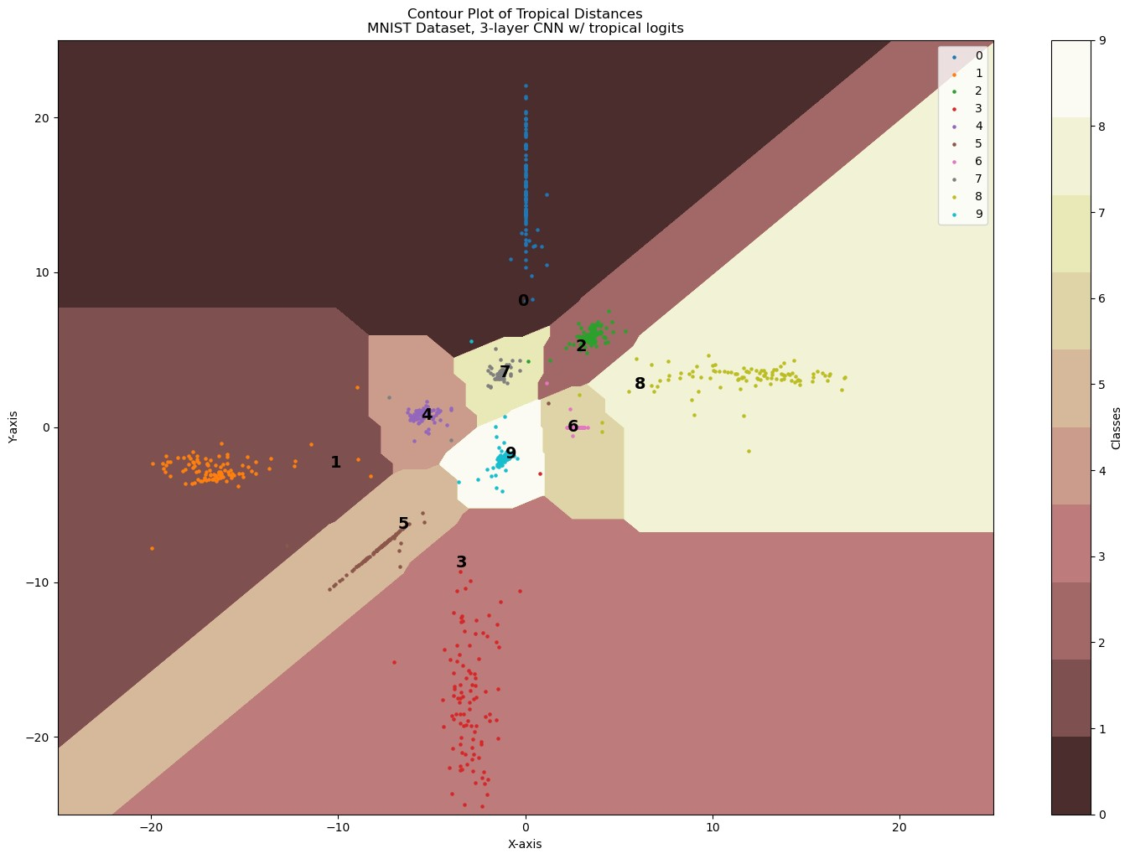
Decision Boundaries Visualized
3 neurons in this layer allow us to project our trained weights (labeled 0-9 in black), the Voronoi diagram representing the decision boundaries, and 100 input samples of each class (the dots)
This model structure was trained on MNIST data and still classified pretty well (~0.98 accuracy), allowing us to produce this visual.

Slide 7
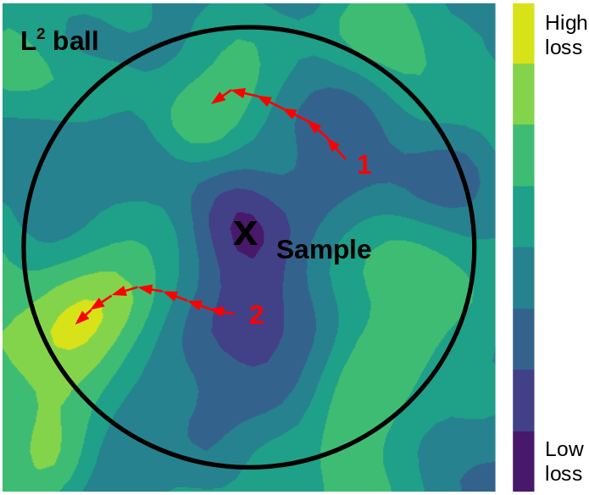
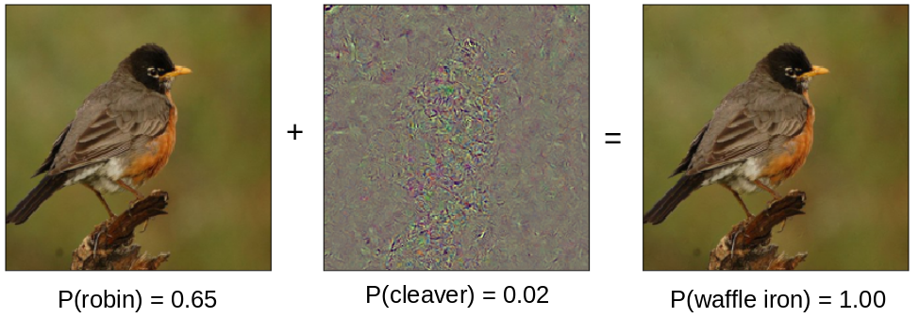
Attack Used
Projected gradient descent attack
Method:
Take a gradient step in the direction of greatest loss
Project perturbation back into L^1 ball if necessary
Repeat 2–3 for user specified number of steps
Parameters we used:
Epsilon = 0.1 (MNIST) -or- 4/255 (SVHN, CIFAR)
Step size = 0.01
Possible expansion: starting the attack from a random perturbation within the L^1 ball like the visual on the right.
2-D visual where the starting point is a random place within L^2 ball. Our method currently would start at the “x” in this visual and not 1 or 2 and our method would be a square not a circle:
Notes:
source:https://towardsdatascience.com/know-your-enemy-7f7c5038bdf3

