Slide 1
CS411
Database Systems
04: Relational Algebra

Slide 2

Why Do We Learn This?

Slide 3
Querying the Database
Goal: specify what we want from our database
UIUC-employee ( SSN, name, address, salary)
IRS-IL (SSN, city, year-of-filed-return)
Find all the employees who earn more than $50,000 and pay taxes in Champaign-Urbana.

Slide 4
Querying the Database
Could write in C++/Java, but bad idea
Instead use high-level query languages:
  Theoretical: Relational Algebra, Datalog
  Practical: SQL
  Relational algebra: a basic set of operations on relations that provide the basic principles.
Worry free

Slide 5
Motivation by analogy: The Stack
To use the “stack” data structure in my program, I need to know
  what a stack looks like
  what (useful) operations I can perform on a stack
    PUSH and POP
Next, I look for an implementation of stack
  browse the Web
  find many of them
  choose one, say LEDA

Slide 6
Motivation: The Stack (cont.)
LEDA already implements PUSH and POP
It also gives me a simple language L, in which to define a stack and call PUSH and POP
  S = init_stack(int);
  S.push(3); S.push(5);
  int x = S.pop();
Can also define more complex operations
  T = init_stack(int);
  T.push(S.pop());

Slide 7
Motivation: The Stack (cont.)
To summarize, I know
  definition of stack
  its operations (PUSH, POP): that is, a stack algebra
  an implementation called LEDA, which tells
  me how to call PUSH and POP in a language L
  I can use this implementation to manipulate stacks
  LEDA hides the implementation details
  LEDA optimizes implementation of PUSH and POP

Slide 8
Now Contrast It with Rel. Databases
Defn. of relations
relational algebra
To summarize, I know
  definition of stack
  its operations (PUSH, POP): that is, a stack algebra
  an implementation called LEDA, which tells
  me how to call PUSH and POP in a language L
  I can use these implementations to manipulate stacks
  LEDA hides the implementation details
  LEDA optimizes implementation of PUSH and POP
SQL language
operation and query optimization

Slide 9
What is an “Algebra”?
Mathematical system consisting of:
  Operands --- variables or values from which new values can be constructed.
  Operators --- symbols denoting procedures that construct new values from given values.

Slide 10
Q: Example algebra?
Arithmetic algebra. Linear algebra.
What are operands?
What are operators?

Slide 11
What is Relational Algebra?
An algebra whose operands are relations or variables that represent relations.
Operators are designed to do common things that we need to do with relations in a database.
The result is an algebra that can be used as a query language for relations.

Slide 12
Relational Algebra at a Glance
Operators: relations as input, new relation as output
Five basic RA operations:
  Basic Set Operations
    union, difference (no intersection, no complement)
  Selection: σ
  Projection: π
  Cartesian Product: X
When our relations have attribute names:
  Renaming: ρ
Derived operations:
  Intersection, complement
  “Join”s (natural, equi-join, theta join)

Slide 13
Basic RA Operations

Slide 14
Set Operations
Union, difference
Binary operations

Slide 15
Set Operations: Union
Union: all tuples in R1 or R2
Notation: R1 U R2
R1, R2 must have the same schema
R1 U R2 has the same schema as R1, R2
Example:
  ActiveEmployees U RetiredEmployees

Slide 16
Set Operations: Difference
Difference: all tuples in R1 and not in R2
Notation: R1 – R2
R1, R2 must have the same schema
R1 - R2 has the same schema as R1, R2
Example
  AllEmployees - RetiredEmployees

Slide 17
Selection
Returns all tuples which satisfy a condition
Notation: σ_{c}(R)
c is a condition (uses =, <, >, and, or, not)
Output schema: same as input schema
Find all employees with salary more than $40,000:
  σ_{Salary > 40000} (Employee)

Slide 18
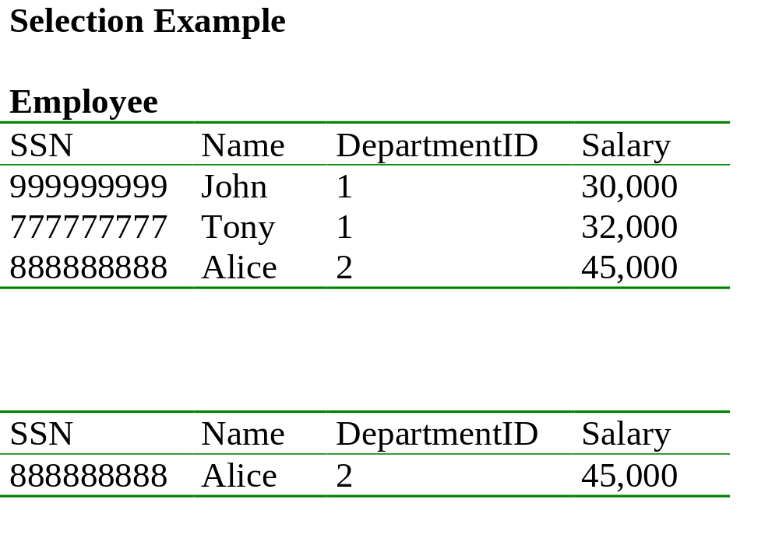
Find all employees with salary more than $40,000.
σ _{Salary > 40000} (Employee)

Slide 19
salary more than $30,000 and department id = 2
σ _{Salary > 40000} (Employee)

Slide 20

Projection
Unary operation: returns certain columns
Eliminates duplicate tuples !
Notation: Π _{A1,…,An} (R)
Input schema R(B1,…,Bm)
Require: {A1, …, An} {B1, …, Bm}
Output schema S(A1,…,An)
Example: project social-security number and names:
  Π _{SSN, Name} (Employee)

Slide 21
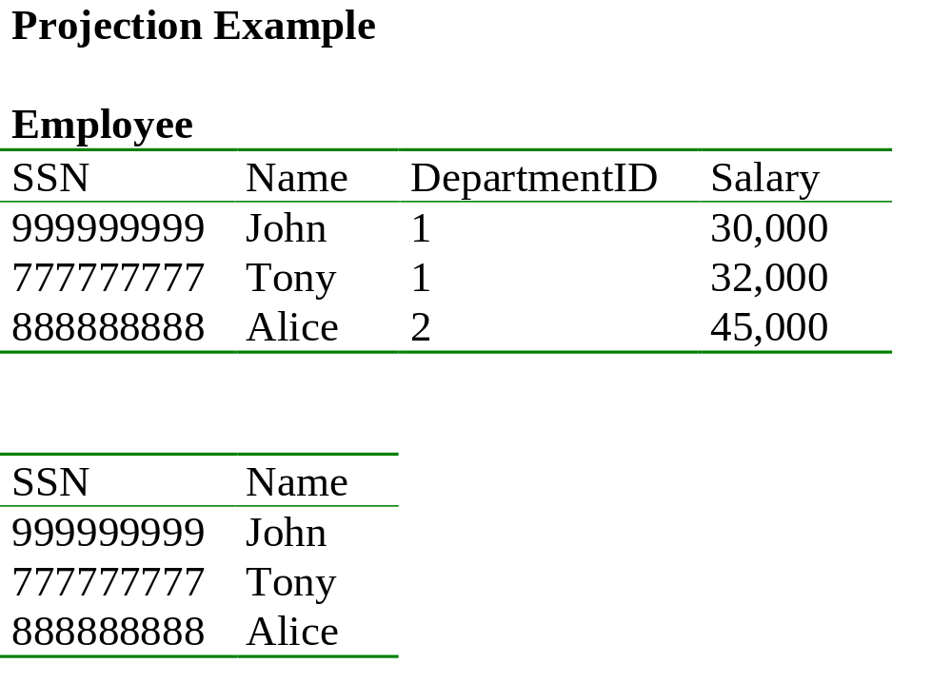
Π _{SSN, Name} (Employee)

Slide 22
Q: Comparing projection and selection?
Think of relation as a table.
How are they similar?
How are they different?
Why do you need both?

Slide 23

Cartesian Product
Each tuple in R1 with each tuple in R2
Notation: R1 x R2
Input schemas R1(A1,…,An), R2(B1,…,Bm)
Condition: {A1,…,An} {B1,…Bm} = Φ
Output schema is S(A1, …, An, B1, …, Bm)
Notation: R1 x R2
Example: Employee x Dependents
Very rare in practice; but joins are very common

Slide 24
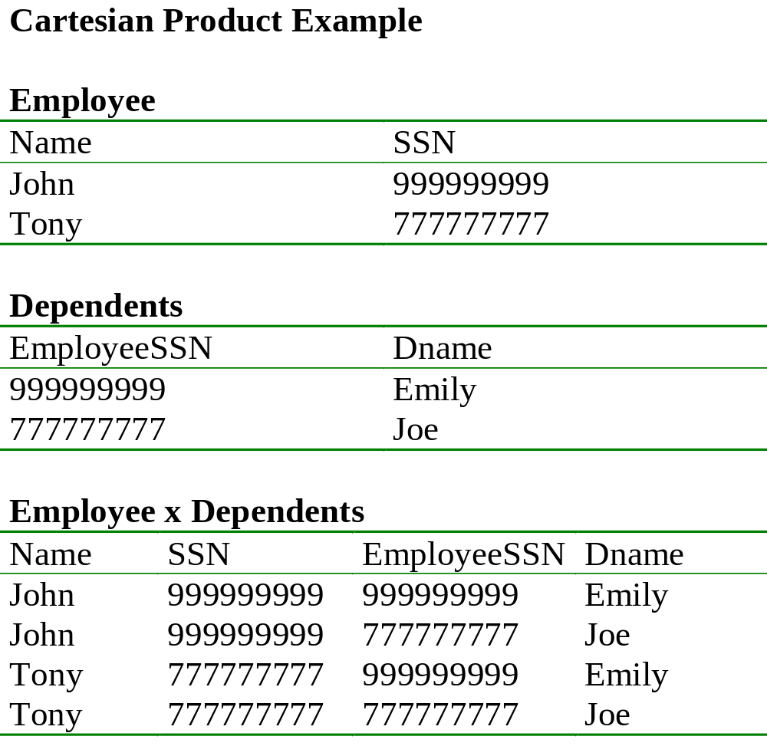

Slide 25
Cartesian Product
Each tuple in R1 with each tuple in R2
Notation: R1 x R2
Input schemas R1(A1,…,An), R2(B1,…,Bm)
Condition: {A1,…,An} {B1,…Bm} = Φ
Output schema is S(A1, …, An, B1, …, Bm)
Notation: R1 x R2
Example: Employee x Dependents
Very rare in practice; but joins are very common

Slide 26
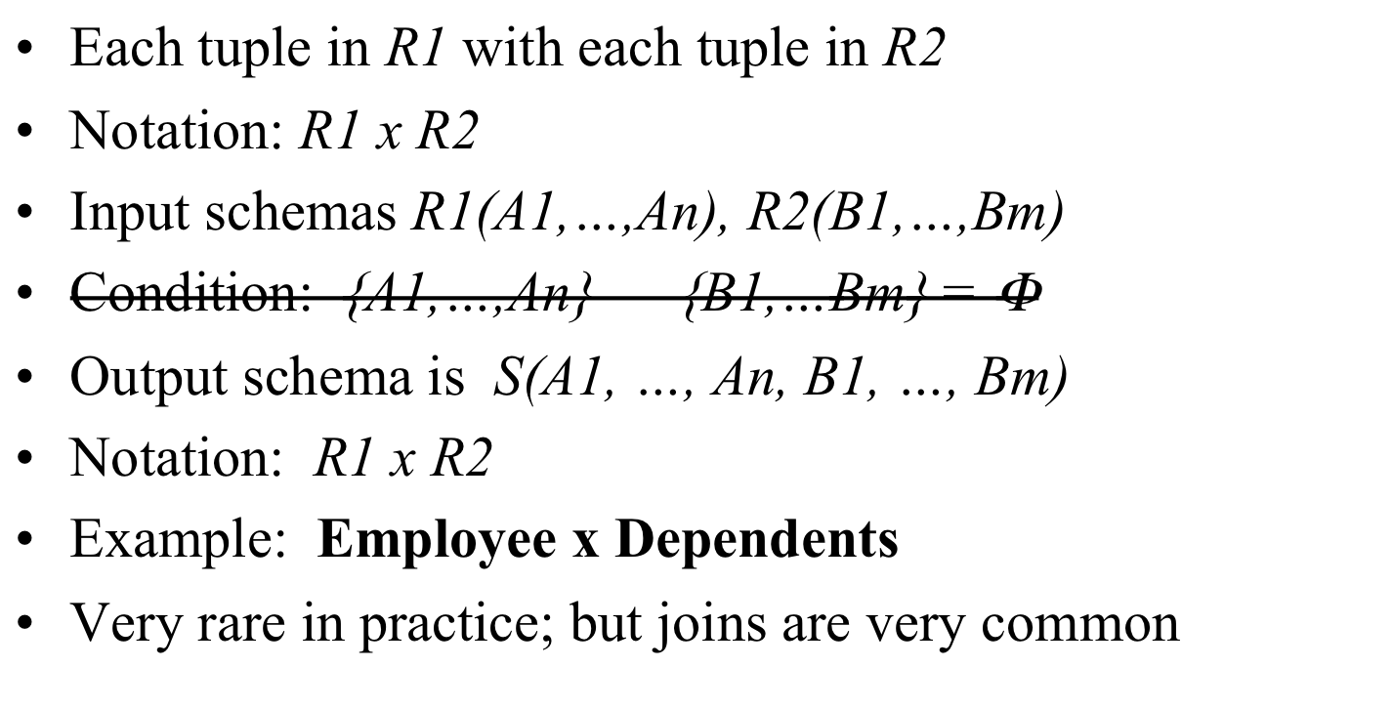
Cartesian Product
If Ai is same as Bj, rename them as R1.Ai, R2.Ai

Slide 27
Renaming
Does not change the relational instance
Changes the relational schema only
Notation: ρ _{S(B1,…,Bn)} (R)
Input schema: R(A1, …, An)
Output schema: S(B1, …, Bn)
Example:
    RenamedEmployee(LastName, SocSocNo) (Employee)

Slide 28
Renaming Example
Employee
Name
SSN
John
999999999
Tony
777777777
    RenamedEmpl(LastName, SocSocNo) (Employee)
LastName
SocSocNo
John
999999999
Tony
777777777

Slide 29
Derived RA Operations
1) Intersection
2) Most importantly: Join

Slide 30
Set Operations: Intersection
Difference: all tuples both in R1 and in R2
Notation: R1 R2
R1, R2 must have the same schema
R1 R2 has the same schema as R1, R2
Example
  UnionizedEmployees RetiredEmployees
Intersection is derived:
  R1 R2 = R1 – (R1 – R2)

Slide 31
Joins
Theta join
Natural join
Equi-join
etc.

Slide 32
Theta Join
A cartesian product followed by a selection
Notation: R1 _{θ} R2 where θ is a condition
Input schemas: R1(A1,…,An), R2(B1,…,Bm)
Output schema: S(A1,…,An,B1,…,Bm)
Derived operator:
R1 _{θ} R2 = σ _{θ} (R1 x R2)
Note that in output schema, if an attribute of R1 has the same name as an attribute of R2, we need renaming, as in Cartesian Product.

Slide 33
Theta-Join
R3 := R1 JOIN_{C} R2
  Take the product R1 x R2.
  Then apply SELECT_{C} to the result.
As for SELECT, C can be any boolean-valued condition.
  Historic versions of this operator allowed only A theta B, where theta was =, <, etc.; hence the name “theta-join.”

Slide 34
Example
Sells( bar, beer, price ) Bars( name, addr )
Joe’s Bud 2.50 Joe’s Maple St.
Joe’s Miller 2.75 Sue’s River Rd.
Sue’s Bud 2.50
Sue’s Coors 3.00
BarInfo := Sells JOIN _{Sells.bar = Bars.name} Bars
BarInfo( bar, beer, price, name, addr )
Joe’s Bud 2.50 Joe’s Maple St.
Joe’s Miller 2.75 Joe’s Maple St.
Sue’s Bud 2.50 Sue’s River Rd.
Sue’s Coors 3.00 Sue’s River Rd.

Slide 35

Natural Join
Notation: R1 R2
Input Schema: R1(A1, …, An), R2(B1, …, Bm)
Output Schema: S(C1,…,Cp)
  Where {C1, …, Cp} = {A1, …, An} U {B1, …, Bm}
Meaning: combine all pairs of tuples in R1 and R2 that agree on the attributes:
  {A1,…,An} {B1,…, Bm} (called the join attributes)
Equivalent to a cross product followed by selection
Example Employee Dependents

Slide 36
Natural Join Example
Employee
Name
SSN
John
999999999
Tony
777777777
Dependents
SSN
Dname
999999999
Emily
777777777
Joe
Employee Dependents =
Π_{Name, SSN, Dname}(σ _{SSN=SSN2}(Employee x ρ_{SSN2, Dname}(Dependents))
Name
SSN
Dname
John
999999999
Emily
Tony
777777777
Joe

Slide 37
Natural Join
R= S=
R S =
A | B
X | Y
X | Z
Y | Z
Z | V
B | C
Z | U
V | W
Z | V
A | B | C
X | Z | U
X | Z | V
Y | Z | U
Y | Z | V
Z | V | W

Slide 38
Natural Join
Given the schemas R(A, B, C, D), S(A, C, E), what is the schema of R S ?
Given R(A, B, C), S(D, E), what is R S ?
Given R(A, B), S(A, B), what is R S ?

Slide 39
Equi-join
Most frequently used in practice:
R1 _{Α=Β} R2
A lot of research on how to do it efficiently

Slide 40
Summary of Relational Algebra
Basic primitives:
  E ::= R
  | σ_{C}(E)
  | π _{A1, A2, ..., An} (E)
  | E1 X E2
  | E1 ∪ E2
  | E1 - E2
  |
  |ρ_{S(A1, A2, …, An)}(E)
Abbreviations:
  | E1 JOIN E2
  | E1 JOIN_{C} E2
  | E1 ∩ E2

Slide 41
Relational Algebra
Six basic operators, many derived
Combine operators in order to construct queries: relational algebra expressions, usually shown as trees

Slide 42
Building Complex Expressions
Algebras allow us to express sequences of operations in a natural way.
Example
  in arithmetic algebra: (x + 4)*(y - 3)
  in stack "algebra": T.push(S.pop())
Relational algebra allows the same.
Three notations:
    Sequences of assignment statements.
    Expressions with several operators.
    Expression trees.

Slide 43
Sequences of Assignments
Create temporary relation names.
Renaming can be implied by giving relations a list of attributes.
Example: R3 := R1 JOIN_{C} R2 can be written:
  R4 := R1 x R2
  R3 := SELECT_{C} (R4)

Slide 44
Expressions with Several Operators
Example: the theta-join R3 := R1 JOIN_{C} R2 can be written: R3 := SELECT_{C} (R1 x R2)
Precedence of relational operators:
    Unary operators --- select, project, rename --- have highest precedence, bind first.
    Then come products and joins.
    Then intersection.
    Finally, union and set difference bind last.
But you can always insert parentheses to force the order you desire.

Slide 45
Expression Trees
Leaves are operands (relations).
Interior nodes are operators, applied to their child or children.

Slide 46
Example
Given Bars(name, addr), Sells(bar, beer, price), find the names of all the bars that are either on Maple St. or sell Bud for less than $3.

Slide 47
As a Tree:
UNION
RENAME_{R(name)}
PROJECT_{name}
PROJECT_{bar}
SELECT_{addr = “Maple St.”}
SELECT _{price<3 AND beer=“Bud”}
Bars
Sells

Slide 48
Q: How to do this?
Using Sells(bar, beer, price), find the bars that sell two different beers at the same price.

Slide 49
More Queries
Product ( pid, name, price, category, maker-cid)
Purchase (buyer-ssn, salesperson-ssn, store, pid)
Company (cid, name, stock price, country)
Person(ssn, name, phone number, city)
Find phone numbers of people who bought gizmos from Fred.

Slide 50
Expression Tree
Π _{name}
ssn=buyer-ssn
pid=pid
salesperson-ssn=ssn
Π _{ssn}
Π _{pid}
σ_{name=fred}
σ_{category=gizmo}
Person Purchase Person Product

Slide 51
Operations on Bags
(and why we care)
Union: {a,b,b,c} U {a,b,b,b,e,f,f} = {a,a,b,b,b,b,b,c,e,f,f}
  add the number of occurrences
Difference: {a,b,b,b,c,c} – {b,c,c,c,d} = {a,b,b}
  subtract the number of occurrences
Intersection: {a,b,b,b,c,c} {b,b,c,c,c,c,d} = {b,b,c,c}
  minimum of the two numbers of occurrences
Selection: preserve the number of occurrences
Projection: preserve the number of occurrences (no duplicate elimination)
Cartesian product, join: no duplicate elimination
Read the book for more detail

Slide 52
Summary of Relational Algebra
Why bother ? Can write any RA expression directly in C++/Java, seems easy.
Two reasons:
  Each operator admits sophisticated implementations (think of , σ _{C})
  Expressions in relational algebra can be rewritten: optimized

