Slide 1
Web Programming Tutorial
Slides Designed by Tao Cheng
Augmented & Presented by Marina Danilevsky
CS 411, Fall 2010

Slide 2
What is Web Development?
Web development is a broad term for any activity related to developing a web site for the World Wide Web or an intranet.
Usually refers to the non-design aspects of writing markup and coding

Slide 3
Why Web Programming
One of the choices for building applications around DBMS (the front end)
Many database applications require easy access to serve the public

Slide 4
The Objective of This Lecture
To give you a very high-level overview of some of the tools for Web Programming
Use several typical tools to show the basics of Web Programming
Not meant for advanced Web developers
The next in-class tutorial will be on DB Programming
We will assume minimal interaction with DBMS in this lecture to focus on the Web programming part

Slide 5
Client Side Coding: Code that runs on the client side’s browsers
HTML
  stands for HyperText Markup Language, and is the predominant markup language for web pages. It is written in the form of HTML elements consisting of "tags" surrounded by angle brackets within the web page content
Javascript
  Formally called EMCAScript, Javascript is a ubiquitous client side programming tool, often implemented as part of a web browser in order to provide enhanced user interfaces and dynamic websites. It’s typically used to enable programmatic access to computational objects within a host environment.
Applet and ActiveX.
  Applet (e.g. Java Applet): small application that performs one specific task, sometimes running within a larger program, perhaps as a plug-in.
AJAX (Asynchronous Javascript And XML)
  Group of technologies that provides new methods of using Javascript, PHP and other languages to improve the user experience

Slide 6
Server Side Coding: Code that runs on the server’s side
CGI (standard protocol for server-client communication)
PHP (open source)
ASP.NET (Microsoft proprietary)
JSP (JavaServer Pages)
Python, e.g. Django (web framework) (open source)
Ruby, e.g. Ruby on Rails (open source)

Slide 7
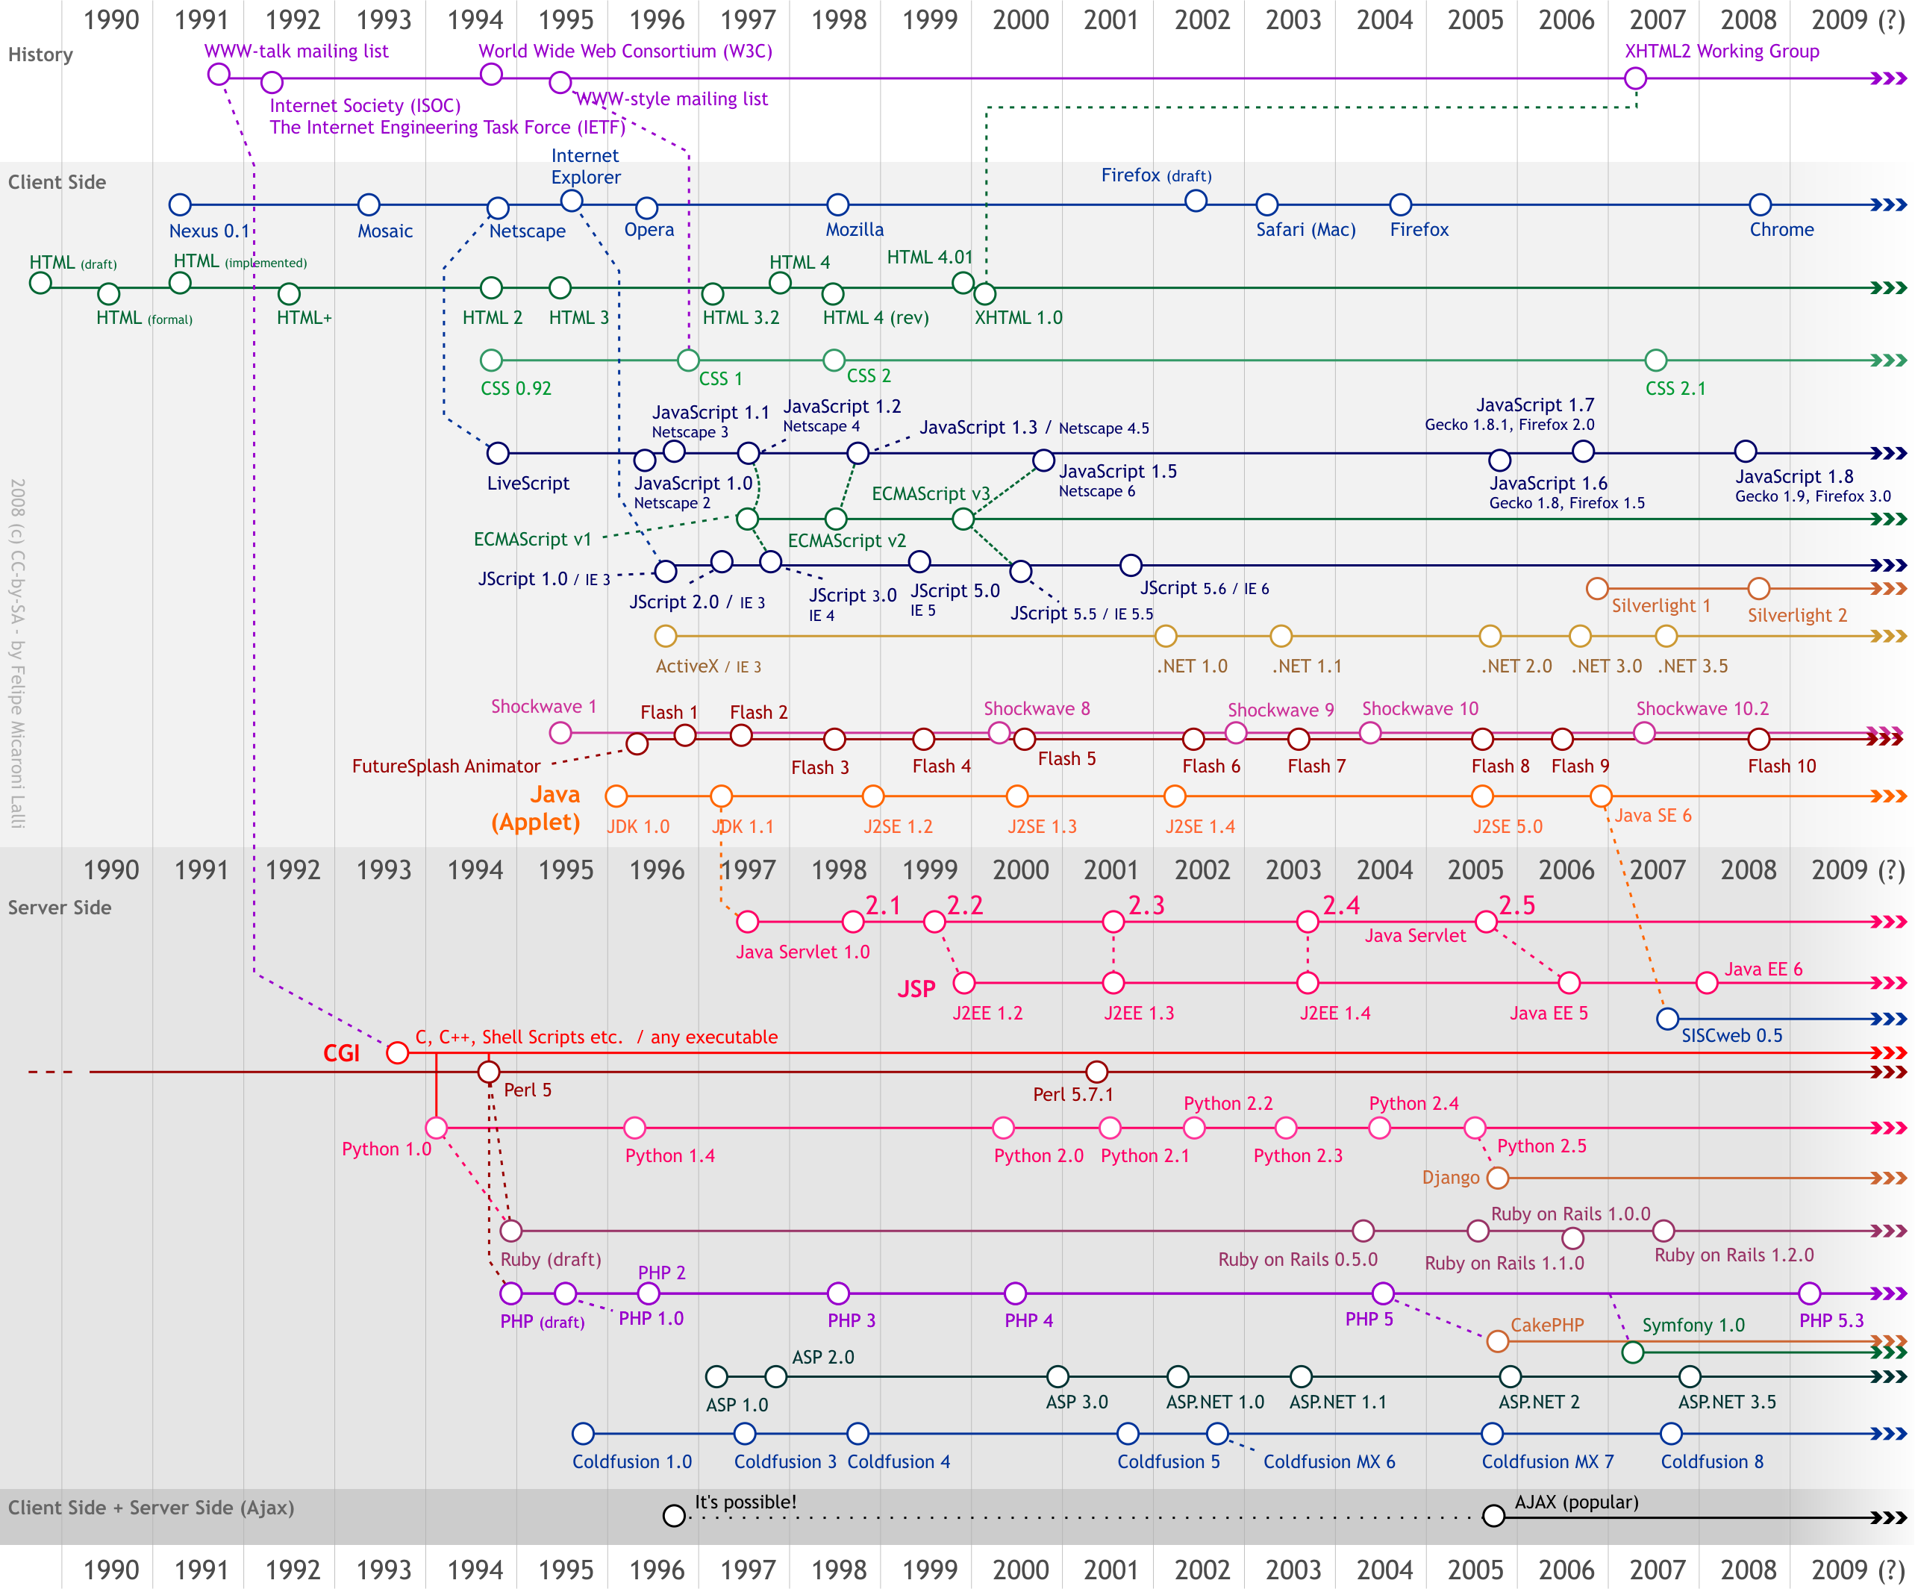
Roadmap

Slide 8
Development of Web Programming
The first generation mainly relied on HTML and CGI to interact with underlying executables, written in C, C++, Java, etc
The next generation of web development tools used the strong growth in LAMP and Microsoft .NET technologies to provide the Web as a way to run applications online.

Slide 9
Plan of the Lecture
Creating a simple page at projects.cs.illinois.edu
Supporting Basic Web Programming using HTML + CGI
More advanced programming using PHP (as in the LAMP architecture)
Additional tools: Ajax, etc

Slide 10
Creating a simple html file at projects.cs.illinois.edu
Go to your project page management site: http://accounts.cs.illinois.edu/projects.
    Web pages created here will appear at netid.cs.projects.illinois.edu
Create a folder called, e.g., "cs411project”
Place a blank or “hello world” page called "index.html" in "cs411project" and make sure that you can access it at http://netid.projects.cs.illinois.edu/cs411project/index.html
    replace"netid” with your netid.
    Make sure to place all of this in the public_html folder, to have the file show up
    See my simple posted example file: http://danilev1.projects.cs.illinois.edu/cs411project/index.html

Slide 11
HTML + CGI
HTML: Hyper-Text Markup Language, the building blocks of all basic websites
CGI: a standard protocol for the communication between client software with an information server. CGI is completely independent of programming language, operating system and web server.
<html>
<head>
<title>Hello HTML</title>
</head>
<body>
<p>Hello World!</p>
</body>
</html>

Slide 12
HTML + CGI: How to get input?
Using the default GET method, the data sent is placed in the environment variable QUERY_STRING for the CGI script to process.
  e.g. in C, write:
  char *data = getenv("QUERY_STRING");
When the method POST is used the data is sent by a separate stream and becomes the standard input to the CGI script.
For examples & getting started with CGI Programming in C:
  http://www.cs.tut.fi/~jkorpela/forms/cgic.html

Slide 13
HTML + CGI: How to generate output?
How to generate output and display it as HTML?
CGI returns its output (HTTP headers and HTML document, or XML) to the server by writing it to standard out.
  In a Perl or Python script just use the print statement.
  In C use printf or some equivalent (C++ uses cout << )
  In Java use System.out.println
For examples & getting started with CGI Programming in C:
  http://www.cs.tut.fi/~jkorpela/forms/cgic.html

Slide 14
Javascript
The HTML <script> tag is used to insert a JavaScript into an HTML page.
Caution! Javascript may be browser dependent
<html>
<body>
<script type="text/javascript">
document.write("Hello World!");
</script>
</body>
</html>

Slide 15
Verification using Javascript
Recall, Javascript is client-side. What is a good example of a task that could use Javascript?
  Number verification (given input from HTML, we want to do some computation with it, but must first make sure the input is numeric)
  Recommended to be done on client side, to reduce server load
  Compare to the computation step (server-side)

Slide 16
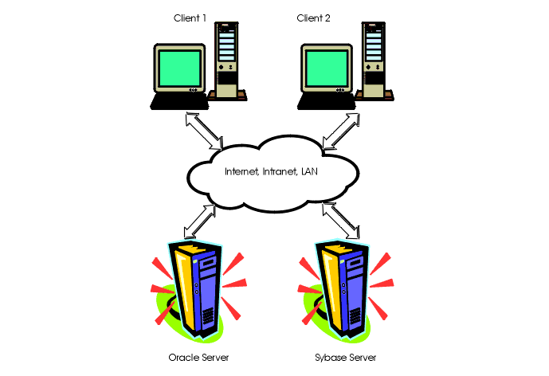
Architecture
Client Side:
HTML (input),
e.g. m=5, n=4
Javascript (checking),
e.g. whether 4 is number
Server Side:
C (Computation),
e.g. 4 * 5 = 20

Slide 17
“LAMP”: Open Source Solution, Bundle of Software
Linux, referring to the operating system;
Apache, the Web server;
MySQL, the database management system (or database server);
PHP or others, i.e., Perl, Python, the programming languages
LAMP is easy to code locally and deploy, allows for cheap & ubiquitous hosting

Slide 18
What is “PHP”?
Self-referentially short for PHP: Hypertext Preprocessor, an open source, server-side, HTML embedded scripting language used to create dynamic Web pages.
  PHP files can contain text, HTML tags and scripts
  PHP files are returned to the browser as plain HTML
  PHP files have a file extension of ".php", ".php3", or ".phtml”
Contrast with Javascript, which is client-side, HTML embedded scripting lanuage

Slide 19
PHP Basics
A PHP file normally contains HTML tags, just like an HTML file, and some PHP scripting code
A PHP scripting block always starts with <?php and ends with ?>.
A PHP scripting block can be placed anywhere in the document.
All variables in PHP start with a $ sign symbol.
  $var_name = value;
  for example, $txt="Hello World!";

Slide 20
PHP Hello World in browser
Example of a simple HTML + PHP script which sends the text "Hello World" to the browser:
There are two basic statements to output text with PHP: echo and print. In the example above we have used the echo statement to output the text "Hello World”.
<html>
<body>
<?php
echo "Hello World!;
?>
</body>
</html>

Slide 21
PHP Basics
Arrays and Regex
  Arrays (syntax is: array(key => value), so create key-value pairs)
    <?php
    $a=array("a"=>"Dog","b"=>"Cat","c"=>"Horse");
    print_r($a);
    ?>
    output: Array ( [a] => Dog [b] => Cat [c] => Horse )
  Regular expression (preg_match)
    <?php
    // create a string
    $string = 'abcdefghijklmnopqrstuvwxyz0123456789’;
    echo preg_match("/abc/", $string);
    ?>
    output: ‘1’ because ‘abc’ was found in $string

Slide 22
How to Get User Input?
$_GET[“var”]
  if the url sent to the server (e.g. after a form submission looks like:
    http://www.w3schools.com/welcome.php?fname=Peter&age=37
  The "welcome.php" file can now use the $_GET function to collect form data
  Welcome <?php echo $_GET["fname"]; ?>
  output: Displays “Welcome Peter”
$_POST[“var”]
  similar to GET, but the information sent with a POST method is invisible, unlike if sent with GET method

Slide 23
Using Cookies in PHP
A cookie is often used to identify a user
  small file that the server embeds on the user's computer.
Each time the same computer requests a page with a browser, it will send the cookie too.
With PHP, you can both create and retrieve cookie values
  create a cookie: setcookie(name, value, expire, path, domain);
  The PHP $_COOKIE variable is used to retrieve a cookie value.

Slide 24
Using Session Control in PHP
A PHP session variable is used to store information about, or change settings for a user session.
Session variables hold information about one single user, and are available to all pages in one application.
  To store and retrieve session variables, use the PHP $_SESSION variable

Slide 25
Cookie vs Session
Cookie
  More permanent
  Typically small (need to be sent to server)
Session
  Typically in server memory (ends when you close browser)
  Can be of any size

Slide 26
Authentication using PHP
Can use crypt() or md5() for encrypting
  md5() syntax:
    string md5 ( string $str [, bool $raw_output = false ] )
    Calculates the MD5 hash of $str
  crypt() syntax:
    string crypt ( string $str [, string $salt ] )
    returns a hashed string using the standard Unix DES-based algorithm
Authentication can also be done through DBMS

Slide 27
ASP.net and JSP
They follow pretty similar architecture
ASP.net
  server side scripting technology that enables scripts (embedded in web pages) to be executed by an Internet server.
  normally used together with SQLServer (MS proprietary)
JSP
  Roughly, allows Java code and certain pre-defined actions to be combined with static web markup content.
  The resulting page is compiled and executed on the server-side to deliver an HTML or XML document
  Since it’s Java, JSP is Sun proprietary

Slide 28
AJAX
Ajax, or AJAX (Asynchronous JavaScript and XML), is a group of interrelated web development techniques used to create interactive web applications or rich Internet applications.
AJAX allows web pages to be updated asynchronously by exchanging small amounts of data with the server behind the scenes.
  This means that it is possible to update parts of a web page, without reloading the whole page.

Slide 29
AJAX Suggestion Example
Google Suggest is using AJAX to create a dynamic web interface:
  When you start typing in Google's search box, a JavaScript sends the letters off to a server and the server returns a list of suggestions.
  Note that the page does not reload as you type

Slide 30
Other Tools for Web Programming
Django
  open source web application framework written in Python
  emphasizes reusability and "pluggability" of components, rapid development
Ruby on Rails
  open source web application framework for the Ruby programming language
  similar philosophies of reusability, convention over configuration

Slide 31
Take Away Message
Web Programming is not hard
Many tutorials (with examples) available
  W3Schools is a great place to start: http://www.w3schools.com
Choose your preferred tools early, and start to get familiar with them

Slide 32
References
Getting starting with CGI Programming in C
  http://www.cs.tut.fi/~jkorpela/forms/cgic.html
PHP related examples, including PHP + MySQL
  http://www.w3schools.com/php/
W3Schools tutorials are generally very helpful, on almost all the tools we covered
Also for using PHP with MySQL:
  Hugh Williams and David Lane, ``Web Database Applications with PHP and MySQL'' http://www.webdatabasebook.com/

