Slide 1
CS411
Database Systems
10: Transaction Management

Slide 2
Why Do We Learn This?

Slide 3
Outline
Transaction management
  motivation & brief introduction
  major issues
    recovery
    concurrency control
Recovery

Slide 4
Users and DB Programs
End users don't see the DB directly
  are only vaguely aware of its design
  may be acutely aware of part of its contents
  SQL is not a suitable end-user interface
A single SQL query is not a sufficient unit of DB work
  May need more than one query
  May need to check constraints not enforced by the DBMS
  May need to do calculations, realize “business rules”, etc.

Slide 5
Users and DB Programs
Ergo, a program is needed to carry out each unit of DB work
End users interact with DB programs
  Rather than SQL
  May be many users simultaneously
    Thus many simultaneous executions of these programs
  Each user expects service and correct operation
    A user should not have to wait forever
    A user should not be affected by errors of others

Slide 6
Definition of "Transaction"
Definition: A transaction is the execution of a DB program.
DB applications are designed as a set of transactions
Typical transaction
  starts with data from user or from another transaction
  includes DB reads/writes
  ends with display of data or form, or with request to start another transaction

Slide 7
Behind the Scene: Who invented Transaction?
Edgar Codd?
Jim Gray?
Al Gore?

Slide 8
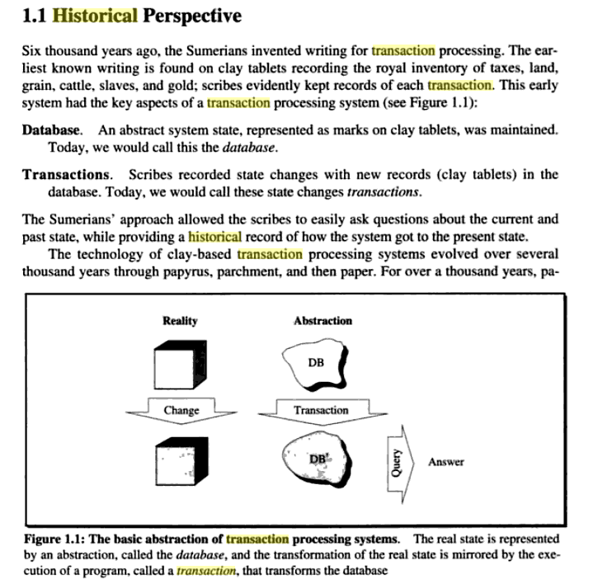



Slide 9
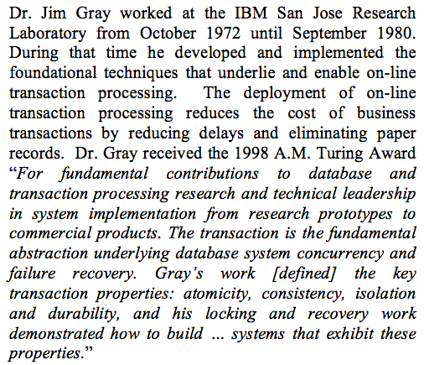
And He is a Key Contributor
From: Jim Gray at IBM: the transaction processing revolution. Bruce G. Lindsay. ACM SIGMOD Record. 37(2). June 2008.

Slide 10
Atomicity
Transactions must be "atomic"
  Their effect is all or none
  DB must be consistent before and after the transaction executes (not necessarily during!)
EITHER
  a transaction executes fully and "commits" to all the changes it makes to the DB
  OR it must be as though that transaction never executed at all

Slide 11
A Typical Transaction
User view: “Transfer money from savings to checking”
Program:
  read savings;
  verify balance is adequate;
  update savings balance;
  read checking;
  update checking balance;

Slide 12
"Commit" and "Abort"
A transactions which only READs expects DB to be consistent, and cannot cause it to become otherwise.
When a transaction which does any WRITE finishes, it must either
  COMMIT: "I'm done and the DB is consistent again" OR
  ABORT (ROLLBACK): "I'm done but I goofed: my changes must be undone."

Slide 13
Complications
A DB may have many simultaneous users
  simultaneous users implies simultaneous transactions implies simultaneous DB access
    multiprogramming/multiprocessing
Things can go wrong!
  transactions can conflict with one another
  programs may crash, OS may crash, disk may crash
    company loses customer, gets sued, goes bankrupt, etc.

Slide 14
But DB Must Not Crash
Can't be allowed to become inconsistent
  A DB that's 1% inaccurate is 100% unusable.
Can't lose data
Can't become unavailable
Can you name information processing systems that are more error tolerant?

Slide 15
Transaction Manager
(or TP Monitor)
Part of the DBMS
Main duties:
  Starts transactions
    locate and start the right program
    ensure timely, fair scheduling
  Logs their activities
    especially start/stop, writes, commits, aborts
  Detects or avoids conflicts
  Takes recovery actions

Slide 16
Big Picture: DBMS Architecture
User/Web Forms/Applications/DBA
query
transaction
DDL commands
Query Parser
Transaction Manager
DDL Processor
Query Rewriter
Query Optimizer
Concurrency Control
Logging &
Recovery
Query Executor
Records
Indexes
Lock Tables
Buffer:
data, indexes, log, etc
Buffer Manager
Main Memory
Storage Manager
Storage
data, metadata, indexes, log, etc
Notes:
See Fig. 1.1 in text for data flow
To Records Manager: e.g.: read/write/scan records (record-level operation)

Slide 17
What’s on the Log File?
Transaction starts/stops
DB writes: "before" and/or "after" images of DB records
  befores can be used to rollback an aborted transaction
  afters can be used to redo a transaction (recovery from catastrophe)
COMMITs and ABORTs
The log itself is as critical as the DB!

Slide 18
The Big TP Issues
Recovery
  Taking action to restore the DB to a consistent state
Concurrency Control
  Making sure simultaneous transactions don't interfere with one another

Slide 19
The ACID Properties
Atomicity
Consistency Preservation
Isolation
Durability

Slide 20
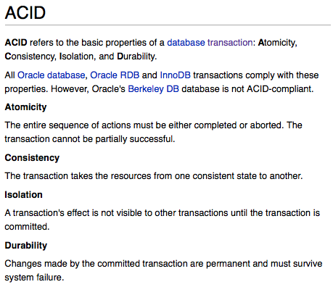
The ACID Properties: From Oracle Wiki

Slide 21
Behind the Scene: It’s Your Turn!
So, who coined “ACID”?
Notes:
@article{291,
author = {Haerder,, Theo and Reuter,, Andreas},
title = {Principles of transaction-oriented database recovery},
journal = {ACM Comput. Surv.},
volume = {15},
number = {4},
year = {1983},
issn = {0360-0300},
pages = {287--317},
doi = {http://doi.acm.org/10.1145/289.291},
publisher = {ACM},
address = {New York, NY, USA},
}

Slide 22
Recovery

Slide 23

Q: What Might Go Wrong?
Notes:
Types of Failures
Wrong data entry
Prevent by having constraints in the database
Fix with data cleaning
Disk crashes
Prevent by using redundancy (RAID, archive)
Fix by using archives
Fire, theft, bankruptcy…
Buy insurance, change profession…
System failures: most frequent (e.g. power)
Use recovery

Slide 24
System Failures
Each transaction has internal state
When system crashes, internal state is lost
  Don’t know which parts executed and which didn’t
Remedy: use a log
  A file that records every single action of the transaction

Slide 25
Transactions
Start Transaction
  Oracle
    autocommit is off by default, so a new transaction is started after each COMMIT or ROLLBACK
  MySQL
    START TRANSACTION
End Transaction
  COMMIT or ROLLBACK
Notes:
Commit marks the end of a successful implicit or explicit transaction
COMMIT TRANSACTION makes all data modifications performed since the start of the transaction a permanent part of the database, frees the resources held by the transaction
Rollbacks are important for database integrity because they mean that the database can be restored to a clean copy even after erroneous operations are performed. They are crucial for recovering from database server crashes; by rolling back any transaction which was active at the time of the crash, the database is restored to a consistent state.

Slide 26
Transaction Abstraction
Database is composed of elements
  Usually 1 element = 1 block
  Can be smaller (=1 record) or larger (=1 relation)
Each transaction reads/writes some elements

Slide 27
Correctness Principle
There exists a notion of correctness for the database
  Explicit constraints (e.g. foreign keys)
  Implicit conditions (e.g. sum of sales = sum of invoices)
Correctness principle:
Transaction will be programmed such that:
if a transaction starts in a correct database state, it ends in a correct database state.
Consequence: we only need to guarantee that transactions are atomic, and run (as if) in isolation.
Notes:
Database doesn’t worry about programming bugs
Atomicity: the A of ACID: the entire sequence of actions must be either completed or aborted. The transaction cannot be partially successful.

Slide 28
Primitive Operations of Transactions
INPUT(X)
  read element X to memory buffer
READ(X,t)
  copy element X to transaction local variable t
WRITE(X,t)
  copy transaction local variable t to element X
OUTPUT(X)
  write element X to disk

Slide 29
Example
READ(A,t); t := t*2; WRITE(A,t); READ(B,t); t := t*2; WRITE(B,t)
Action | t | Mem A | Mem B | Disk A | Disk B
INPUT(A) |  | 8 |  | 8 | 8
READ(A,t) | 8 | 8 |  | 8 | 8
t:=t*2 | 16 | 8 |  | 8 | 8
WRITE(A,t) | 16 | 16 |  | 8 | 8
INPUT(B) | 16 | 16 | 8 | 8 | 8
READ(B,t) | 8 | 16 | 8 | 8 | 8
t:=t*2 | 16 | 16 | 8 | 8 | 8
WRITE(B,t) | 16 | 16 | 16 | 8 | 8
OUTPUT(A) | 16 | 16 | 16 | 16 | 8
OUTPUT(B) | 16 | 16 | 16 | 16 | 16

Slide 30
The Log
An append-only file containing log records
Note: multiple transactions run concurrently, log records are interleaved
After a system crash, use log to:
  Redo some transaction that did commit.
  Undo other transactions that did not commit.

Slide 31
Undo Logging

Slide 32
Undo Logging
Log records
<START T>
  transaction T has begun
<COMMIT T>
  T has committed
<ABORT T>
  T has aborted
<T,X,v>
  T has updated element X, and its old value was v

Slide 33
Undo-Logging Rules
U1: If T modifies X, then <T,X,v> entry must be written to log before X is written to disk
U2: If T commits, then <COMMIT T> entry must be written to log only after all changes by T are written to disk
Hence: OUTPUTs are done early (before commit)

Slide 34
Action | T | Mem A | Mem B | Disk A | Disk B | Log
 |  |  |  |  |  | <START T>
READ(A,t) | 8 | 8 |  | 8 | 8
t:=t*2 | 16 | 8 |  | 8 | 8
WRITE(A,t) | 16 | 16 |  | 8 | 8 | <T,A,8>
READ(B,t) | 8 | 16 | 8 | 8 | 8
t:=t*2 | 16 | 16 | 8 | 8 | 8
WRITE(B,t) | 16 | 16 | 16 | 8 | 8 | <T,B,8>
OUTPUT(A) | 16 | 16 | 16 | 16 | 8
OUTPUT(B) | 16 | 16 | 16 | 16 | 16
 |  |  |  |  |  | <COMMIT T>

Slide 35
Recovery with Undo Log
After system’s crash, run recovery manager
Idea 1. Decide for each transaction T whether it is completed or not
  <START T>….<COMMIT T>…. = yes
  <START T>….<ABORT T>……. = yes
  <START T>……………………… = no
Idea 2. Undo all modifications by incompleted transactions

Slide 36
Recovery with Undo Log
Recovery manager:
Read log from the end; cases:
  <COMMIT T>: mark T as completed
  <ABORT T>: mark T as completed
  <T,X,v>: if T is not completed
  then write X=v to disk
  else ignore /* committed or aborted xact. */
  <START T>: ignore

Slide 37
Recovery with Undo Log
…
…
<T6,X6,v6>
…
…
<START T5>
<START T4>
<T1,X1,v1>
<T5,X5,v5>
<T4,X4,v4>
<COMMIT T5>
<T3,X3,v3>
<T2,X2,v2>

Slide 38
Recovery with Undo Log
Note: all undo commands are idempotent
  If we perform them a second time, no harm is done
  E.g. if there is a system crash during recovery, simply restart recovery from scratch
Notes:
idempotent: unchanged when applied to itself. So, can apply undo commands multiple times with no change to the result.

Slide 39
Recovery with Undo Log
When do we stop reading the log ?
We cannot stop until we reach the beginning of the log file
This is impractical
Better idea: use checkpointing

Slide 40
Checkpointing
Checkpoint the database periodically
Stop accepting new transactions
Wait until all curent transactions complete
Flush log to disk
Write a <CKPT> log record, flush
Resume transactions

Slide 41
Undo Recovery with Checkpointing
…
…
<T9,X9,v9>
…
…
(all completed)
<CKPT>
<START T2>
<START T3
<START T5>
<START T4>
<T1,X1,v1>
<T5,X5,v5>
<T4,X4,v4>
<COMMIT T5>
<T3,X3,v3>
<T2,X2,v2>
other transactions
During recovery,
Can stop at first
<CKPT>
transactions T2,T3,T4,T5

Slide 42
Nonquiescent Checkpointing
Problem with checkpointing: database freezes during checkpoint
Would like to checkpoint while database is operational
=nonquiescent checkpointing
Notes:
The problem with checkpointing is that we effectively stop the system until all current operations have committed or aborted.
Nonquiescent checkpointing is a technique that avoids this bottleneck. The to do this steps are to:

Slide 43
Nonquiescent Checkpointing
Write a <START CKPT(T1,…,Tk)>
where T1,…,Tk are all active transactions
Continue normal operation
When all of T1,…,Tk have completed, write <END CKPT>

Slide 44
Undo Recovery with Nonquiescent Checkpointing
…
…
…
…
…
…
<START CKPT T4, T5, T6>
…
…
…
…
<END CKPT>
…
…
…
earlier completed trans plus
T4, T5, T6
T4, T5, T6, plus
later transactions
later transactions
Q: why do we need
<END CKPT> ?
Notes:
Answer: because if the system crashes before it writes <END CKPT> then we cannot use the checkpoint. We use <END CKPT> to ensure that the system didn’t crash and the checkpoint terminated.

Slide 45
Redo Logging

Slide 46
Redo Logging
Log records
<START T> = transaction T has begun
<COMMIT T> = T has committed
<ABORT T>= T has aborted
<T,X,v>= T has updated element X, and its new value is v

Slide 47
Redo-Logging Rules
R1: If T modifies X, then both <T,X,v> and <COMMIT T> must be written to disk before X is written to disk
Hence: OUTPUTs are done late (after commit)

Slide 48
Action | T | Mem A | Mem B | Disk A | Disk B | Log
 |  |  |  |  |  | <START T>
REAT(A,t) | 8 | 8 |  | 8 | 8
t:=t*2 | 16 | 8 |  | 8 | 8
WRITE(A,t) | 16 | 16 |  | 8 | 8 | <T,A,16>
READ(B,t) | 8 | 16 | 8 | 8 | 8
t:=t*2 | 16 | 16 | 8 | 8 | 8
WRITE(B,t) | 16 | 16 | 16 | 8 | 8 | <T,B,16>
 |  |  |  |  |  | <COMMIT T>
OUTPUT(A) | 16 | 16 | 16 | 16 | 8
OUTPUT(B) | 16 | 16 | 16 | 16 | 16

Slide 49
Recovery with Redo Log
After system’s crash, run recovery manager
Step 1. Decide for each transaction T whether it is completed or not
  <START T>….<COMMIT T>…. = yes
  <START T>….<ABORT T>……. = yes
  <START T>……………………… = no
Step 2. Read log from the beginning, redo all updates of committed transactions

Slide 50
Recovery with Redo Log
<START T1>
<T1,X1,v1>
<START T2>
<T2, X2, v2>
<START T3>
<T1,X3,v3>
<COMMIT T2>
<T3,X4,v4>
<T1,X5,v5>
…
…

Slide 51
Nonquiescent Checkpointing
Write a <START CKPT(T1,…,Tk)>
where T1,…,Tk are all active transactions
Flush to disk all blocks of committed transactions (dirty blocks), while continuing normal operation
When all blocks have been written, write <END CKPT>

Slide 52
Redo Recovery with Nonquiescent Checkpointing
…
<START T1>
…
<COMMIT T1>
…
…
<START CKPT T4, T5, T6>
…
…
…
…
<END CKPT>
…
…
…
<START CKPT T9, T10>
…
Step 2: redo
from <START Ti> for Ti in {T4, T5, T6}.
Step 1: look for
The last
<END CKPT>
All OUTPUTs
of T1 are
known to be on disk

Slide 53
Comparison Undo/Redo
Undo logging:
  OUTPUT must be done early
  If <COMMIT T> is seen, T definitely has written all its data to disk (hence, don’t need to undo)
Redo logging
  OUTPUT must be done late
  If <COMMIT T> is not seen, T definitely has not written any of its data to disk (hence there is not dirty data on disk)
Would like more flexibility on when to OUTPUT: undo/redo logging (next)

Slide 54
Undo & Redo Logging: Downsides
Undo logging: data must be written to disk immediately after a transaction finishes, which can increase number of disk I/O's
Redo logging: need to keep all modified blocks in memory until transaction commits and log is flushed, which can increase the number of buffers required
Solution: Undo/Redo logging

Slide 55
Undo/Redo Logging
Log records, only one change
<T,X,u,v>= T has updated element X, its old value was u, and its new value is v

Slide 56
Undo/Redo-Logging Rule
UR1: If T modifies X, then <T,X,u,v> must be written to disk before X is written to disk
Note: we are free to OUTPUT early or late (I.e. before or after <COMMIT T>)

Slide 57
Action | T | Mem A | Mem B | Disk A | Disk B | Log
 |  |  |  |  |  | <START T>
REAT(A,t) | 8 | 8 |  | 8 | 8
t:=t*2 | 16 | 8 |  | 8 | 8
WRITE(A,t) | 16 | 16 |  | 8 | 8 | <T,A,8,16>
READ(B,t) | 8 | 16 | 8 | 8 | 8
t:=t*2 | 16 | 16 | 8 | 8 | 8
WRITE(B,t) | 16 | 16 | 16 | 8 | 8 | <T,B,8,16>
OUTPUT(A) | 16 | 16 | 16 | 16 | 8
 |  |  |  |  |  | <COMMIT T>
OUTPUT(B) | 16 | 16 | 16 | 16 | 16

Slide 58
Recovery with Undo/Redo Log
After system’s crash, run recovery manager
Redo all committed transaction, top-down
  handles committed transactions with some changes not yet on disk
Undo all uncommitted transactions, bottom-up
  handles uncommitted transactions with some changes already on disk

Slide 59
Recovery with Undo/Redo Log
<START T1>
<T1,X1,v1>
<START T2>
<T2, X2, v2>
<START T3>
<T1,X3,v3>
<COMMIT T2>
<T3,X4,v4>
<T1,X5,v5>
…
…

