Slide 1
Distributed Hash Tables
CS425 /CSE424/ECE428 – Distributed Systems – Fall 2011
Material derived from slides by I. Gupta, M. Harandi,
J. Hou, S. Mitra, K. Nahrstedt, N. Vaidya

Slide 2
Distributed System Organization
Centralized
Ring
Clique
How well do these work with 1M+ nodes?

Slide 3
Centralized
Problems?
Leader a bottleneck
O(N) load on leader
Leader election expensive

Slide 4
Ring
Problems?
Fragile
O(1) failures tolerated
Slow communication
O(N) messages

Slide 5
Clique
Problems?
High overhead
O(N) state at each node
O(N²) messages for failure detection

Slide 6
Distributed Hash Tables
Middle point between ring and clique
Scalable and fault-tolerant
Maintain O(log N) state
Routing complexity O(log N)
Tolerate O(N) failures
Other possibilities:
State: O(1), routing: O(log N)
State: O(log N), routing: O(log N / log log N)
State: O(√N), routing: O(1)

Slide 7


Distributed Hash Table
A hash table allows you to insert, lookup and delete objects with keys
A distributed hash table allows you to do the same in a distributed setting (objects=files)
DHT also sometimes called a key-value store when used within a cloud
Performance Concerns:
Load balancing
Fault-tolerance
Efficiency of lookups and inserts

Slide 8
Chord
Intelligent choice of neighbors to reduce latency and message cost of routing (lookups/inserts)
Uses Consistent Hashing on node’s (peer’s) address
(ip_address,port) →hashed id (m bits)
Called peer id (number between 0 and )
Not unique but id conflicts very unlikely
Can then map peers to one of logical points on a circle
Notes:
“sha” – secure hash algorithm
Morris worm November 1988
The program took advantage of a hole in the debug mode of the Unix sendmail program, which runs on a system and waits for other systems to connect to it and give it email, and a hole in the finger daemon fingerd, which serves finger requests. People at the University of California at Berkeley and MIT had copies of the program and were actively disassembling it (returning the program back into its source form) to try to figure out how it worked.
Graduate student at Cornell CS
3 years in jail 1990 – 1993 then joined MIT
Harvard PhD, 1999

Slide 9
Ring of peers
Say m=7
0
6 nodes
N112
N16
N96
N32
N80
N45

Slide 10
Peer pointers (1): successors
Say m=7
0
N112
N16
N96
N32
N80
N45
(similarly predecessors)

Slide 11
Peer pointers (2): finger tables
Say m=7
Finger Table at N80
0
N112
N16
i ft[i]
0 96
1 96
2 96
3 96
4 96
5 112
6 16
80 + 2⁵
80 + 2⁶
N96
80 + 2⁴
N32
80 + 2³
80 + 2²
80 + 2¹
80 + 2⁰
N80
N45
ith entry at peer with id n is first peer with id >=

Slide 12
Mapping Values
Key = hash(ident)
m bit string
Value is stored at first peer with id greater than its key (mod 2^{m})
0
N112
N16
N96
N32
N80
N45
Value with key K42
stored here

Slide 13
Search
Say m=7
0
N112
N16
N96
Who has cnn.com/index.html?
(hashes to K42)
N32
N80
N45
File cnn.com/index.html with
key K42 stored here

Slide 14
Search
At node n, send query for key k to largest successor/finger entry <= k
if none exist, send query to successor(n)
Say m=7
0
N112
N16
N96
Who has cnn.com/index.html?
(hashes to K42)
N32
N80
N45
File cnn.com/index.html with
key K42 stored here

Slide 15
Search
At node n, send query for key k to largest successor/finger entry <= k
if none exist, send query to successor(n)
0
Say m=7
N112
N16
All “arrows” are RPCs
N96
Who has cnn.com/index.html?
(hashes to K42)
N32
N80
N45
File cnn.com/index.html with
key K42 stored here

Slide 16
Analysis
Here
Next hop
Search takes O(log(N)) time
Proof
(intuition): at each step, distance between query and peer-with-file reduces by a factor of at least 2 (why?)
Takes at most m steps: is at most a constant multiplicative factor above N, lookup is O(log(N))
(intuition): after log(N) forwardings, distance to key is at most (why?)
Number of node identifiers in a range of
is O(log(N)) with high probability (why?)
So using successors in that range will be ok
Key
Notes:
Todo:verify. Ok.

Slide 17
Analysis (contd.)
O(log(N)) search time holds for file insertions too (in general for routing to any key)
“Routing” can thus be used as a building block for
All operations: insert, lookup, delete
O(log(N)) time true only if finger and successor entries correct
When might these entries be wrong?
When you have failures

Slide 18
Search under peer failures
Lookup fails
(N16 does not know N45)
Say m=7
0
N112
N16
N96
X
X
Who has cnn.com/index.html?
(hashes to K42)
N32
X
N80
N45
File cnn.com/index.html with
key K42 stored here

Slide 19
Search under peer failures
One solution: maintain r multiple successor entries
In case of failure, use successor entries
Say m=7
0
N112
N16
N96
X
Who has cnn.com/index.html?
(hashes to K42)
N32
N80
N45
File cnn.com/index.html with
key K42 stored here

Slide 20
Search under peer failures (2)
Lookup fails
(N45 is dead)
Say m=7
0
N112
N16
N96
Who has cnn.com/index.html?
(hashes to K42)
N32
X
X
N80
N45
File cnn.com/index.html with
key K42 stored here

Slide 21
Search under peer failures (2)
One solution: replicate file/key at r successors and predecessors
Say m=7
0
N112
N16
N96
Who has cnn.com/index.html?
(hashes to K42)
N32
K42 replicated
X
N80
N45
File cnn.com/index.html with
key K42 stored here
K42 replicated

Slide 22
Need to deal with dynamic changes
Peers fail
New peers join
Peers leave
P2P systems have a high rate of churn (node join, leave and failure)
→ Need to update successors and fingers, and copy keys

Slide 23
New peers joining
Introducer directs N40 to N45 (and N32)
N32 updates successor to N40
N40 initializes successor to N45, and inits fingers from it
Say m=7
0
N112
N16
N96
N32
N40
N80
N45

Slide 24
New peers joining
Introducer directs N40 to N45 (and N32)
N32 updates successor to N40
N40 initializes successor to N45, and inits fingers from it
N40 periodically talks to its neighbors to update finger table
Say m=7
0
Stabilization
Protocol
(to allow for “continuous”
churn, multiple changes)
N112
N16
N96
N32
N40
N80
N45

Slide 25
New peers joining (2)
N40 may need to copy some files/keys from N45
(files with fileid between 32 and 40)
Say m=7
0
N112
N16
N96
N32
N40
N80
N45
K34,K38

Slide 26
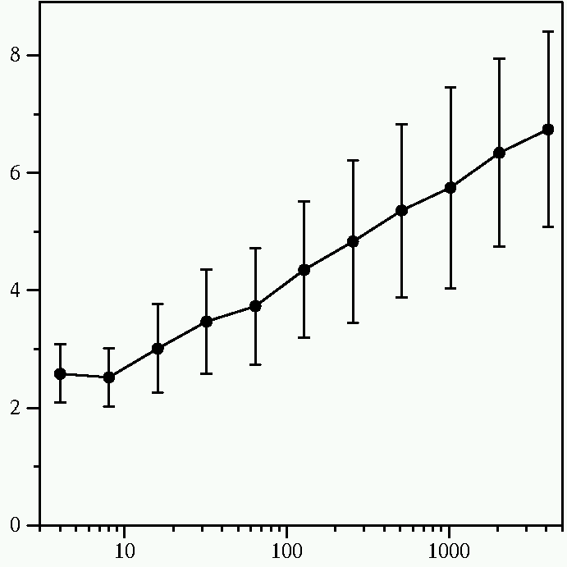
Lookups
Average Messages per Lookup
log N, as expected
Number of Nodes

Slide 27
Chord Protocol: Summary
O(log(N)) memory and lookup costs
Hashing to distribute filenames uniformly across key/address space
Allows dynamic addition/deletion of nodes

Slide 28
DHT Deployment
Many DHT designs
Chord, Pastry, Tapestry, Koorde, CAN, Viceroy, Kelips, Kademlia, …
Slow adoption in real world
Most real-world P2P systems unstructured
No guarantees
Controlled flooding for routing
Kademlia slowly made inroads, now used in many file sharing networks

