Slide 1
Distributed Systems CS 425 / CSE 424 / ECE 428
Global Snapshots
Reading: Sections 11.5 (4th ed), 14.5 (5th ed)
© 2010, I. Gupta, K. Nahrtstedt, S. Mitra, N. Vaidya, M. T. Harandi, J. Hou

Slide 2
Last Lecture
Time synchronization
Berkeley algorithm
Cristian’s algorithm
NTP
Is it possible to synchronize two servers’ clocks with error=0?
Lamport’s timestamps
Logical timestamps
Do the clock values of two servers need to be the same?
What are “concurrent” events?
Vector Timestamps

Slide 3
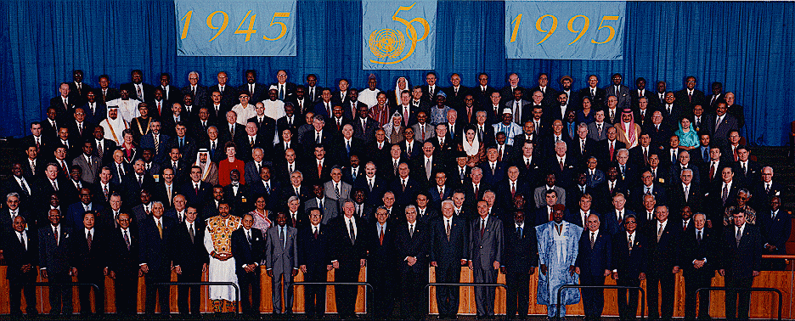
Example of a Global State
[United Nations photo by Paul Skipworth for Eastman Kodak Company ©1995 ]

Slide 4
The distributed version is challenging and important
How would you take this photograph if each country’s premier were sitting in their respective capital, and sending messages to each other?
That’s the challenge of distributed global snapshots!
In a cloud: multiple servers handling multiple concurrent events and interacting with each other
Without the ability to obtain a global photograph of the system, it would be a chaotic system (with potentially lots of inconsistencies)

Slide 5
Detecting Global Properties

Slide 6
Algorithms to Find Global States
Why?
(Distributed) garbage collection
(Distributed) deadlock detection, termination
Two clients buy the last flight ticket at around the same time
What?
Global state = state of all processes + state of all communication channels
Capture the instantaneous state of each process
And the instantaneous state of each communication channel, i.e., messages in transit on the channels
How?
We’ll see this lecture!

Slide 7
Obvious First Solution…
Synchronize clocks of all processes
Ask all processes to record their states at some time t
Time synchronization possible only approximately
What about messages in transit?
Synchronization not required – causality is enough!

Slide 8
Two Processes and Their Initial States

Slide 9
Execution of the Processes
1. Global state S
0
<$1000, 0>
p
c
(empty)
p
<$50, 2000>
1
2
2
c
(empty)
1
2. Global state S
1
c
(Order 10, $100)
<$900, 0>
p
2
p
<$50, 2000>
1
2
c
(empty)
1
Send 5 widgets
3. Global state S
2
c
(Order 10, $100)
<$900, 0>
p
2
p
<$50, 1995>
1
2
c
(five widgets)
1
4. Global state S
3
c
(Order 10, $100)
<$900, 5>
p
2
p
<$50, 1995>
1
2
c
(empty)
1

Slide 10
Process Histories and States
For a process P_{i} , where events e_{i}⁰, e_{i}¹, … occur:
history(P_{i}) = h_{i} = <e_{i}⁰, e_{i}¹, … >
prefix history(P_{i}^{k}) = h_{i}^{k} = <e_{i}⁰, e_{i}¹, …,e_{i}^{k} >
S_{i}^{k} : P_{i} ’s state immediately after k^{th} event
For a set of processes P₁ , …,P_{i} , …. :
global history: H = ∪_{i} (h_{i})
global state: S = ∪_{i} (S_{i}^{k}i)
a cut C ⊆ H = h₁^{c1} ∪ h₂^{c2} ∪ … ∪ h_{n}^{cn}
the frontier of C = {e_{i}^{ci}, i = 1,2, … n}

Slide 11
Consistent States
Lamport’s “happens-before”
A cut C is consistent if and only if
∀_{e ∈ C} (if f → e then f ∈ C)
A global state S is consistent if and only if
it corresponds to a consistent cut
e₁⁰
e₁¹
e₁²
e₁³
P1
e₂¹
P2
e₂⁰
e₂²
P3
e₃⁰
e₃¹
e₃²
Consistent cut
Inconsistent cut
Notes:
Boundary – to the right and to the left
Consistent Cut = global state (process states and messages)

Slide 12
The “Snapshot” Algorithm
Records a set of process and channel states such that the combination is a consistent global state.
Assumptions (System Model!):
There is a communication channel between each pair of processes (@each process: N-1 in and N-1 out)
Communication channels are unidirectional and FIFO-ordered
No failure, all messages arrive intact, exactly once
Any process may initiate the snapshot (by sending “Marker” message)
Snapshot does not interfere with normal execution
Each process is able to record its state and the state of its incoming channels (no central collection)

Slide 13
The “Snapshot” Algorithm (2)
1. Marker sending rule for initiator process P₀
Record own state. After P₀ has recorded its own state
for each outgoing channel C, send a marker message on C
2. Marker receiving rule for a process P_{k}
on receipt of a marker over channel C
if P_{k} has not yet recorded its own state
record P_{k}’s own state
record the state of C as “empty”
for each outgoing channel C, send a marker on C
turn on recording of messages over other incoming channels
else
record the state of C as all the messages received over C since P_{k} saved its own state; stop recording state of C

Slide 14
Chandy and Lamport’s ‘Snapshot’ Algorithm
Marker receiving rule for process p_{i}
On p_{i}’s receipt of a marker message over channel c:
if (p_{i} has not yet recorded its state) it
records its process state now;
records the state of c as the empty set;
turns on recording of messages arriving over other incoming channels;
else
p_{i} records the state of c as the set of messages it has received over c
since it saved its state.
end if
Marker sending rule for process p_{i}
After p_{i} has recorded its state, for each outgoing channel c:
p_{i} sends one marker message over c
(before it sends any other message over c).

Slide 15
Snapshot Example
e₁⁰
e₁^{1,2}
e₁³
e₁⁴
e₁⁵
P1
M
M
a
M
e₂³
e₂⁴
M
P2
e₂⁰
e₂^{1, 2,3}
M
M
b
P3
e₃⁰
e_{3,} ^{1, 2,3}
e₃⁵
1- P1 initiates snapshot: records its state (S1); sends Markers to P2 & P3; turns on recording for channels C21 and C31
2- P2 receives Marker over C12, records its state (S2), sets state(C12) = {} sends Marker to P1 & P3; turns on recording for channel C32
3- P1 receives Marker over C21, sets state(C21) = {a}
4- P3 receives Marker over C13, records its state (S3), sets state(C13) = {} sends Marker to P1 & P2; turns on recording for channel C23
5- P2 receives Marker over C32, sets state(C32) = {b}
6- P3 receives Marker over C23, sets state(C23) = {}
7- P1 receives Marker over C31, sets state(C31) = {}

Slide 16
Earlier Example with Snapshot Algorithm
1. Global state S
0
<$1000, 0>
p
c
(empty)
p
<$50, 2000>
1
2
2
c
(empty)
1
2. Global state S
1
c
(Order 10, $100) , M
<$900, 0>
p
2
p
<$50, 2000>
1
2
c
(empty)
1
Send 5 widgets
3. Global state S
2
c
(Order 10, $100) , M
<$900, 0>
p
2
p
<$50, 1995>
1
2
c
(five widgets)
1
4. Global state S
3
c
(Order 10, $100)
<$900, 5>
p
2
p
<$50, 1995>
1
2
c
M
1
recorded C₁ channel state = (five widgets) recorded C₂ channel state = empty

Slide 17
Provable Assertion: Chandy-Lamport algo. determines a consistent cut
Let e_{i} and e_{j} be events occurring at p_{i} and p_{j}, respectively such that e_{i} → e_{j}
The snapshot algorithm ensures that
if e_{j} is in the cut then e_{i} is also in the cut.
if e_{j} → p_{j} records its state, then it must be true that e_{i} → p_{i} records its state.
Why?
➔A stable predicate that is true in S-snap must be true in S-final

Slide 18
Global States useful for detecting Global Predicates
A cut is consistent if and only if it does not violate causality
A Run is a total ordering of events in H that is consistent with each h_{i}’s ordering
A Linearization is a run consistent with happens-before (→) relation in H.
Linearizations pass through consistent global states.
A global state S_{k} is reachable from global state S_{i}, if there is a linearization, L, that passes through S_{i} and then through S_{k}.
The distributed system evolves as a series of transitions between global states S₀ , S₁ , ….

Slide 19
Global State Predicates
A global-state-predicate is a function from the set of global states to {true, false} , e.g., deadlock, termination
If P is a global-state predicate of reaching termination, then a global state S0 satisfies liveness if:
liveness(P(S₀)) ≡ ∃ L_{∈ linearizations from S0 ,}S_{L} :L passes through S_{L} & P(S_{L}) = true
A stable global-state-predicate is one that once it becomes true, it remains true in subsequent global states, e.g., an object O is orphaned
if P is a global-state-predicate of being deadlocked, then a global state S0 satisfies this safety if:
safety(P(S₀)) ≡ ∀S reachable from S₀, P(S) = false

Slide 20
Quick Note – Liveness versus Safety
Can be confusing, but terms are relevant outside CS too:
Liveness=guarantee that something good will happen eventually
“Guarantee of termination” is a liveness property
Guarantee that “at least one of the atheletes in the 100m final will win gold” is liveness
A criminal will eventually be jailed
Safety=guarantee that something bad will never happen
Deadlock avoidance algorithms provide safety
A peace treaty between two nations provides safety
An innocent person will never be jailed
Can be difficult to satisfy both liveness and safety!

Slide 21
Summary, Announcements
This class: importance of global snapshots, Chandy and Lamport algorithm, violation of causality
Next topic: Multicast, broadcast, impossibility of consensus in asynchronous systems (see course website for readings, to be posted soon)

Slide 22
Optional Slides

Slide 23
Side Issue: Causality Violation
Physical Time
Include(obj1)
P1
1
2
0
1
P2
0
5
6
2
4
P3
obj1.method()
0
3
4
P2 has obj1
Causality violation occurs when order of messages causes an action based on information that another host has not yet received.
In designing a DS, potential for causality violation is important

Slide 24
Detecting Causality Violation
Physical Time
Violation: (1,0,0) < (2,1,2)
0,0,0
1,0,0
2,0,0
P1
(1,0,0)
P2
0,0,0
2,1,2
(2,0,0)
2,2,2
(2,0,2)
P3
0,0,0
2,0,1
2,0,2
Potential causality violation can be detected by vector timestamps.
If the vector timestamp of a message is less than the local vector timestamp, on arrival, there is a potential causality violation.

