Slide 1
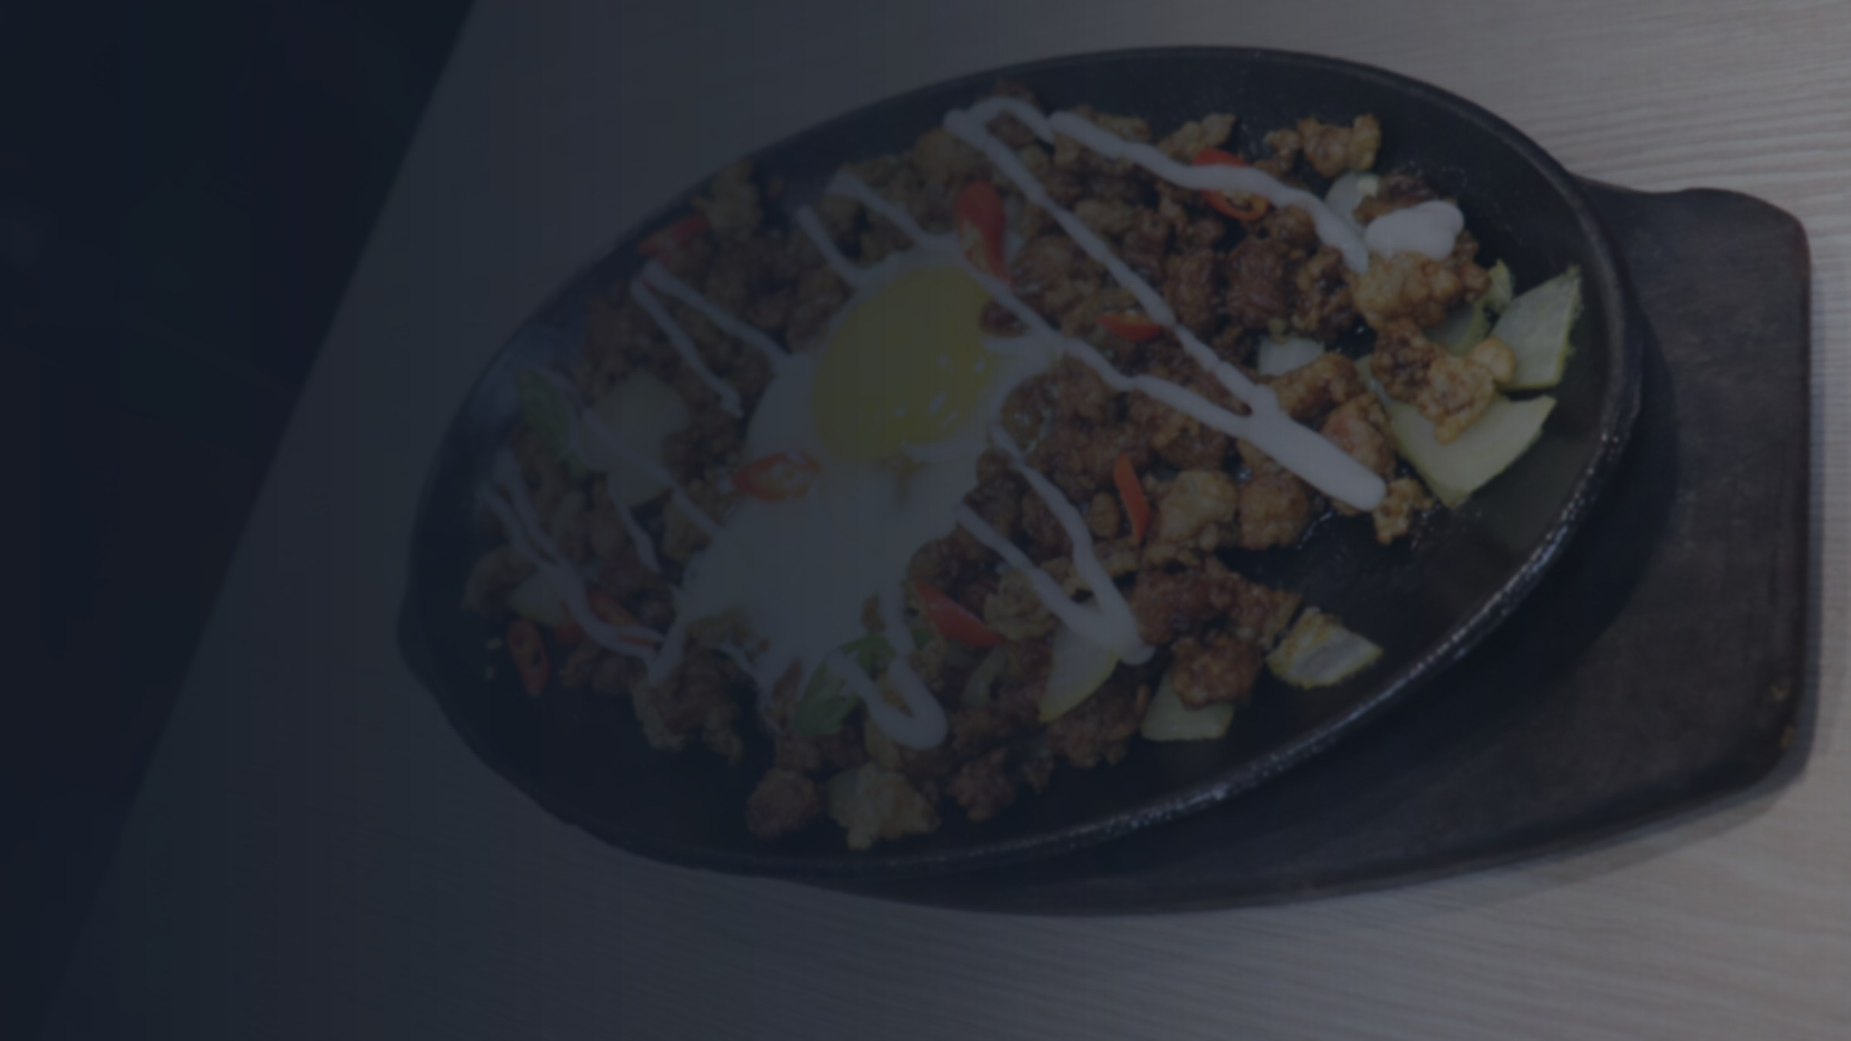


A fast-food app
On the way
Your rider is 3 min away
QUICK QUESTION
Why can a fast-food chain bring dinner to your door…
Placed
Cooking
On the way
Delivered
Live map · Pay in the app · Order in seconds
VS
…but your suki carinderia can’t even reply to your chat?
Your suki carinderia
Seen
7:02 PM
Open pa po kayo?
7:09 PM
May adobo pa po?
7:41 PM
Hello po??
Seen 7:42 PM · no reply
Notes:
Ask the panel this question, then pause. Big chains have apps with live tracking and online payment. But the carinderias, bakeries and home kitchens of Naval, the ones we actually call our suki, still take orders by chat, and we wait on 'seen'. They cook food people love, but they have no way to sell it online. That's the gap Feasto fills.

Slide 2


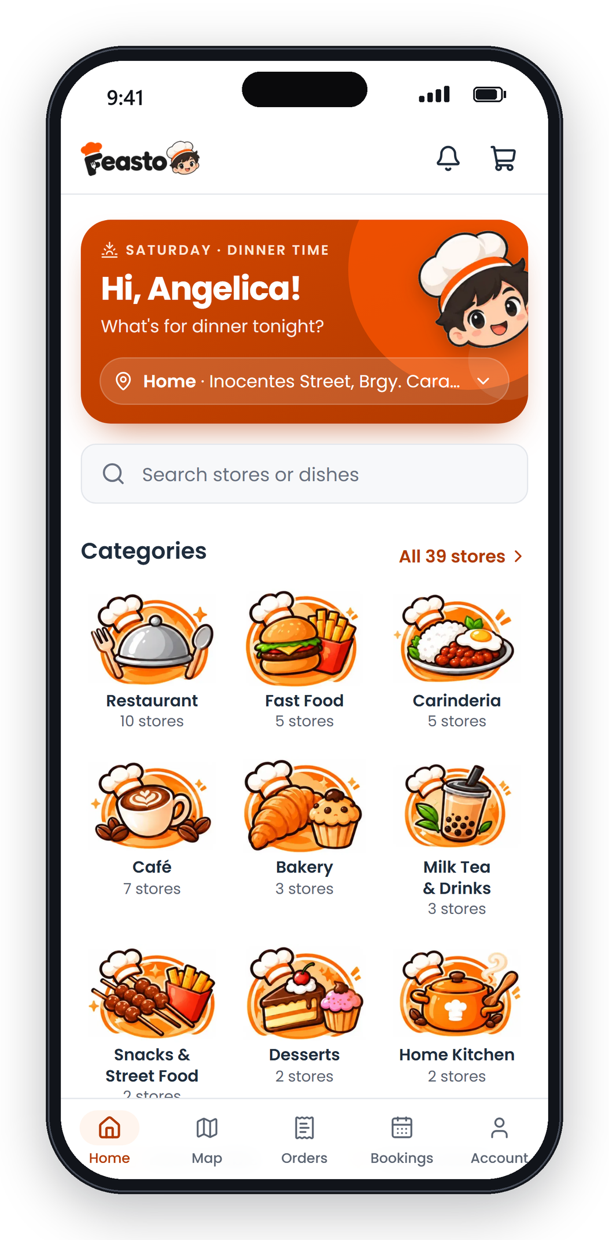



Naval’s food,
one tap away.
A food ordering and delivery platform for the stores, riders and residents of Naval, Biliran.
PRESENTED BY
Kurt Michael S. Salut
John Ivan Acuesta
Joemari Buhain
Almejoy Ancero
Made for Naval, Biliran
Biliran Province State University
School of Technology and Computer Studies
Notes:
We are Feasto: Naval's food, one tap away. A startup that puts every Naval food spot, rider and resident in one app.

Slide 3
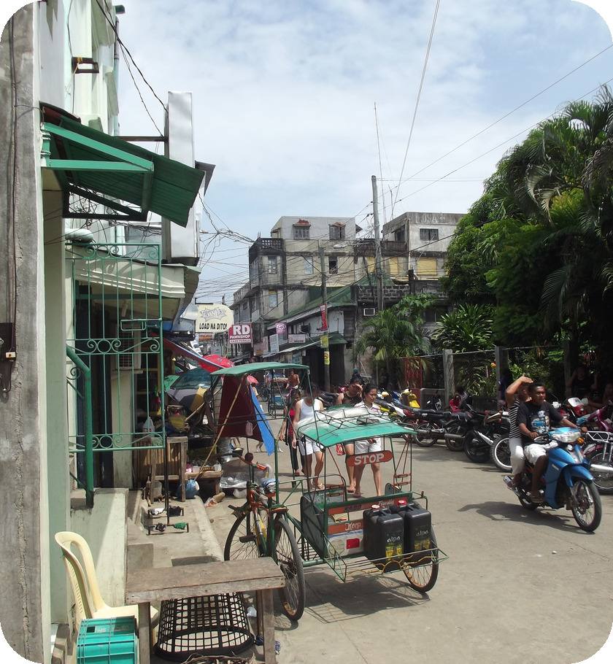


Naval still orders food by chat and call
THE PROBLEM
Residents order by chat, then wait
No menu, prices or waiting time in one place, and no way to see where the food is.
Stores lose orders in the inbox
Orders arrive by chat, text and calls, then go on paper. Sales are hard to track.
Riders have no steady stream of jobs
Delivery work depends on who you know, and every peso is collected in cash.
Downtown Naval
Notes:
Three groups feel the pain. Residents chat and wait. Stores juggle orders across chats, calls and paper. Riders have no steady way to find delivery jobs.

Slide 4
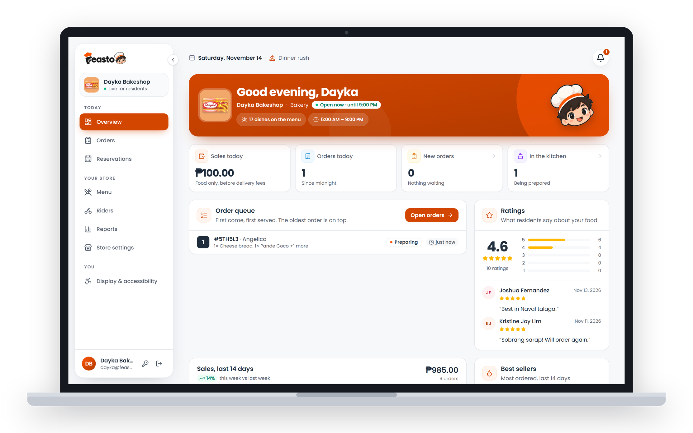



One app for everyone who feeds Naval
OUR SOLUTION
Residents
Stores
Order from any Naval store, delivered or for pickup.
Get orders in one queue, cook, and see every sale.
Riders
Admin
Pick up nearby jobs and get paid for each trip.
Approves partners and keeps the marketplace fair.
Notes:
Feasto connects four people in one platform: residents order, stores cook, riders deliver, and the admin keeps it fair. It runs on any phone or laptop, no app store needed.

Slide 5
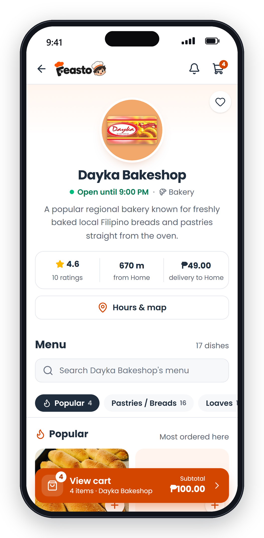
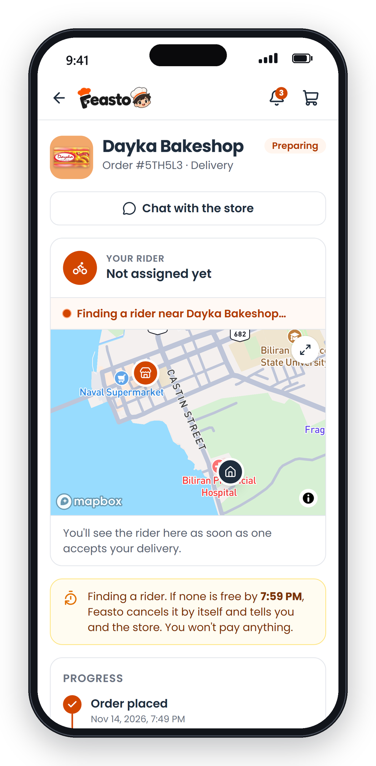
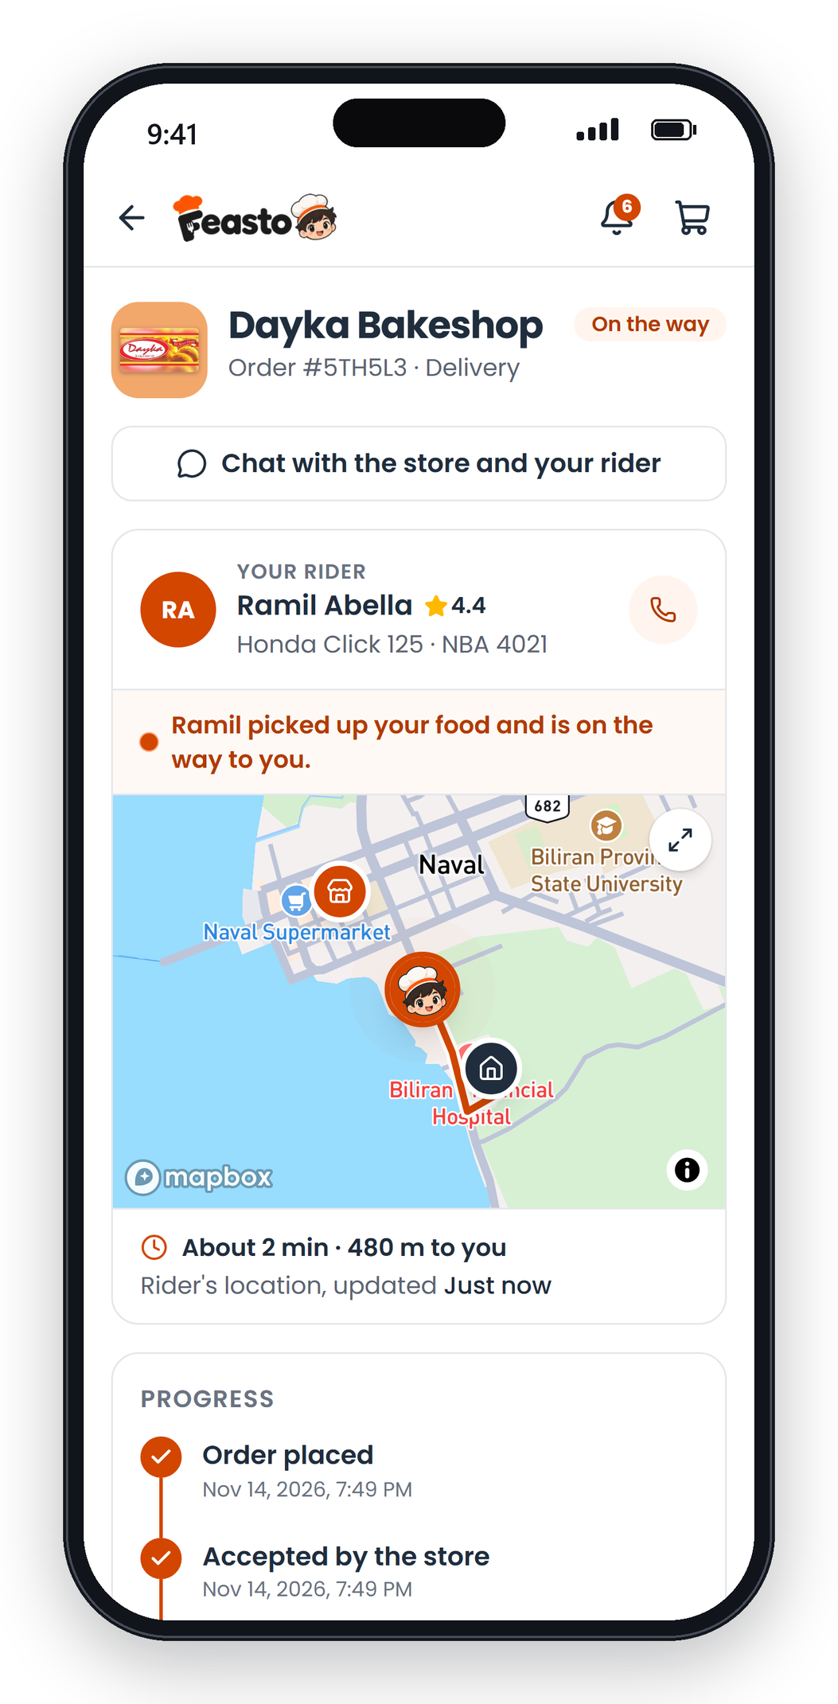
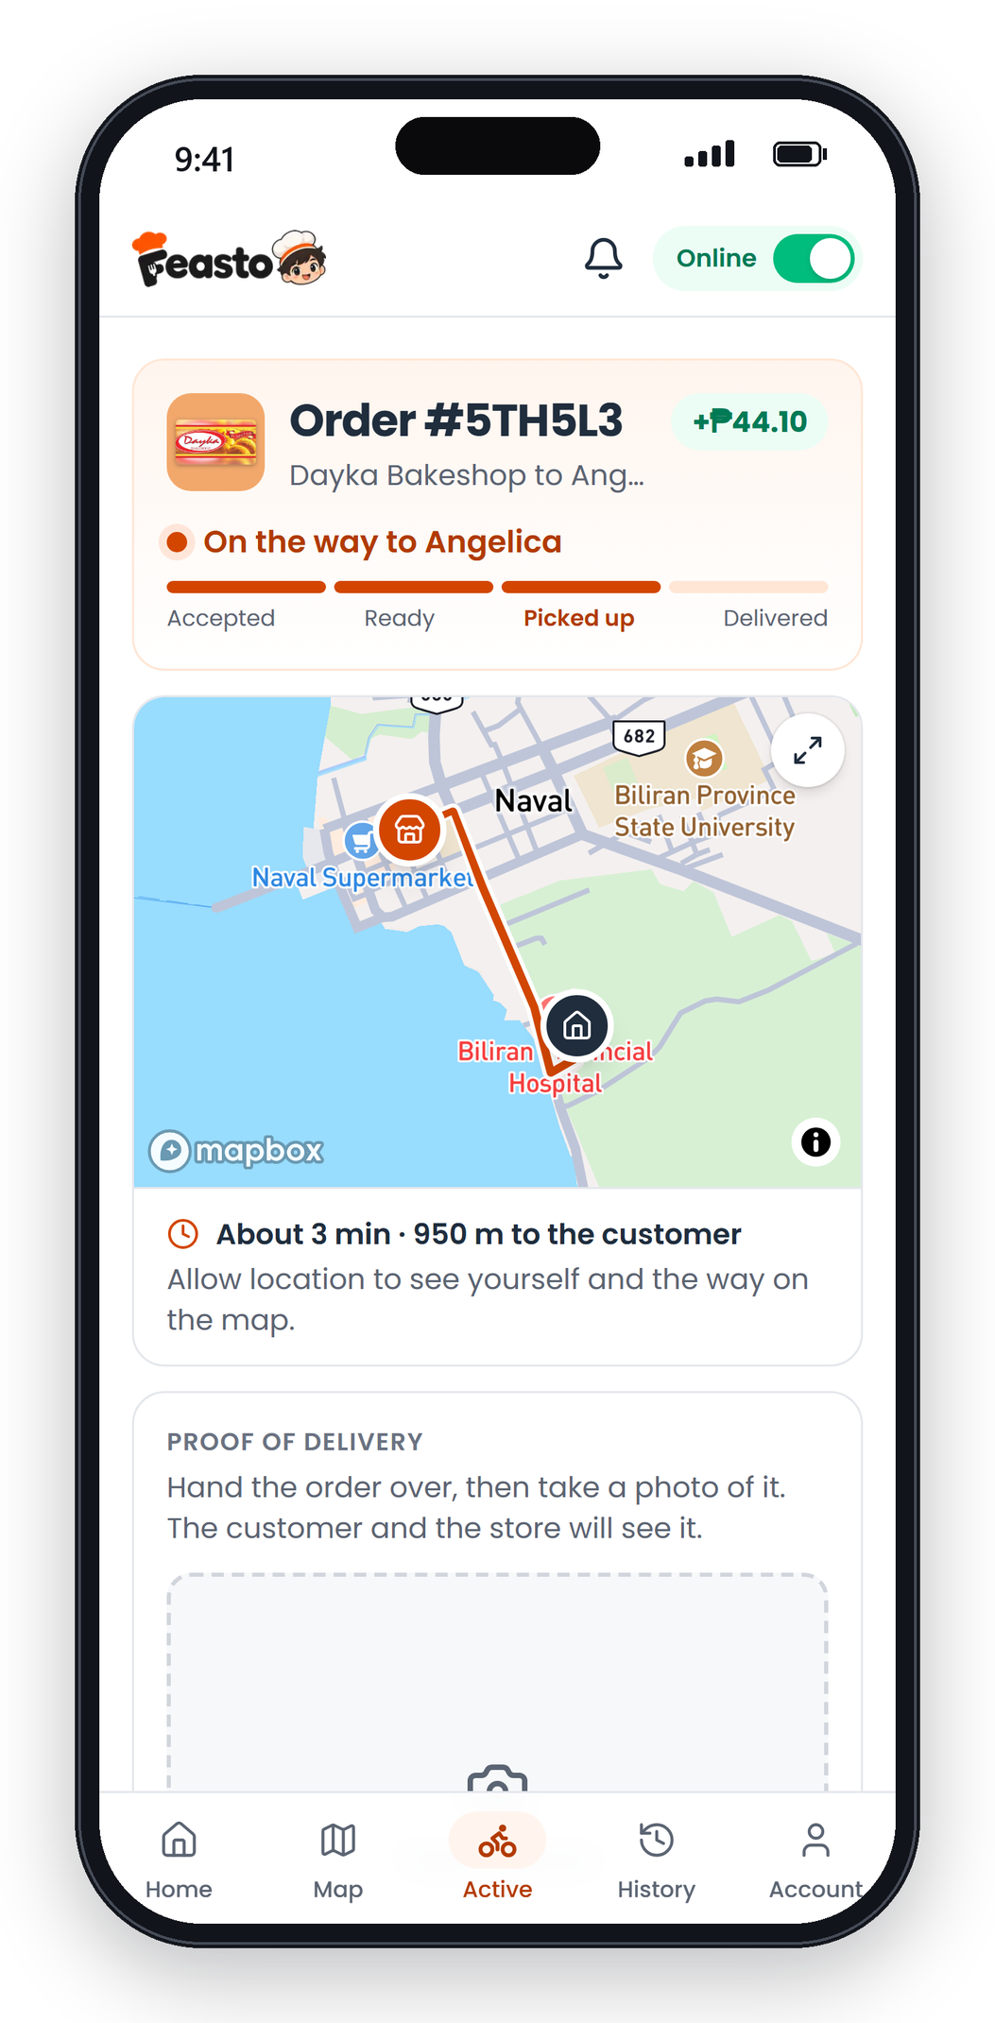

From craving to doorstep in four steps
HOW IT WORKS
1
Order
Pick a store and add your favorites.
2
Store cooks
The store accepts and starts preparing.
3
Rider delivers
Follow your rider on the map.
4
Everyone gets paid
This rider earns +₱44.10 for the trip.
Notes:
This is a real order we ran through Feasto: the resident orders from Dayka Bakeshop, the store prepares it, rider Ramil picks it up and the resident follows him on the map. When it's done, everyone is paid.

Slide 6





Built for Naval first
WHY FEASTO
Local first
39 Naval food spots, from carinderias and bakeries to cafés and fast food.
Delivery, pickup or a table
Order now or later, and book a table where stores take reservations.
Pay your way
Cash on delivery, GCash, Maya, Visa or Mastercard.
Stores and riders paid automatically
Their share goes to their GCash, Maya or bank when the order is done.
Made for everyone
Bigger text, high contrast and screen reader support.
Notes:
Why us? Feasto is built around Naval: its own stores, its own riders, and the ways people here actually pay, cash included.

Slide 7






What Feasto delivers
CORE CAPABILITIES
Live order tracking
Smart rider dispatch
Online and cash payments
Every step of the order, then the rider on the map.
The store’s own riders first, then the nearest free riders.
GCash, Maya and cards through Xendit, or cash on delivery.
Automatic payouts
Store dashboard and reports
Accessible to everyone
Feasto keeps its share and sends the rest out.
One order queue, menu control, and sales reports.
Text size, high contrast, reduce motion, bigger buttons.
Notes:
Six things Feasto does today: live tracking, smart rider dispatch, online and cash payments, automatic payouts, a full store dashboard, and accessibility for everyone.

Slide 8










Who Feasto serves
TARGET MARKET
9 kinds of food spots
39 stores
Residents
Students, families and workers in Naval who want good food without the trip.
10
7
5
Restaurant
Café
Fast food
Food businesses
Carinderias, bakeries, cafés, milk tea shops, home kitchens and restaurants.
5
3
3
Carinderia
Bakery
Milk tea
2
2
2
Riders
Motorcycle owners looking for flexible income close to home.
Desserts
Street food
Home kitchen
Starting in Naval, then all 8 towns of Biliran.
Notes:
Three customers: residents who order, food businesses of every size, and riders who want flexible income. We start in Naval, then grow to the other seven towns of Biliran.

Slide 9
We earn only when an order is completed
BUSINESS MODEL
10%
5%
EXAMPLE
A ₱500 meal delivered 3 km away
commission on delivery orders
commission on pickup orders
Customer pays ₱555 = ₱500 food + ₱55 delivery
10%
30 days
Store
₱450.00
the food, minus 10%
Rider
₱49.50
the delivery fee, minus 10%
of each delivery fee
commission-free for new stores
Feasto
₱55.50
₱50 + ₱5.50 from the fee
Delivery fee: ₱39 for the first km, ₱8 per km after, +₱10 at lunch and dinner rush.
Notes:
Feasto earns only when an order is completed: 10% of the food on delivery orders, 5% on pickup, and 10% of the delivery fee. New stores pay no commission for their first 30 days. In this example, a 500-peso meal delivered 3 km away: the store gets 450, the rider 49.50, and Feasto 55.50.

Slide 10


Easier than chat, closer than the big apps
WHERE WE FIT
Messenger and calls
Big delivery apps
Local and modern, in one app
What most Naval stores use today
Polished, but made for big cities first
Every Naval food spot, menu and price
No menu or prices in one place
Small local eateries compete with national chains
Live tracking and online payment
Replies get missed at rush hour
Not focused on Naval’s own stores and riders
Local riders, paid automatically
No tracking and no sales records
10% commission, first 30 days free
Notes:
Today, stores use Messenger and calls: free, but messy. The big delivery apps are polished, but they're built for big cities first. Feasto sits in between: modern ordering, made around Naval's own stores and riders.

Slide 11


Already running, not just a mockup
TRACTION
39
611
4
0
Naval food spots listed
dishes on the menu
apps in one: resident, store, rider, admin
accessibility issues on 41 pages (WCAG 2.2 AA)
Payments tested end to end
Payments run on Xendit, a payment gateway used by Philippine businesses. We ran every money flow through Feasto in Xendit’s test mode.
GCash payment
Card payment
Automatic refund
Payout to GCash
Payout to Maya
Notes:
Feasto is working today: 39 Naval food spots and 611 dishes are in the app, all four roles work, and the whole app passes accessibility checks. We also ran payments, a refund and payouts to GCash and Maya through Xendit in test mode, so going live only needs live keys.

Slide 12
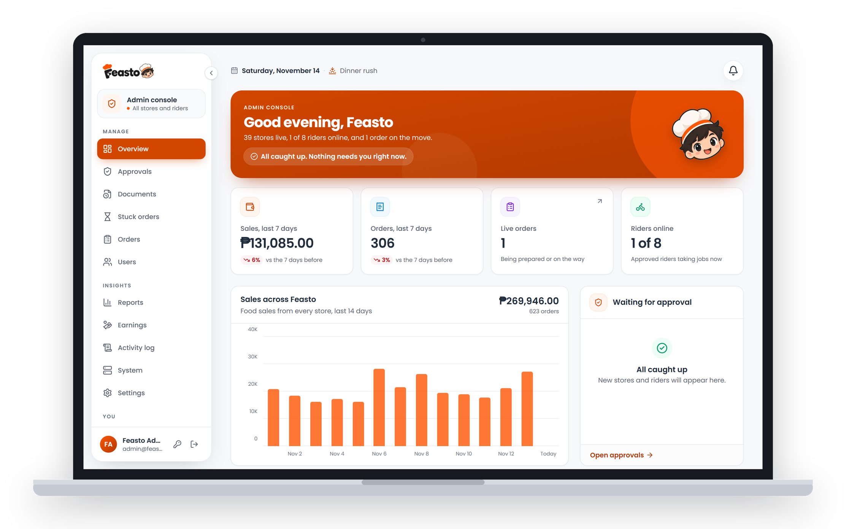
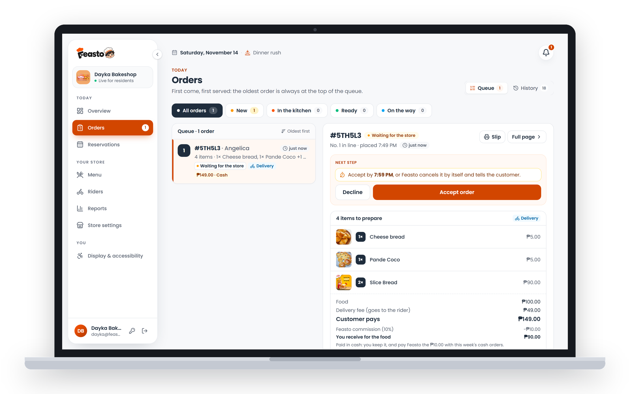
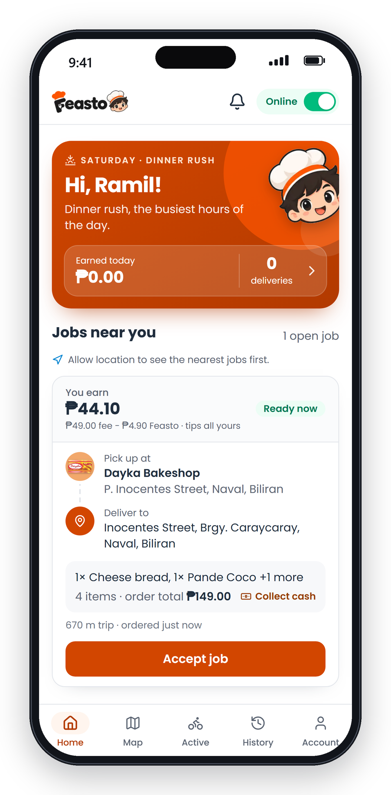
INITIAL USER FACE
The real Feasto, on phones and laptops
Notes:
Here's Feasto as each person sees it: the admin console and store dashboard on laptops, and the resident and rider apps on phones.

Slide 13



Find it, order it, get it delivered
FEATURES · RESIDENTS
Browse by craving
Nine food categories, search, and a map of what’s open near you.
Now or later, delivered or picked up
Order for right now, schedule for lunch, or pick it up on the way home.
Order again in one tap
Your past orders are saved, ready to order again.
Notes:
Residents browse by category or search, order now or schedule for later, and choose delivery or pickup.

Slide 14
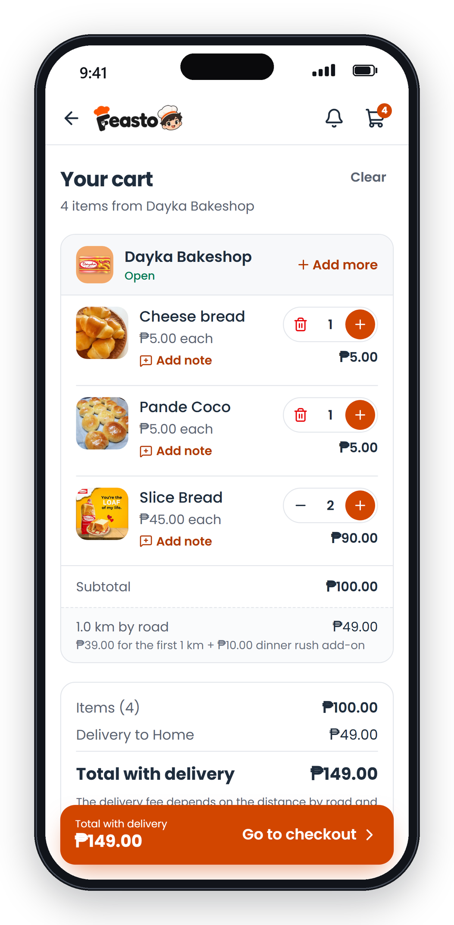
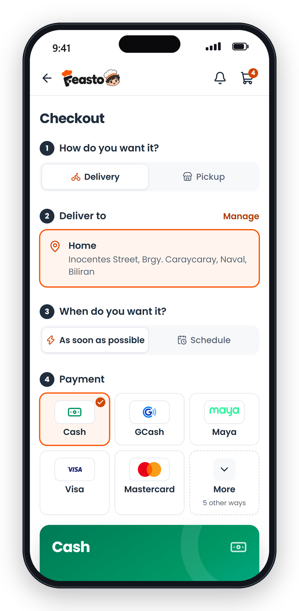


Pay the way Naval pays
FEATURES · PAYMENT
Cash, GCash, Maya or card
Pay on delivery, or online with GCash, Maya, Visa or Mastercard.
Fees shown before you pay
The delivery fee follows the distance, and the rush-hour add-on is spelled out.
Safe online payments
Paid on Xendit’s secure page. If a store declines, the refund is automatic.
Notes:
Checkout shows every fee before paying. Residents can pay cash, GCash, Maya or card. If a store declines an online order, the money goes back automatically.

Slide 15


Watch your food on its way
FEATURES · LIVE TRACKING
Every step, as it happens
Placed, accepted, preparing, ready, on the way, delivered.
Your rider on the map
Name, motorcycle, plate number and how many minutes away.
Chat with the store and rider
No more hunting for a phone number.
Notes:
Left is what the resident sees, right is what the rider sees, at the same moment. The rider's location updates live on the resident's map.

Slide 16



Every order in one queue, every peso on record
FEATURES · STORES
Never miss an order
A chime, a buzz and a message for every new order.
Accept, prepare, ready
One tap for each step, and the customer is told each time.
Sales you can download
Reports by day, best sellers and ratings, in PDF, Word or Excel.
Notes:
Stores see every order in one queue with a chime and vibration for new ones. They tap through accept, preparing and ready, and download their sales as PDF, Word or Excel.

Slide 17
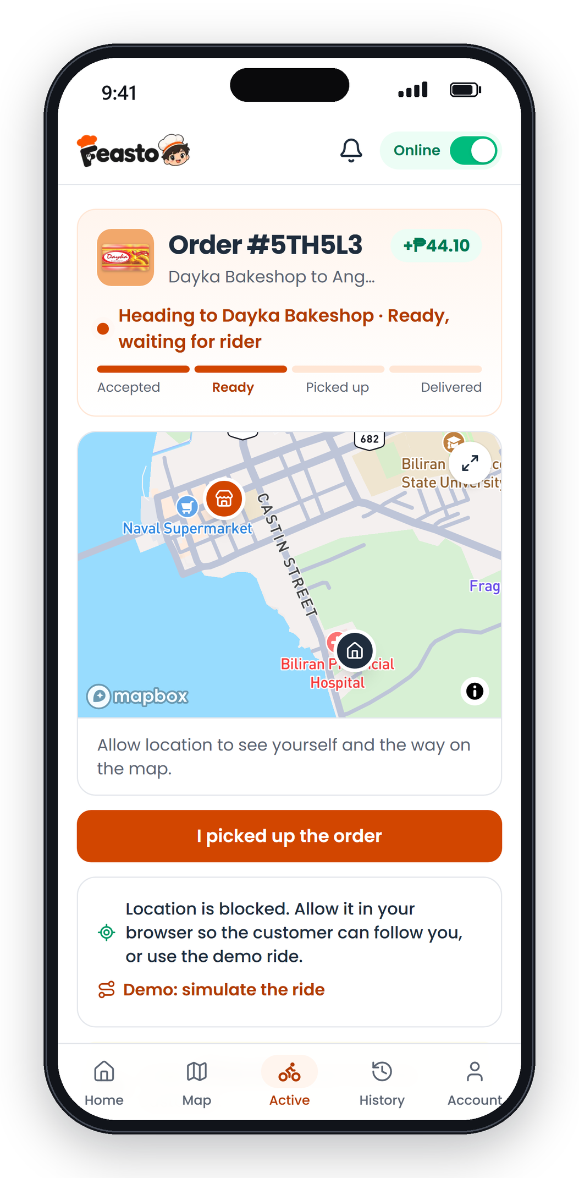


Jobs nearby, earnings you can see
FEATURES · RIDERS
Go online, get nearby jobs
See the pay, the distance and the pickup before accepting.
Step by step to the door
Pick up, deliver, and snap a photo as proof.
Paid straight to GCash or Maya
For online orders, the rider’s share is sent automatically.
Notes:
Riders go online and see nearby jobs with the pay shown upfront. The app guides them from pickup to delivery, with a photo as proof. For online orders their share is sent to their GCash or Maya automatically.

Slide 18



Keep the whole marketplace healthy
FEATURES · ADMIN
Approve stores and riders
Business permits and driver’s licenses are checked first.
Spot stuck orders
Orders that stop moving for 15 minutes are flagged.
Earnings and payouts
Feasto’s share, money sent out, and sales reports.
Notes:
The admin approves every store and rider, watches live orders for anything stuck, and sees Feasto's earnings and every payout in one place.

Slide 19
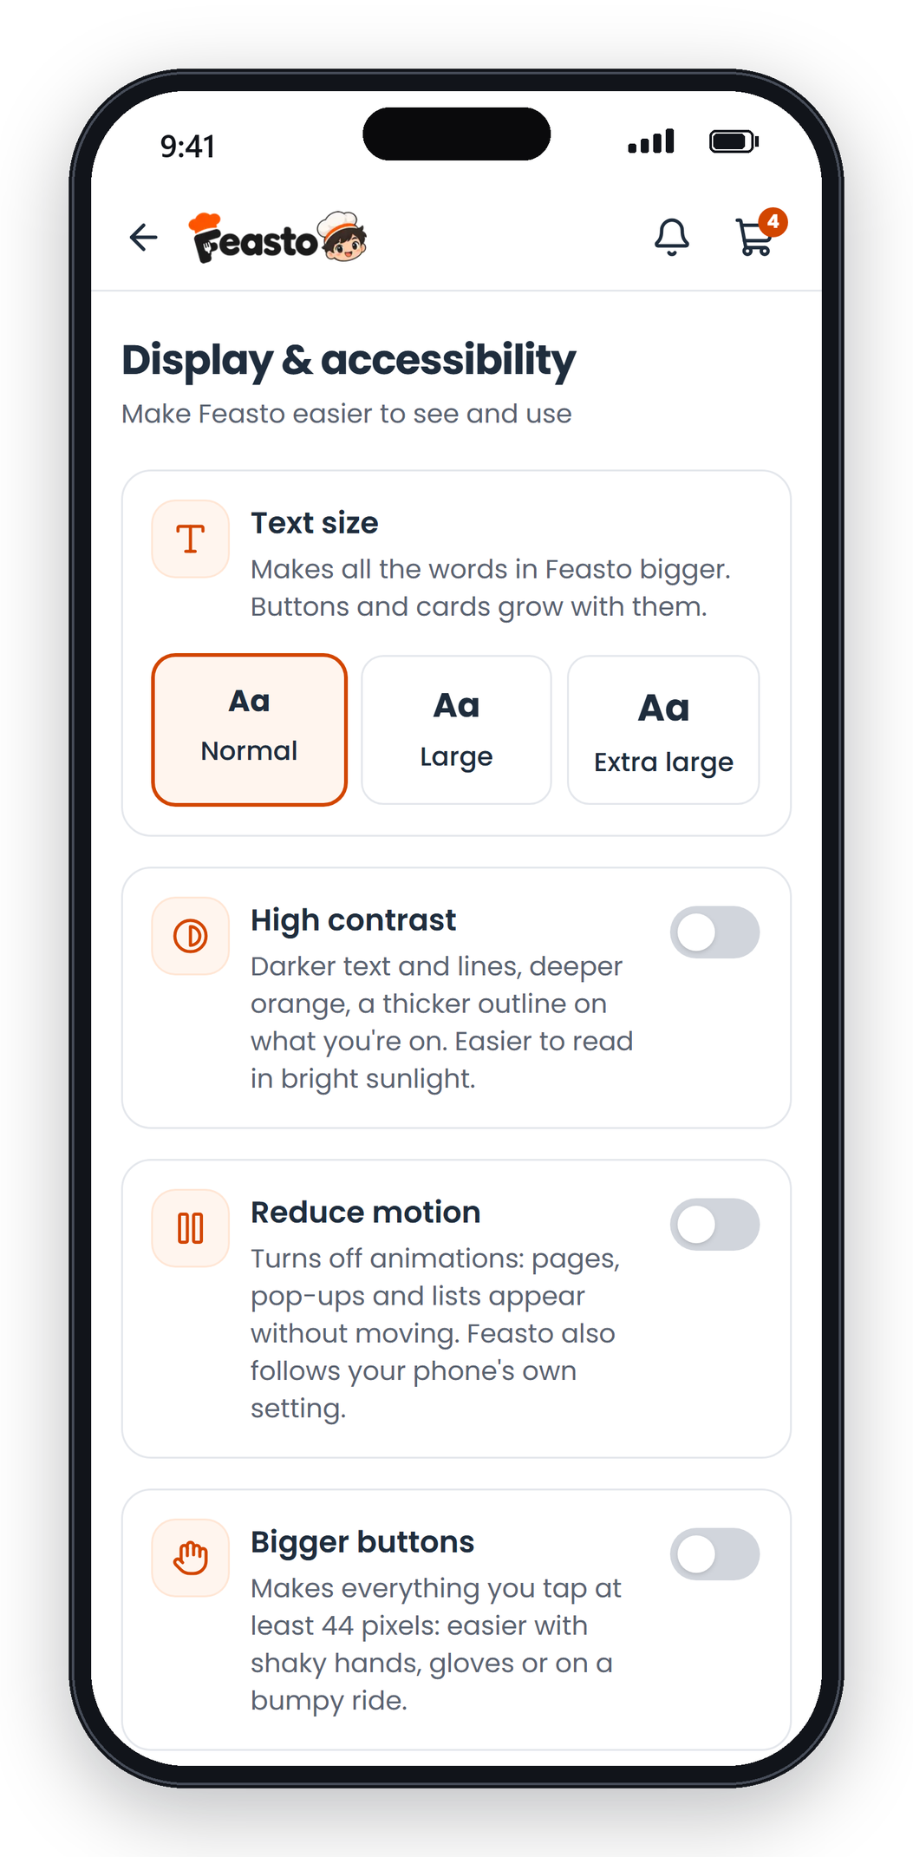




Made to be used by everyone
FEATURES · ACCESSIBILITY
Bigger text and buttons
Text up to Extra large, and every button at least 44 pixels.
0
High contrast and less motion
Easier to read in bright sunlight, and no animations for those who need them.
accessibility issues across 41 pages
Screen readers and keyboards
Every button and picture is named for screen readers; a whole order works by keyboard.
Checked against WCAG 2.2 AA, the international standard.
Notes:
Feasto works for people with low vision, shaky hands or who use screen readers. We checked all 41 pages against the international WCAG 2.2 AA standard: zero issues.

Slide 20





WHAT’S NEXT
From Naval to all of Biliran
NOW
NEXT
LATER
Launch in Naval
All 8 towns of Biliran
More than meals
Sign up Naval’s food spots and riders, and open to residents.
Almeria, Biliran, Cabucgayan, Caibiran, Culaba, Kawayan and Maripipi.
Groceries, pasalubong and featured-store promos.
What we’re looking for: store partners, riders and investors to help us launch in Naval.
Notes:
We launch in Naval first, then grow to the other seven towns of Biliran, and later go beyond meals. We're looking for store partners, riders and investors to help us launch.

Slide 21




The people behind Feasto
THE TEAM
Kurt Michael S. Salut
John Ivan Acuesta
Joemari Buhain
Almejoy Ancero
Co-founder
Co-founder
Co-founder
Co-founder
BiPSU · STCS
BiPSU · STCS
BiPSU · STCS
BiPSU · STCS
Notes:
We are four students of the School of Technology and Computer Studies at BiPSU, and we built Feasto from the ground up.

Slide 22
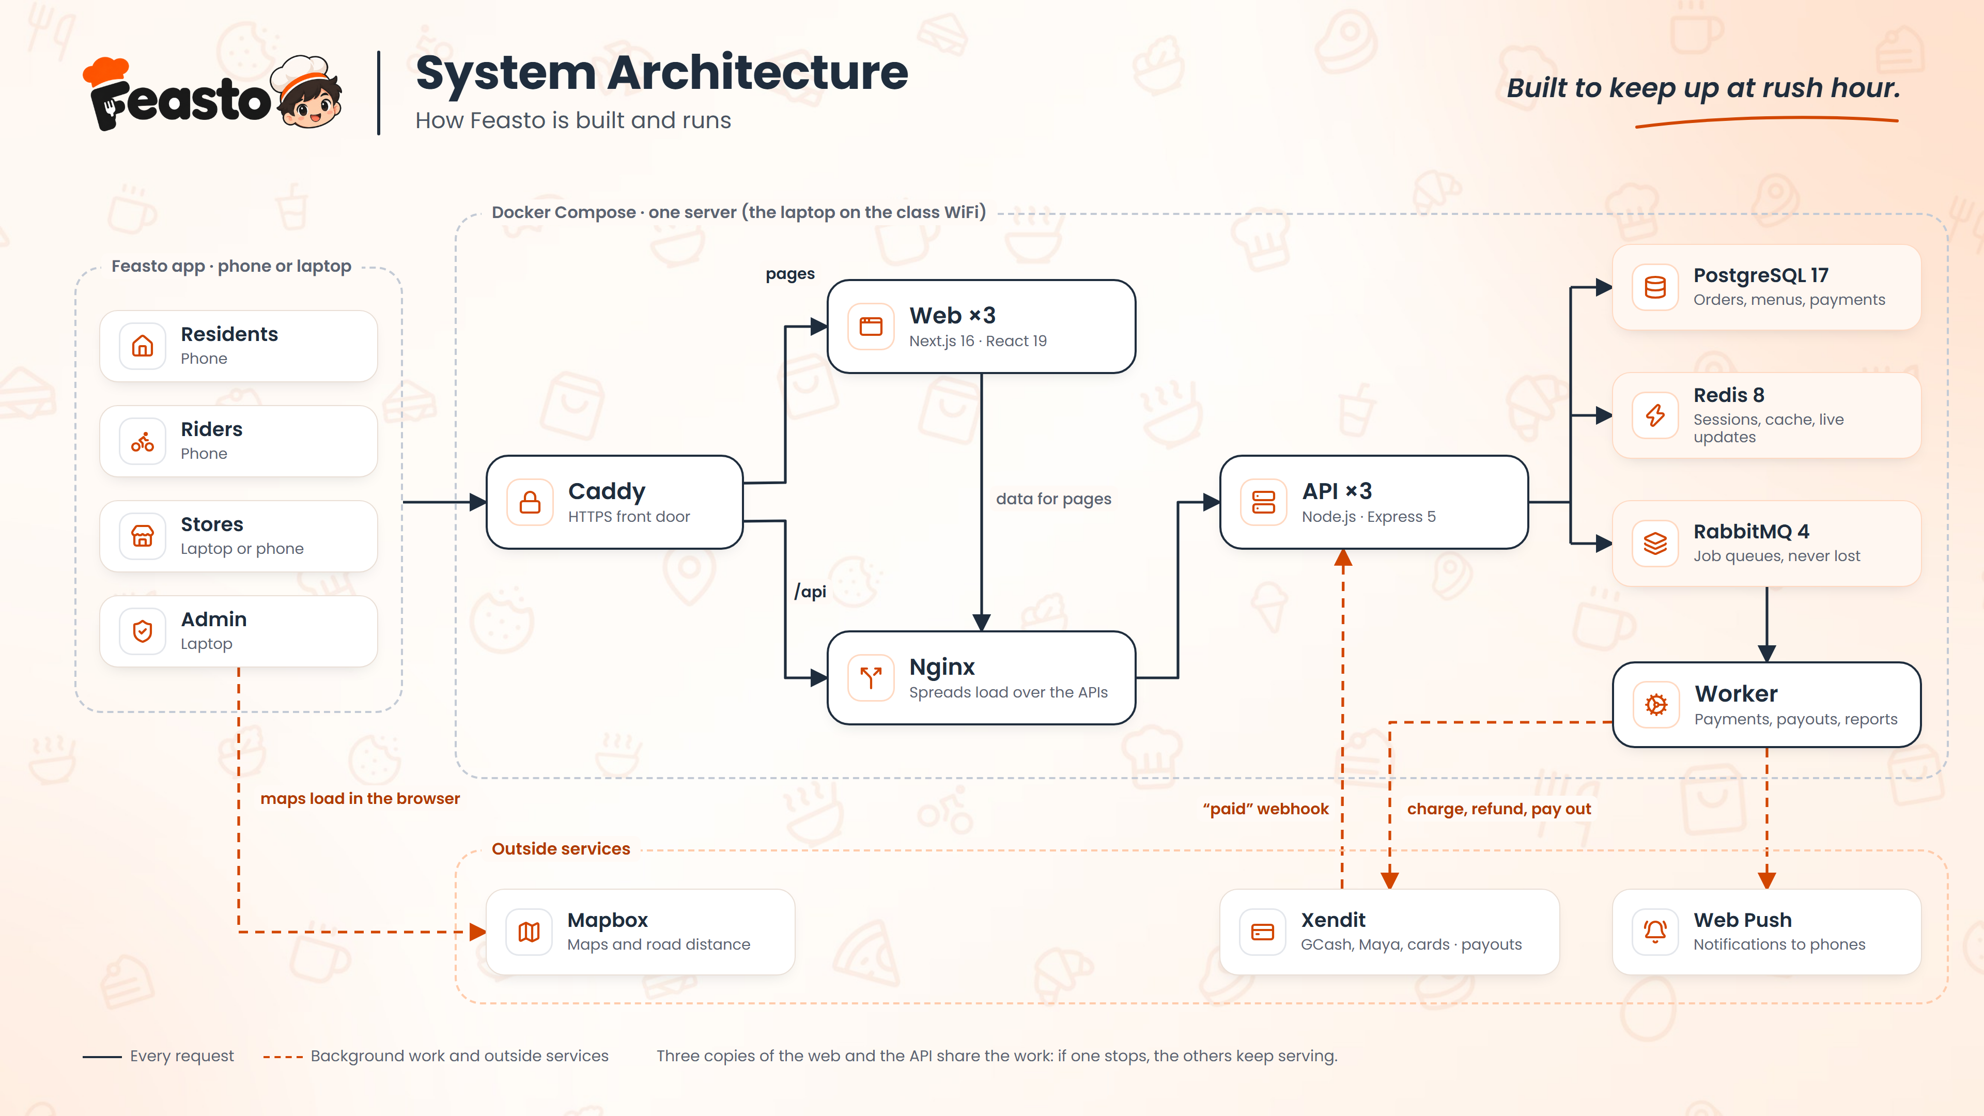
Notes:
How Feasto runs: every phone or laptop reaches Caddy over HTTPS. Pages come from three web servers, and data from three API servers behind Nginx, so if one stops the others keep going. PostgreSQL keeps the orders and money, Redis the live updates, and RabbitMQ hands slow work like payments and reports to a worker.

Slide 23
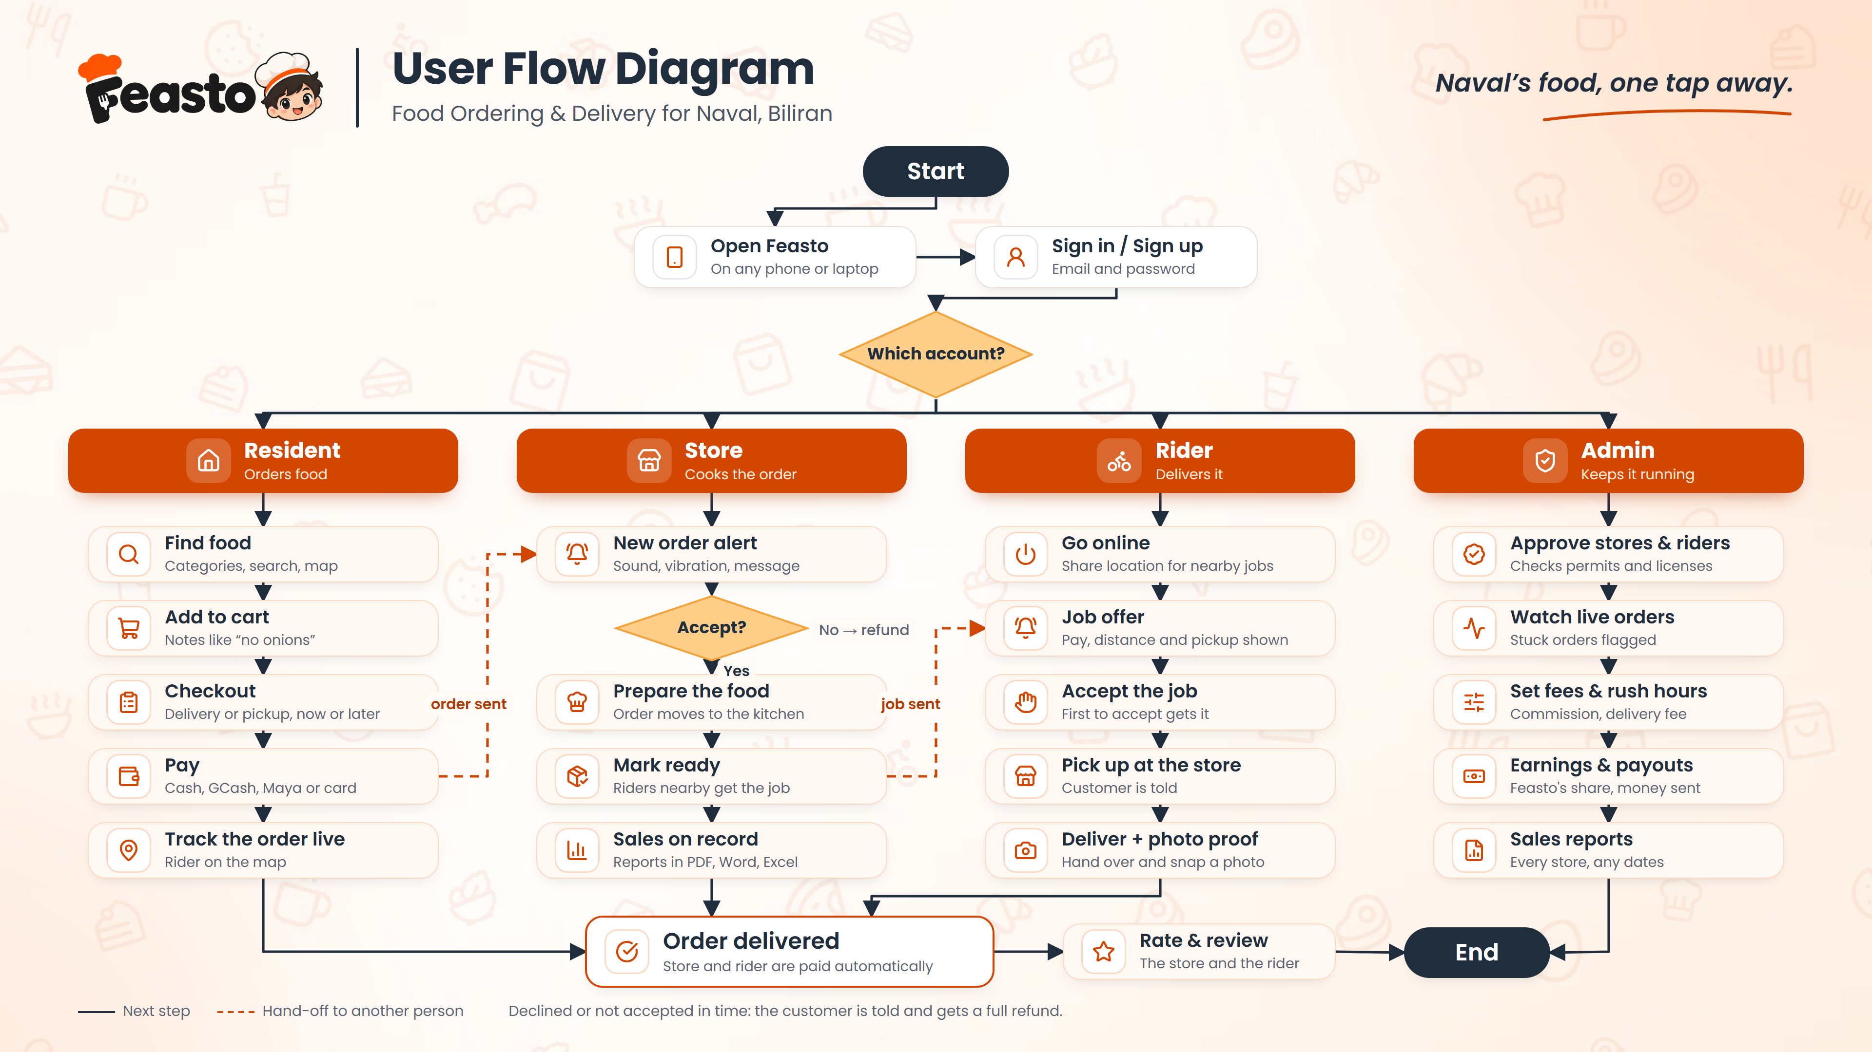
Notes:
The user flow: everyone signs in, then follows their own path. The dashed lines are hand-offs: the resident's order goes to the store, and the store's ready order goes to the riders. Every order ends delivered, with the store and rider paid.

Slide 24


Thank you!
Salamat po!
Photos from Wikimedia Commons. Biliran Bridge: rogel tura (CC0) · Naval: TravellerQLD (CC BY-SA 3.0) · Sisig: ShmilyDigital (CC BY-SA 4.0) · Higatangan Island: Jonrolf Alroi Abrantes (CC BY-SA 4.0) · BiPSU oval: Mark Anthony Efe (CC BY-SA 4.0)
Notes:
Thank you! We're happy to take your questions, and to show Feasto live.

