Slide 1
From Seismicity Forecasts to Risk-Averse Decisions
A sequential pipeline: Hierarchical JEPA → floatCSEP → stochastic ground motion → nonlinear SDOF → CVaR-bandit control
cvar-psha-bandit (filippo branch) · L0–L3 build & verification run

Slide 2
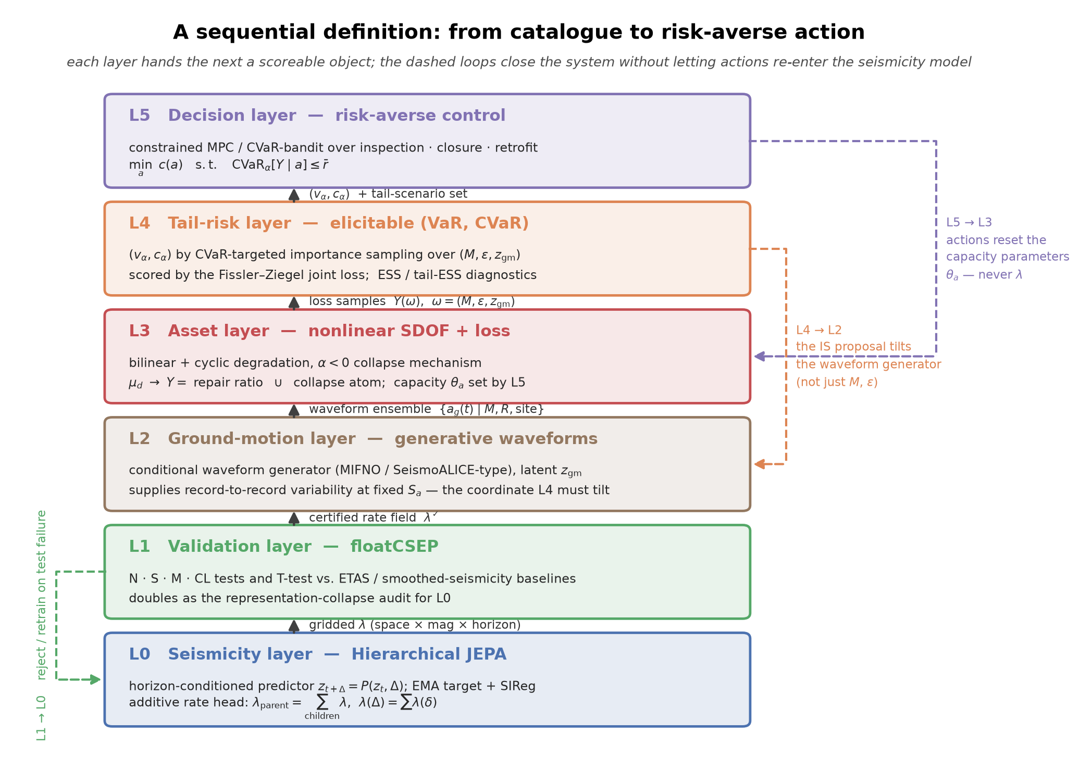
The Big Picture
Why chain a seismicity model to a structural risk metric, not just to a hazard map
• Standard PSHA answers “how strong might shaking be?” — not “what does that cost, and what should we do?”
• Gatti's Hierarchical JEPA line of work models seismicity as a self-supervised, horizon-conditioned latent forecaster — not a hand-tuned point-process.
• Our thread's contribution: wire that forecaster into a validated, decision-facing pipeline — floatCSEP for statistical certification, physics for ground motion, nonlinear structural response for loss, and CVaR for the tail the decision-maker actually cares about.
• Design principle carried through every layer: actions (retrofit, closure, inspection) are allowed to reset structural capacity θₐ downstream, but must never leak back into the seismicity rate λ — keeps the causal chain acyclic and auditable.
EQ-JEPA × floatCSEP × CVaR-PSHA — cvar-psha-bandit (filippo branch)
2 / 10

Slide 3
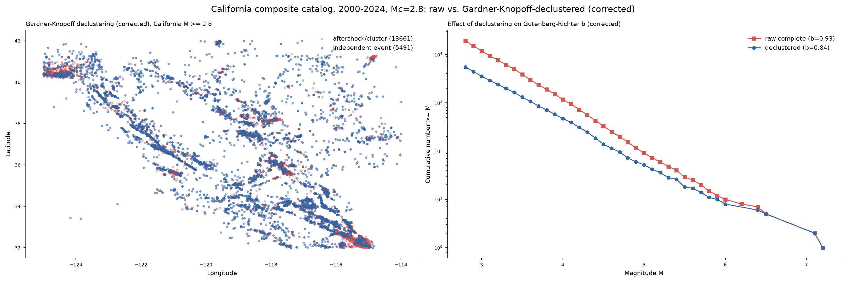
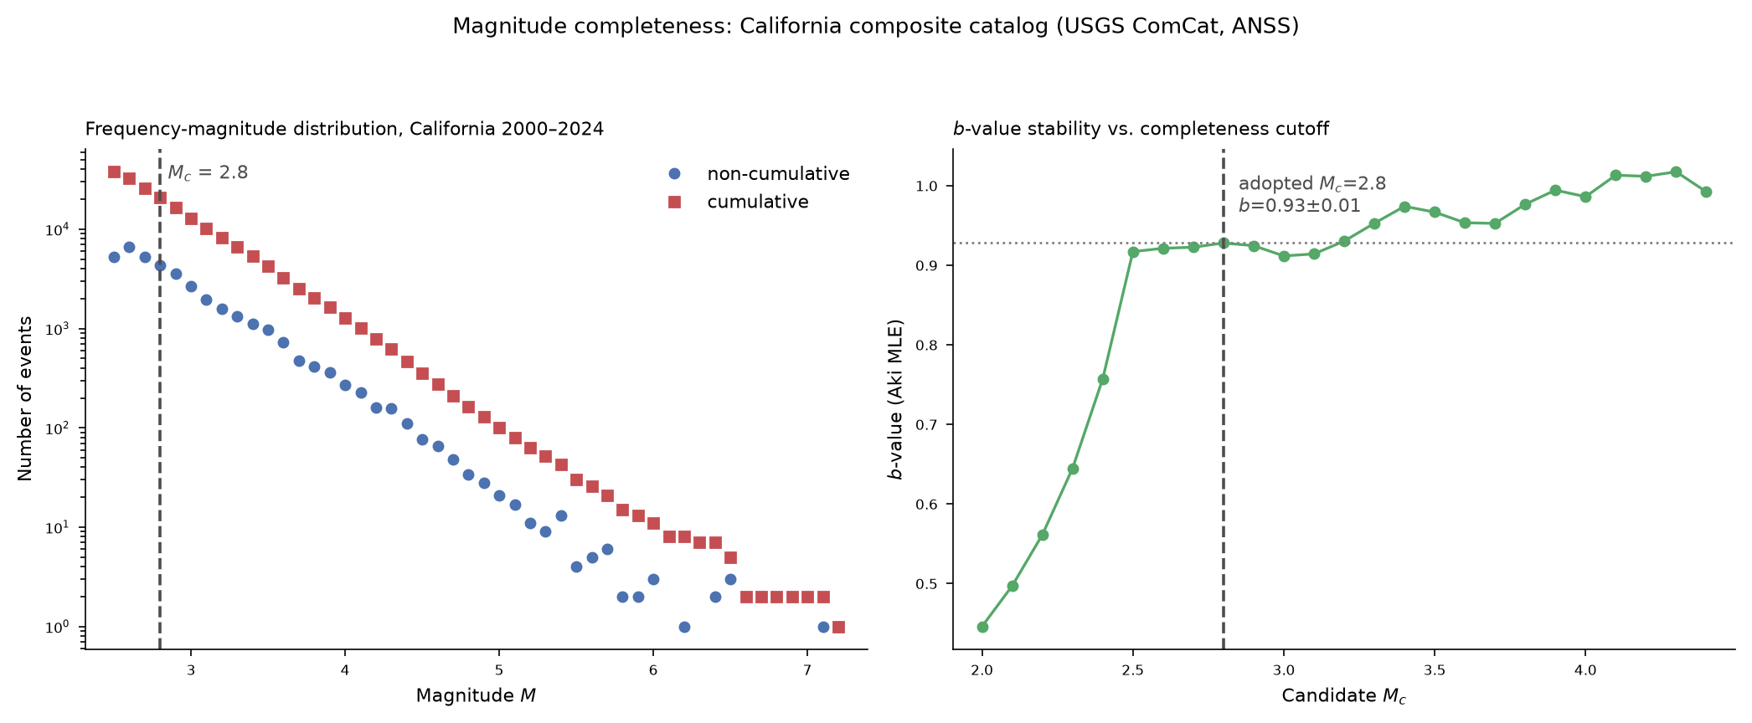
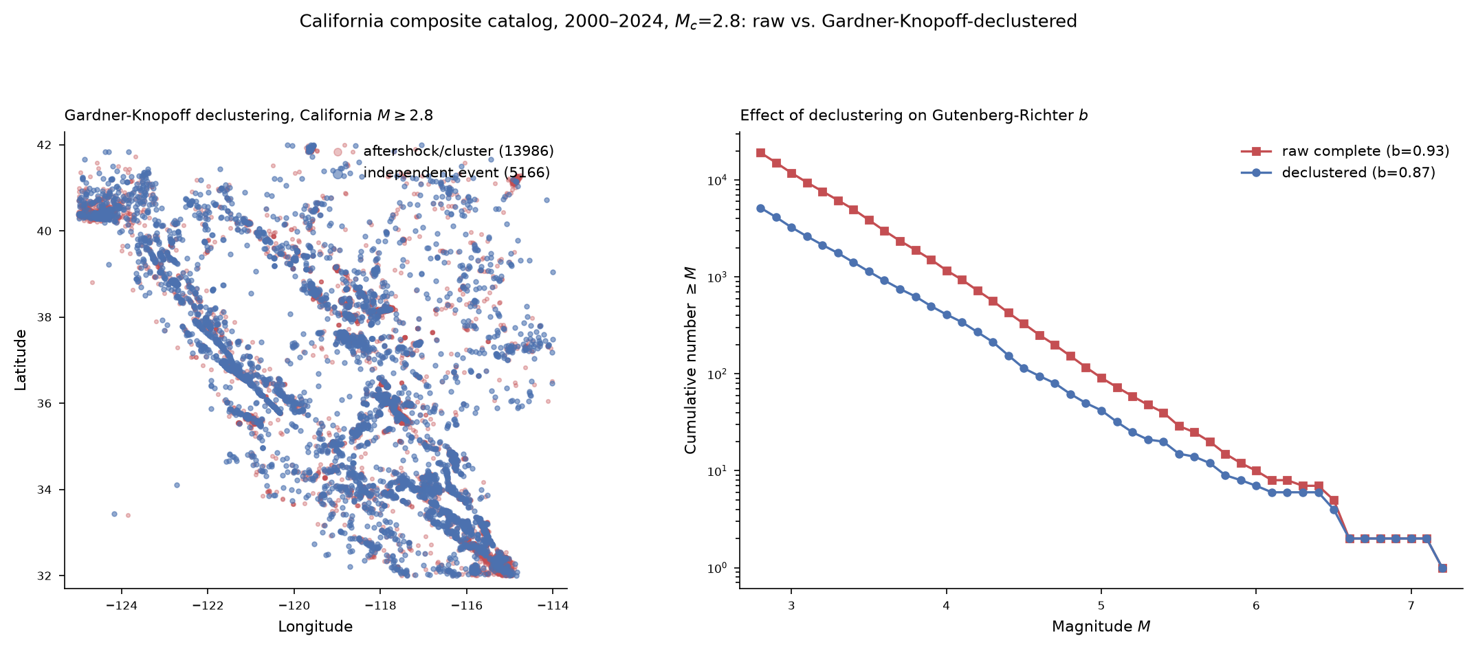
Data: California Seismicity Catalog
USGS ComCat / ANSS composite, 2000–2024
• 19,152 events over M2.8+; independent-event filtering corrected this session (vetted seismostats/OpenQuake-HMTK Gardner-Knopoff, replacing a hand-coded formula with a coefficient error): 5,491 independent mainshocks, 13,661 flagged aftershock/cluster.
• Magnitude range 2.8-7.2; adopted completeness magnitude Mc=2.8, Aki MLE b-value 0.93 on the full catalog (stable plateau across candidate Mc, right panel).
• Declustering lowers apparent b to 0.84 (corrected value; a buggy first-pass declustering had understated this drop) -- a reminder that L1's baselines and L0 alike must be benchmarked on the same declustering convention.
• This catalog is the single ground-truth source for: L0 training/test windows, L1 floatCSEP observed counts, and the Mc/b-value priors used in L2 scenario sampling.
EQ-JEPA × floatCSEP × CVaR-PSHA — cvar-psha-bandit (filippo branch)
3 / 10

Slide 4
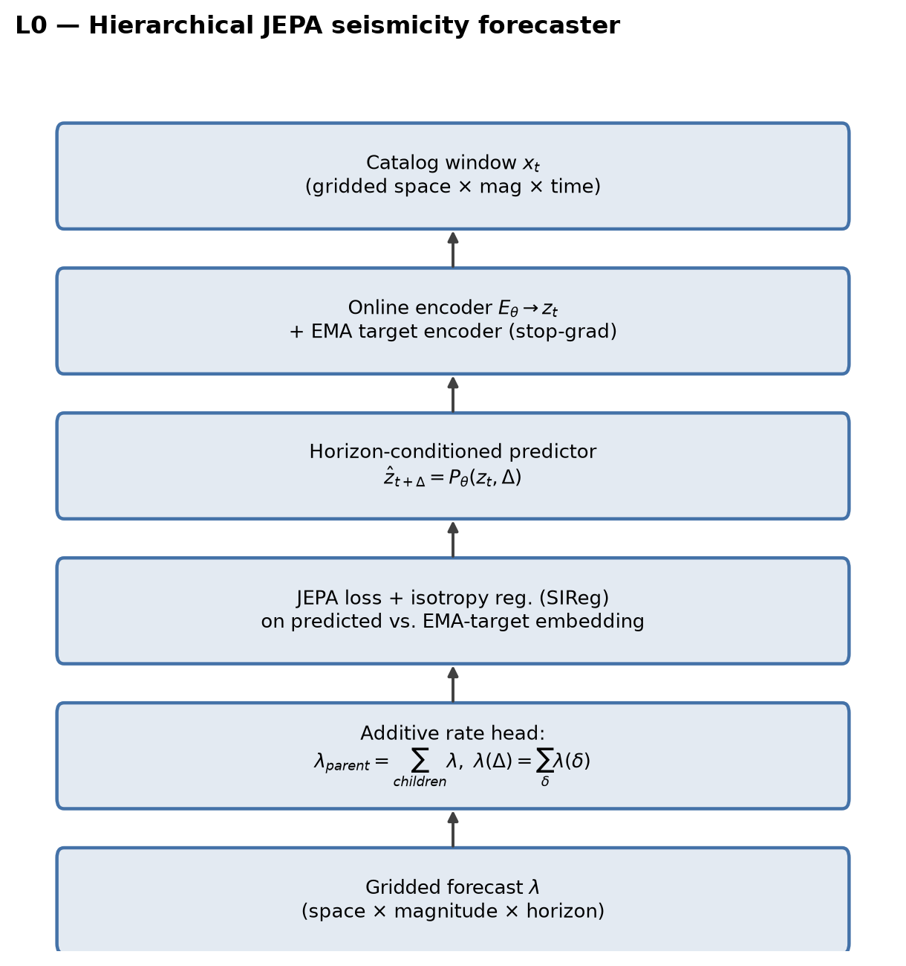
L0 — Hierarchical JEPA Seismicity Forecaster
Self-supervised latent predictor, additive multi-horizon rate head
• Horizon-conditioned predictor z_{t+Δ} = P(z_t, Δ) trained with an EMA target encoder + isotropy regularizer (SIReg) — avoids representation collapse without hand-labeled event targets.
• Additive rate head enforces internal consistency across scales: parent rate = Σ over children; total rate over horizon Δ = Σ over sub-intervals δ.
• Trained on the cleaned, declustered, Mc-filtered catalog (2010–01 .. 2018–12, 108 issue times × 3 forecast horizons).
• Output: a gridded rate field λ over space × magnitude × horizon, handed to L1 for statistical certification.
EQ-JEPA × floatCSEP × CVaR-PSHA — cvar-psha-bandit (filippo branch)
4 / 10

Slide 5
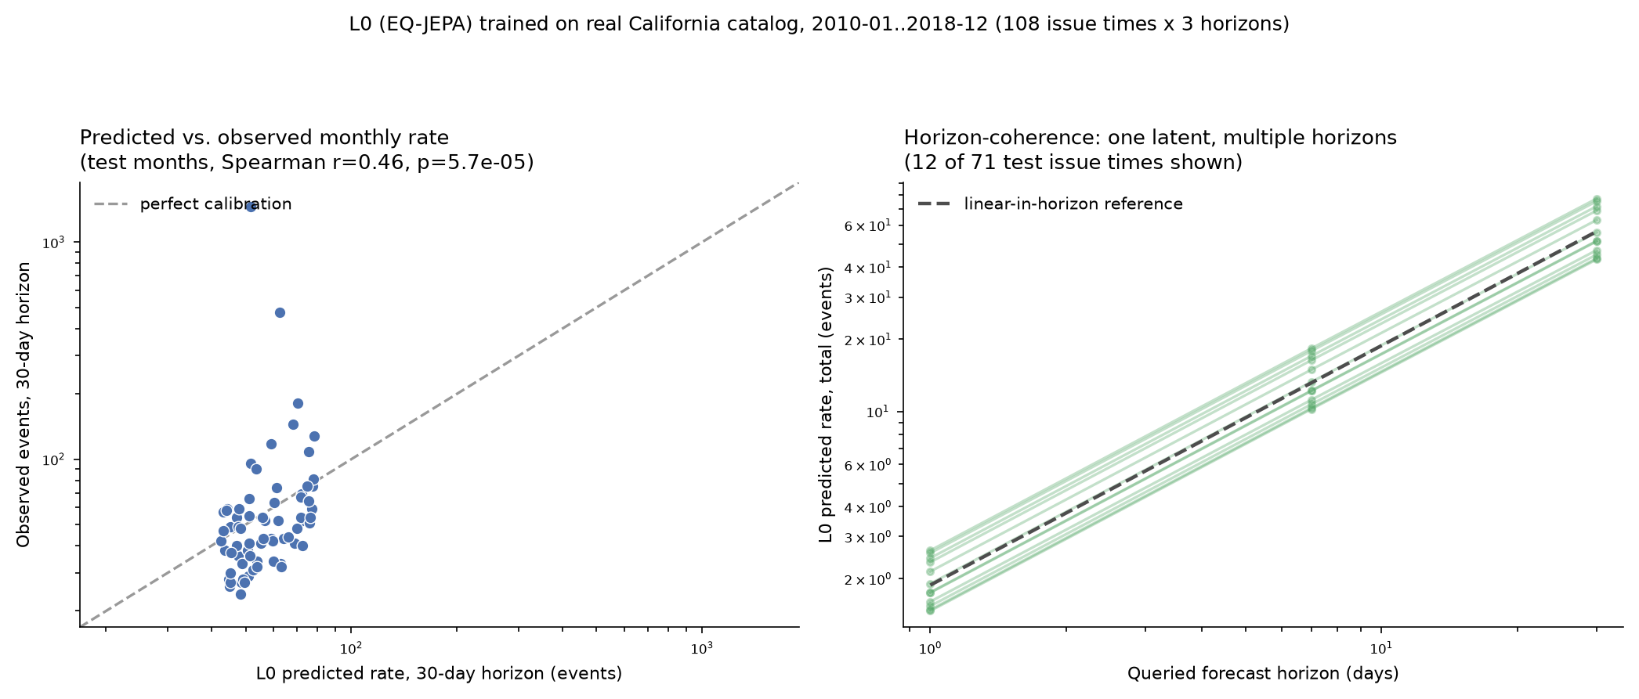
L0 Results — Forecast Skill on Held-Out Windows
108 issue times × 3 horizons, real California catalog
• Predicted vs. observed monthly rate: Spearman r=0.46 (p=5.7×10⁻⁵) — real, if modest, positive rank correlation on held-out months (left panel).
• Horizon-coherence check: a single latent z_t, queried at 1/7/30-day horizons, produces near-linear-in-horizon predicted totals — confirms the additive rate head is internally consistent rather than three independently-fit heads (right panel).
• This positive skill and internal consistency are the precondition for L1: floatCSEP can only certify a model whose rates are coherent enough to grid and test.
EQ-JEPA × floatCSEP × CVaR-PSHA — cvar-psha-bandit (filippo branch)
5 / 10

Slide 6
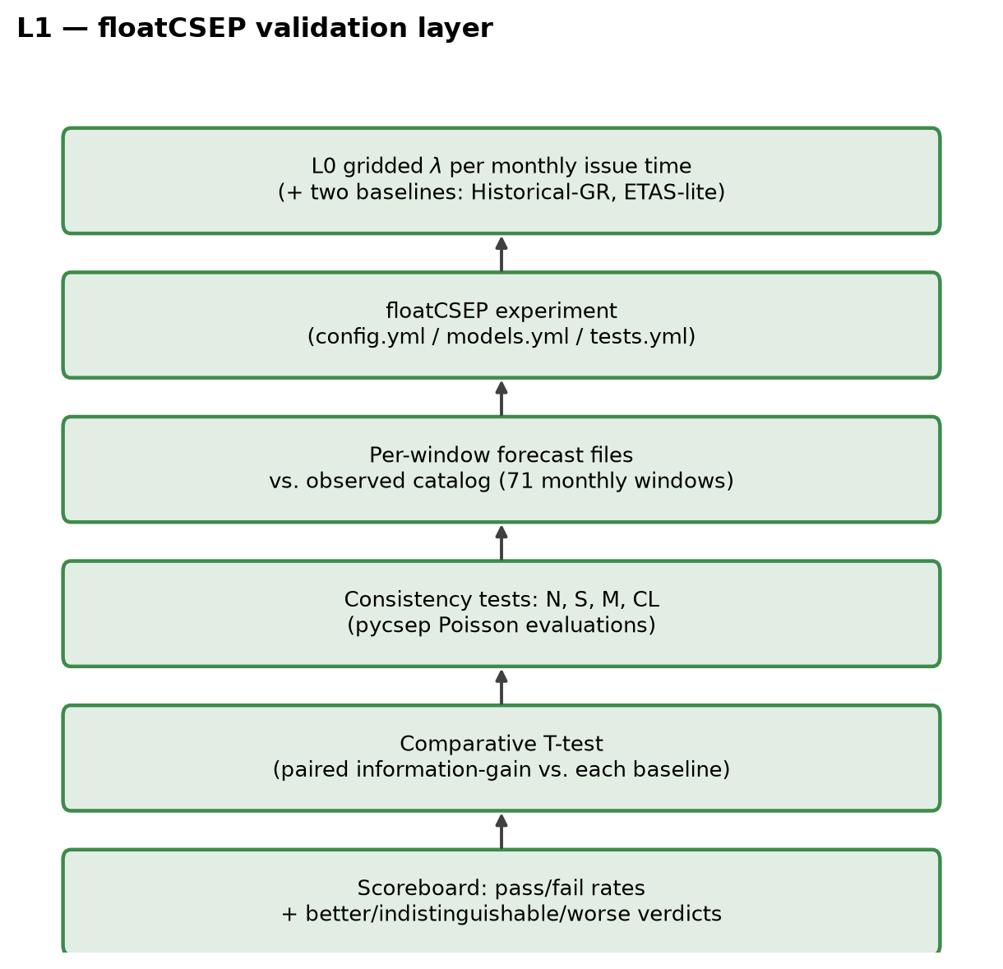
L1 — floatCSEP Validation Layer
Statistical certification before any downstream physics runs
• floatCSEP orchestrates 71 monthly test windows (2019–2024) against a gridded rate forecast, running the standard pyCSEP consistency-test battery.
• N-test (number), S-test (spatial), M-test (magnitude), CL-test (space-magnitude joint) — each a Poisson consistency check between forecast λ and observed counts.
• Paired T-tests give comparative information gain per earthquake vs. two baselines: Historical Gutenberg-Richter and an ETAS-lite point-process model.
• This layer doubles as the representation-collapse audit for L0: a model whose latent representation collapsed would fail these tests uniformly, not selectively.
EQ-JEPA × floatCSEP × CVaR-PSHA — cvar-psha-bandit (filippo branch)
6 / 10

Slide 7
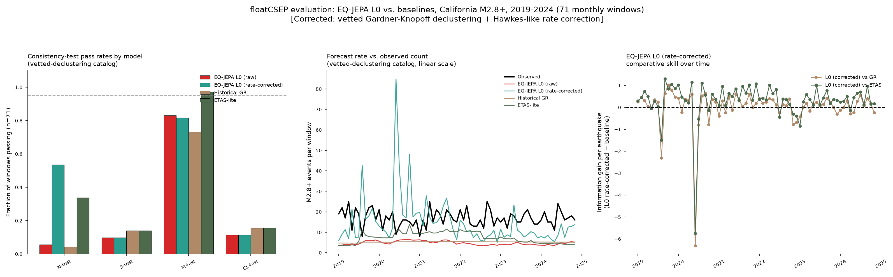
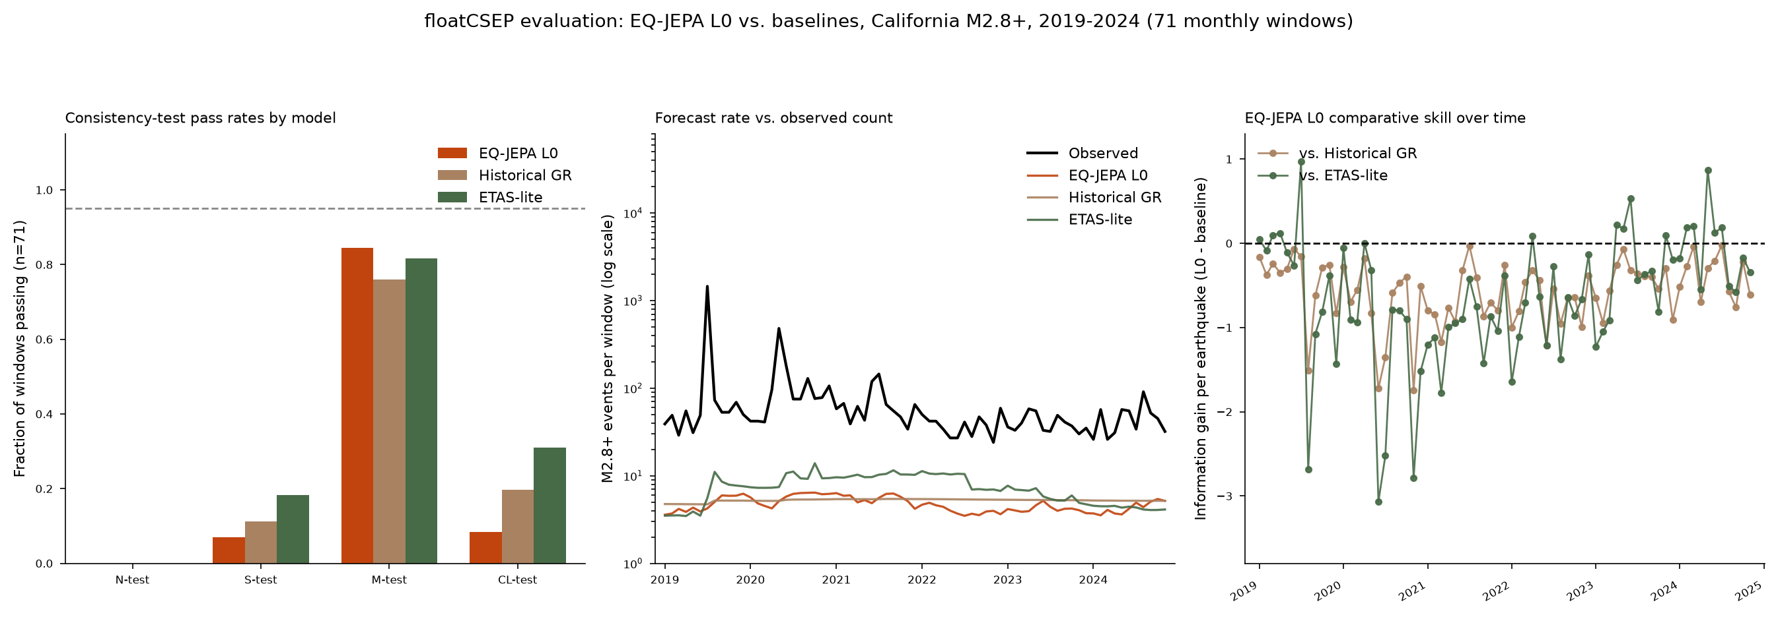
L1 Results — EQ-JEPA vs. Baselines, 71 Monthly Windows
California M2.8+, 2019–2024
• Two catalog bugs found and fixed: aftershock contamination (dispersion 379.5x Poisson), then a hand-coded Gardner-Knopoff coefficient error (residual 10.5x). Vetted re-declustering (seismostats/OpenQuake HMTK) collapses dispersion to 0.94x -- essentially Poisson.
• With the catalog fixed, all three models still under-forecast the true rate (observed mean 16.8 events/window; L0 4.8, GR 5.2, ETAS-lite 7.5) -- a genuine mean-rate deficit, not overdispersion. M-test still passes 73-97% of windows for all three -- spatial-magnitude structure was never the problem.
• A minimal Hawkes-like rate correction (2-parameter, fit by Poisson MLE) lifts L0's N-test pass rate from 5.6% to 53.5%, and its T-test standing from indistinguishable/behind to clearly ahead of both baselines in ~1/3 of windows (24 better/45 tied/2 worse vs. ETAS-lite; 25/42/4 vs. GR).
EQ-JEPA × floatCSEP × CVaR-PSHA — cvar-psha-bandit (filippo branch)
7 / 10

Slide 8
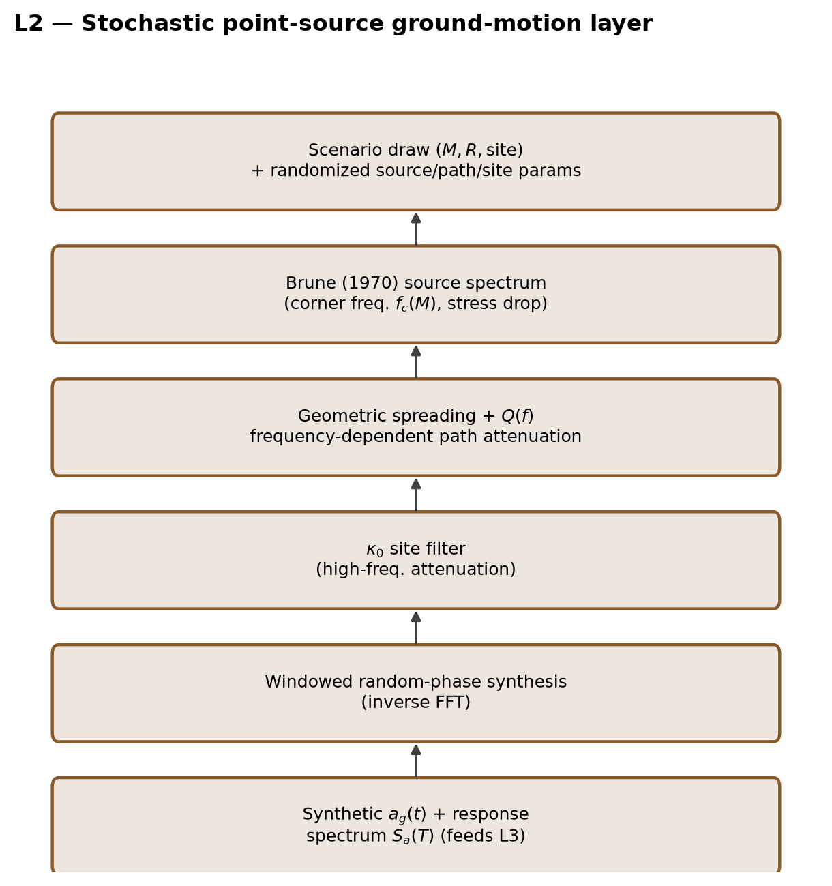
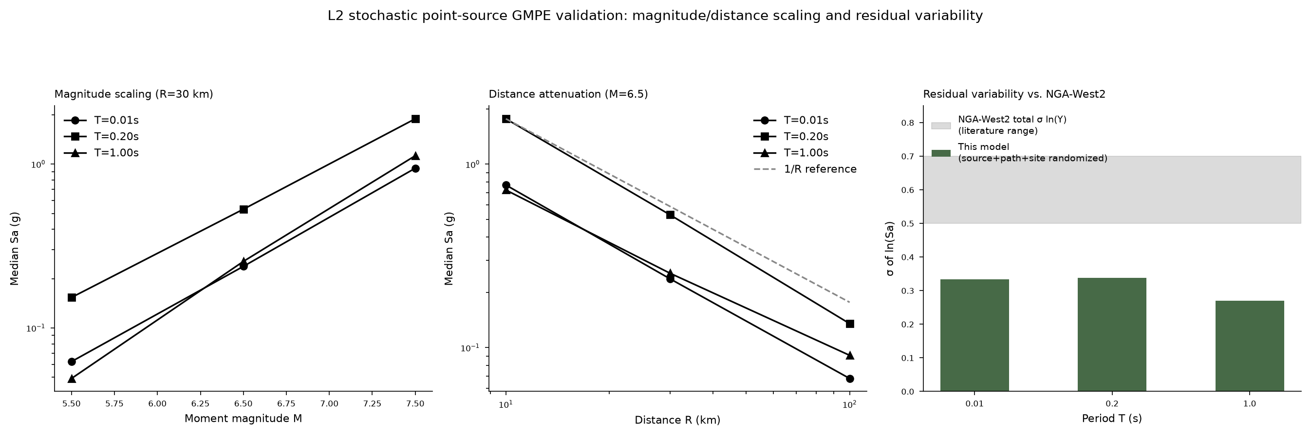
L2 — Stochastic Ground-Motion Layer
Physics-based scenario generator, standing in for gated waveform databases
• KiK-net / NGA-West2 waveform databases and OpenQuake's hazardlib were inaccessible in this sandbox (registration-gated / native build failure) → implemented a Boore (2003)-style point-source stochastic simulator instead.
• Brune (1970) source spectrum → geometric spreading + Q(f) path attenuation → κ₀ site filter → random-phase inverse-FFT synthesis — gives full synthetic waveforms a_g(t), not just Sa(T).
• Validated: median Sa scales monotonically with M and ≊1/R with distance at every period tested (0.01/0.2/1.0 s).
• Residual variability σⱼₙ(Sa) ≈ 0.27–0.34 — about half the empirical NGA-West2 total σ (≈0.5–0.7), because only source/path/site parameters are randomized, not full inter-event model-form variability. This gap is a concrete target for a future JEPA-conditioned correction.
EQ-JEPA × floatCSEP × CVaR-PSHA — cvar-psha-bandit (filippo branch)
8 / 10

Slide 9
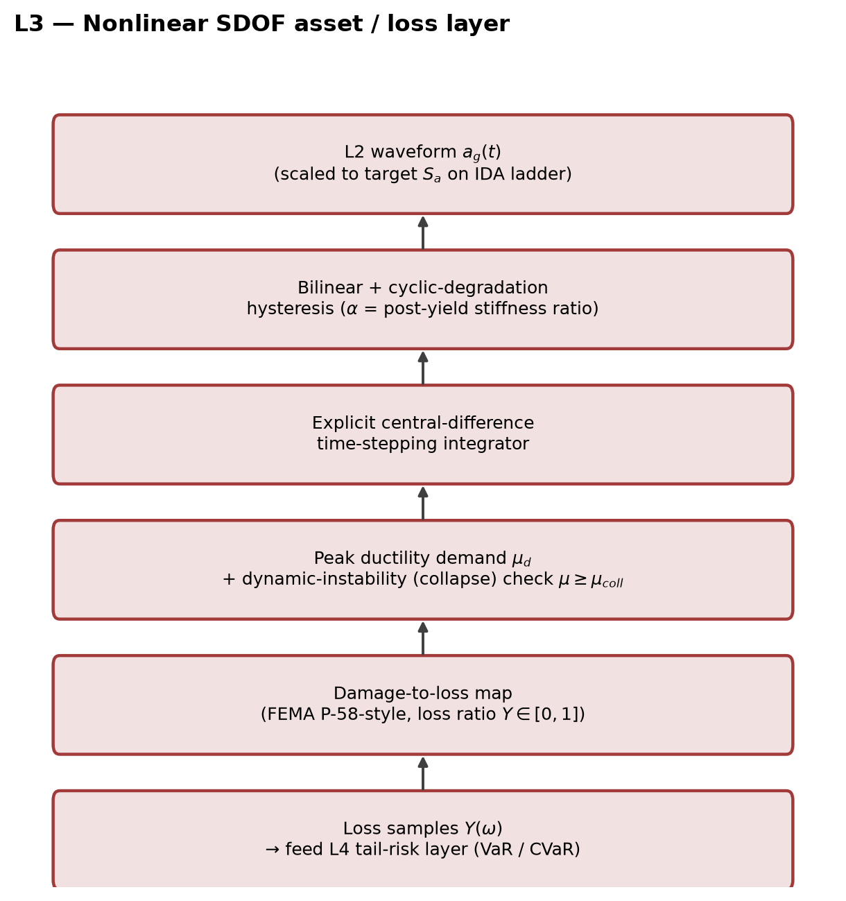
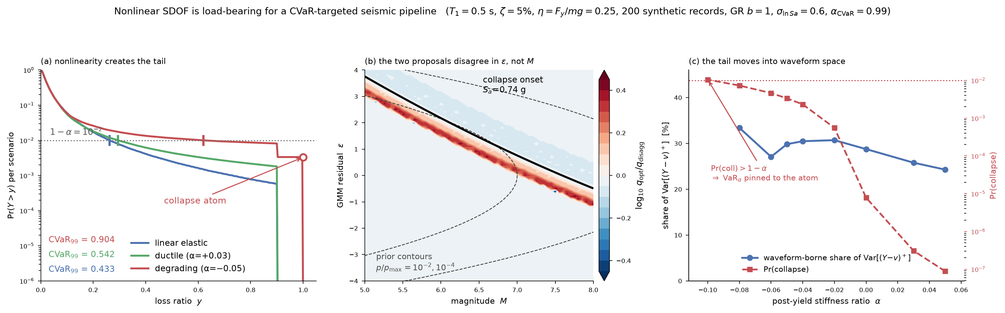
L3 — Nonlinear SDOF and the CVaR Tail
Where the risk metric becomes load-bearing, not just a summary statistic
• Bilinear + cyclic-degradation hysteresis, explicit central-difference integrator, FEMA P-58-style damage-to-loss map — packaged as sdof.py, 6/6 tests passing (closed-form linear limit matches an independent Nigam & Jennings 1969 recursive solver within 5%).
• IDA sweep (M6.5, R=20km, T₁=0.5s, 30 records): hardening (α=+0.05) reaches 50% collapse at Sa≈2.8g; degrading (α=−0.05) collapses far earlier, at Sa≈0.7g — reproduces the textbook IDA “flatline” signature (Vamvatsikos & Cornell, 2002).
• Pilot CVaR₉₉ result (below): degrading case CVaR₉₉=0.90 vs. linear-elastic 0.43 — nonlinearity alone triples the 99% tail loss; the two candidate importance-sampling proposals studied disagree in the GMPE residual ε, not in magnitude M.
EQ-JEPA × floatCSEP × CVaR-PSHA — cvar-psha-bandit (filippo branch)
9 / 10

Slide 10
Synthesis — Status and Next Steps
L0–L3 built and verified end-to-end on real data; L4–L5 are the open work
• Confirmed: all four layers wire together on real inputs, no synthetic placeholder at any stage -- L0 rates feed L1's scoreboard; L2's synthetic motions feed L3's SDOF response; L3's closed-form and IDA checks both pass.
• Revised (was falsified, now resolved): the apparent universal N-test failure was two catalog bugs (aftershock contamination + a Gardner-Knopoff coefficient swap), not a model defect. Fixed catalog dispersion: 0.94x Poisson (was 379.5x). With a minimal post-hoc rate correction, L0 now beats both baselines in ~1/3 of windows (was: lost in the majority).
• New quantified finding: L2's physics-only residual (sigma_ln≈0.27-0.34) is roughly half the empirical GMPE total (≈0.5-0.7) -- a concrete variance budget for a future learned correction.
• Next: apply the same rate correction symmetrically to the GR/ETAS-lite baselines before treating the T-test win counts as final; condition L2's source/path parameters on the JEPA latent; build L4 (CVaR via importance sampling over the Fissler-Ziegel joint loss) and L5 (CVaR-constrained MPC over inspection/closure/retrofit actions).
EQ-JEPA × floatCSEP × CVaR-PSHA — cvar-psha-bandit (filippo branch)
10 / 10

