Slide 1
EQ-JEPA L0: what the next iteration found
Ten open defects addressed · 71 monthly windows, California M2.8+ · every correction fitted pre-2019 and frozen
Full write-up: §10 of EQ-JEPA_sequential_definition.md and L0_L3_verification_report_v2.md

Slide 2
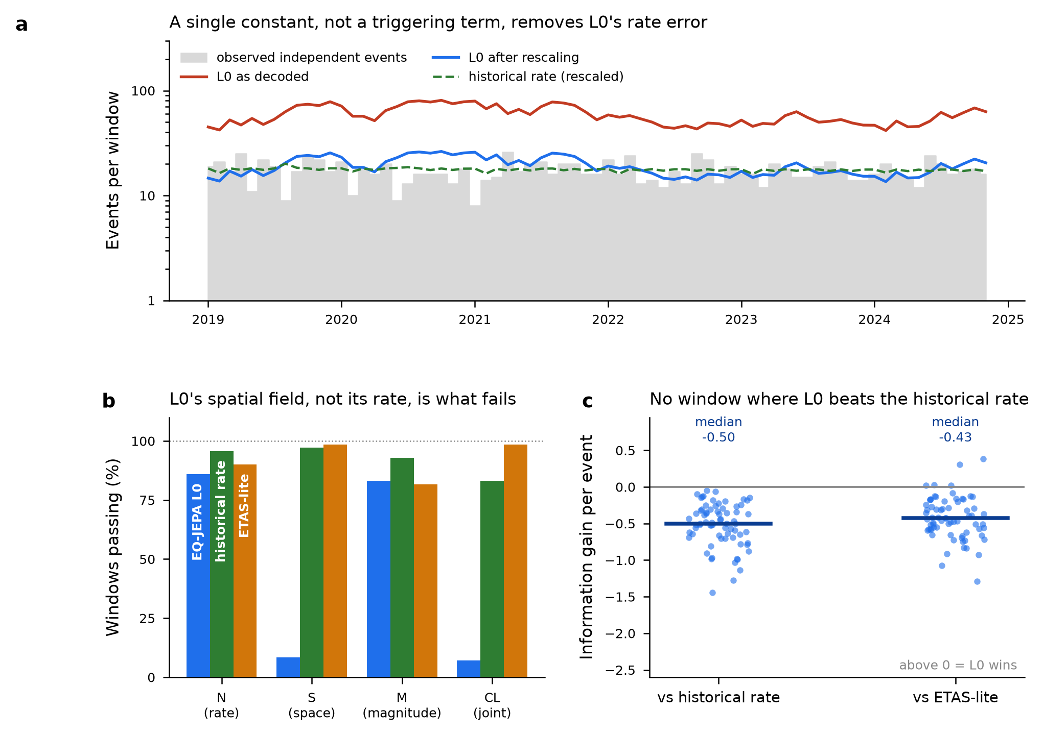
Two headline numbers were measuring the plumbing
• Decoding per window at its own horizon reverses the rate error: 58.8 forecast vs 17.1 observed — an over-forecast of 3.4x, not the 3.5x under-forecast on record
• The ratio is the declustering ratio: trained on 19,152 raw events, scored on 5,491 independent ones; fitted constant c0 = 0.326
• Admit a constant scale and the Hawkes excitation amplitude fits to zero for all three models — the correction was a constant
• Applied symmetrically: L0 beats the historical-rate baseline in 0 of 71 windows. H1 refuted

Slide 3
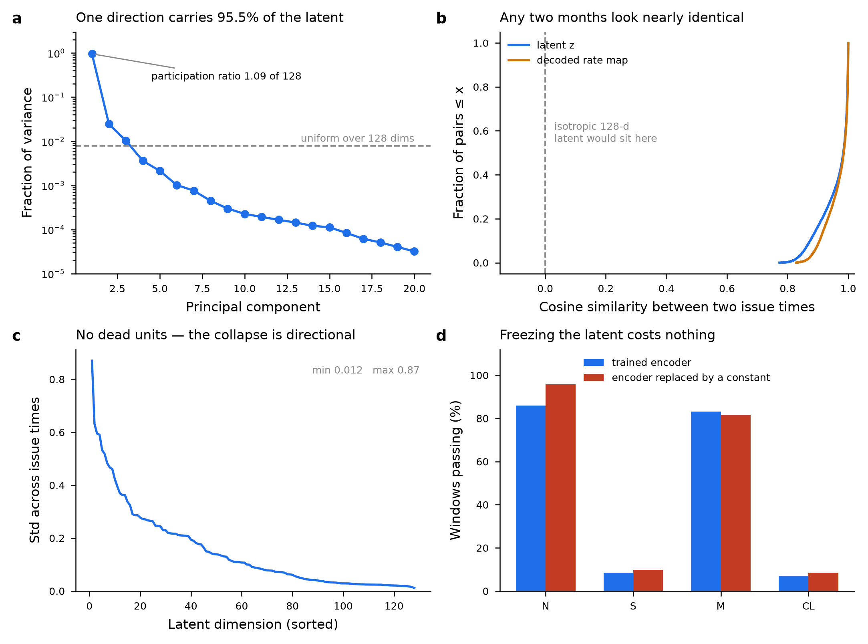
The encoder had collapsed — and a frozen latent scores the same
• Participation ratio 1.09 of 128; PC1 = 95.5% of variance; mean pairwise cosine 0.958
• No dead units (std 0.012–0.87) — the collapse is directional, invisible to a per-dimension check
• 85% of 512 sketched projections reject Gaussianity
• Control: replacing the latent with a constant matches or beats the trained encoder on all four CSEP tests

Slide 4
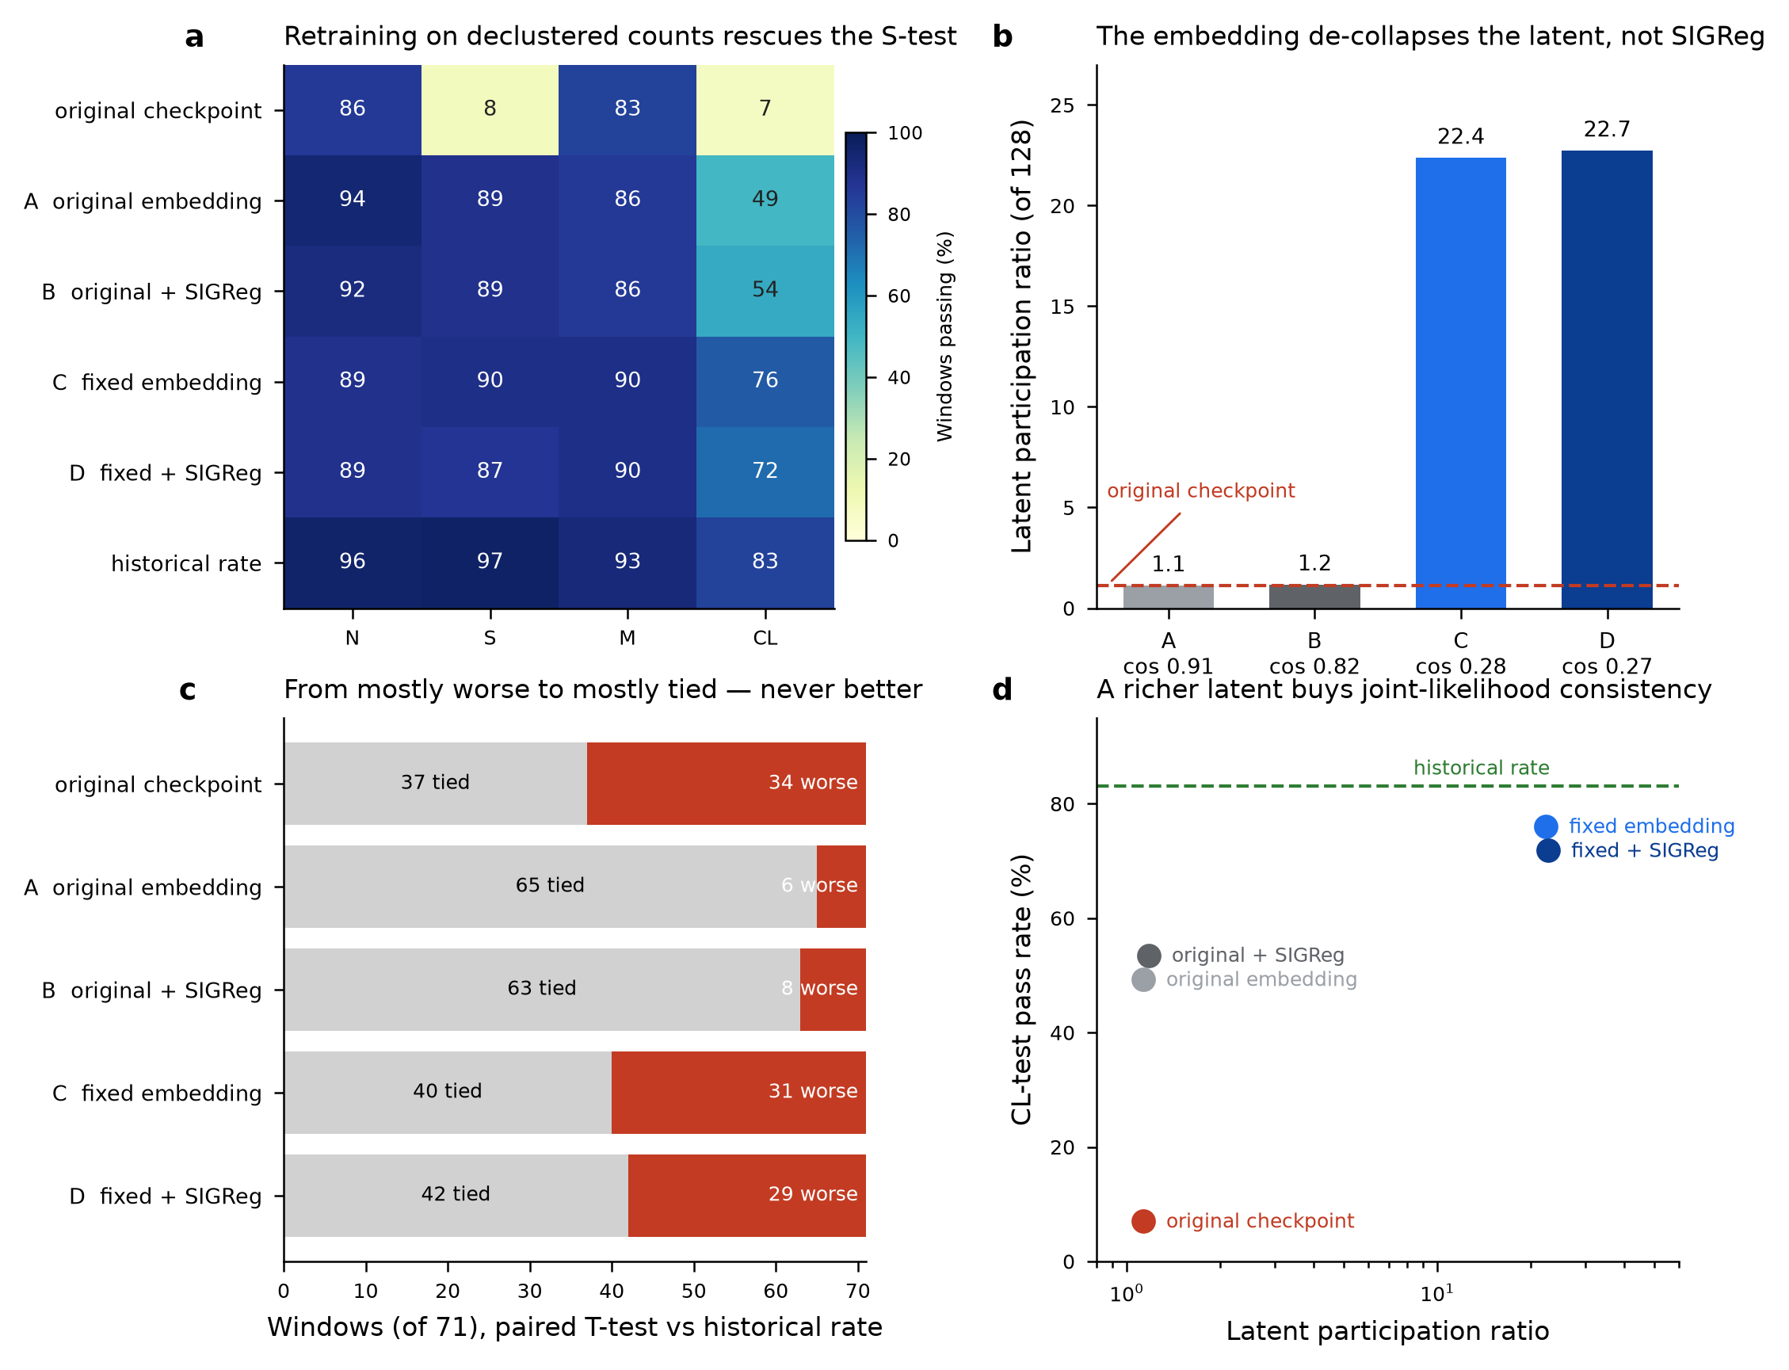
The input embedding, not the missing isotropy term, caused it
• Retraining the unchanged architecture on declustered counts: S-test 8.5% → 88.7%
• Fixed embedding (normalisation + Fourier for lat/lon/depth + Time2Vec for dt): participation ratio 1.13 → 22.4, CL pass 49% → 76%
• SIGReg cannot rescue the original embedding (1.13 → 1.18) and adds nothing once the embedding is fixed
• No arm beats the baseline; the best is tied in 65 of 71 windows, up from 37

Slide 5
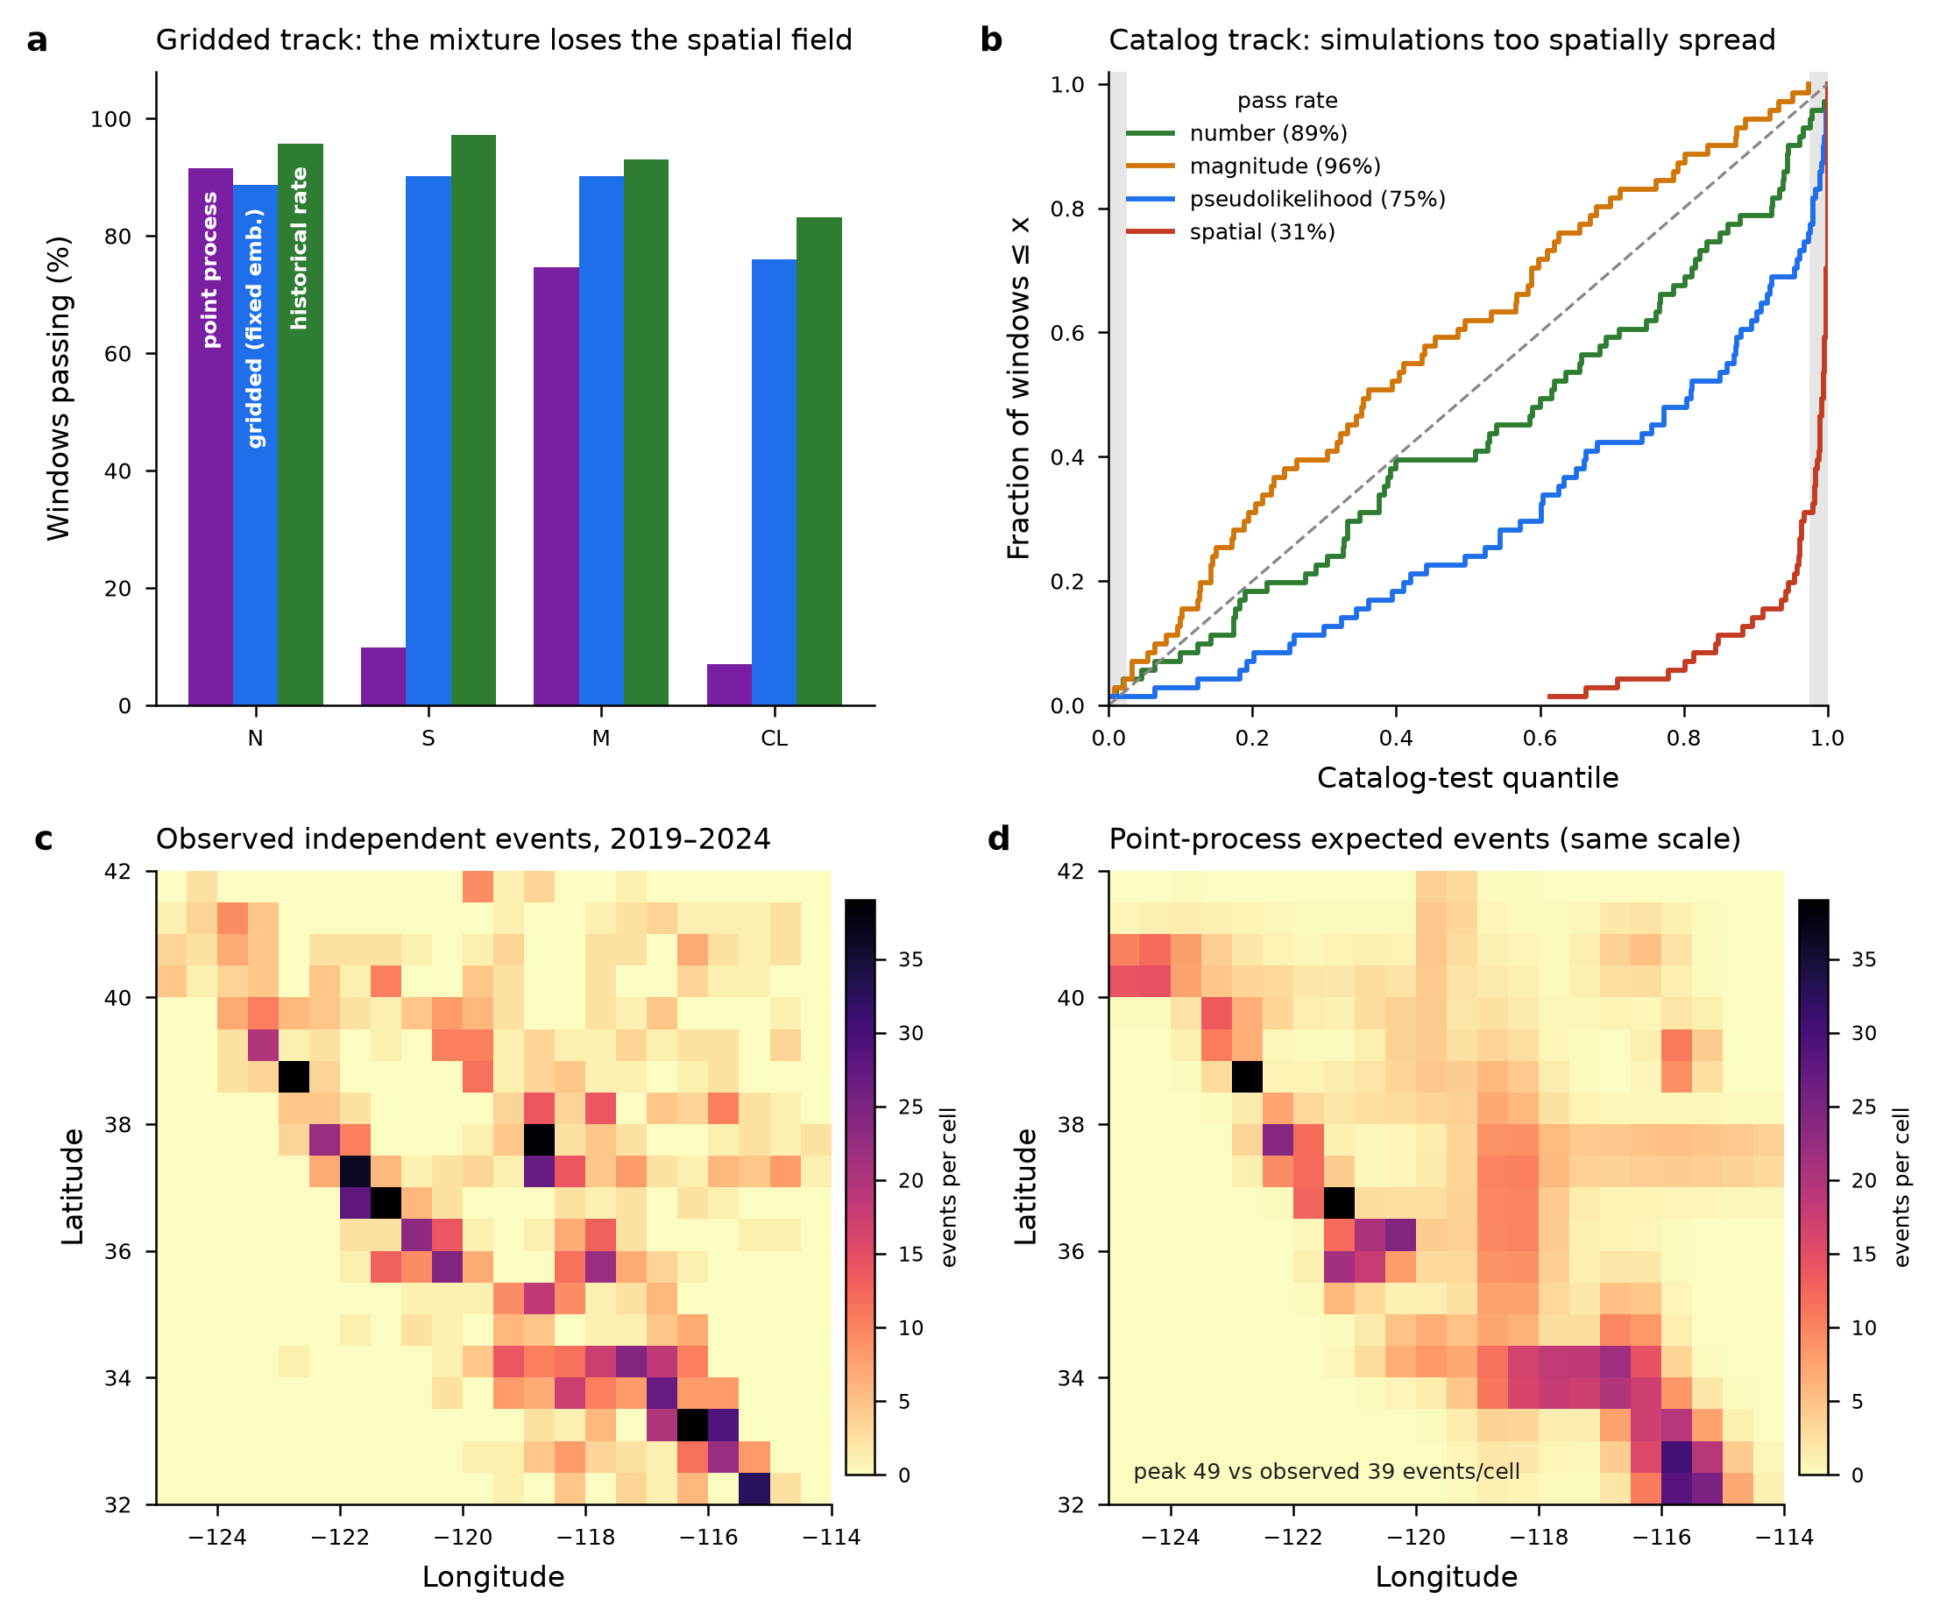
Point process: magnitude side fixed, spatial side broken
• Exactly normalised closed-form intensity λ(t,x,y,z,m); trained on the marked-Poisson likelihood of real coordinates; self-calibrates at 18.0 vs 17.1 events/window
• Moment budget well-posed for the first time: 4.14e18 N·m/yr = 0.38x observed, against 4–60x for every gridded forecast
• Spatial field fails: S-test 9.9% gridded, catalog-track spatial 31%, calibration quantile 2e-46 — axis-aligned components cannot make fault-aligned lineaments
• Fix: an anisotropic spatial family, not more components (H10)

Slide 6
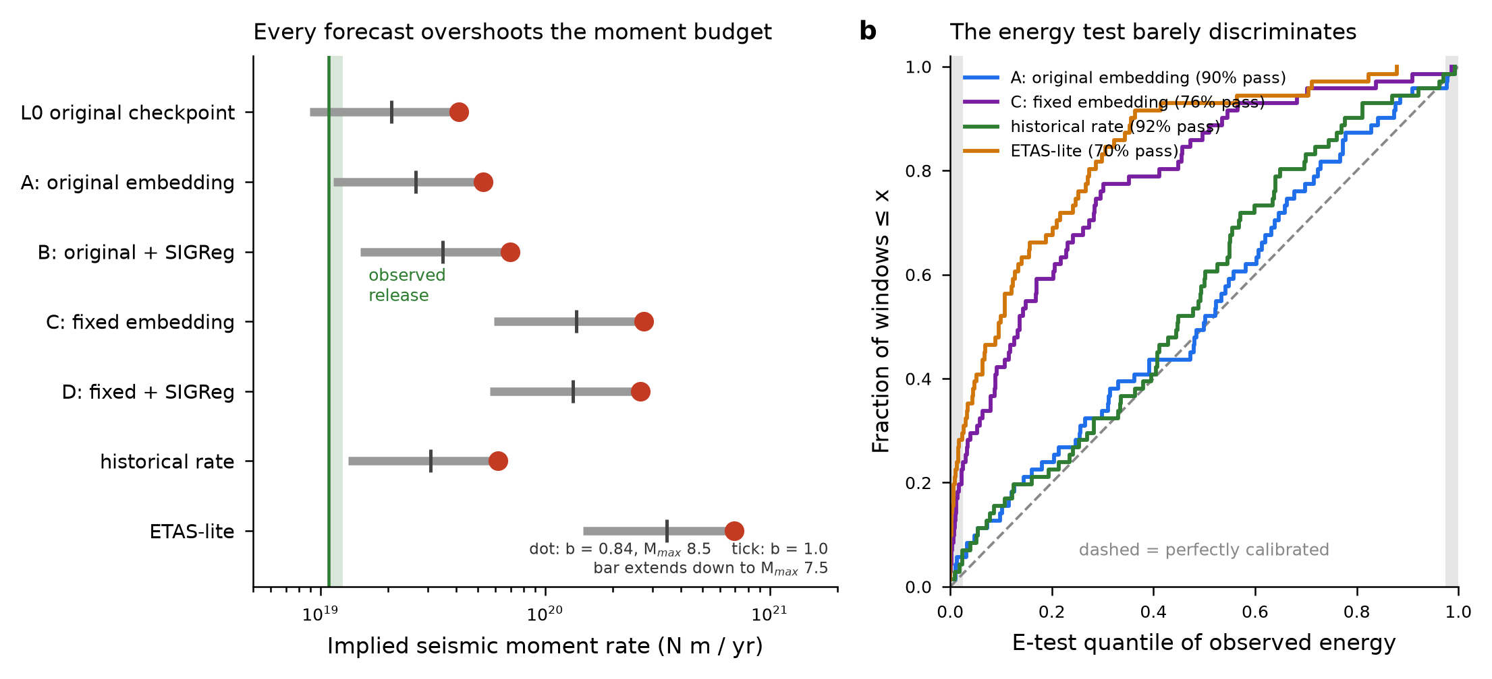
Energy is a weighting and a constraint, not a target
• log10 E = 1.5M + const is a bijection: forecasting converted energy is forecasting magnitude
• A window's energy is its largest event: median 42% monthly, 50% annually; r(log E, Mmax) = 0.98 against 0.75 for log-count
• Moment-rate budget: every gridded forecast overshoots 4–60x through the open [5.5, 8.5] bin — M-test passes while the budget is an order of magnitude off
• The E-test works but barely discriminates; the moment-rate constraint is the useful form

Slide 7
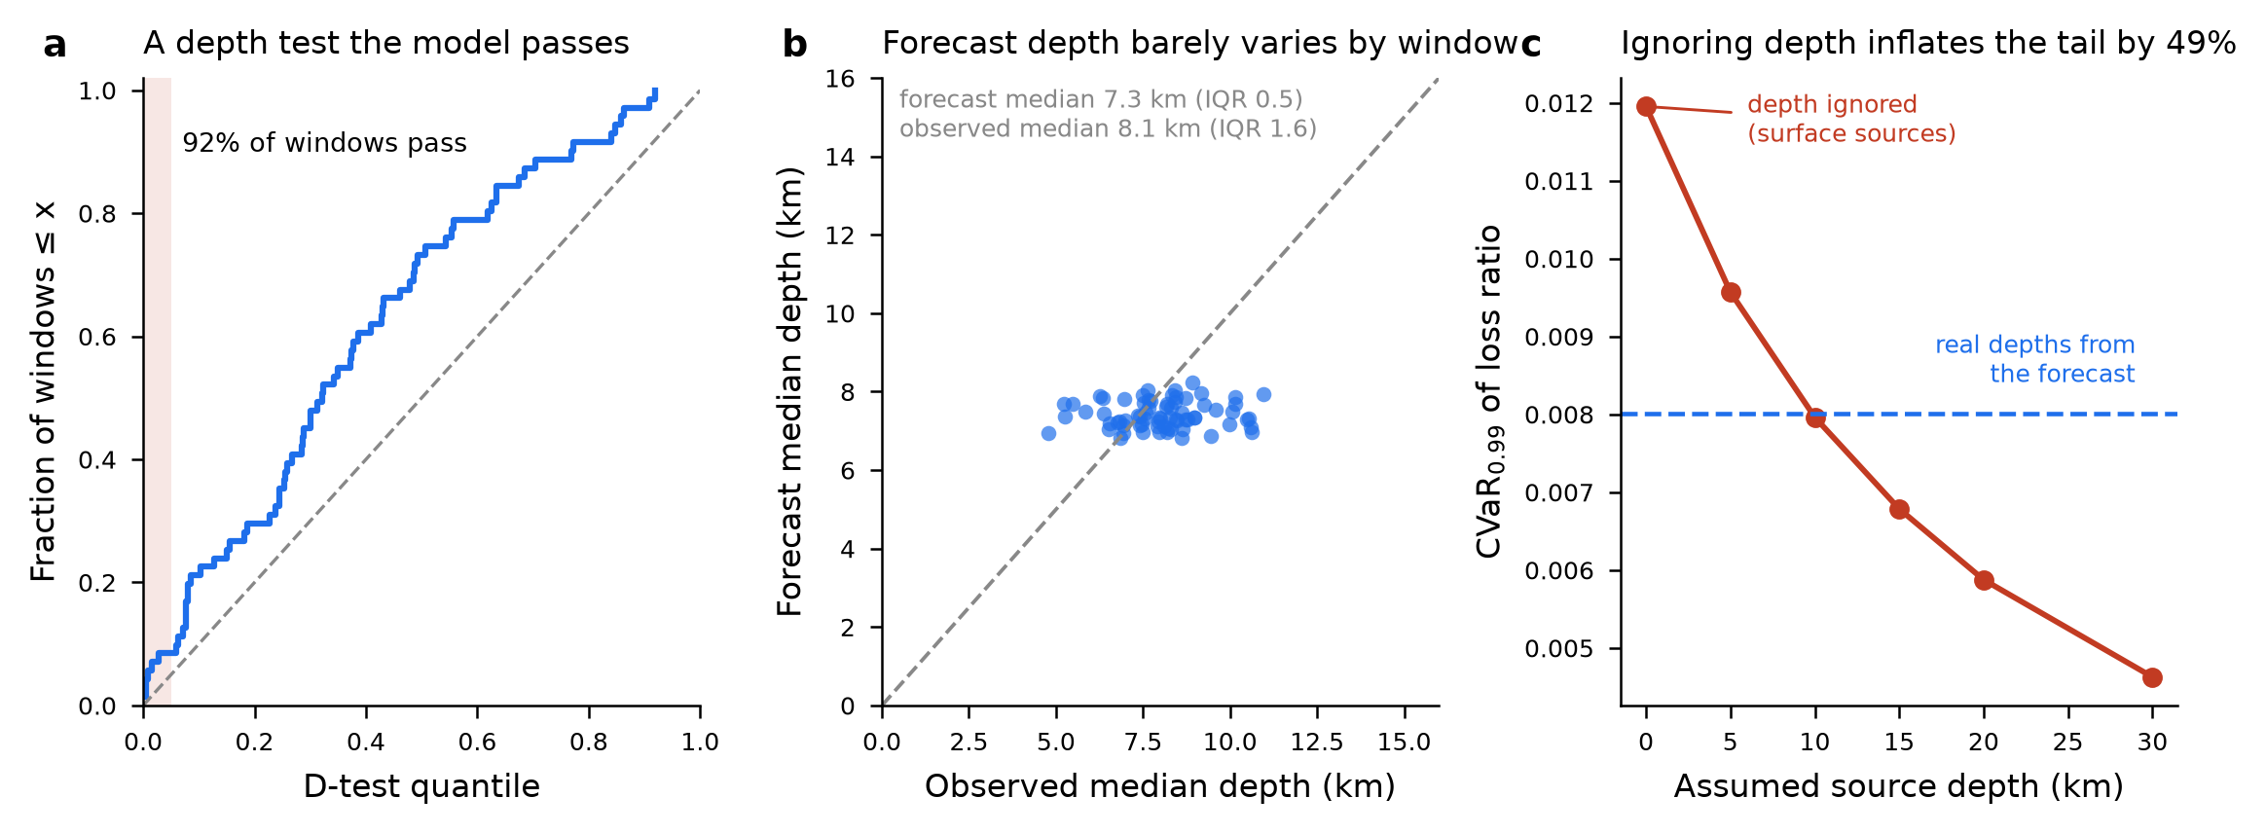
Depth: a test that works, and 49% of the risk tail
• D-test written on pycsep's simulate-and-rank pattern (no depth test exists in the package): the point-process L0 passes in 91.5% of windows
• Real hypocentral distance cuts CVaR₀.₉₉ from 0.0120 to 0.0080 — a 33% reduction; surface-source treatment inflates the tail 49%
• Entirely near-field: only 4% of forecast events fall within 50 km, and those set the tail
• A lower bound — the ductility map here is the linear limit μ = Sa/η

Slide 8
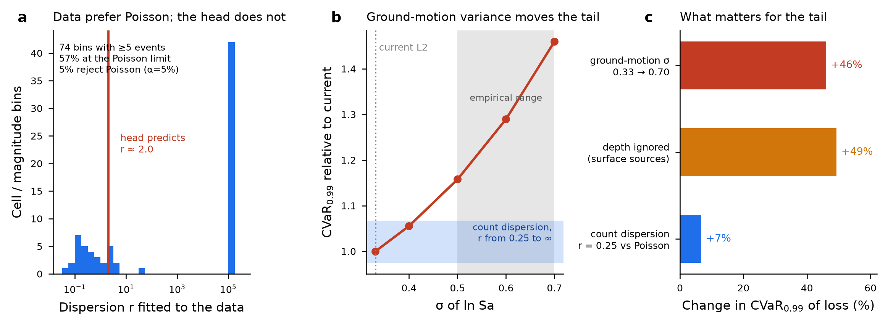
What actually moves the tail
• Ground-motion σ 0.33 → 0.70 (the empirical range): +46%
• Depth ignored: +49%
• Count dispersion, NB r = 0.25 vs Poisson: +7%
• Of 1,760 cell/magnitude bins only 74 have ≥5 events; 57% fit at the Poisson limit and 5.4% reject Poisson — the nominal false-positive rate — while the NB head predicts r ≈ 2.0

Slide 9
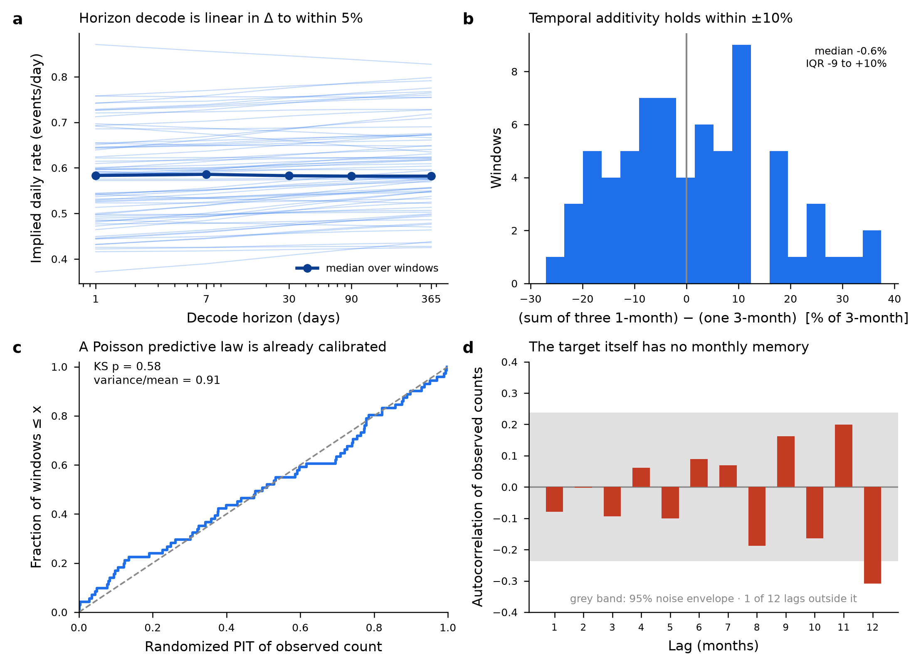
The temporal machinery is fine; the target is the problem
• Temporal additivity holds: implied daily rate 0.583 at horizons 1 to 365 days; three monthly decodes vs one three-month decode, median residual −0.6%
• The Poisson predictive law is already calibrated (PIT KS p = 0.58, variance/mean 0.91) — so the conditional-mean decoder is not the limitation
• Observed counts: lag-1 autocorrelation −0.08, no memory at any lag
• No model correlates positively with them: L0 −0.05, gridded L0 −0.09, historical rate −0.16, ETAS-lite −0.17

Slide 10
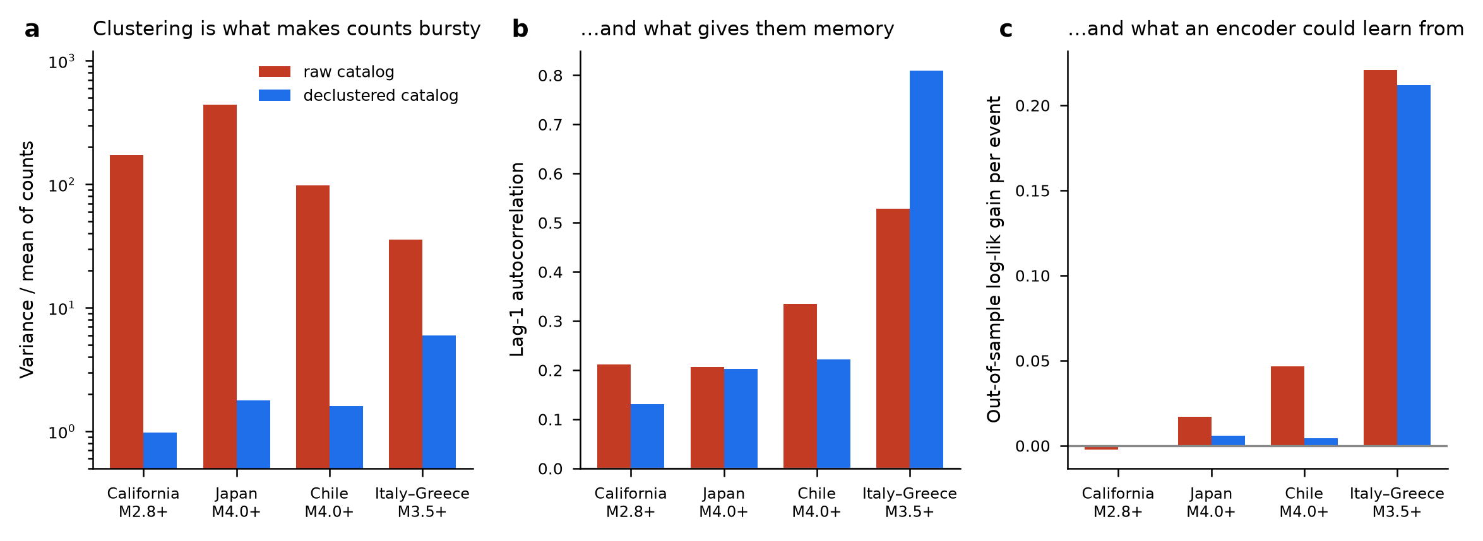
Declustering removes the signal L0 is asked to learn
• Four regions, two thresholds, three window lengths, fresh from USGS ComCat
• Variance/mean raw → declustered: California 173 → 0.98, Japan 443 → 1.78, Chile 98 → 1.60, Italy–Greece 36 → 5.99
• Out-of-sample log-likelihood gain per event from an excitation feature: 0.017–0.22 raw, 0.0001–0.006 declustered
• Exception: Italy–Greece M3.5+ keeps ACF 0.81 after declustering — fixed windows do not remove swarm clustering

Slide 11
Where this leaves the build order
M11 — move the target before touching the architecture: undeclustered catalog, 1/3/7-day horizons, with the measured excitation baselines as the bar to beat (H9)
M12 — anisotropic spatial decoder; swap only f_xy and rescore both tracks (H10)
M13 — moment-rate budget as a training constraint, not an after-the-fact check
M14 — partition the L2 residual; carry the 0.375–0.617 missing-sigma interval into every CVaR
M15 — retire the NB dispersion head, or move it to a target that is actually overdispersed

