Slide 1


Economic Analysis of
Software Projects

Slide 2
WHAT DOES IT DO ?
Cost Estimation
Financial Analysis
Risk Assessment
Estimate effort, time & team size using the COCOMO model
Calculate ROI, Net Present Value and Payback time
Score risks based on probability and impact levels

Slide 3




WHAT DID WE USE ?
PYTHON
JAVASCRIPT
HTML/CSS
Backend logic and real-time calculation engine
Handles user input and dynamic updates
Responsive interface design for easy interaction

Slide 4



HOW IT WORKS
INPUT
CALCULATION
RESULTS
PDF REPORT

Slide 5
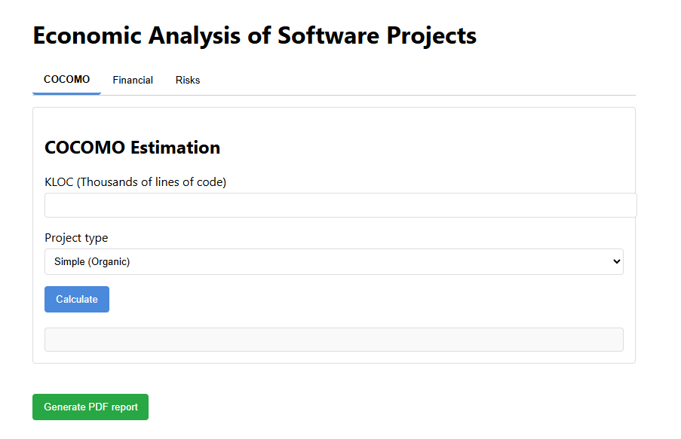
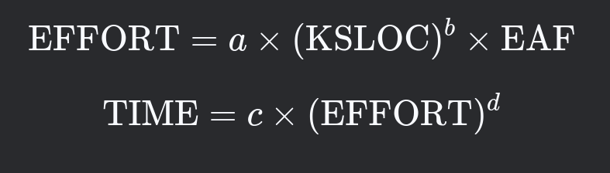
COCOMO ESTIMATION
Basic COCOMO model

Slide 6
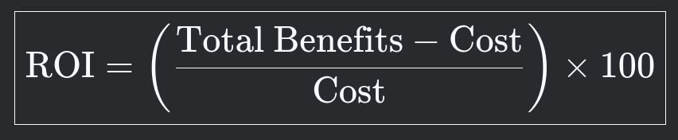
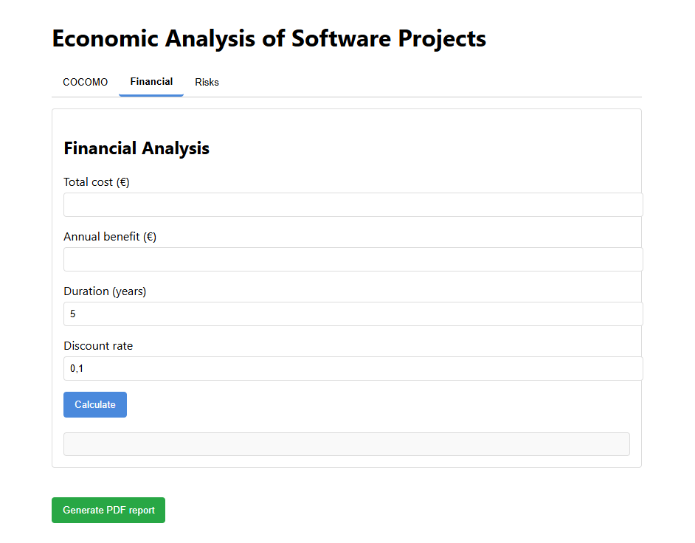
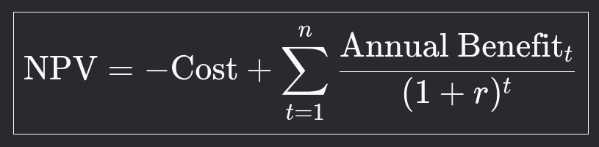

ROI: Profit vs. cost
NPV: Value of future gains
PAYBACK: Years to break even
Financial Analysis

Slide 7
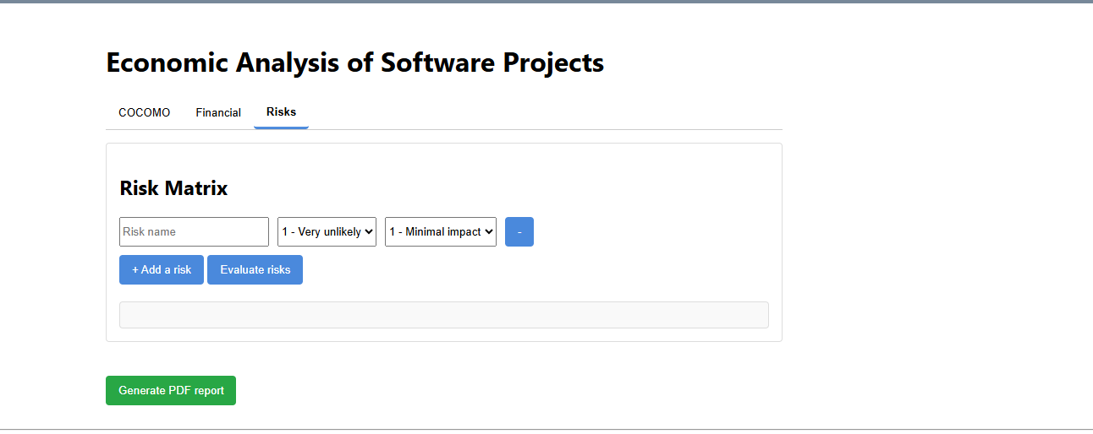
Risk Assessment Matrix
Probability: Likelihood of the risk happening (scale 1–5)
Impact: How serious the effect would be (scale 1–5)
Risk Score: Product of probability × impact
Categories: Low (1–5), Medium (6–15), High (16–25)

Slide 8
Challenges & What’s Next
CHALLENGES | FUTURE IDEAS
🧩 Real-time logic | 💡 Save user sessions
🔧 No database logic | 📊 Graphical comparison
🎯 User-friendly UI | 📁 Excel export feature

Slide 9
THANK
YOU !

