Slide 1
Project presentation
Computer simulations in physics
Kürti Zoltán

Slide 2
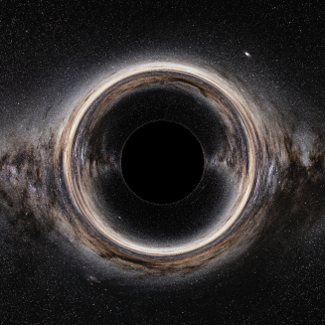
Project 1
What can we see around a black hole?
  General relativity
  Ray tracing (geometric optics)
https://www.eso.org/public/images/eso0932a/

Slide 3
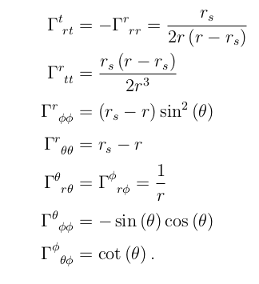


Project 1
Schwarzschild spacetime
Christoffel symbols
Geodesic equation
Numeric solution

Slide 4
Project 1
Initial conditions
  Position
    Just the position of the camera
  Velocity
    Local reference frame (set of 4 orthonormal vectors)
    Parameters of the camera (field of view, resolution)
    Lighlike vector corresponding to each pixel

Slide 5
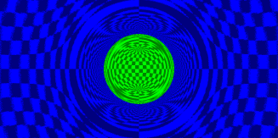
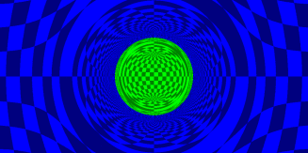
Project 1
Other details
  Collision detection
  Mapping to the celestial sphere
  Redshift

Slide 6
Project 1

Slide 7
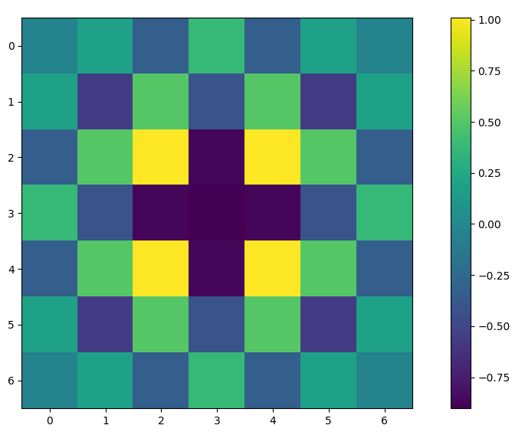
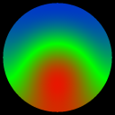
Project 2
Investigating linear PDEs (finite difference methods)
  Discretized laplace operator stencils
    N dimensional
    Higher order
    Isotropic
  Bondary conditions with arbitrary geometry

Slide 8
Project 2
Obtaining the stencils
  Taylor expand
  Linear equations for stencil coefficients
    Affine subspace
  Restrict solutions with extra conditions
    Isotropy (leading order error is spherically symmetric)
Works for arbitrary discretization, not just regular ones!

Slide 9
Project 2
Boundary conditions
  Update the inner points according to the differential equation
  Update the boundary points according to the boundary conditions (average for Neumann, set to constant for Dirichlet)
  Two birds with one stone!
    Laplacian can only be evaluated for inner points
    Respects boundary conditions (also easily generalizes to complicated boundary conditions)

Slide 10
Project 2

