Slide 1
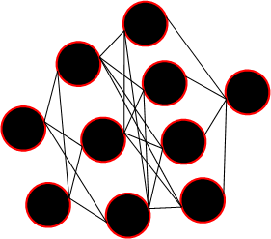
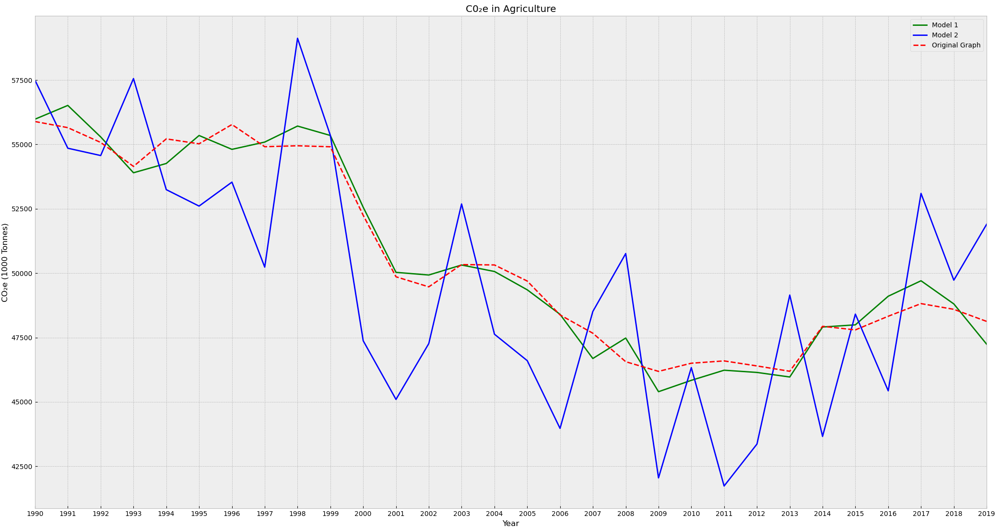
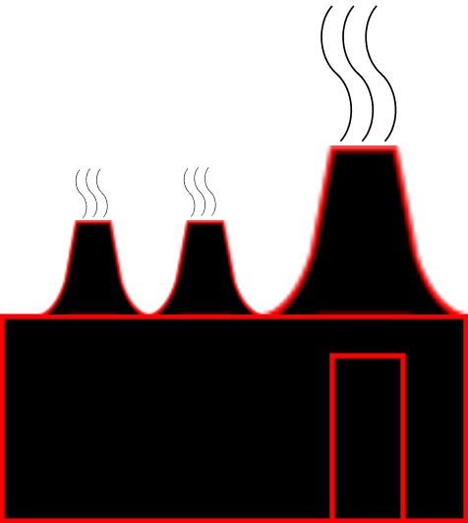


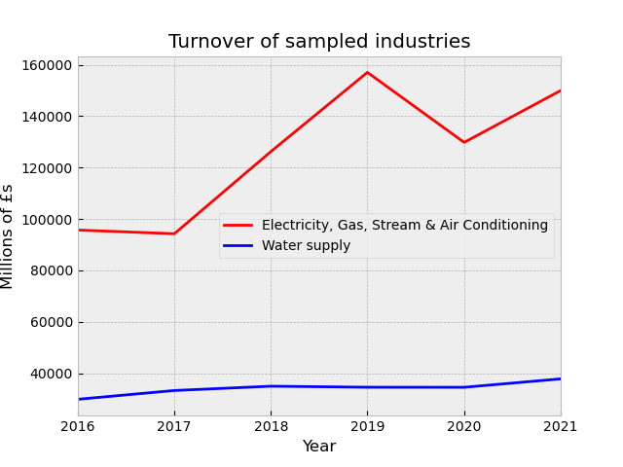
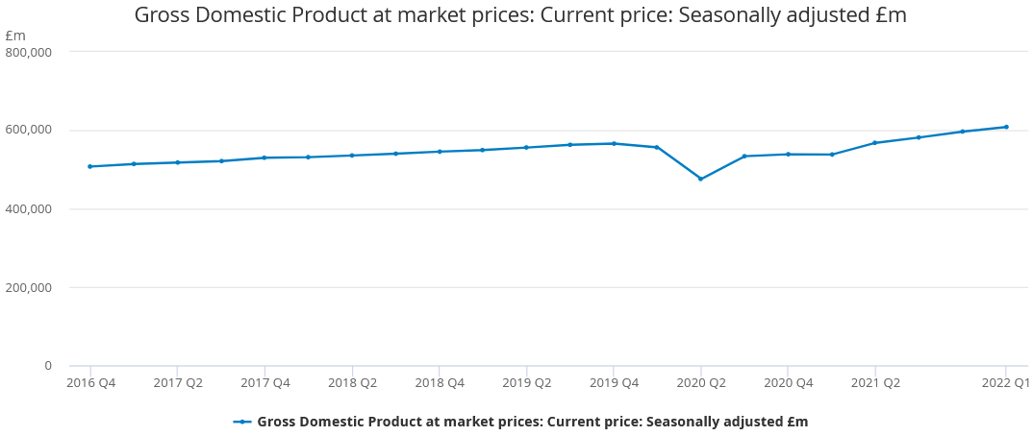
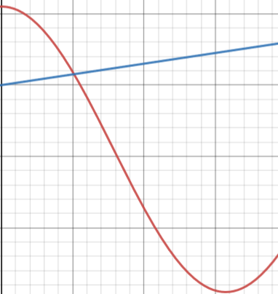
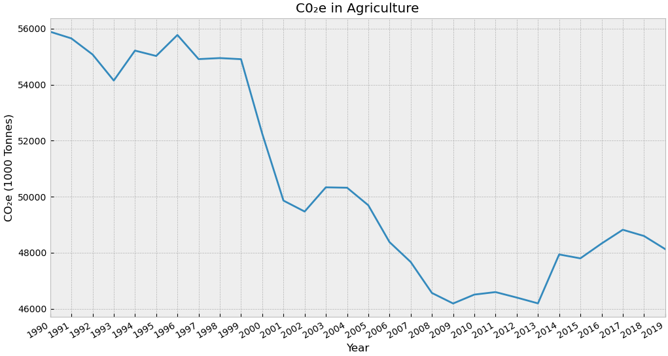
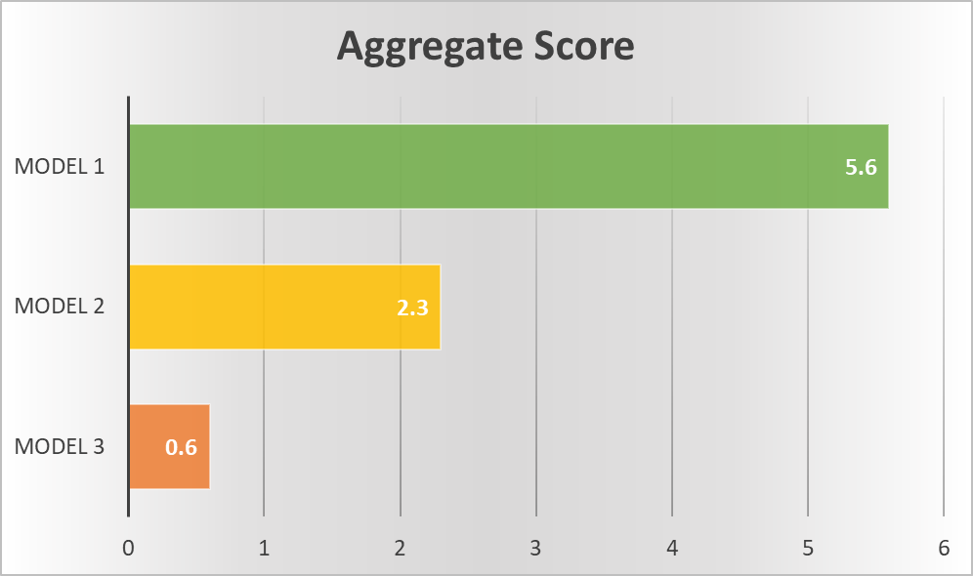
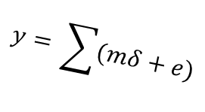
Forecasting Greenhouse Gas Emissions in relation to Industry Turnover
Kurtis Jackson
Hassan Chizari
Background:
Despite national efforts to reduce Greenhouse Gas emissions (GHGe), which have been across the board successful, emissions in the UK remain around 20th globally [1].
Whilst consumer GHGe has remained constant since around 1990, businesses still contribute around three quarters of the UK’s total GHGe (measured in carbon dioxide equivalent units) despite a large reduction in the same period.
As industries expand in size, through an increasing number of businesses in the industry or growth in existing businesses, it is reasonable to assume GHGe’s will increase with it.
Conversely, receding industries should be expecting a net reduction in GHGe in respects to decrease production.
Despite this connection, little work has been done in forecasting GHGe in respect to industry turnover.
Forecasting GHGe, especially carbon dioxide, has been done but is generally focused on one industry, or part of one industry [2].
Data pertaining to sector turnover is limited, and very little work has been done in forecasting this.
To identify long term trends for industries going into the future, identifying key ‘target’ industries that are exhibiting high GHGe/£, or high growth of GHGe/£, time-series analysis should be used to predict future trends.
Little is done regarding best-practices for predicting either factor, although general best-practices are well documented [3], especially considering how to factor in the limited industry turnover rates.
As data sets improve and interest in the subject is increased, a developed methodology should be provided for people wishing to enter the field.
Literature:
[1]:
Friedrich, J. et al. (2023). Available at: https://www.wri.org/insights/interactive-chart-shows-changes-worlds-top-10-emitters. Date Accessed: 13/12/2023
Tiseo, I. (2023). Available at: https://www.statista.com/statistics/271748/the-largest-emitters-of-co2-in-the-world/. Date Accessed: 13/12/2023
[2]:
Alfaseeh, L., Tu, R., Farooq, B., & Hatzopoulou, M. (2020). Greenhouse gas emission prediction on road network using deep sequence learning. Transportation Research Part D: Transport and Environment, 88, 102593.
Hamrani, A., Akbarzadeh, A., & Madramootoo, C. A. (2020). Machine learning for predicting greenhouse gas emissions from agricultural soils. Science of the Total Environment, 741. https://doi.org/10.1016/j.scitotenv.2020.140338
[3]:
Parmezan, A. R. S., Souza, V. M. A., & Batista, G. E. (2019). Evaluation of statistical and machine learning models for time series prediction: Identifying the state-of-the-art and the best conditions for the use of each model. Information Sciences, 484, 302–337.
Cerqueira, V., Torgo, L., & Mozetič, I. (2020). Evaluating time series forecasting models: an empirical study on performance estimation methods. Machine Learning, 109(11), 1997–2028. https://doi.org/10.1007/s10994-020-05910-7
Rathipriya, R., Abdul Rahman, A. A., Dhamodharavadhani, S., Meero, A., & Yoganandan, G. (2023). Demand forecasting model for time-series pharmaceutical data using shallow and deep neural network model. Neural Computing and Applications, 35(2), 1945–1957. https://doi.org/10.1007/s00521-022-07889-9
Methodology:
Top performing methods from [3] will be utilised to predict future GHGe and sector turnover.
Sector turnover will first need to be simulated in order to provide a more robust dataset. National GDP should be a summation of all sectors performance and is very well kept and will be used for this.
Performance metrics, as used in [3], such as Root Mean Square Error, TU score (MSE normalised with a naïve algorithm) and POCID (accuracy of predicting if the next value will increase or decrease) will be used to evaluate the best method for both data sets.
New forecasted data can be used to find target sectors, based off GHGe/£ growth.
Formulas
Doubled income
Increased relative GHGe disguised under shrinking turnover
$$y= \sum{(mδ}+e)$$
Neural Networks
Same relative GHGe
From Office of National Statistics (https://www.ons.gov.uk/economy/grossdomesticproductgdp/timeseries/ybha/qna)
‘Problem’ industry Actions should be taken
‘Improving industries’:
Electricity generally has less GHGe due to the declining use of coal and oil, whilst its turnover is generally increasing.
‘Declining or stagnant industries’:
Transport and storage has relatively consistent growth in both GHGe and turnover.
Industries are generally all improving, some just improve more.
Easy to monitor/prevent growth

