Slide 1


Hand gesture recognition in industry
By
Thiry Nicolas
Dumoulin William

Slide 2

01
Project
03
Gantt Diagram
02
Interface
04
State of the art

Slide 3
Project
01

Slide 4
Project
Image recorded by a camera
Send to a computer
Analyzed by our model
Hands classifications

Slide 5
Interface
02

Slide 6
List of gestures
Add new gesture
Camera ON/OFF
Open hand : 95%

Slide 7
Gantt Diagram
03

Slide 8
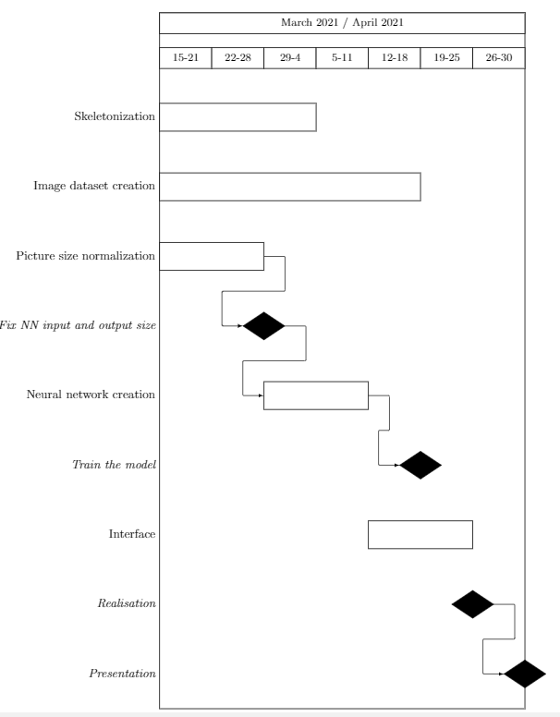
Gantt Diagram:

Slide 9
State of the art
04

Slide 10
State of the art
Dynamic hand gesture recognition
2004
2009
Skeleton based visual pattern recognition
Finger Segmentation
2014

Slide 11

Thank You for your attention

