Slide 1
Django admin
Kusal Bista

Slide 2

Create a model
from django.db import models
class Event(models.Model):
name = models.CharField(max_length=255)
date = models.DateField()
venue = models.CharField(max_length=255)
manager = models.CharField(max_length=255)
description = models.TextField()

Slide 3
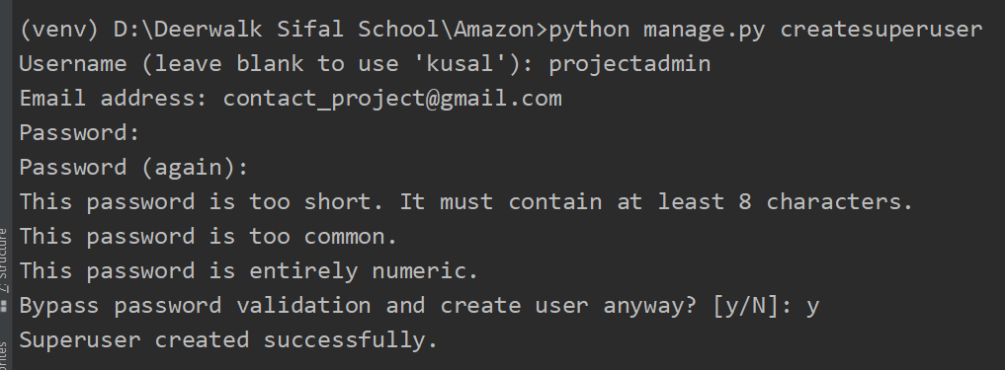
Creating a django-admin
python manage.py createsuperuser

Slide 4
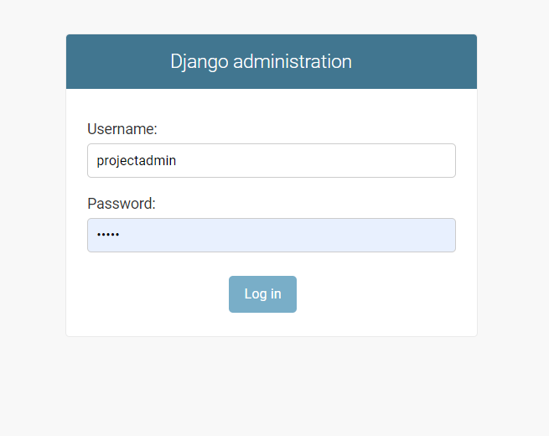
Accessing django-admin
After creating a superuser goto http://127.0.0.1:8000/admin to access the admin panel.
Use the provided credentials while creating the super user to login the panel.

Slide 5
Registering the model in django-admin
from django.contrib import admin
from myapp.models import Event #Importing the model
# Register your models here.
admin.site.register(Event) #registering the model

Slide 6
Unregistering the model in django-admin
from django.contrib import admin
from django.contrib.auth.models import Group #importing the model
# Register your models here.
admin.site.unregister(Group) #unregistering the model

Slide 7
Changing the title django-admin
from django.contrib import admin
# Register your models here.
admin.site.site_header = 'Naya heading'

Slide 8
Creating a list display
class EventAdmin(admin.ModelAdmin):
list_display = ('name', 'date', 'venue', 'manager', 'description')
admin.site.register(Event, EventAdmin)

Slide 9
Adding search filter
class EventAdmin(admin.ModelAdmin):
search_fields = ('name', 'date', 'venue', 'manager', 'description')
admin.site.register(Event, EventAdmin)

Slide 10
Creating a editable list
class EventAdmin(admin.ModelAdmin):
search_fields = ('name', 'date', 'venue', 'manager', 'description')
list_display = ('name', 'date', 'venue', 'manager', 'description')
list_editable = ['venue', 'manager']
admin.site.register(Event, EventAdmin)

Slide 11
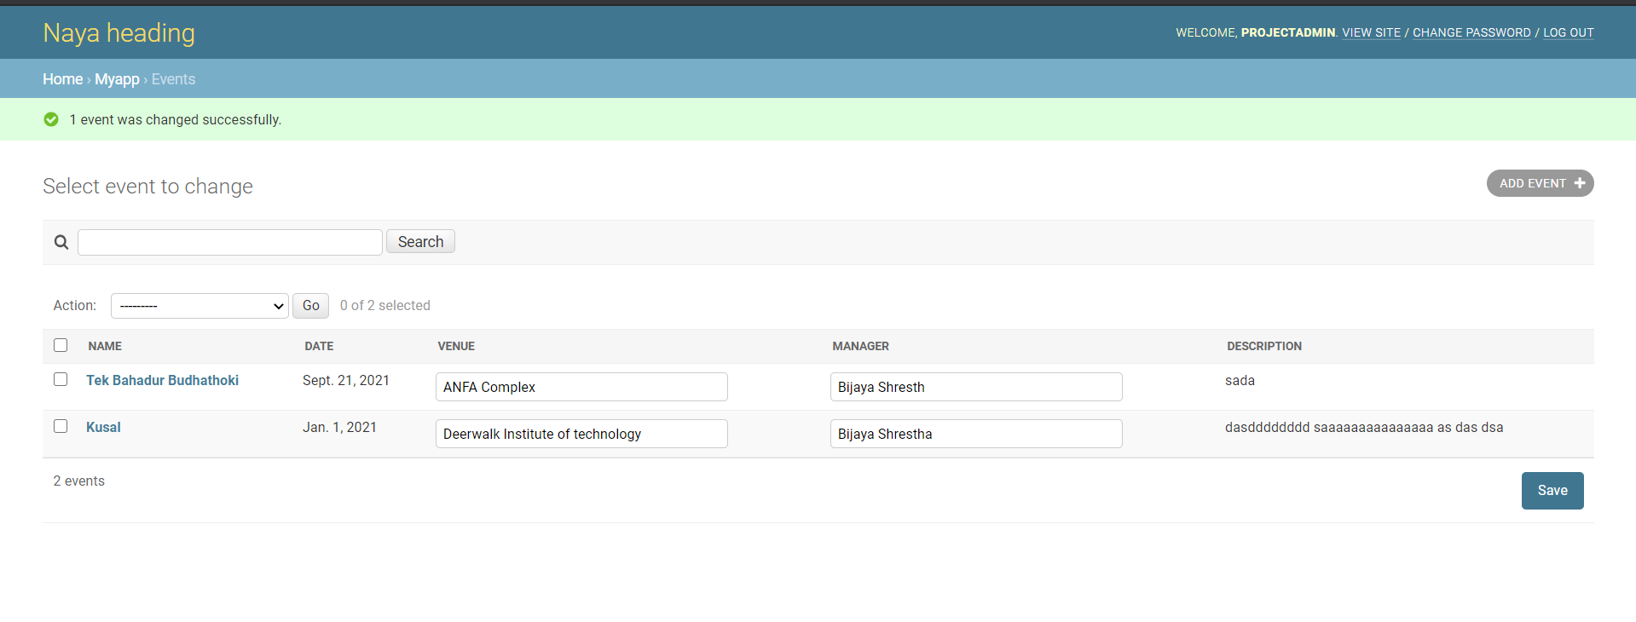
Final

Slide 12
Templates
Create a index.html in template folder.

Slide 13
Add the following in views.
from django.http import HttpResponse
from django.shortcuts import render
# Create your views here.
from shop.models import Event
def index(request):
event_list = Event.objects.all()
context = {
'events': event_list
}
return render(request, 'shop/registration/index.html', context)

Slide 14
Add the following in body section of index.html
This is front end. TEMPLATES
{% for event in events %}
{{ event.name }}<br>
{{ event.date }}<br>
{{ event.venue }}<br>
{{ event.manager}}<br>
{{ event.description }}<br><br>
{% endfor %}

