Slide 1

SE101.3
By: Manoja Weerasekara
NSBM- Nugegoda

Slide 2
Lecture 10
Files & Streams
(I/O Basics)

Slide 3
I/O Stream:
An I/O Stream represents an input source or an output destination (sequence of data).
A stream can represent different kinds of sources and destinations, including disk files, devices, other programs, and memory arrays.
Streams support many different kinds of data, including simple bytes, primitive data types, characters, and objects.
Some streams simply pass on data; others manipulate and transform the data in useful ways.

Slide 4
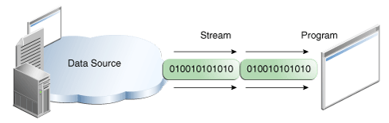
Input Stream:
A program uses an input stream to read data from a source, one item at a time:

Slide 5
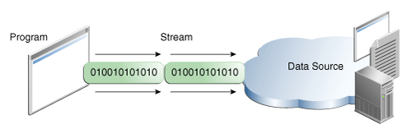
Output Stream:
A program uses an output stream to write data to a destination, one item at a time:

Slide 6
Byte Streams & Character Streams:
Byte Streams:
Streams that input and output bytes to a file.
Binary Files: Files that are created using byte based streams are called as, Binary Files.
Character Streams:
Streams that input and output characters to a file.
Text Files: Files that are created using character based streams are called as, Text Files.

Slide 7
InputStream/ Reader
Source
Destination
An InputStream or Reader is linked to a source of data.
An OutputStream or Writer is linked to a destination of data.
OutputStream/ Writer
Source
Destination

Slide 8
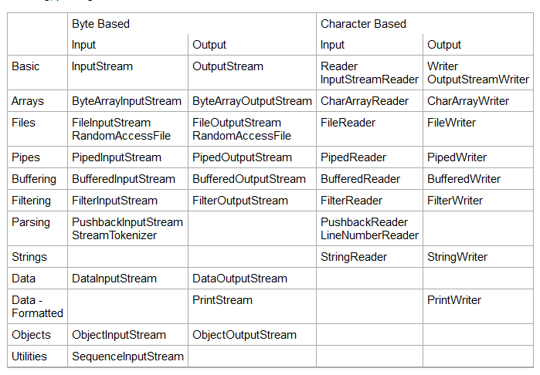

Slide 9
InputStream:
The InputStream class is the base class of all input streams in the java I/O API.
InputStream's are used for reading byte based data, one byte at a time.
An InputStream is typically connected to some data source, like a file.
In order to use InputStrem in your program you have to import them to your code.
E.g: import java.io.InputStream;
import java.io.FileInputStream;

Slide 10
InputStream: read()
The read() method of an InputStream returns an int which contains the byte value of the byte read.
E.g. if it reads letter ‘a’ then it will return 97
If the read() method returns -1, there is no more data to read in the stream, and it can be closed.
Subclasses of InputStream may have alternative read() methods.
E.g.
DataInputStream allows you to read Java primitives like int, long, float, double, boolean etc. with its corresponding methods readBoolean(), readDouble() etc

Slide 11
FileInputStream:
The FileInputStream class makes it possible to read the contents of a file as a stream of bytes.
The read() method of a FileInputStream returns an int which contains the byte value of the byte read.
If the read() method returns -1, there is no more data to read in the stream, and it can be closed.

Slide 12
//we have open an inputstream
InputStream input = new FileInputStream("c:\\data\\inputext.txt");
int data = input.read();
while(data != -1) {
data = input.read();
}
// close the input stream
input.close();

Slide 13
Reader:
The Reader class is the base class for all Reader's in the Java IO API.
A Reader is like an InputStream except that it is character based rather than byte based.
Reader is intended for reading text, where as an InputStream is intended for reading raw bytes.
You will normally use a Reader subclass rather than a Reader directly.
Subclasses of Reader include InputStreamReader, CharArrayReader, FileReader, and many others.

Slide 14
Reader: read()
The read() method of a Reader returns an int which contains the char value of the character read.
If the read() method returns -1, there is no more data to read in the Reader, and it can be closed.

Slide 15
FileReader:
The FileReader class makes it possible to read the contents of a file as a stream of characters.
It works much like the FileInputStream except the FileInputStream reads bytes, whereas the FileReader reads characters.
The FileReader is intended to read text, in other words.
One character may correspond to one or more bytes depending on the character encoding scheme

Slide 16
//we have open a Reader
Reader reader = new FileReader("c:\\data\\inputext.txt");
int data = reader.read();
while(data != -1) {
doSomethingWithData(data);
data = reader.read();
}
//We have closed the reader
reader.close();

Slide 17
OutputStream:
The OutputStream class is the base class of all output streams in the Java IO API.
Subclasses include the BufferedOutputStream and the FileOutputStream among others.
OutputStream's are used for writing byte based data, one byte at a time.
An OutputStream is always connected to some data destination.

Slide 18
OutputStream: write()
The write() method of an OutputStream takes an int which contains the byte value of the byte to write.

Slide 19
FileOutputStream:
The FileOutputStream class makes it possible to write a file as a stream of bytes.
The write() method of a FileOutputStream takes an int which contains the byte value of the byte to write.

Slide 20
//we have open a OutputStream
OutputStream output = new FileOutputStream("c:\\data\\outputtext.txt");
output.write(“Hello World”);
}
// we have closed the outputstream
output.close();

Slide 21
Writer:
The Writer class is the base class for all Writer's in the Java IO API.
A Writer is like an OutputStream except that it is character based rather than byte based.
In other words, a Writer is intended for writing text, whereas an OutputStream is intended for writing raw bytes.

Slide 22
FileWriter:
The FileWriter class makes it possible to write a file as a stream of characters.
In that respect it works much like the FileOutputStream except that a FileOutputStream is byte based, whereas a FileWriter is character based.
The FileWriter is intended to write text, in other words.
One character may correspond to one or more bytes, depending on the character encoding scheme in use.

Slide 23
//we have open a Writer
Writer writer = new FileWriter("c:\\data\\output.txt");
int moredata = getMoreData();
while(moreData) {
String data = getMoreData();
write.write(data);
}
// we have closed the Writer
writer.close();

Slide 24
BufferedInputStrem/ BufferedReader:
The BufferedInputStream class provides buffering to your input streams. Buffering can speed up IO quite a bit.
Rather than read one byte at a time from the network or disk, you read a larger block at a time.
The BufferedReader class provides buffering to your Reader's. Buffering can speed up IO quite a bit.
Rather than read one character at a time from the network or disk, you read a larger block at a time.
The main difference between BufferedReader and BufferedInputStream is that Reader's work on characters (text), wheres InputStream's works on raw bytes.
readLine();

Slide 25
Reader input = new BufferedReader( new FileReader("c:\\data\\input-file.txt"));
InputStream input = new BufferedInputStream( new FileInputStream("c:\\data\\input-file.txt"));

Slide 26
BufferedOutputStrem/ BufferedWriter:
The BufferedOutputStream class provides buffering to your output streams. Buffering can speed up IO quite a bit.
Rather than write one byte at a time to the network or disk, you write a larger block at a time.
The BufferedWriter class provides buffering to your Writer's. Buffering can speed up IO quite a bit.
Rather than write one character at a time to the network or disk, you write a larger block at a time.
writeLine();
flush();

Slide 27
OutputStream output = new BufferedOutputStream( new FileOutputStream("c:\\data\\output-file.txt"));
Writer writer = new BufferedWriter( new FileWriter("c:\\data\\output-file.txt"));

Slide 28
Thank You

