Slide 1
CSE400 Fundamentals of Probability in Computing
Domain : Finance
Group: s1_g1_fin
Group Members:
Kush Kelaiya AU2440018
Kesar Thakkar AU2420041
Ishika Patel AU2440088
Pranav Jain AU2420166
Nissarg Danidhariya AU2440261

Slide 2
Background & Motivation
Background
Stock markets are uncertain and are influenced by multiple unpredictable factors.
Investment decisions involve balancing both risk and return.
Portfolio theory helps in managing this uncertainty through diversification.
Motivation
Course Perspective
Applied concepts of probability like random variables, and uncertainty modeling.
Used statistical measures like mean, variance and covariance.
Shows how theoretical concepts are used in real world scenarios.

Slide 3
Background & Motivation
Real-World Perspective
Investors need to make decisions under uncertainty and with risk.
Poor portfolio allocation migh lead to high losses in investment.
Optimized portfolios help in achieving better balance between risk and return.
It is used widely in areas like finance,asset management, etc.
Why this problem is important
It helps in making decisions related to investments.
It reduces risk through diversification.
It gives a systematic way to handle uncertainty in financial markets especially portfolio optimization.

Slide 4
Base Paper Overview
Base Paper: Algorithmic Portfolio Optimization
Main Idea
It uses historical stock data and mathematical models to find optimal portfolio allocation.
Minimize Risk and Maximize Returns.
Key Approach
It converts the stock prices into returns.
It Computes the expected returns and covariance matrix.
It generates multiple portfolios with different weights.
It evaluates using facors like return, risk and sharpe ratio.

Slide 5
Base Paper Overview
Contribution of the Paper
It demonstrates the practical implementation of Modern Portfolio Theory.
It uses simulation and optimization techniques.
It helps in identifying efficient frontier and optimal portfolio with best risk-return tradeoff.

Slide 6
Problem Formulation
🔹 Problem Statement
Allocate capital across nnn assets with uncertain (random) returns
Goal: design a portfolio that performs well under uncertainty
🔹 Objective
Maximize expected return
Minimize risk (variability in returns)
Achieve an optimal risk–return tradeoff
🔹 Key Challenge
Returns are unpredictable and correlated
Higher returns typically come with higher risk
Poor diversification can increase overall risk
🔹 Key Insight
Portfolio performance depends not just on individual assets, but also on their interdependence (correlation/diversification)

Slide 7
Mathematical Modelling
🔹 Core Idea
Stock returns are random variables
Model uncertainty using probability distributions
Analyze risk–return tradeoff
🔹 Model Components
Ri​: Return of asset i(random variable)
μi=E[Ri]:Expected return
Σ: Covariance matrix
wi​: Weight of asset i
Rp​: Portfolio return
)
🔹 Mathematical Model
Portfolio Return:Rp=w^T* R
ExpectedReturn:E[Rp]=w^T*μ=∑wiμi
Portfolio Risk (Variance):σp^2 = w^T Σw
ExpandedVariance:σp^2=∑wi^2*σi^2+∑i≠jwiwjCov(Ri,Rj)
🔹 Optimization Formulation
min⁡w wTΣw s.t.w^T*μ=R∗,∑wi​=1
🔹 Assumptions
R∼N(μ,Σ)
Parameters from historical data
Fixed weights (deterministic baseline)

Slide 8
Bounds Used in the Problem
Portfolio Constraints
Budget Constraint: → Sum of weights = 1
Non-negativity Constraint: → No short-selling ( wi≥0w_i \ge 0wi​≥0 )
Upper Bound on Weights: → wi≤1w_i \le 1wi​≤1 (no over-allocation to one asset)
Why These Bounds Are Necessary
Capital Allocation Reality → Total investment must be fully distributed
Risk Control → Prevents extreme exposure to a single asset
Realistic Investment Strategy → Avoids unrealistic scenarios like infinite leverage
Feasible Portfolio Space → Ensures solutions are valid and implementable
Impact on the Model
Defines the feasible region of portfolios
Guides optimization towards practical solutions
Ensures stable and interpretable results

Slide 9
Deterministic Approach
Core Method: Mean–Variance Optimization (MVO)
Mathematical Foundation: Uses traditional calculus-based optimization (Quadratic Programming) to find the "Efficient Frontier."
Inputs: Requires estimated Expected Returns (μ) and a Covariance Matrix (Σ).
Objective: Maximize the Sharpe Ratio (Risk-adjusted return).
Constraints: * No short-selling: w_i ≥ 0
Full investment: Σ w_i = 1

Slide 10
Deterministic Approach
The Process
Estimation: Calculate historical or projected μ and Σ.
Calculation: Uses solvers like scipy.optimize.minimize to follow the steepest gradient toward the solution.
Output: Generates a single, mathematically "perfect" portfolio based on the provided inputs.
Limitations
Lack of Exploration: Moves in a fixed path; if the "search landscape" is complex, it can get stuck in a local optimum.
Input Sensitivity: Small changes in input data can lead to massive swings in the "optimal" weights (the "Markowitz Optimization").

Slide 11
Randomized Approach
Core Method: Particle Swarm Optimization (PSO)
The Model: Mimics the social behavior of a flock of birds. Each "Particle" represents a potential set of portfolio weights searching for the best "feeding ground" (highest Sharpe Ratio).
Optimization Goal: Maximize Sharpe Ratio through collective intelligence.
Why Use Randomization?
Global Search: Unlike the deterministic approach, PSO scatters "particles" across the entire search space simultaneously.
Avoids Local Optima: Random "velocity" updates allow particles to "jump" out of low-performance areas that might trap a deterministic solver.
Robustness: Performs better when the objective function is "noisy" or non-convex.

Slide 12
Randomized Approach
The Stochastic (Randomized) Process
Initialization: Uses a Dirichlet Distribution to create random starting portfolios that automatically satisfy constraints (w_i ≥ 0 and sum to 1).
Evaluation: Each particle calculates its "fitness" (Sharpe Ratio).
The Update Rule: Particles move toward a mix of:
Their own personal best (pBest).
The swarm's global best (gBest).
Injected Randomness: Random weightings (r_1, r_2) ensure the swarm doesn't converge too quickly on a mediocre solution.
How Randomness Improves Results
Diversified Sampling: By starting from multiple random points, we explore thousands of portfolio combinations that a deterministic model would never see.
Dynamic Adaptation: The random component allows the model to "explore" (try new areas) while "exploiting" (honing in on the best known area), leading to a more reliable global maximum.

Slide 13
Coding and Simulation
Deterministic Approach:
Collect historical data
Compute mean vector and covariance matrix
Assign equal weights initially
Compute optimal weights using builtin functions (scipy.optimize.minimize)
Compare with a randomly generated sample set
Randomized Approach:
Collect historical data
Compute mean vector and covariance matrix
Generate n(5000) random portfolios
Use k(40) particles by selecting k random portfolios from sample space
Compute the returns, risk and sharpe
Do i(5000) iterations to achieve the optimal weights
Select particle with best weight
Repeat for s(20) simulations to select overall best

Slide 14
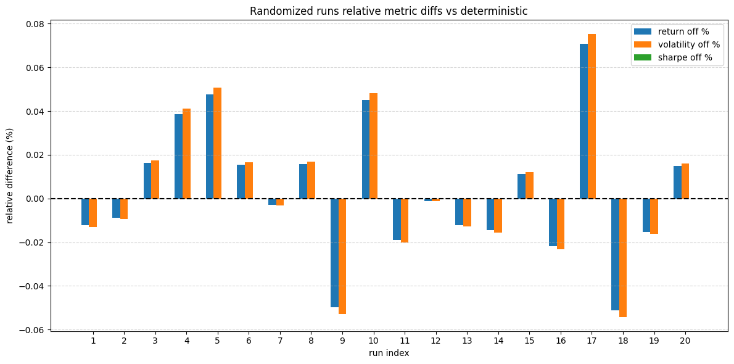
Results
Relative performance from deterministic baseline varies across runs
Sharpe ratio is almost constant

Slide 15
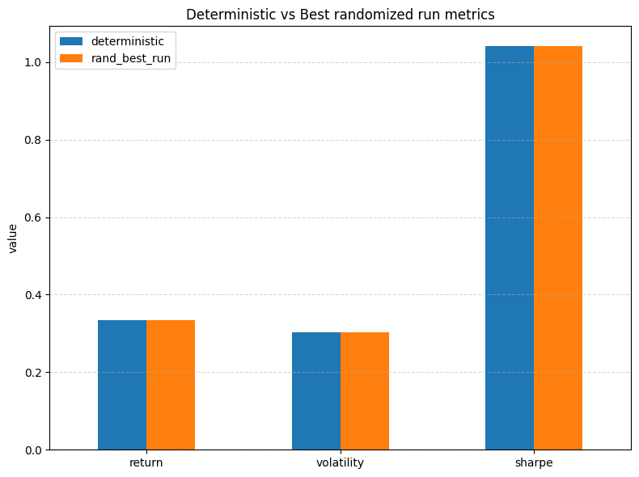
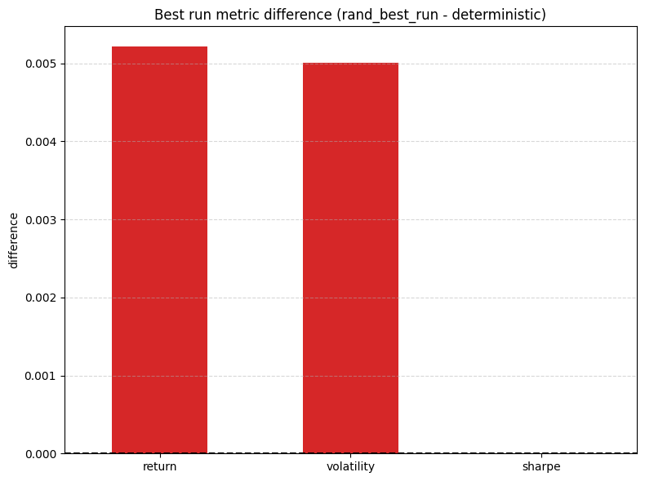
Results
Almost similar returns and risks between randomized and deterministic
Difference between runs is minimal
Randomized gives us better returns, at higher risk

Slide 16
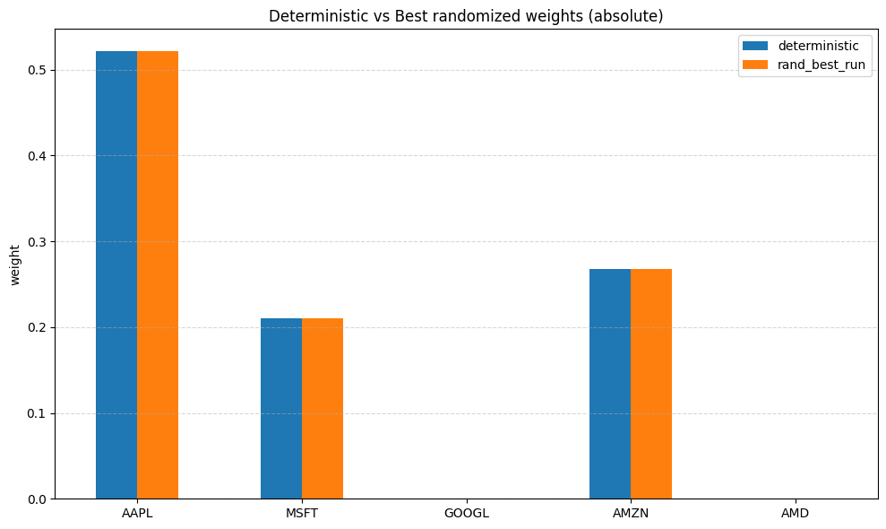
Results
Weight allocation is almost same
Results in similar performance
Randomized explores more, gives better approach to assigning weights

Slide 17
Inference – Domain Perspective
Key Financial Insights
Stock markets are inherently uncertain and stochastic
Returns cannot be predicted exactly — only probabilistically
Risk–Return Understanding
Higher expected return comes with higher risk
Portfolio performance depends on both mean and variance
Role of Diversification
Combining assets reduces risk through covariance effects
Low/negative correlation → risk reduction
High correlation → risk amplification
Decision-Making Insight
Deterministic models give single estimate
Probabilistic models provide range of possible outcomes
Enables better risk-aware investment decisions

Slide 18
Inference – Computer Science Perspective
• System Modeling → Stochastic input, deterministic transformation
• Search Space → Continuous, high-dimensional weight space
• Algorithm Behavior → Deterministic → converges to single optimum → PSO → explores multiple candidate solutions
• Optimization Dynamics → Local optimum vs global exploration
• Key Observation → Randomization improves coverage of solution space

Slide 19
Conclusion
Problem
Portfolio optimization under uncertain market conditions
Approach
Modeled returns using probability & covariance structure
Compared deterministic baseline with probabilistic simulation
Key Outcome
Generated a distribution of portfolio outcomes
Identified portfolios with better risk–return balance
Key Insight
Diversification reduces risk through asset dependency
Single estimates are insufficient — uncertainty must be modeled

