Slide 1


M.Tech
Advanced Industry Integrated Programs
Jointly offered by University and LTIMindTree
Review III
Smart Label
Model-Assisted Human-in-the-Loop Labeling
Kushal Samirkumar Shah
Knowledge partner | Implementation partner

Slide 2
Smart Label
Introduction
Smart Label provides model-assisted labelling where a model suggests labels and humans validate or correct them.
Key idea is to combine model predictions + human decisions to build a practical, scalable annotation workflow.
It is built using CNNs, HTML, CSS and Flask

Slide 3
Smart Label
Problem Statement
Automated classification of blood cells can significantly speed up diagnostics, but single AI models often make high-confidence errors ("silent failures").
These errors can corrupt curated datasets and reduce pathologist trust in the system.
A simple "low confidence" threshold is insufficient, as it fails to catch confidently wrong predictions.

Slide 4
Smart Label
Objective
Provide model-generated label suggestions to annotators.
Reduce human effort by automating routine or high-confidence cases.
Prioritize samples for human review using uncertainty or informativeness.

Slide 5
Smart Label
Modules
Model Training & Inference
Resnet18 and MobileNetv2 is used.
Transfer learning to fine-tune both models
Generates two independent predictions and confidence scores.
Active Sampling / Prioritization
Compares the predictions from both ResNet18 and MobileNetV2.
Confidence-based sampling (low-confidence items flagged).

Slide 6
Smart Label
Modules
Human Annotation Interface
Selects the most uncertain samples for human review
Clean, minimal annotation UI with model suggestions visible.
Simple dropdown and Confirm button for quickly correct label.
Deployment
Users (Hematopathologists) will upload the unlabeled images.
Output will be labeled images suggesting the type of blood cell.
Corrected images are stored in folders of there respective type.

Slide 7
Smart Label
Methodology/Modeling Plan
Core Methodology: Ensemble Learning A prediction is only auto-accepted if it passes two sequential checks, ensuring both agreement and high confidence.
Modelling Plan:
Gate 1: Disagreement Check
If model predictions disagree → Flag for HITL (ambiguity trigger)
Gate 2: Confidence Check
If predictions agree:
If avg. confidence < 85% → Flag for HITL (low confidence)
If avg. confidence ≥ 85% → Auto-label

Slide 8
Smart Label
Approach/Algorithms/Tools
Algorithms used: Ensemble Learning (Voting Classifier), HITL, Residual Learning(ResNet18), Depth-wise Separable Convolutions (MobileNetv2) and Grad-CAM.
Tools & Frameworks:
Deep Learning Framework: PyTorch
Web Application & HITL: Flask
Numerical & Scientific Libraries: NumPy, OpenCV
Data Analysis & Metrics: Pandas, Scikit-learn
Notes:
Ensemble Learning (Voting Classifier)Combines predictions from multiple models for higher accuracy and reliability.
Human-in-the-Loop (HITL)A workflow that uses model disagreement to intelligently request expert validation.
Inside ResNet-18: Residual Learning (Skip Connections) Enables the training of very deep networks by preventing accuracy degradation.
Inside MobileNetV2: Depth-wise Separable Convolutions Drastically reduces computation and model size, making the network fast and efficient.

Slide 9
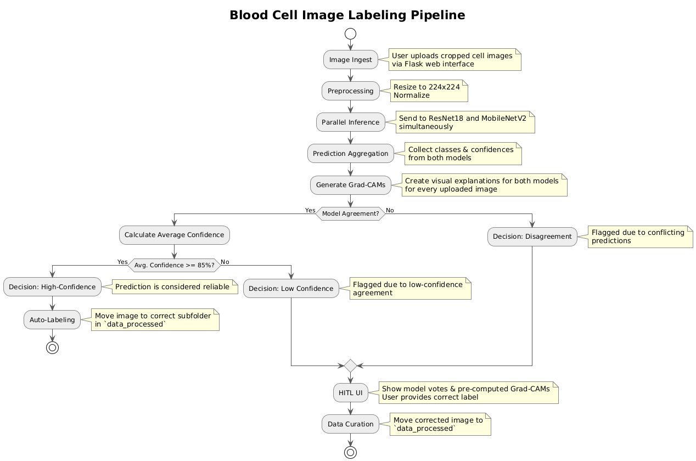
Smart Label
Pipeline Flowchart

Slide 10
Findings and Results
Key Insights with a Twist:
Ensemble Wins the Race: Combining ResNet-18 and MobileNetV2 consistently outperformed solo runs. Teamwork makes the dream work—even for models!
Disagreement = Discovery: When models disagree, it’s a red flag for tricky or unusual cases—far more insightful than just low confidence.
Double-Gate, Double the Catch: The dual-gate logic (triggered by disagreement OR low-confidence agreement) smartly captures both ambiguous and hesitant predictions—reducing silent slip-ups.

Slide 11
Smart Label
Findings and Results
Results That Speak Volumes:
AI First-Pass Agreement: 92–95% The models nailed it on the first go—automatically processing the vast majority of test images with high confidence. Efficiency, unlocked!
Expert Workload? Minimized! By smartly flagging only the top 5–8% of tricky cases for Human-in-the-Loop (HITL) review, the system turbocharges annotation productivity.
Why the Disagreement? Grad-CAM Knows! Visual analysis showed that model clashes often stem from different feature sensitivities—like one eyeing the nucleus shape, while the other zooms in on cytoplasm texture. It's like having two specialists with unique perspectives!

Slide 12
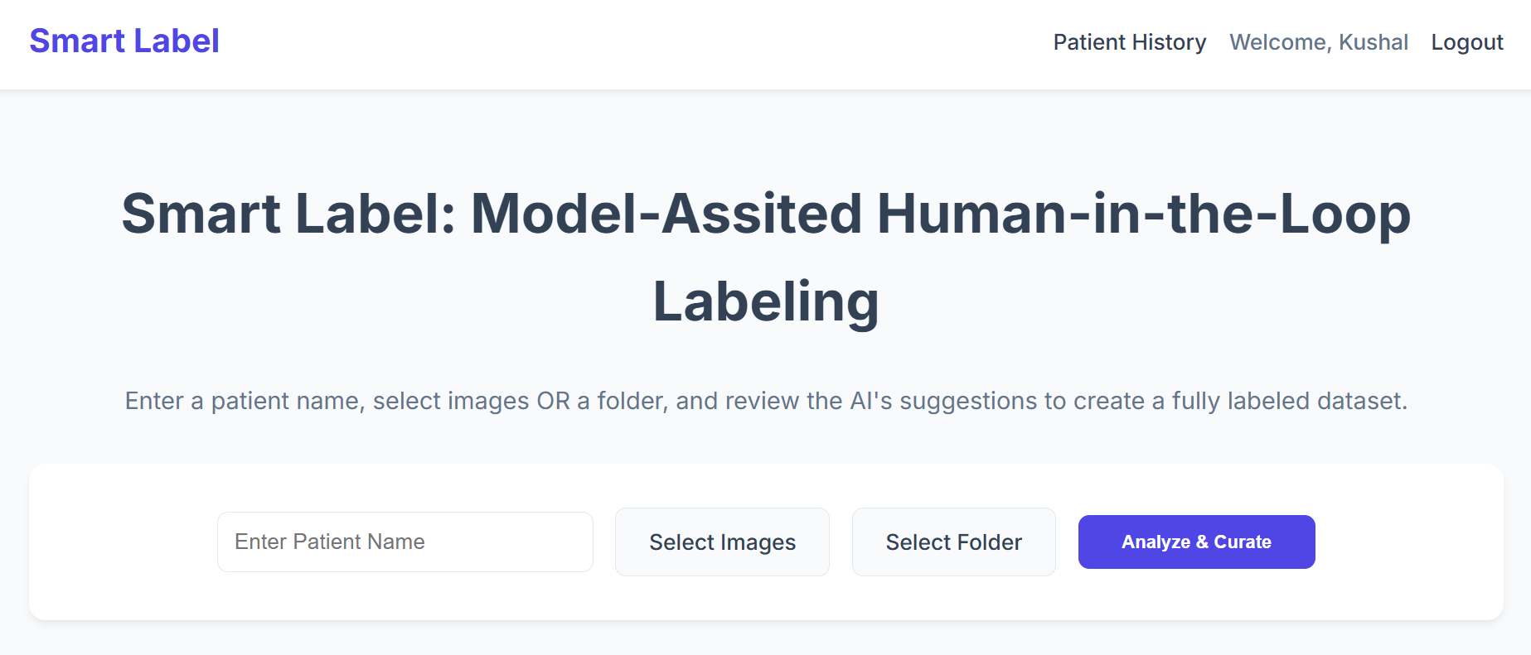
Smart Label
Demo

Slide 13
Smart Label
Conclusion
An ensemble-based approach with a dual-gate HITL trigger proves highly effective for reliable medical image curation.
It strikes the right balance between automation and expert oversight, boosting both labeling speed and dataset quality.
With Explainable AI (Grad-CAM), the system transforms the AI from a “black box” into a collaborative diagnostic partner, building trust and insight.

Slide 14
Smart Label
Future Work
Implement a Re-training Loop: Periodically fine-tune the models on the newly curated data to create a self-improving system.
Expand the Ensemble: Introduce a third, architecturally distinct model (e.g., a Vision Transformer) to further improve robustness.
Deploy as a Clinical Tool: Package the application for deployment in a lab setting for real-world testing and data collection.

Slide 15
Smart Label
Acknowledgement
I would like to extend my sincere gratitude to:
Hari Sir and Jayakanthan Sir for their invaluable guidance, mentorship, and support throughout this project.
VIT and LTIMindtree for providing the platform and resources to implement this project.

Slide 16
Smart Label
References
TXL-PBC: a freely accessible labeled peripheral blood cell dataset - Lu Gan and Xi Li (2024)
Automatic Labels Are As Effective As Manual Labels In Biomedical Images Classification With Deep Learning - Niccolo Marini ,Stefano Marchesin, Lluis Borras Ferris, Simon Püttmann, Marek Wodzinski, Riccardo Fratti, Damian Podareanu, Alessandro Caputo, Svetla Boytcheva, Simona Vatrano, Filippo Fraggetta, Iris Nagtegaal, Gianmaria Silvello, Manfredo Atzori, Henning Müller (2024)
Deep learning-based image annotation for leukocyte segmentation and classification of blood cell morphology - Vatsala Anand, Sheifali Gupta, Deepika Koundal, Wael Y. Alghamdi and Bayan M. Alsharbi (2024)

Slide 17
Smart Label
References
WBCAtt: A White Blood Cell Dataset Annotated with Detailed Morphological Attributes - Satoshi Tsutsui, Winnie Pang, Bihan Wen (2023)
Machine Learning (ML)-Enabled Automation for High-Throughput Data Processing in Flow Cytometry - Anna L. Kamysheva, Dmitrii V. Fastovets, Roman N. Kruglikov, Arseniy A. Sokolov, Anastasiya S. Fefler, Anastasiia A. Bolshakova, Anastasia Radko, Ilya E. Krauz, Sheila T. Yong, Michael Goldberg, Ravshan Ataullakhanov, Aleksandr Zaitsev (2023)

Slide 18
Smart Label
Any Questions ?

Slide 19
Smart Label
THANK YOU

