Slide 1


M.Tech Program
Advanced Industry Integrated Programs
Jointly offered by University and LTIMindTree
Smart Label:
Model-Assisted Human-in-the-Loop Labeling
Kushal Samirkumar Shah
Knowledge partner | Implementation partner

Slide 2
Smart Label
Introduction
Smart Label provides model-assisted labelling where a model suggests labels and humans validate or correct them.
Key idea is to combine model predictions + human decisions to build a practical, scalable annotation workflow.
It is built using CNNs and Streamlit.

Slide 3
Smart Label
Objective
Provide model-generated label suggestions to annotators.
Reduce human effort by automating routine or high-confidence cases.
Prioritize samples for human review using uncertainty or informativeness.

Slide 4
Smart Label
Scope
Applicable to image, text, audio and video annotation projects.
Useful in industries such as healthcare, finance, autonomous systems, and content moderation.
Supports both single-annotator and collaborative team workflows.
Not intended as a fully autonomous labelling system for ambiguous or purely subjective tasks.

Slide 5
Smart Label
Literature Review
TXL-PBC: a freely accessible labeled peripheral blood cell dataset - Lu Gan and Xi Li (2024)
Automatic Labels Are As Effective As Manual Labels In Biomedical Images Classification With Deep Learning - Niccolo Marini ,Stefano Marchesin, Lluis Borras Ferris, Simon Püttmann, Marek Wodzinski, Riccardo Fratti, Damian Podareanu, Alessandro Caputo, Svetla Boytcheva, Simona Vatrano, Filippo Fraggetta, Iris Nagtegaal, Gianmaria Silvello, Manfredo Atzori, Henning Müller (2024)
Deep learning-based image annotation for leukocyte segmentation and classification of blood cell morphology - Vatsala Anand, Sheifali Gupta, Deepika Koundal, Wael Y. Alghamdi and Bayan M. Alsharbi (2024)

Slide 6
Smart Label
Literature Review
WBCAtt: A White Blood Cell Dataset Annotated with Detailed Morphological Attributes - Satoshi Tsutsui, Winnie Pang, Bihan Wen (2023)
Machine Learning (ML)-Enabled Automation for High-Throughput Data Processing in Flow Cytometry - Anna L. Kamysheva, Dmitrii V. Fastovets, Roman N. Kruglikov, Arseniy A. Sokolov, Anastasiya S. Fefler, Anastasiia A. Bolshakova, Anastasia Radko, Ilya E. Krauz, Sheila T. Yong, Michael Goldberg, Ravshan Ataullakhanov, Aleksandr Zaitsev (2023)

Slide 7
Smart Label
Summary of Literature
TXL-PBC Dataset: Introduces a unified and re-annotated dataset for peripheral blood cell detection using YOLO-based models.
Automatic Labeling in Biomedical Imaging: Demonstrates that deep learning models trained on automatically labeled WSIs can match manually labeled performance with minimal noise.
Leukocyte Classification via CNN: Proposes a CNN-based framework achieving high accuracy in segmenting and classifying leukocytes from blood smear images.

Slide 8
Smart Label
Summary of Literature
WBCAtt Dataset with Morphological Attributes: Presents a white blood cell dataset annotated with detailed morphological features to support explainable AI in diagnostics.
Platelet-Targeted Gene Therapy for Hemophilia A: Reports successful clinical trial of lentiviral gene therapy delivering Factor VIII via platelets in a patient with severe hemophilia A.

Slide 9
Smart Label
Research Gaps
Label noise in automatic annotation.
Annotation accuracy and bounding box precision.
Class imbalance and rare cell types.
Adaptability across domains and datasets.

Slide 10
Smart Label
About Dataset
Title: Blood Cell Images for Cancer Detection
Source: Kaggle - Sumith Singh Kothwal
Size: 127 MB
File Format: PNG images
Total Samples: Approximately 5,000 images
Resolution: High-resolution images suitable for detailed analysis
Type: Peripheral blood smear images
The dataset does not need data preprocessing because it is curated by expert hematopathologist under standardized imaging conditions.

Slide 11
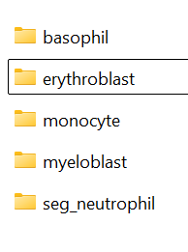
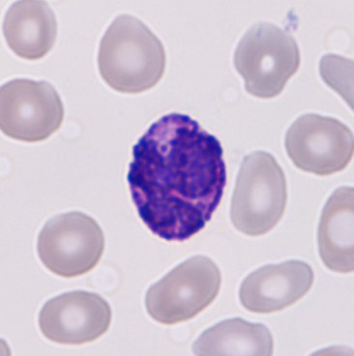
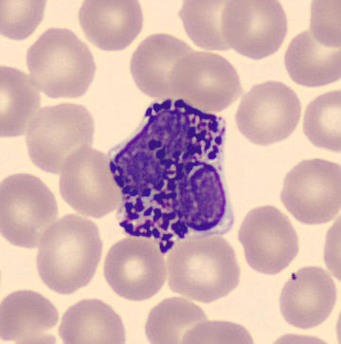
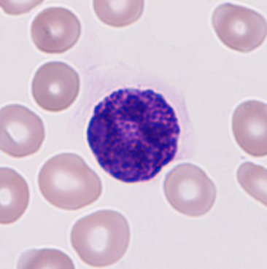
Smart Label
About Dataset (Continued…)
Class Distribution:
ALL (Acute Lymphoblastic Leukemia): 1,000 images
AML (Acute Myeloid Leukemia): 1,000 images
CML (Chronic Myeloid Leukemia): 1,000 images
Normal: 2,000 images
Images taken from kaggle dataset

Slide 12
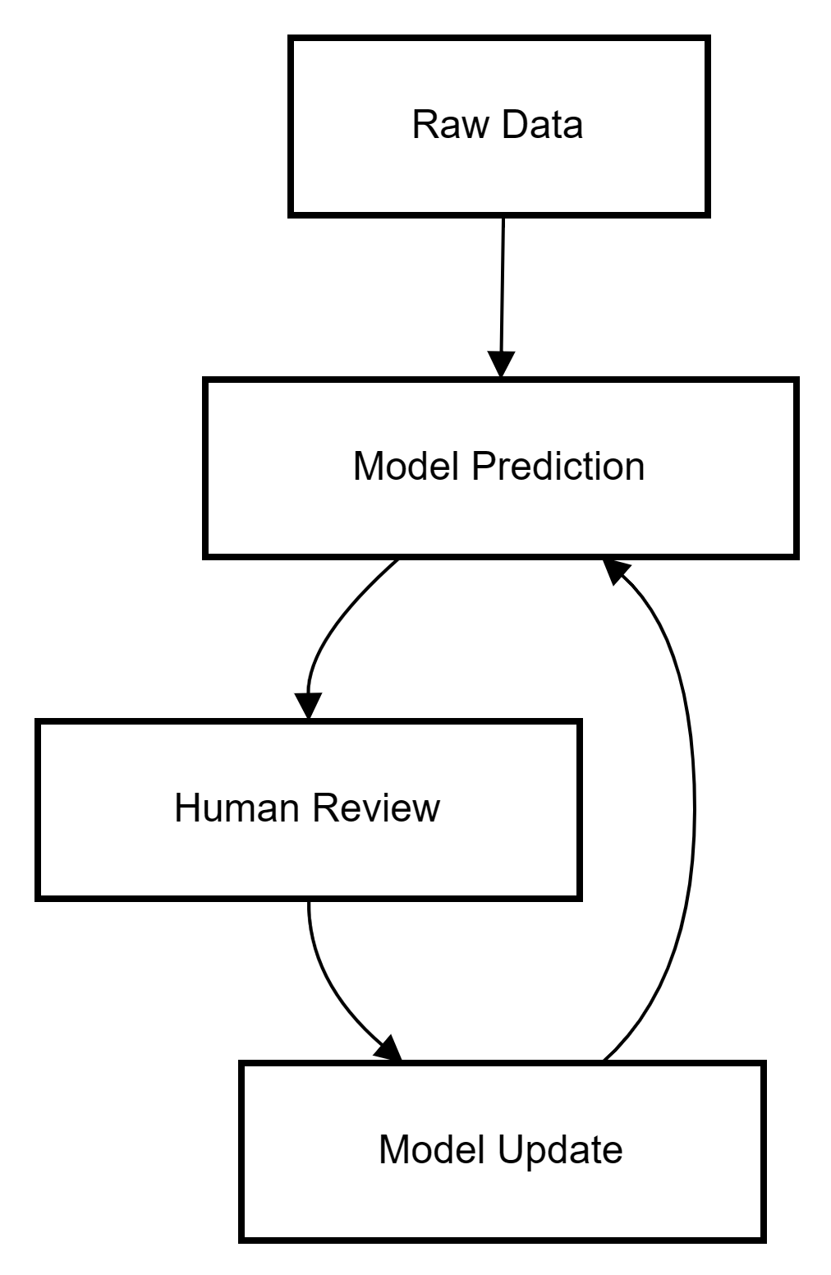
Smart Label
Workflow

Slide 13
Smart Label
Modules to cover
Model Training & Inference
Active Sampling / Prioritization
Human Annotation Interface
Deployment

Slide 14
Smart Label
Model Training & Inference
Custom CNN model, Resnet50 and EfficientNet is used initially.
Model packaging and deployment process.
Calculates confidence score.

Slide 15
Smart Label
Active Sampling / Prioritization
Uses pre-trained ML models to generate initial labels.
Confidence-based sampling (low-confidence items flagged).

Slide 16
Smart Label
Human Annotation Interface
Selects the most uncertain or informative samples for human review
Clean, minimal annotation UI with model suggestions visible.
Button for quickly correct label.

Slide 17
Smart Label
Deployment
Users (Hematopathologists) will upload the unlabeled images.
Output will be labeled images suggesting the type of blood cell.
Users will be shown the average confidence level and if it less then user can modify it.
Using Streamlit UI.

Slide 18
Smart Label
Future Scope
Integrate Clinical Metadata.
Support Real-Time Annotation.
Expand to Multi-Modal Data such as Genomics, EHRs etc.
Synthetic Data Generation for rare conditions or cell types.

Slide 19
Smart Label
Thank You

