Slide 1
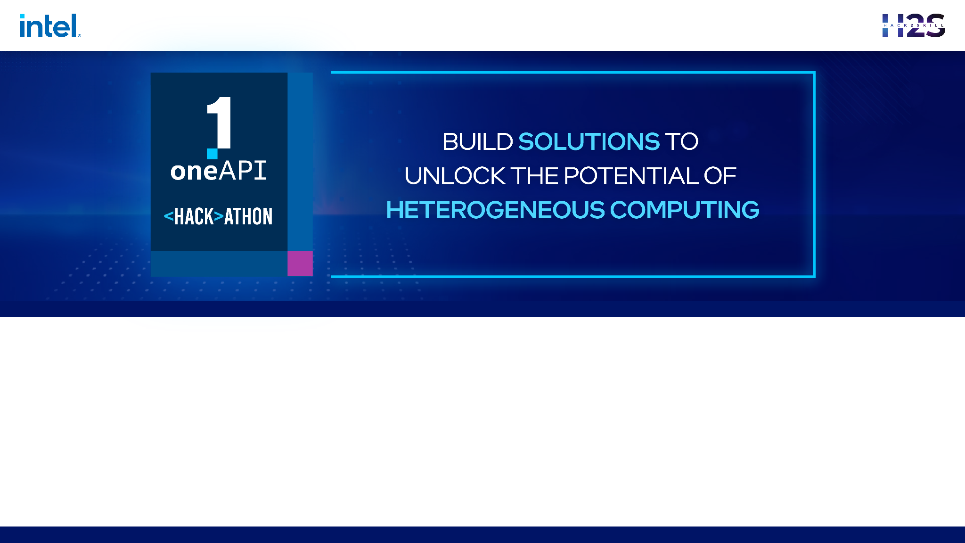
Team Name : Jethakejabaz
Problem Statement :Open Innovation in Education

Slide 2


Brief about the Idea
The idea is to create a browser extension that provides real-time interview preparation assistance to aspiring software developers. The extension uses Intel One API ,an AI Chatbot with gpt-3 to assist with interview preparation & improving the coding skills by providing specific and personalized guidance to users.
The extension overcomes the existing problems with AI chatbots by extracting questions from various coding platforms automatically, eliminating the need for copy-pasting, and providing guidance within the context of the problem. It also preserves the chat history and provides prompts that yield desirable responses.
Overall, our extension aims to help developers overcome the lack of guidance, time constraints, and interview anxiety associated with interview preparation.

Slide 3
Opportunity
The browser extension will be able to solve the problems associated with interview preparation by providing real-time guidance and support to aspiring software developers. Here's how it will address each of the problems
Lack of guidance: The extension uses AI chatbot to provide specific and personalized guidance to users. It can answer doubts and questions related to the specific coding problem that the user is working on, eliminating the need for generic answers or predefined hints.
Time constraints: The extension extracts coding questions from various platforms, making it easier for developers to find problems to work on. It also eliminates the need for copy-pasting by providing context-specific guidance within the problem page, saving time for the user
Interview anxiety: The extension provides a safe environment for developers to practice interview questions and gain confidence. It allows developers to ask questions and receive feedback in real-time, which can help alleviate anxiety and build confidence.

Slide 4
Opportunity
How different is it from any other existing ideas out there?
As there are many resources available for interview preparation, the proposed browser extension differs in several ways:
Personalized guidance: The extension uses AI chatbot to provide specific and personalized guidance to users. This differs from many existing interview preparation resources that provide generic solutions or predefined hints.
Context-specific guidance: The extension extracts coding questions from various platforms and provides context-specific guidance within the problem page. This eliminates the need for copying and pasting and saves time for the user.
Real-time support: The extension allows developers to ask questions and receive feedback in real-time. This differs from many existing interview preparation resources that only provide static content or pre-recorded video tutorials.
Preserving chat history: The extension allows developers to preserve their chat history, which can help them review their progress and identify areas for improvement.

Slide 5
List of features offered by the solution
1) Help you to get started
Our idea can explain the question better and give you a hint on how to start solving the question.
2) Conduct a mock interview
It can conduct a complete mock interview by using the current problem as a reference.
3) List all approaches
It can list all the different approaches for solving a question.
4) Help you optimize your solution
It can give you hints and tell you how to get the best possible solution.
5) Ask a real interview question
It can ask you a potential interview question based on the problem. This would be really useful for those afraid of interviews.
6) Guide you when you're stuck
It can guide you by giving hints, and point you towards the solution, just like in a real interview setting.

Slide 6
List of oneAPI Ai Analytics Toolkits, its libraries and
the SYCL/DPC++ Libraries used
Intel Math Kernel Library (MKL) to optimize numerical computations.
Intel Distribution for Python or the Intel Data Analytics Acceleration Library (DAAL) to perform data analytics tasks on the output of the GPT-3 API. These libraries provide optimized functions for data manipulation, statistics, and machine learning that can speed up processing.

Slide 7
Process Flow Diagram
Installing Extension
Navigates to coding platform
Detects and Extracts the Question
User Asks Doubts & Hints
Extension provides Feedback and Guidance
Keeps track of user’s progress and suggest additional questions
User may save questions and responses & export for future references

Slide 8
Work Flow Diagram
User Interference
(Chrome Extension)
Web Scraping (BeautifulSoup/Scrapy)
oneAPI AI Analytics Toolkits (Intel Distribution for Python, Intel oneAPI Data Analytics Library, etc.)
SYCL/DPC++ Libraries (Intel oneAPI DPC++ Compiler, Intel oneAPI Math Kernel Library, etc.)
Chatbot (AI Language Model)
Storage (Local storage or cloud-based database)

Slide 9

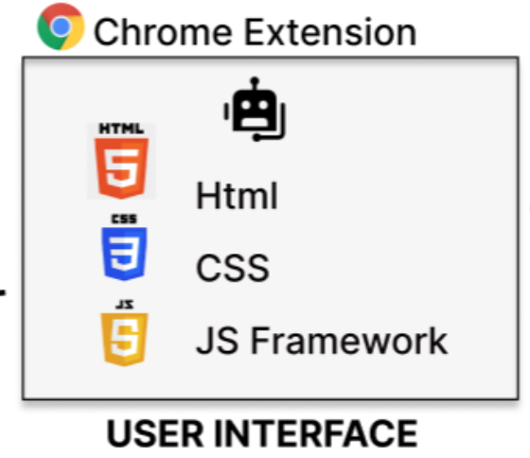

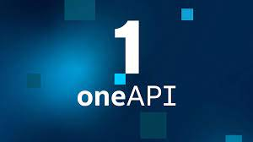
Architectural Diagram
Find Answer
Request
Give Answer
Send Answer
Performance Boosting

Slide 10
Technologies used
Frontend | Backend | AI / ML
React.js for building the user interface | Node.js for server-side programming | Intel Math Kernel Library (MKL) to optimize numerical computations.
Redux for state management | Express.js for building REST APIs | Intel Distribution for Python or the Intel Data Analytics Acceleration Library (DAAL) to perform data analytics tasks on the output of the GPT-3 API. These libraries provide optimized functions for data manipulation, statistics, and machine learning that can speed up processing.
Bootstrap or Material UI for styling and responsive design | Socket.io for real-time communication between the client and server | OpenAI's GPT-3 for natural language generation and question answering

Slide 11
Estimated cost of/after implementing the solution
Assumption:
Team size → 2 to 3 developers ; Implementation Time → 6 months
Development Cost | $7200 - $10800 | Assuming an average hourly rate of $100 per developer
Infrastructure Cost | $300 - $500 | Assuming cloud hosting services like AWS or Azure are used, the estimated monthly cost would be around $500 - $1000 per month, depending on the traffic and data storage requirements.
oneAPI licensing cost | (Commercial Cost) | Depending on the specific libraries used, the licensing costs could range from a few hundred dollars to several thousand dollars.
Maintenance Cost | ($1440 - $2160) p.a. | Assuming a yearly maintenance cost of around 20% of the development cost
Overall, the rough estimated cost of implementing this solution would be around $8,000 - $12,000 for the first year, and around $14,40 - $21,60 for each subsequent year.

Slide 12
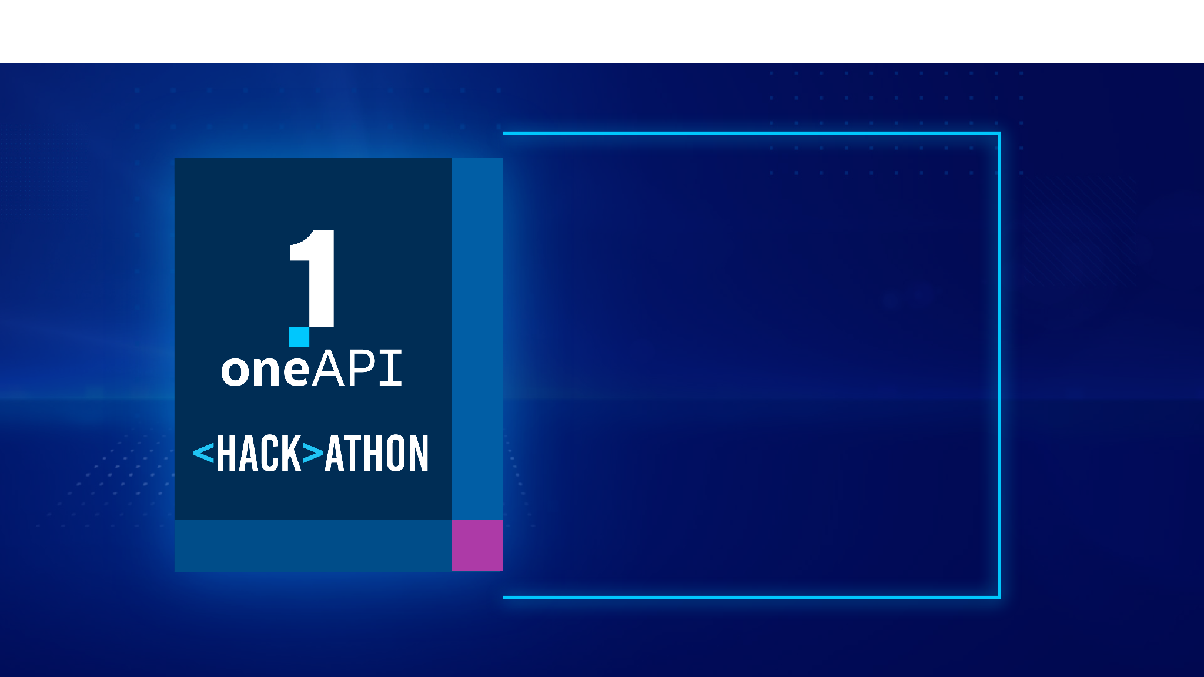
THANK YOU

