Slide 1
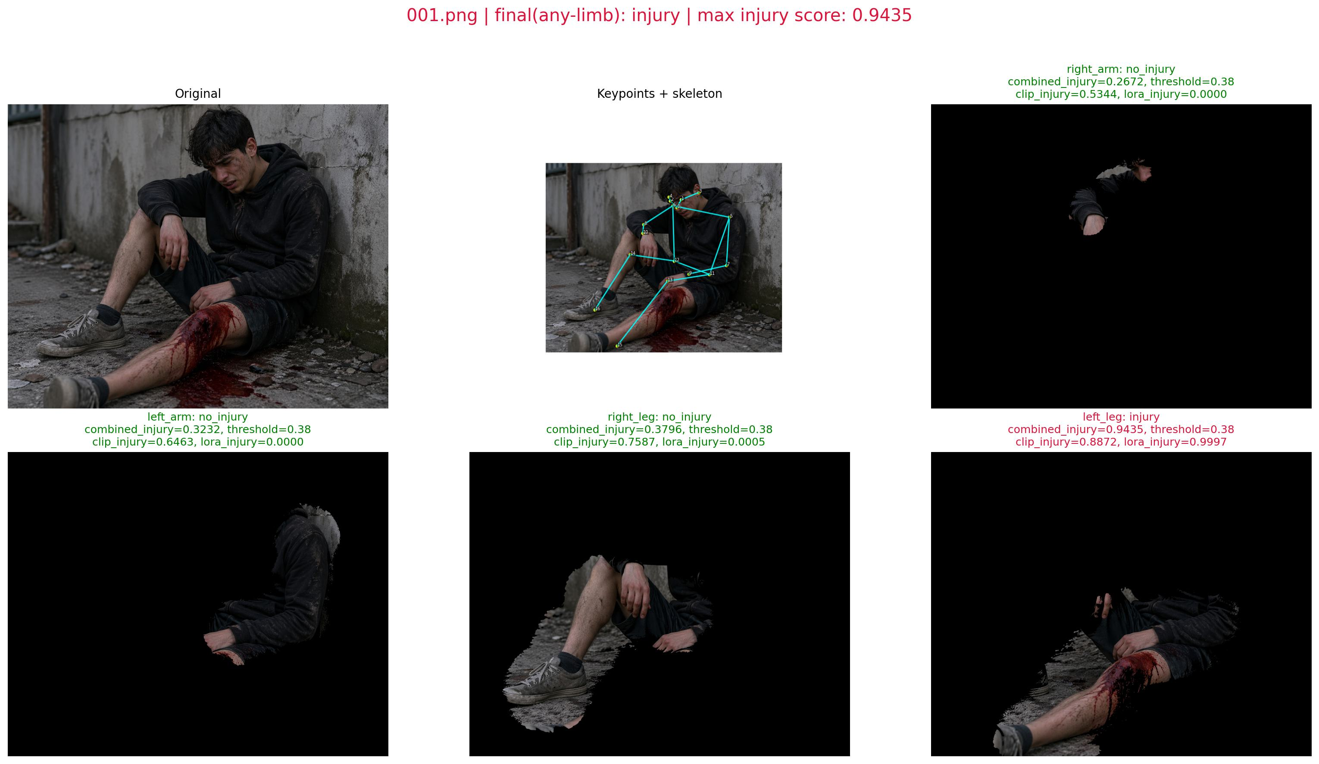
Keypoint-Guided Gaussian Segmentation + CLIP-LoRA Pipeline for Injury Assessment
Computer Vision Project Presentation (IT 420/322)
Kush Garg | KG-001
Sahil | SA-002
Shivansh | SH-003
Uvais | UV-004
GitHub: https://github.com/Kush2210/CLIP-LoRA-Pose2Injury

Slide 2
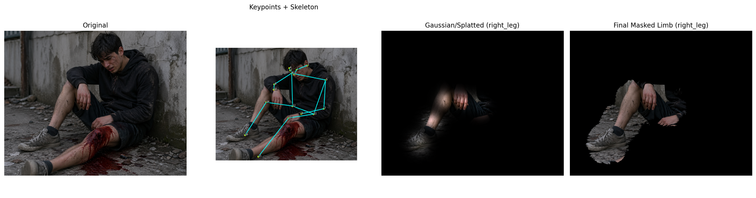
Problem Statement
What the project solves and why it matters
Goal: detect a person, focus on an informative limb region, and classify injury condition from images.
Motivation: manual injury inspection from visual data is slow and inconsistent in emergency-style scenarios.
Computer Vision relevance: the pipeline combines pose estimation, region-focused preprocessing, segmentation-style masking, and image classification.
Project objective: use body keypoints to guide Gaussian masking and use CLIP-LoRA for limb-condition prediction.
Teacher guideline match: problem statement + project relevance to Computer Vision.

Slide 3
Workflow / Flowchart
Complete pipeline from input to final outputs
1. Collect image inputs from `testing/` and the TromNet-style dataset used by the CLIP-LoRA code.
2. Run YOLOv8 pose estimation to extract 17 body keypoints.
3. Select a limb path from arm or leg keypoint triplets.
4. Compute Gaussian spread from inter-keypoint distance and build a splatted soft mask.
5. Generate a masked limb-focused image for classification.
6. Run CLIP and CLIP-LoRA inference with prompt-based class text features.
7. Export CSV files, report panels, proof images, and evaluation plots.
Dataset
Limb
Mask
Results
Pose
Gaussian
CLIP-LoRA
Teacher guideline match: dataset collection, preprocessing, model/algorithm, tasks performed, and final output flow.

Slide 4
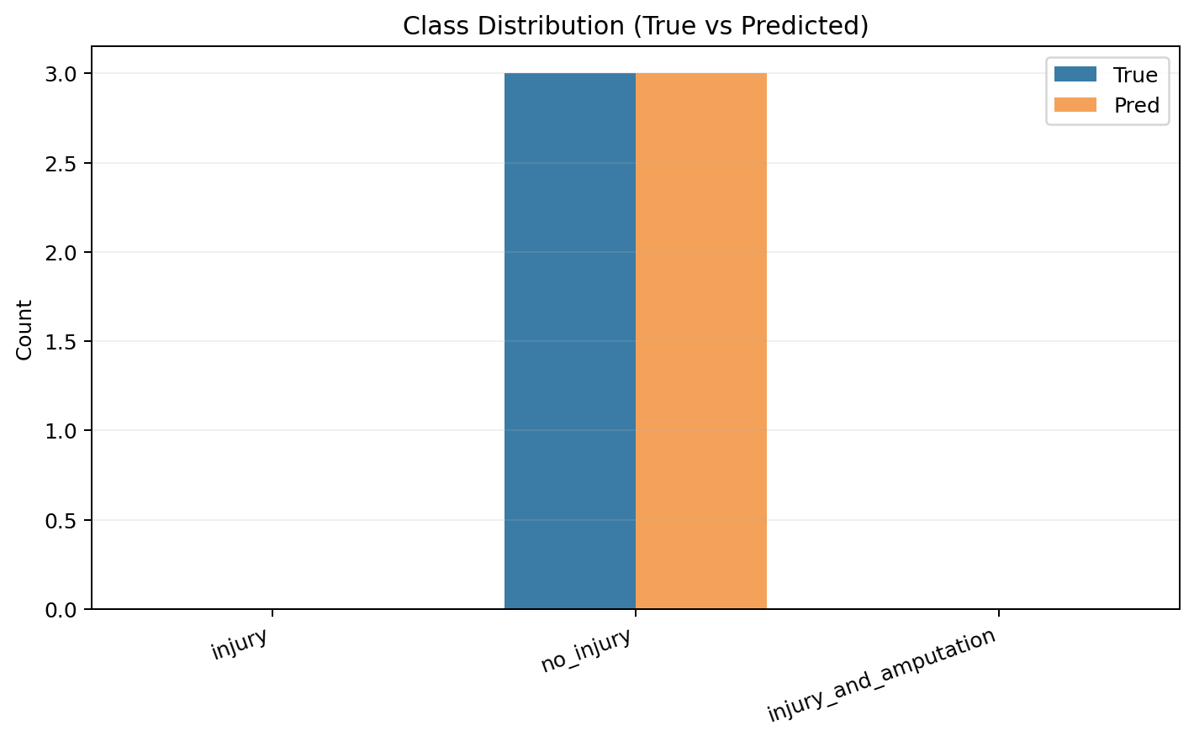
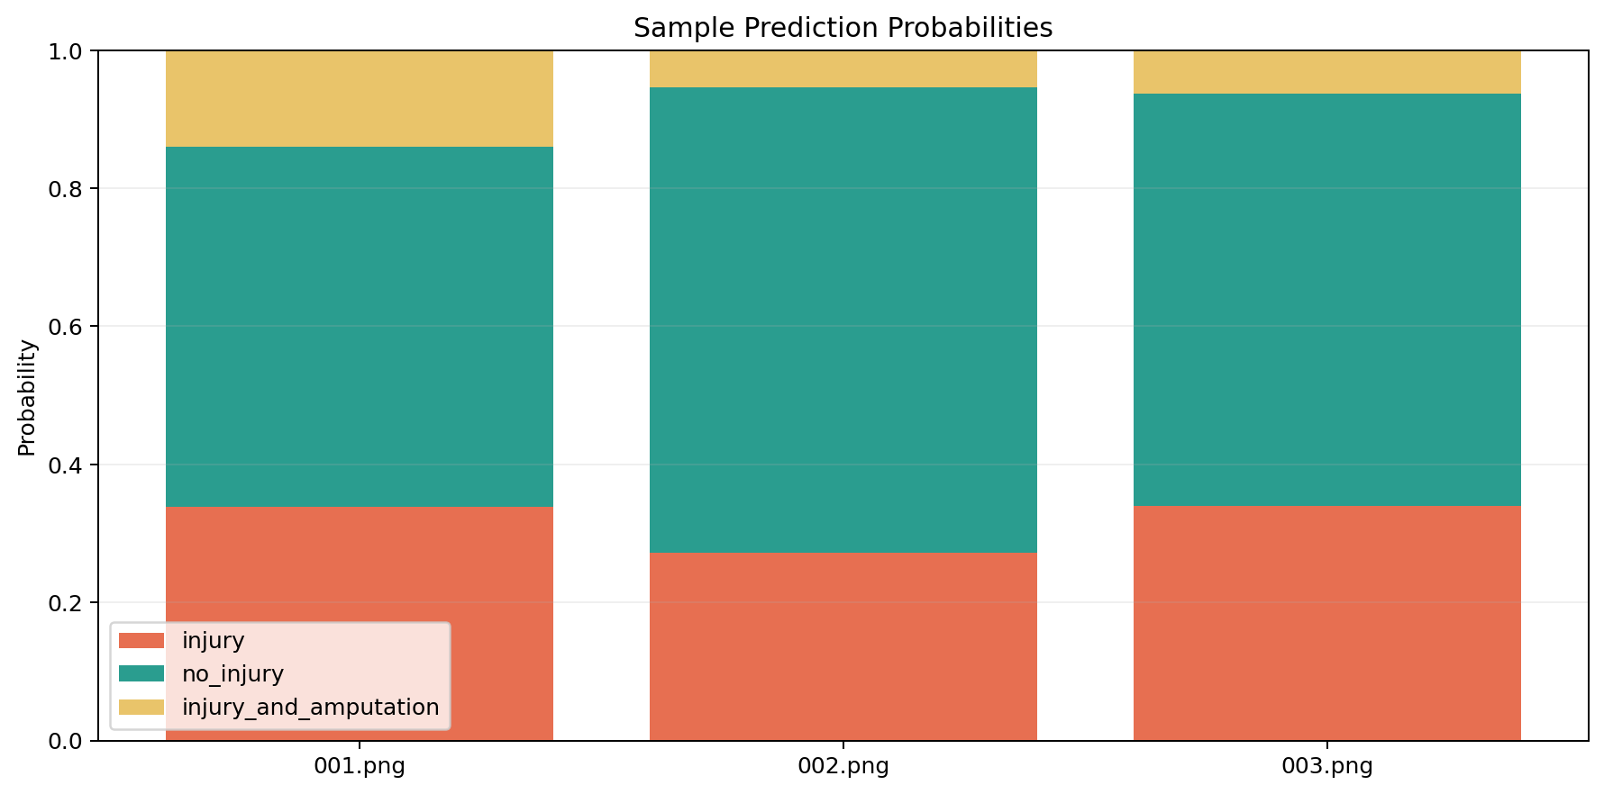
Dataset Details
Structure, counts, and effective features
Dataset Structure
Demo Evaluation Set
Effective Attributes
TromNet-style classes: injury, no_injury, injury_and_amputation.
Training images in repo: 3 total, with 1 image per class.
Test frames in repo: 108 images under CLIP-LoRA/DATASET/test/frames.
Folder used for report generation: testing/.
Images used: 001.png, 002.png, 003.png.
Current labels in draft PPT are provisional demo labels.
RGB image input.
17 pose keypoints from YOLOv8.
3 selected limb points.
Gaussian mask and 3-class probability output.
Feature perspective: 17 human joints define geometry and CLIP/LoRA returns 3 semantic class scores.
This project is inference-focused; no new train/validation benchmark protocol is implemented in the current repo.
Teacher guideline match: dataset source/structure, counts, attributes, and dataset statistics.

Slide 5
Preprocessing
Before-vs-after image transformation used before classification
Preprocessing is applied before classification.
Input image is decoded and converted to RGB.
YOLOv8 pose extracts body joints from the image.
A limb-specific keypoint triplet is selected from arm or leg joints.
Sigma is computed from adjacent keypoint distance with scale factor 0.15 and minimum value 1.0.
Gaussian kernels are placed around joints and midpoints to build a smooth limb-focused mask.
The original full-body image becomes a masked limb-focused image used for inference.
Teacher guideline match: exact preprocessing techniques + sample original vs processed image.

Slide 6
Tasks Performed and Tools
CV tasks, methods, libraries, and development environment
Tasks
Algorithms
Stack
Environment
Detection: human pose/keypoint extraction.
Segmentation-style masking: Gaussian splatting and bitwise masking.
Classification: CLIP and CLIP-LoRA prediction.
Feature extraction: keypoints and CLIP embeddings.
YOLOv8 pose for 17-keypoint detection.
Distance-based Gaussian splatting for limb emphasis.
CLIP ViT-B/16 image-text similarity.
LoRA adapters on attention projections.
Python
PyTorch
OpenCV
Matplotlib
Ultralytics
PIL
NumPy
Local Python environment
VS Code
Notebook support through cv_project_usage.ipynb
GitHub-based code submission workflow
Teacher guideline match: tasks, methods, libraries, language, and IDE/environment.

Slide 7
Algorithm / Method Explanation
How the pipeline works internally
Pose + Gaussian Region Focus
CLIP-LoRA Semantic Classification
YOLOv8 predicts 17 body keypoints.
A 3-point limb chain is selected for a target arm or leg.
Sigma is derived from inter-keypoint distance.
Gaussian kernels are placed at joints and midpoints.
The splatted map is thresholded to retain activated limb pixels.
The masked limb image is encoded by CLIP ViT-B/16.
Prompt-based text features are built for the three classes.
Image-text similarity logits are softmaxed into probabilities.
Pretrained LoRA adapters on q/k/v projections refine prediction.
Per-limb results are aggregated into image-level outputs.
Teacher guideline match: what task is done, what method is used, and how it works.

Slide 8
Environment and Hyperparameters
System specification and configuration used in the run
System
Models and Classes
LoRA Setup
Platform: macOS-26.3.1-x86_64-i386-64bit.
Python: 3.12.2.
PyTorch: 2.2.2.
Device: cpu.
Scaled dot-product attention: available.
Pose model: yolov8n-pose.pt.
CLIP backbone: ViT-B/16.
Classes: injury, no_injury, injury_and_amputation.
Injury-score threshold: 0.38.
Rank r = 2.
Alpha = 1.
Dropout = 0.25.
Params = q, k, v.
Position = all.
Encoder = both.
Dataset = tromnet.
Shots = 16, Seed = 1.
Teacher guideline match: system specification, language, and tuning parameters/hyperparameters.

Slide 9
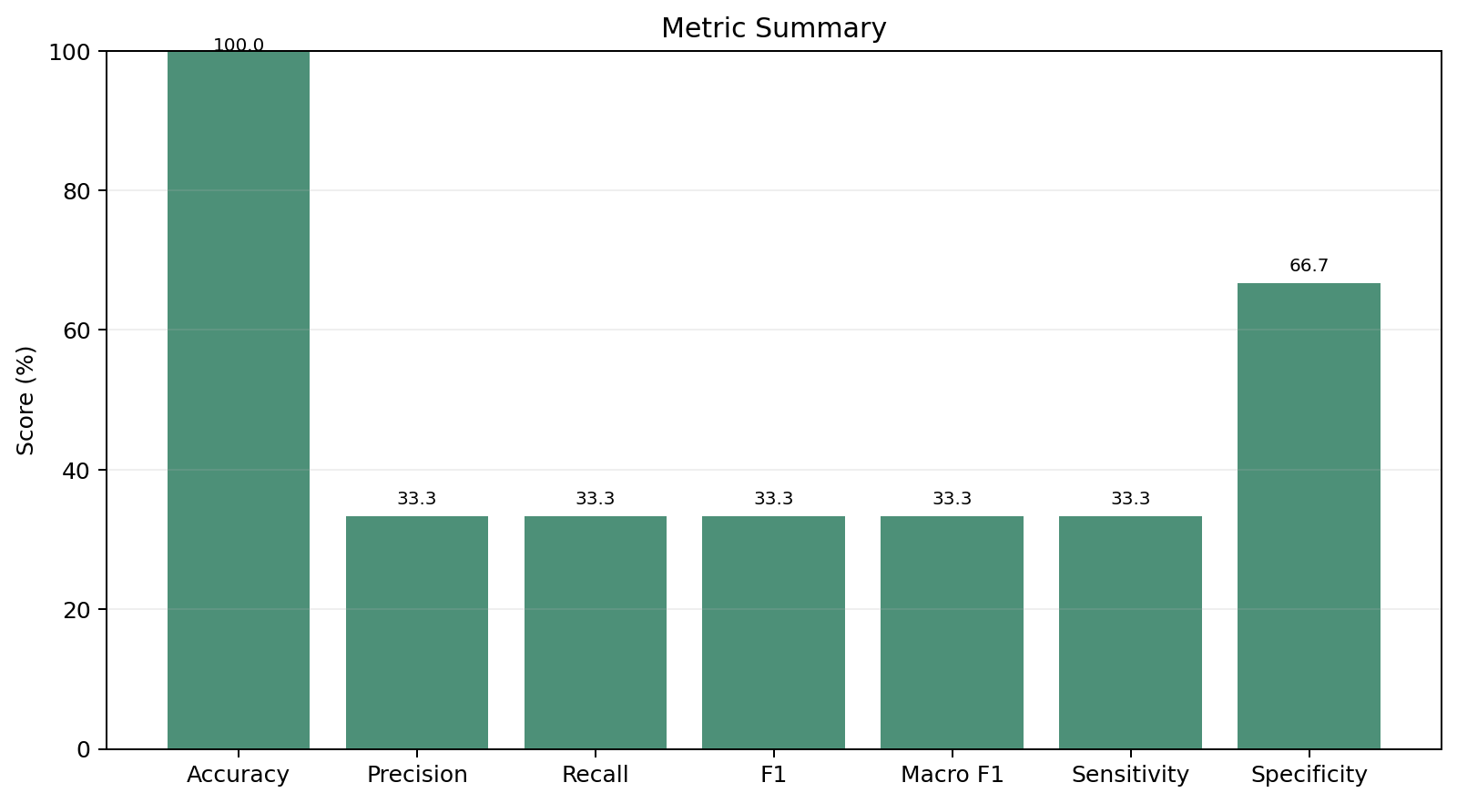
Numeric Results Table
Compulsory metric summary for the current demo evaluation
Overall Metrics
Evaluation Context
Accuracy = 1.00
Precision = 0.33
Recall = 0.33
F1 Score = 0.33
Macro F1 = 0.33
Sensitivity = 0.33
Specificity = 0.67
Binary accuracy = 1.00
mAP = N/A
Sample size: 3 demo images.
Artifacts generated from testing/.
Metrics are based on provisional labels for draft PPT preparation.
Use final ground-truth labels before formal submission if available.
Teacher guideline match: compulsory numeric table including accuracy, precision, recall, F1, macro F1, sensitivity, specificity, and applicable note for mAP.

Slide 10
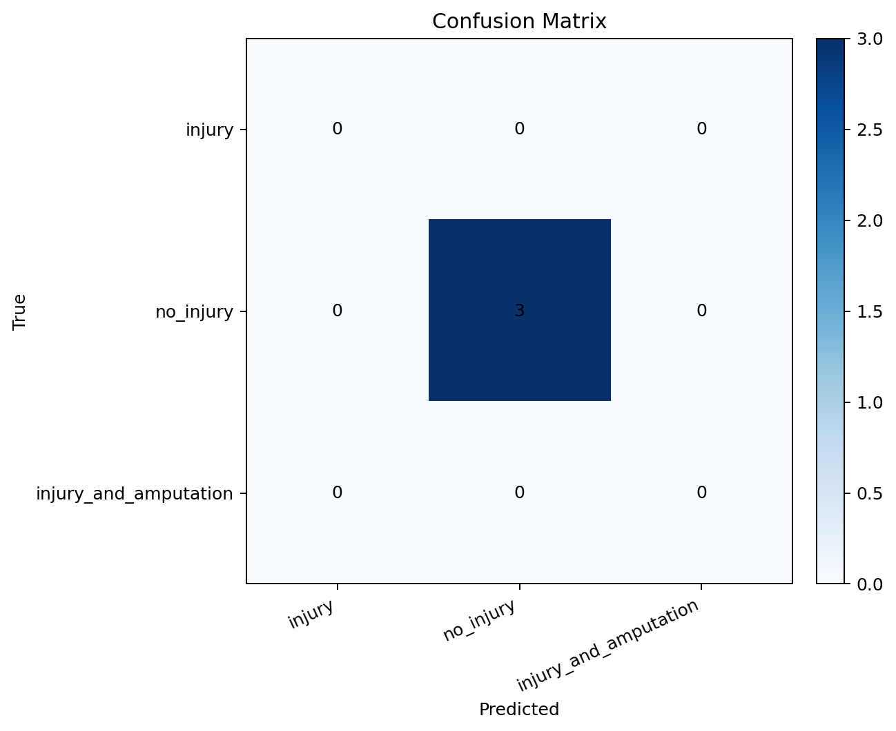
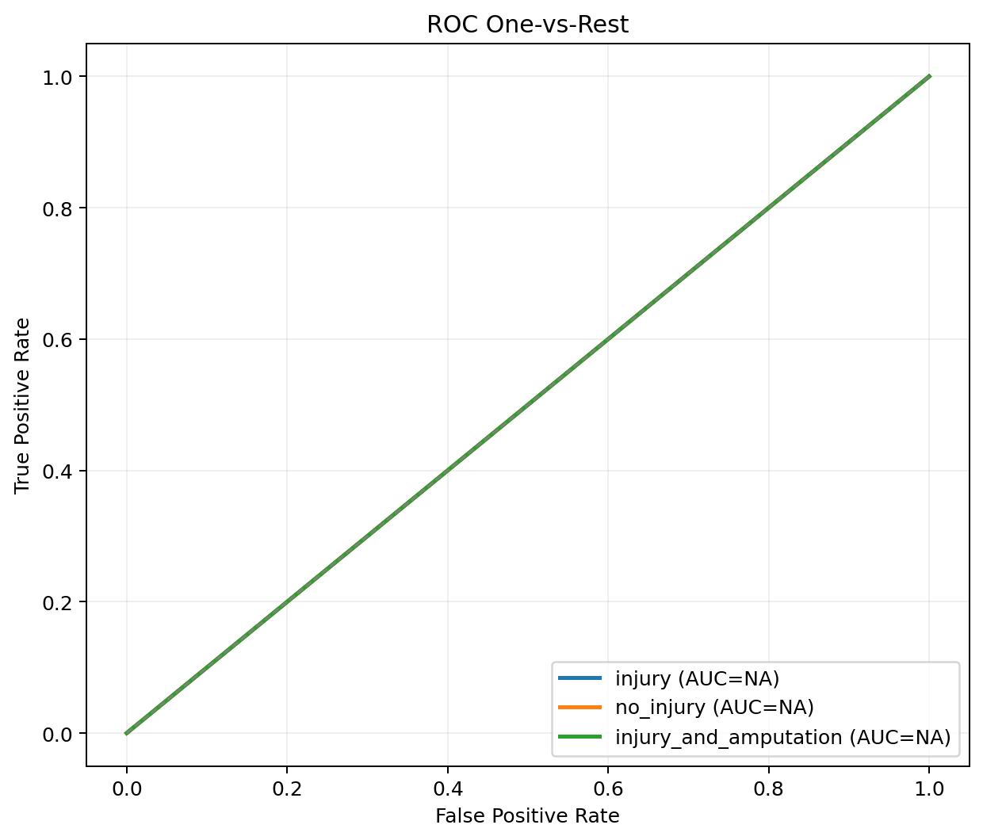
Graphical Results
Plots generated directly from the project outputs
Confusion matrix, ROC OvR, class distribution, and metric summary plots were generated automatically by the evaluation script.
These figures satisfy the graphical-results requirement from the teacher guidelines.
The current run is a draft/demo evaluation using the present label file in the repo.
Teacher guideline match: ROC curve, confusion matrix, and other relevant graphs.

Slide 11
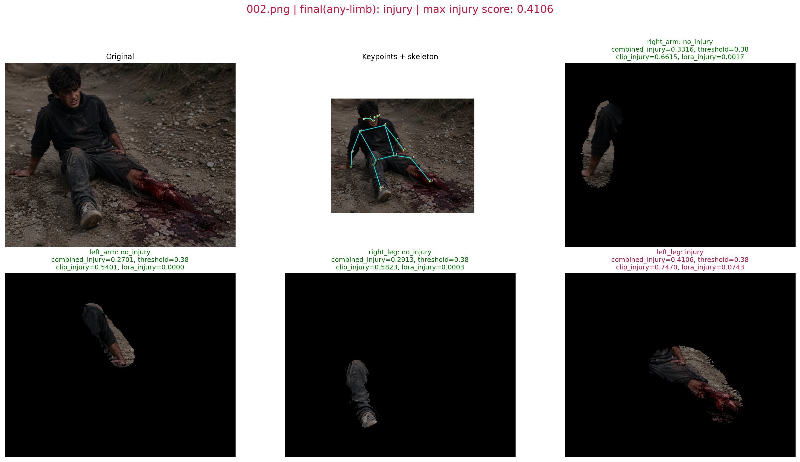
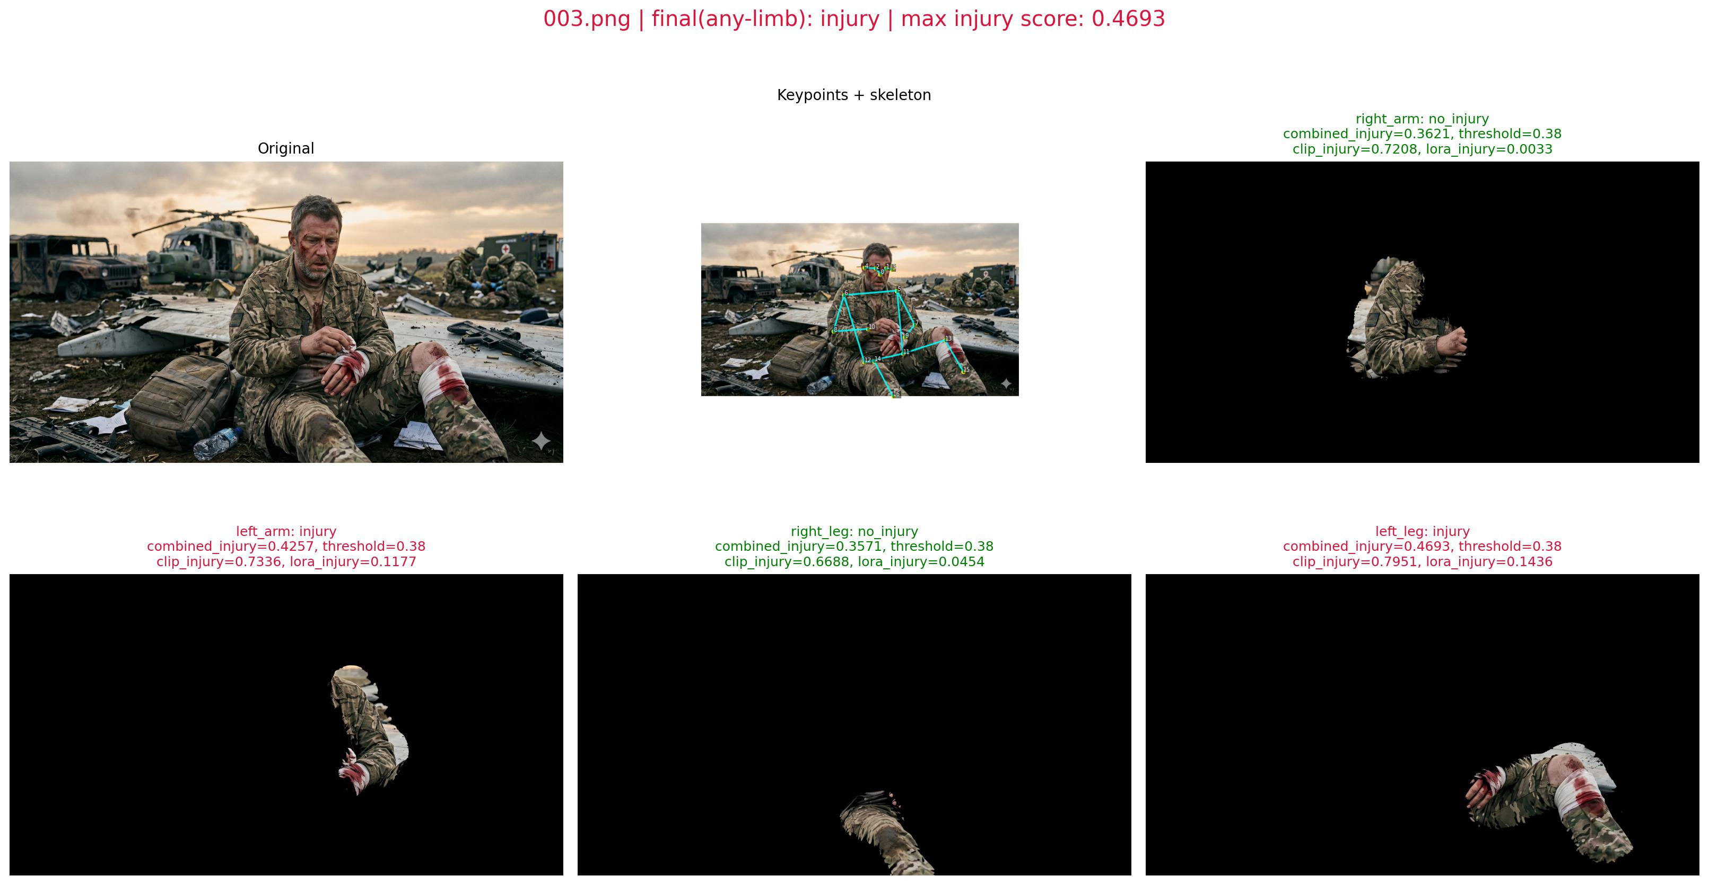
Output Samples
Final output panels and prediction screenshots
Teacher guideline match: final output/prediction screenshots and before-vs-after evidence.

Slide 12
Program Proof and Subject Relevance
Code evidence, repository, and syllabus connection
Program Proof
GitHub Submission
CV Relevance
Source files used for claimed methods: pose_gaussian_only.py, run_pose_then_clip.py, batch_testing_report.py, and CLIP-LoRA/infer_single_wound.py.
Result evidence files: summary.csv, part_probabilities.csv, metrics_summary.json, and generated plots.
Repository: https://github.com/Kush2210/CLIP-LoRA-Pose2Injury.
The repo contains source code, generated artifacts, README instructions, and evaluation outputs.
Pose estimation
Image preprocessing
Feature extraction
Segmentation-style masking
Image classification
Model-based visual inference
Teacher guideline match: compulsory program proof + project relevance to the subject.

Slide 13
Contribution of Each Member
Team roles for the end-to-end project
Kush Garg | KG-001
Sahil | SA-002
Shivansh | SH-003
Uvais | UV-004
Project integration
Batch report pipeline
GitHub maintenance
Final presentation assembly
Pose-estimation stage
Limb selection logic
YOLO-based preprocessing flow
CLIP-LoRA setup
Prompt-based inference
Checkpoint integration
Evaluation artifacts
Graphs
Documentation
Report formatting
Teacher guideline match: clear contribution mapping with names and roll numbers.

Slide 14
References
Related works and project repository
OpenPose: Realtime Multi-Person 2D Pose Estimation using Part Affinity Fields | Cao et al. | 2019
Simple Baselines for Human Pose Estimation and Tracking | Xiao et al. | 2018
Deep High-Resolution Representation Learning for Human Pose Estimation | Sun et al. | 2019
Learning Transferable Visual Models From Natural Language Supervision (CLIP) | Radford et al. | 2021
LoRA: Low-Rank Adaptation of Large Language Models | Hu et al. | 2021
CoOp: Learning to Prompt for Vision-Language Models | Zhou et al. | 2022
Tip-Adapter: Training-free CLIP-Adapter for Better Vision-Language Modeling | Zhang et al. | 2022
Project repository: https://github.com/Kush2210/CLIP-LoRA-Pose2Injury
Final slide as required by the teacher guidelines.

