Slide 1
UCF-439 Capstone Project AUTOSHIELD: A REAL-TIME MACHINE LEARNING-DRIVEN DDOS DETECTION AND MITIGATION SYSTEM
Group Details:
Group No. 71
Angela Paul SAP: 1000018001
Krishna Sharma SAP: 1000018720
Kushagra Upadhyaya SAP: 1000018770
Supervisor Details
Supervisor Name : Prof. Mohd. Shariq

Slide 2
Introduction
AutoShield is a comprehensive, real-time autonomous security platform designed to detect and mitigate Distributed
Denial of Service (DDoS) attacks without human intervention. The project specifically addresses the fundamental
inadequacy of traditional signature-based Intrusion Detection Systems (IDS), which cannot adapt to novel attack
patterns and depend on slow, manual response cycles. By shifting from reactive manual processes to an automated,
millisecond-latency defense model, the system bridges the critical gap between intelligent threat detection and active
network defense.
The system's core architecture integrates high-level network engineering with sophisticated machine learning to convert
raw packets into high-fidelity intelligence. Built on a three-layer pipeline, it leverages Apache Kafka for robust data ingestion
and PySpark Structured Streaming for immediate telemetry analysis. When the analytical "brain"—powered by models
like Random Forest—identifies a threat, it triggers an immediate "muscle" response via an automated firewall controller.
This triggers Linux iptables rules within milliseconds to neutralize attacks at the source, achieving a closed-loop defense
cycle that requires no operator involvement.

Slide 3
Background/Related Work
Background
Modern cyberattacks such as DDoS occur at multiple layers (network, protocol, and application), making them difficult to detect and mitigate.
Volumetric attacks (UDP/ICMP floods) overwhelm bandwidth, while protocol attacks (SYN floods) exhaust system resources.
Application-layer attacks (HTTP floods, Slowloris) closely mimic real user traffic, making detection more complex.
Threat intelligence data is scattered across multiple sources like IP reputation systems, CVE databases, and malware feeds.
Combining and analyzing this data manually is time-consuming and inefficient for real-time protection.

Slide 4
Related Work
Traditional tools like Snort and Suricata rely on signature-based detection and fail to detect zero-day or unknown attacks.
Machine learning approaches (e.g., Random Forest on CIC-DDoS datasets) have shown high accuracy but are mostly limited to offline analysis.
Deep learning models such as LSTM and CNN improve detection accuracy but suffer from high latency, making them less suitable for real-time systems.
Existing automated mitigation systems use SDN or firewall APIs but lack integration with real-time threat intelligence and ML models
.
There is no unified open-source system that combines threat data aggregation, real-time ML classification, and automated firewall response.

Slide 5
Feasibility Study
Technical Feasibility
The system is built using Python 3.11, which provides a strong ecosystem for data processing, machine learning, and automation.
Real-time data ingestion is handled using Kafka streaming, enabling high-throughput processing of threat intelligence data.
Machine learning is implemented using Random Forest (scikit-learn), providing high accuracy (~99.85%) with low inference time (~1 ms per record).
Data processing and storage are managed using pandas, pyarrow (Parquet), and SQLite, ensuring fast and efficient handling of large datasets.
Operational Feasibility
The system runs on standard Windows/Linux machines, requiring no specialized hardware.
Fully automated pipeline with a scheduler (daily execution at 02:00 UTC) reduces the need for manual monitoring.
Demonstrated ability to process real-time data and generate firewall rules in under 3 minutes.
Easy to maintain and extend due to modular architecture (ETL, ML, Firewall separated).
Suitable for small organizations as well as scalable for larger systems.

Slide 6
Economic Feasibility
The entire project is built using open-source technologies, resulting in zero licensing cost.
No need for expensive commercial security solutions or hardware appliances.
Can be deployed on low-cost or existing infrastructure, reducing overall investment.
Automated system reduces human effort and operational cost in long-term maintenance.
Risk Assessment
False positives (Medium): Controlled using class balancing and threshold tuning in ML model.
API rate limits (Medium): Managed using delay and retry mechanisms.
Kafka load issues (Low): Handled through scalable partitioning.
New attack evasion (Low): Reduced by periodic retraining of the ML model.

Slide 7
Project Description
Autonomous Defense: A self-contained, machine learning-driven Intrusion Prevention System (IPS) that monitors and mitigates malicious network flows without human oversight.
Modular Pipeline: Built as a three-tier, closed-loop system consisting of an Ingestion Layer (packet capture), an Analysis Layer (intelligence), and a Reaction Layer (firewall control).
High-Speed Streaming: Utilizes Apache Kafka and PySpark Structured Streaming toconvert raw network packets into high-fidelity intelligence in real-time.
Intelligent Classification: Employs optimized Random Forest and XGBoost models to distinguish malicious actors with approximately 99.85% accuracy.
Instant Mitigation: Automatically updates the Linux kernel-level firewall (iptables) within milliseconds to block offending IP addresses at the source.
Real-Time Visibility: Features a Streamlit dashboard providing live throughput analytics, threat geolocation, and "Explainable AI" heatmaps for security analysts.

Slide 8
Problem Statement
Reliance on Reactive Defenses: Traditional security tools like Snort and Suricata rely on static signatures
and manual intervention, which results in significant damage before a human administrator can respond.
Zero-Day Vulnerability: Signature-based systems are unable to detect previously unseen attack variants
or complex, multi-vector attacks that combine volumetric and protocol-layer tactics.
Throughput and Scalability Bottlenecks: Modern volumetric DDoS attacks generate millions of packets
per second, which often exceed the processing capacity of single-threaded analyzers, leading to missed detections
.
Lack of Closed-Loop Response: Existing open-source solutions typically provide discovery but not mitigation
creating a dangerous time gap between identifying an attack and blocking it.
High-Dimensional Complexity: The sheer volume and dimensionality of network telemetry make it nearly
impossible for human analysts to identify subtle anomalies in real-time without intelligent automation.

Slide 9
Proposed Solution – “Sandwich Architecture”
Six-Stage Pipeline: The system operates as a six-stage closed-loop pipeline:
Ingestion → Buffering → Processing → Intelligence → Mitigation → Visualization.
Layered Separation:
Ingestion Layer (The Senses)
Stage 1: Packet Ingestion: Utilizing the Scapy library in promiscuous mode, the system acts as a sensory organ,
sniffing every incoming packet at the Network Interface Card (NIC).
Stage 2: Buffering: Raw packet metadata (source/destination IPs, protocols, and payload lengths) is serialized
into JSON and published to Apache Kafka. This acts as a critical "shock absorber," allowing the system to ingest
millions of events per second without data loss during massive volumetric spikes.

Slide 10
Analysis Layer (The Brain)
Stage 3: Processing & Feature Extraction: PySpark Structured Streaming consumes the Kafka feed in 5-second
micro-batches. It aggregates individual packets into "network flows" based on a 5-tuple key (Source/Destination IP,
Ports, and Protocol) while calculating over 20 behavioral metrics like packet rate and protocol entropy.
Stage 4: Intelligence & Classification: The system’s "analytical brain" applies an optimized Random Forest model
to the extracted flow features. To maintain ultra-low latency, the model is distributed across Spark worker
nodes using broadcast variables, achieving 99.85% accuracy with near-zero inference time

Slide 11
Reaction & Visualization Layer (The Muscle)
Stage 5: Autonomous Mitigation: When a flow is classified as malicious, a Python controller immediately triggers the
"muscle" response. It injects a "DROP" rule into the Linux iptables at the kernel level, silently terminating all
further connections from the offending IP address within milliseconds.
Stage 6: Visualization & Auditing: The final stage provides operational visibility through a Streamlit dashboard.
Security analysts can monitor live throughput, view the geolocation of blocked threats, and access persistent
audit logs for forensic analysis and compliance.

Slide 12
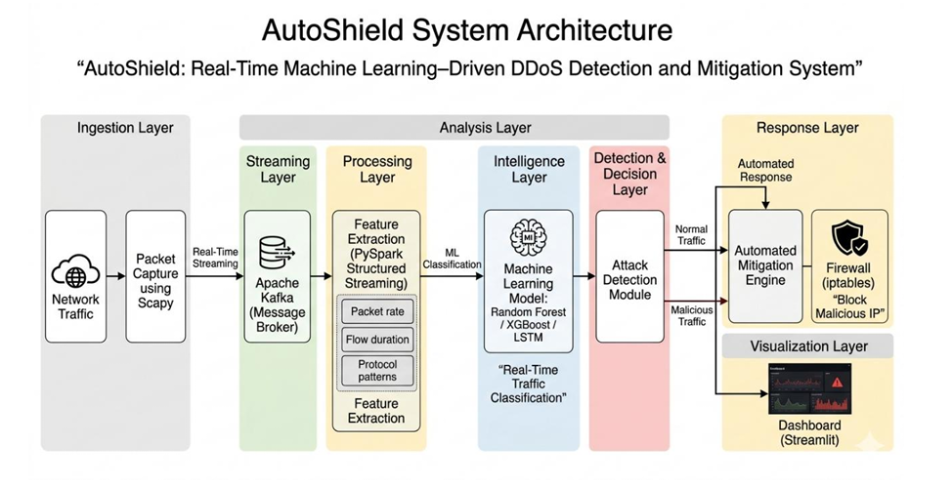
Architecture

Slide 13
Machine Learning Model Performance
High Accuracy: Achieved a peak classification accuracy of 99.85% on the CICIDS2017 benchmark dataset.
Precision Focus: Maintains a precision score of 0.99 to minimize false positives and prevent blocking legitimate users.
Optimized Features: Used Recursive Feature Elimination (RFE) to prune 80+ features down to the 30 most
predictive variables
Ultra-Low Latency: Delivers near-instant inference with a latency of approximately 1ms per flow
Balanced Training: Applied SMOTE oversampling to correct class imbalances and identify rare attack patterns.
Outlier Resistance: Utilized RobustScaler (median/IQR) for normalization to ensure stability during varying
traffic conditions.
Algorithm Benchmarking: Outperformed secondary models like XGBoost (99.11%) and sequential LSTM (~94.6%)
in overall precision.

Slide 14
Security Audit & Evaluation
Framework Compliance: System operational protocols are aligned with the NIST Cybersecurity Framework (CSF)
to ensure robust access control and incident logging.
Automated Audit Logging: Every autonomous mitigation action—including the blocked IP, timestamp, and flow features
is recorded in a persistent, patient inspection log.
Benchmark Validation: The system was rigorously evaluated using the industry-standard CICIDS2017 and CIC-DDoS2023
datasets to confirm high-fidelity threat detection.
Closed-Loop Performance: Stress testing confirms the architecture satisfies core requirements for autonomous intrusion
prevention by achieving a detection-to-block latency of under 100 milliseconds

Slide 15
Project Timeline
Phase / Period | Tasks
Phase 1 (Feb) | Requirement Analysis - Defined the project scope for autonomous DDoS mitigation and identified hardware/software needs for network sniffing.
Phase 2 (Feb-Mar) | Environment Setup - Configured Ubuntu 22.04 LTS, Docker containers for Kafka, and initial Python scripts for packet capture using Scapy.
Phase 3 (Mar) | Pipeline Development - Implemented the Kafka producer for real-time traffic ingestion and the PySpark consumer for windowed flow feature extraction.
Phase 4 (Mar) | Model Training & Optimization - Developed Random Forest and XGBoost models using the CICIDS2017 dataset; applied RFE for feature reduction.
Phase 5 (Mar-Apr) | Integration & Mitigation - Connected the ML classifier to the reaction layer to execute automated iptables "DROP" rules at the kernel level.
Phase 6 (Apr) | Visualization & Dashboard - Developed a real-time Streamlit dashboard featuring live throughput analytics, geolocation, and audit logging.
Phase 7 (Apr) | Testing & Deployment - Performed stress testing using attack simulation tools to validate the sub-100ms detection-to-block latency.

Slide 16
Conclusion & Future Scope
Autonomous Defense Success: AutoShield effectively bridges the gap between threat detection and active network
defense by achieving an automated detection-to-block latency of under 100 milliseconds.
High-Performance Intelligence: The system demonstrates precision security through 99.85% classification accuracy,
utilizing optimized Random Forest models and real-time Spark streaming.
Encrypted Traffic Research: Future scope includes extending detection capabilities to HTTPS-based attacks by analyzing
TLS flow statistics without requiring packet decryption.
Federated Intelligence: Plans are in place to implement federated learning across multiple nodes to enable collective
threat intelligence while maintaining data privacy.
IoT & Edge Adaptation: Future development aims to adapt the framework for 5G slices and IoT edge nodes using specific
datasets like CIC-DDoS2023 for specialized training.

Slide 17
Work Completed
Real-Time Packet Ingestion: Developed a sensory layer using Scapy to capture live network traffic in promiscuous mode
and stream it into Apache Kafka.
High-Throughput Streaming Pipeline: Configured a Kafka-based buffering system that acts as a shock absorber to
prevent data loss during massive volumetric DDoS spikes.
Automated Feature Extraction: Implemented PySpark Structured Streaming to aggregate raw packets into 5-tuple
flows and calculate over 20 behavioral metrics, such as protocol entropy and flow duration.
Machine Learning Intelligence: Trained and optimized a Random Forest model on the CICIDS2017 dataset, achieving
a classification accuracy of 99.85%.
Feature Optimization (RFE): Utilized Recursive Feature Elimination to reduce the feature set from 80+ variables to the
30 most predictive variables to minimize inference latency.
Autonomous Mitigation Engine: Built a Python-driven controller that automatically injects iptables rules at the Linux
kernel level to block malicious IPs within milliseconds.
SOC Monitoring Dashboard: Developed a real-time Streamlit dashboard that provides live throughput analytics, geolocation
of blocked threats, and persistent audit logging.
System Evaluation & Testing: Successfully validated the system's performance, achieving a total detection-to-block latency
of under 100 milliseconds

Slide 18
Thank You

