Slide 1
Balancer

Slide 2
What is the Balancer Protocol?
Balancer is a protocol for multi-token automated market-making.
It enables portfolio owners to create Balancer Pools, and traders to trade against them.
Balancer Pools contain two or more tokens, each with an independent weight representing its proportion of the total pool value.
The pools provide the Balancer Protocol with liquidity, and charge traders a fee for access to it.
Pools can be considered automated market-makers, since anyone can swap any two tokens, in any pool.

Slide 3
How is the Balancer Protocol useful?
There are two categories of users who can benefit from the Balancer Protocol: liquidity providers - who own Balancer Pools or participate in shared pools, and traders - who buy or sell the underlying pool assets on the open market
Anyone with two or more ERC20 tokens can be a liquidity provider.
Traders can choose from a diverse set of pools, each presenting a unique set of investment opportunities and challenges through its particular configuration of tokens, weights, and fees.
There are three main categories of traders:
1."Retail" traders seeking to exchange tokens with low slippage at favorable rates
2.Arbitrageurs seeking profit through leveling market inefficiencies between DEXs or CEXs
3.Ethereum smart contracts seeking liquidity for a variety of reasons, such as liquidating positions on other protocols, trading on behalf of users, etc.

Slide 4
Is Balancer Protocol fully permissionless?
Yes. Balancer Pools cannot be censored or whitelisted.
Traders cannot be censored or whitelisted.
Balancer Labs does not have the power to halt or edit the smart contracts in any way after they’ve been deployed.
The contracts are not upgradeable, and there is no admin functionality or "backdoor" present in the code.
Of course, Balancer has no control over the contracts of ERC20 tokens placed in Balancer pools.
If a centralized token (e.g., USDC) were to blacklist an address or freeze all transfers, that would affect all USDC tokens everywhere, including those in Balancer Pools.

Slide 5
What is a Balancer Pool?
The fundamental building block of the Balancer Protocol is the Balancer Pool. Pools are smart contracts that implement the Balancer Protocol, and hold value in two or more ERC20 tokens.
You can think of a Balancer Pool as an automated, market-making portfolio. Each token asset has an independent weight, and can be traded against any other token in the pool.
For example, you could have a pool with three tokens in the following proportions 50% WETH, 25% MKR and 25% DAI.
The value proposition of Balancer flows from two main features:
1.Even as the relative unit prices of the tokens vary, the pool as a whole is continuously rebalanced (in an efficient market) to maintain each token's proportion of the total value.
2.Each trade that takes place in a Balancer Pool generates a fee for the pool owner. The fee is a percentage of the trading volume, and is customizable by the pool owner when the pool is created.

Slide 6
Are there constraints for setting up a Balancer Pool?
Only a few. Balancer Protocol limits pools in the following ways:
Number of tokens: pools must contain at least two, and may contain up to eight tokens on V1 (16 on V2 Weighted pools).
Swap fee: the fee must be between 0.0001% and 10%
ERC20 compliance: pool tokens must be ERC20 compliant. Bronze does not support ERC20 tokens that do not return bools for transfer and transferFrom. V2 is a bit more flexible, but will not support some token types, such as tokens that change balances (e.g., elastic supply tokens).
There are a few additional ratio and balance constraints that can be found at Limitations.

Slide 7
Types of Balancer pools are there?
Balancer have 2 types of pools. V1 Core Balancer Pools can be controlled or finalized.
Public - finalized pools are public pools. their parameters are fixed, and anyone can add/remove liquidity and swap tokens.
Private - Controlled pools are private - their parameters are not fixed, but only the pool creator can add liquidity.
There are also various kinds of Smart Pools - Core Balancer Pools controlled by a smart contract. Balancer is designed to be easily extensible. Some Smart Pool concepts have already been implemented, and many more are in development.

Slide 8
Smart Pools?
Smart pools combine the best of both shared and private core pools by allowing the pool’s parameters to remain flexible while also letting any Balancer user participate as a liquidity provider.
In other words, conditional investing strategies can be encoded into a Balancer smart pool.
This means the factors of when, where, and what assets to allocate can be dynamically controlled.
As a result, the introduction of smart pools on Balancer opens up a whole new realm of possibilities for crypto lending and for managing digital assets on the Ethereum network.

Slide 9
Smart Pool Parameters -
There are six variables that determine a smart pool’s staking strategy. When setting up a new smart pool, these variables can be left open to allow for future readjustments or permanently sealed to prevent future changes.
Swap Fees: The swap fee is the fee paid by traders to liquidity providers whenever a token exchange occurs.
Pool Weights: A Balancer pool’s weights are the ratio of assets in a pool. Leaving this parameter open means a smart pool can change its token composition from 80% ETH and 20% BTC to 20% ETH and 80% BTC.
Liquidity Provider Restrictions/Pre-approved Lists: A restrictive list controls who is allowed to become a liquidity provider for a smart pool.
Allowable Tokens: Changing tokens allows different ERC-20 tokens to be added or removed to an existing smart pool.
Limit Total Balancer Pool Token (BPT) Supply: Limiting the total BPT supply controls how big a smart pool can become by restricting the total value of a smart pool.
Swapping Pauses: The pool has the ability to stop trading using the “pause swapping” feature.

Slide 10
Smart Pool applications -
Surge Pricing - If a smart pool’s swap fee variable is left open and managed by a smart contract, surge pricing becomes an option for a liquidity pool. Through the ability to change trading fees depending on demand, liquidity providers can maximize income by raising fees during times of increased trading activity. By dynamically adjusting fees depending on demand, a smart pool can attract more liquidity providers who are enticed by the possibility of earning more fees.
Liquidity Bootstrapping Pools - Balancer’s smart pools are enabling a novel way to distribute a new token that avoids the issues once inherent to token launches. Through a Balancer smart pool, projects are able to “bootstrap” a token by gradually introducing the asset into a Balancer pool. Issuing teams are able to incrementally adjust the pool’s token ratio over time to create liquidity and value at a more steady pace. This allows teams to strategically distribute project tokens in a way that is less volatile.
Smart Treasuries - The final Balancer use case we will examine is smart treasuries, which can be used to automate the management of an organization’s funds. By controlling who can be a liquidity provider for a given smart pool, organizations can control who can withdraw or deposit capital. If only official team members are allowed to move assets in and out of a smart pool, the team can take money out when they need to spend it or add money to the pool when there is an excess.

Slide 11

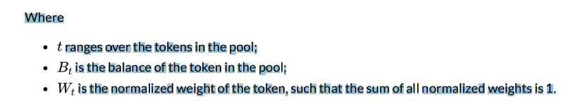
Math -
Value Function - The bedrock of Balancer’s exchange functions is a surface defined by constraining a value function V, a function of the pool’s weights and balances to a constant. t. We will prove that this surface implies a spot price at each point such that, no matter what exchanges are carried out, the share of value of each token in the pool remains constant.
The value function V is defined as:

Slide 12
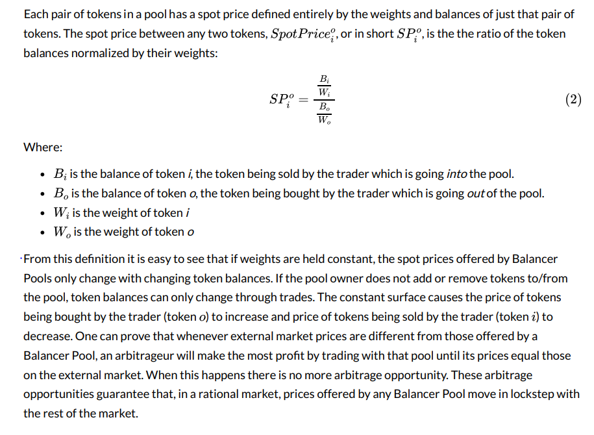
Spot Price -

Slide 13
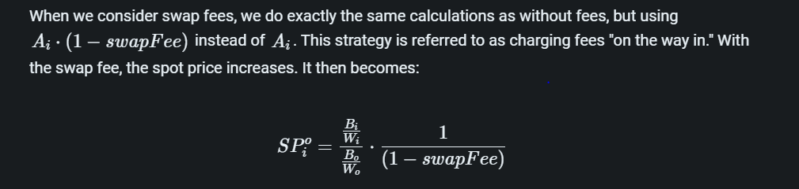
Spot Price -

Slide 14
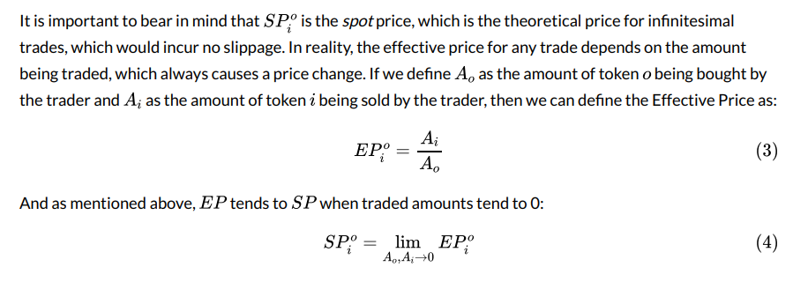
Effective Price -

Slide 15
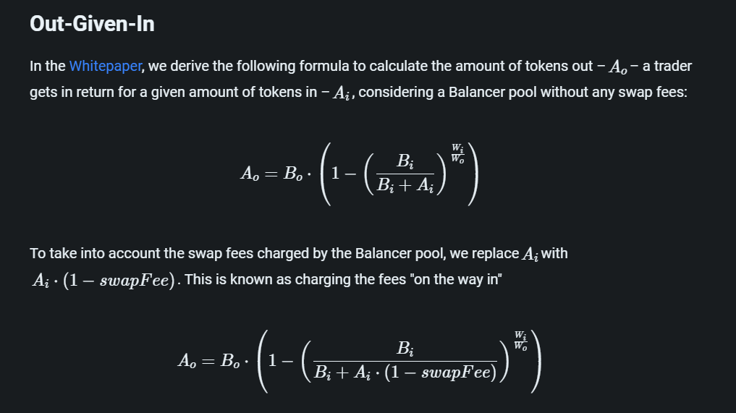

Slide 16
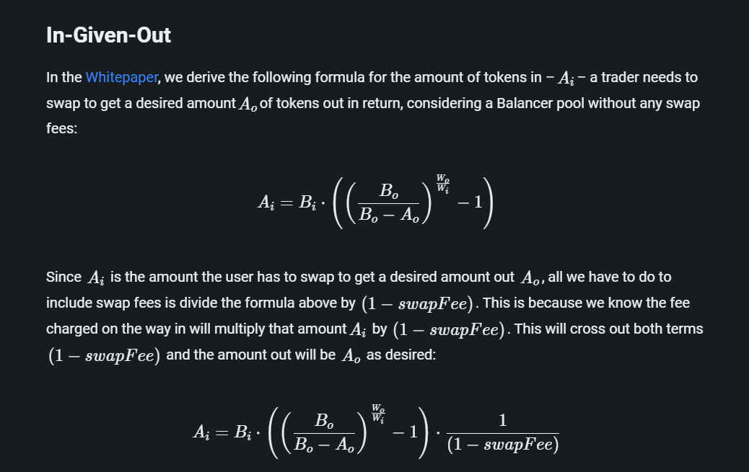

Slide 17
Smart Order Router -
Smart Order Router, or SOR, is an off-chain linear optimization of routing orders across pools for best price execution.
It takes as input a desired amount of any token to be traded for another token, and returns a list of pools/amounts that should be traded such that the amount of returned tokens is maximized.
The sum of the amounts to be traded with each pool equals the desired amount given as input.
How it works –
The fundamental optimization problem is to find the path through a set of Balancer Pools with the highest net yield after gas costs. The algorithm continues to add pools to the trading set, until there are no pools left where the net gain from trading with the pool would exceed the gas cost.

Slide 18
V1 limitations-
pool tokens have to be ERC20 compliant.
Bronze does not support ERC20 tokens that do not return bools for transfer and transferFrom
There are no upgrade mechanisms in the contracts to allow for token upgrades
Tokens that have internal transfer fees or other non-standard balance updates may create arbitrage opportunities.

Slide 19
V2 balancer-
The core tenets of Balancer V2 are security, flexibility, capital efficiency and gas efficiency. These highlights include:
Protocol Vault for all Balancer pool assets
Improved gas efficiency
Permissionless, customizable AMM logic
Capital efficiency through Asset Managers
Low gas cost and resilient oracles
Community-governed protocol fees

Slide 20
Vault -
The main architectural change between Balancer V1 and Balancer V2 is the transition to a single vault that holds and manages all the assets added by all Balancer pools.
Balancer V2 separates the Automated Market Maker (AMM) logic from the token management and accounting. Token management/accounting is done by the vault while the AMM logic is individual to each pool.
Because pools are contracts external to the vault, they can implement any arbitrary, customized AMM logic.

Slide 21
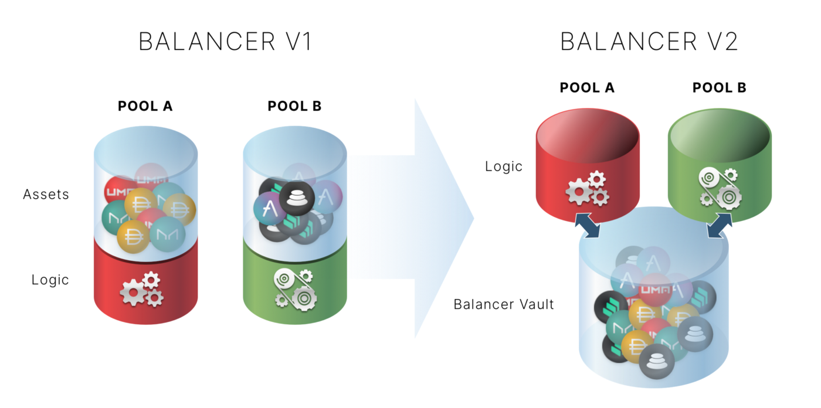
Vault -

Slide 22
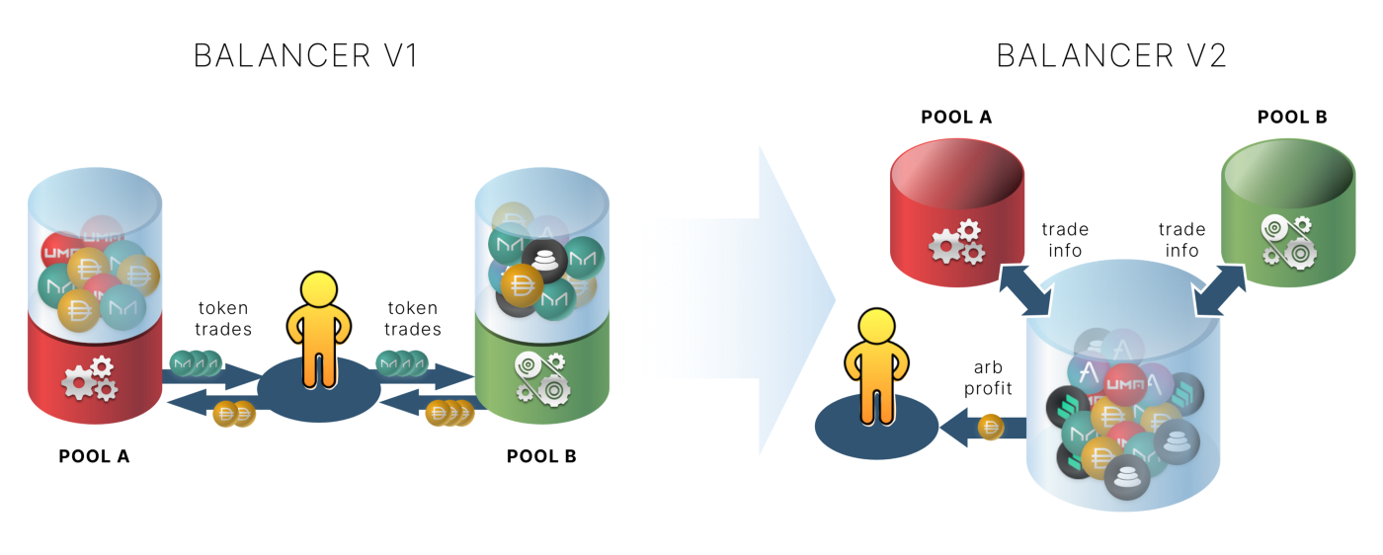
Gas efficiency -
In Balancer V1 — and all AMMs we are aware of — trading with two or more pools is gas inefficient because users have to send and receive ERC20 tokens from all pools.
With Balancer's new Protocol Vault, even though trades are carried out in batches against multiple pools, only the final net token amounts are transferred from and to the vault, saving a significant amount of gas in the process.

Slide 23
Balancer V2 allows users to hold internal token balances. This is extremely useful for high-frequency trader efficiency.
For example, if you trade token A for token B but know that you will trade back B for A in a few hours, then you probably don’t need to take delivery of B after the first trade. Balancer can keep both tokens in the vault which may be used for the next trades, avoiding any ERC20 transactions altogether.
Customizable AMM Logic.
Balancer V2 pioneers customizable AMM logic by creating a launchpad for teams to innovate with different AMM strategies without having to worry about low-level token transfers, balance accounting, security checks and smart order routing.

Slide 24
Swaps –
Batch Swaps
You'll want to use Batch Swaps when you're making a trade that hops through multiple pools. These are useful for swapping between two tokens that aren't in the same pool, and for routes with better prices than naive single swaps.
Flash Swaps
There is a specific case of Batch Swap called a Flash Swap that enables trades with no input tokens. These are useful for doing arbitrage among Balancer pools. To make a Flash Swap, create a Batch Swap with all your token limits set to zero.
Single Swaps
You'll want to use Single Swaps when you're making a trade between two tokens in one pool. While it's possible to do this with a one-step Batch Swap, using a Single Swap will save ~6,000 gas

Slide 25
Thankyou !!

