Slide 1
HEGIC

Slide 2
What is Hegic?
Hegic is a non-custodial on-chain options protocol built on Ethereum.
The protocol is powered by liquidity pools and hedge contracts that support call and put options on ETH and WBTC.
All options on Hegic are collateralized by liquidity providers that act as option sellers when contributing to the protocol’s liquidity pools.
These options can be exercised anytime prior to their expiration date .

Slide 3
What are Options?
An option is a contract giving the buyer the right, but not the obligation, to buy (in the case of a call option contract) or sell (in the case of a put option contract) the underlying asset at a specific price on or before a certain date.
Options are known as derivatives because they derive their value from an underlying asset.

Slide 4
What is a Strike Price?
A strike price is the set price at which an option contract can be bought (call option) or sold (put option) when it is exercised.
For call options, the strike price is where the asset can be bought by the option holder; for put options, the strike price is the price at which the asset can be sold.

Slide 5
What is an Expiration Date?
An expiration date in options is the last day that options contracts are valid.
On or before this day, options contracts holders will have already decided what to do with their expiring position.
efore an option expires, its owners can choose to exercise the option, close the position to realize their profit or loss, or let the contract expire worthless.

Slide 6
What is an Option Premium?
An option premium is the price of an option contract.
It is thus the income received by the seller (writer) of an option contract.
As the price of the underlying asset changes, the option premium changes.
As the underlying asset's price increases, the premium of a call option increases, but the premium of a put option decreases.
As the underlying asset's price decreases, the premium of a put option increases, and the opposite is true for call options.

Slide 7
What is a Call Option?
A call option is option contract giving the owner the right, but not the obligation, to buy a specified amount of an underlying asset at a specified price within a certain time. The pre-determined price the call option buyer can buy at is called the strike price.
Potential Profit: Unlimited as the level of the underlying asset increases
Potential Loss: Limited to premium paid for a call option contract

Slide 8
What is a Put Option?
A put is an option contract giving the owner the right, but not the obligation, to sell a specified amount of an underlying asset at a specified price within a certain time. The pre-determined price the put option buyer can sell at is called the strike price.
Potential Profit: Substantial and increases as the level of the underlying asset decreases to zero
Potential Loss: Limited to premium paid for a put option contract

Slide 9
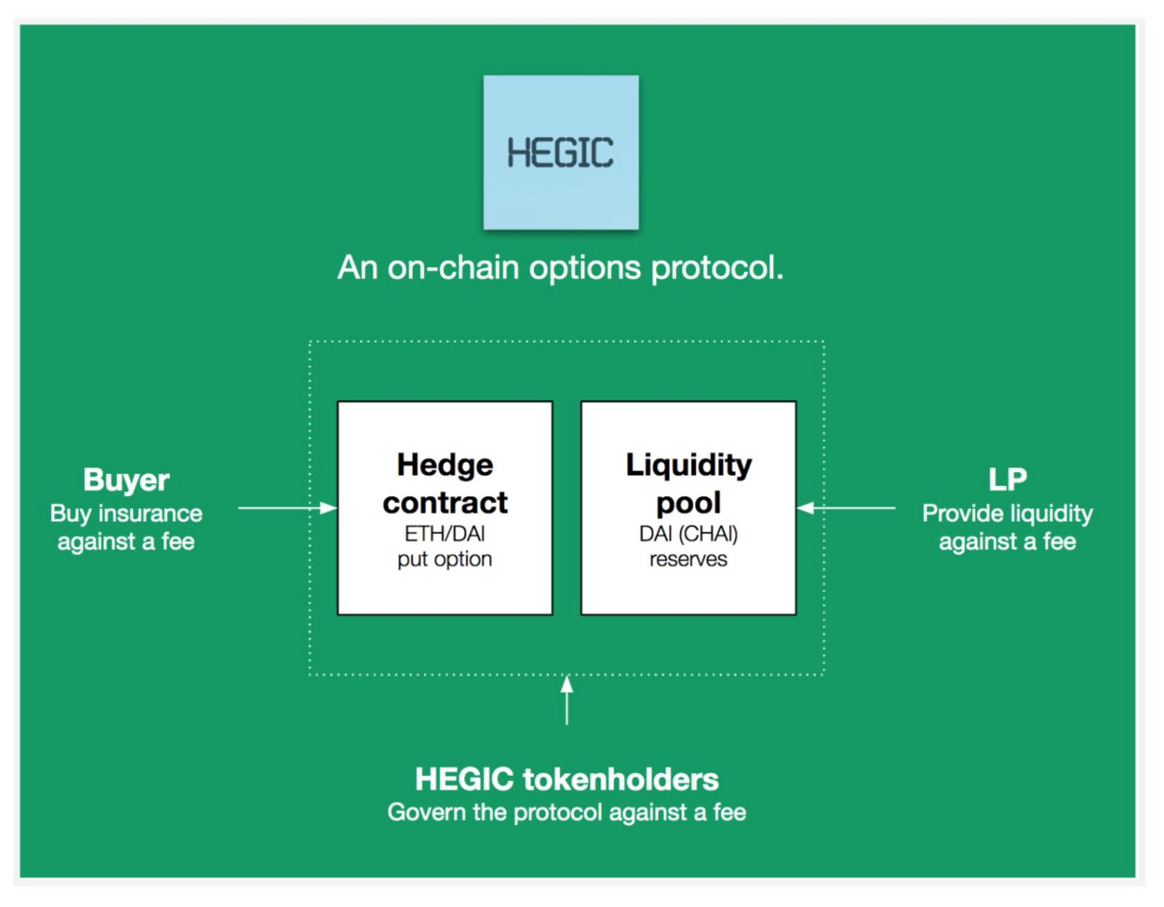

Slide 10
What is a Hegic Token?
A utility and governance token for the protocol.
It is used for
Fees to token holders
Discounts
Governance

Slide 11
Working?
Writer-
A writer provides liquidity to the protocol. Withdrawal of liquidity is processed in a queue. If the writer holds HEGIC in their wallet the request is processed instantly.
Call option-
Option to buy an asset during a certain timeframe (maturity).
and at a certain price (strike price).

Slide 12
Abbreviations ?
ATM – at the money

Slide 13
