Slide 1

Green-World
Theme: Sustainable development
HackNITP 3.0

Slide 2
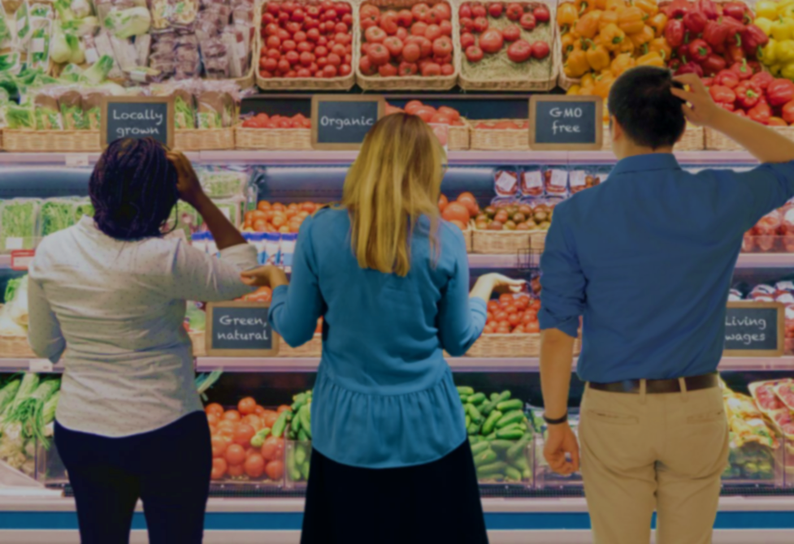
Do you think before purchasing a product?
Are you Consumer ?
Is it necessary?
In 2001, Steen Gade, the Director General of the Danish Environmental Protection Agency (EPA) asked, “I know that perfumed socks are now a possibility. The question is, are they a necessity?”

Slide 3
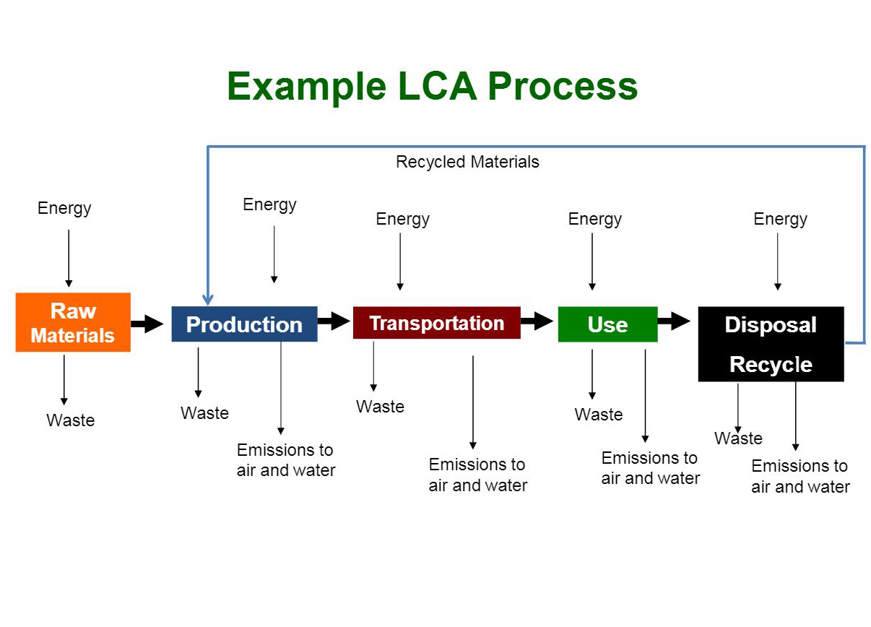
Why Sustainable products ?
Sustainable products minimize environmental and social costs throughout the product lifecycle and aim to maximize environmental and social benefits to communities, while remaining economically viable.

Slide 4
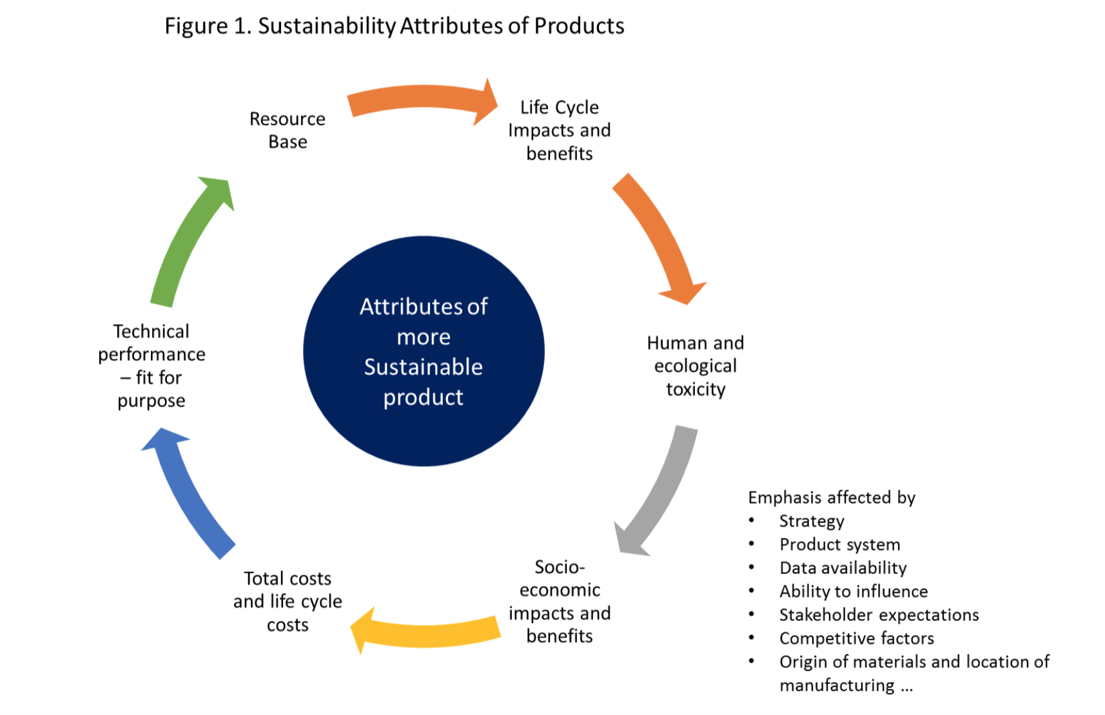

Slide 5
Motivation
We have tried to create this environmentally friendly e-commerce platform , because we believe organic and sustainable products are well suited to reduce personal and societal environmental impact by making positive changes which counteract climate change and other negative environmental concerns.
Our green business portal is an outreach to anyone who wants to do good in the world and make a social and environmental impact while being profitable.
aims to achieve an environmental equilibrium. This is sometimes called “net zero living” or striking a “zero energy balance” with the Earth.
In other words, return to the earth whatever you take from it.

Slide 6
Objectives
Products
Implementing sustainable business practices
Demonstrating social responsibility
Reducing expenses (packaging, transportation, energy/water usage, etc.)
Demonstrating how safe and mindful products or services are
WE will offer customers organic and locally grown produce, chemical- and preservative-free groceries, cruelty-free body care and eco-household products. The products are:
Free of artificial preservatives.
Free of artificial colors.
Free of chemical additives.
Organically grown, whenever possible.
The least processed or unadulterated version available.
Non-irradiated.
Cruelty free.

Slide 7
Market analysis
a natural and organic store ONLINE (with availability of Locally produced segments) would be competitive and offer customers a product selection that will assure repeat business.
The demand for green products has doubled when compared to the last ten years. People have become more concerned about the environment. The changing climatic condition is not just a talk but has become an international concern. This awareness is greatly affecting consumers’ purchasing decision. Even marketers are taking measures to minimize the production of harmful wastes.
All these reasons make the green product an important part of the business.

Slide 8
Target Audience
Families: Many of the young families moving into the Urban area are Deprived of the organic and raw products. As 24*7 service with good local networking These families are a strong customer base for US.
Students: A significant number of students prefer to shop at a natural food store as to maintain a healthy lifestyle. Our service will make US a convenient place to shop on the ‘’FINGER TIPS’’.
Senior citizens: “Older people are at high risk of nutritional deficiencies,”. Older people often have more access to money and time. Elderly customers are a prime target for food and supplement marketing.
“Even if the diet is reasonably healthy and sufficient in calories, the effectiveness of the digestive tract declines with age and [people] are no longer able to absorb optimum levels of nutrients. Too little fiber in the diet is also a common concern.”

Slide 9
Challenges Green Products Face
Costly Products: Green products require innovation and a lot of investment. This increases the cost of developing the products, which results in making them a bit costly than the available alternatives in the market. The cost factor usually discourages the consumers in buying them.
Ignorance: The common masses are still ignorant about the importance and benefits of going green.
Investment: Green products requires the development of new technologies. This requires a large investment in research and development (R&D). Not every company or startup can afford to spend this amount.

Slide 10
by TEAM: Earthlings
Thanks
Sushant Kumar Rai
Kush Gope
Vikrant Kumar
Shivam prakash

