Slide 1


ABinBEV Case Study Submission
Hyperautomation Solution for Payment Dues Management
Kushagra Gupta
MIT Manipal
20 January 2025

Slide 2

Agenda
03
Problem Statement
04
Objective
05
Proposed Solution
06
Solution Workflow
07
Technical Details
08
Flow Diagram
09-11
Code(Solution)
12-13
Code(Dashboard)
14
Impact Of The Solution
15
Conclusion
Page 2

Slide 3
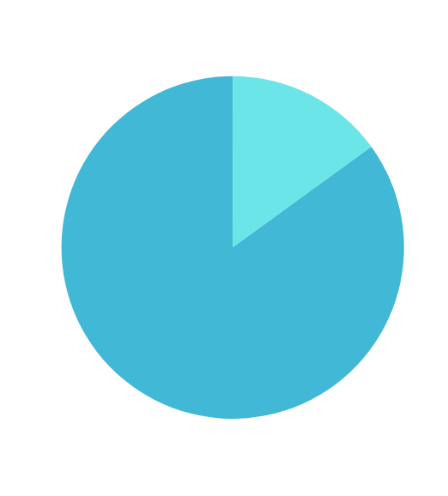

Problem Statement
Statement Analysis
Understanding The Problem
According to the problem statement, The semiconductor company faces significant losses due to payment delays, caused by the customer not being informed about the due dates.
The given information suggests a loss of $400 Million annually, with 85-90% being due to customers being uninformed of the payment dates.
The Current State of the Legacy ERP lacks the capability to send reminders, and sales teams follow up manually with the customers, but replacing the ERP has to be avoided due to large costs and the time intensive nature of the task
Page 3

Slide 4

Objective
What I Aim to Achieve
Create an Automated, Scalable, and Cost Efficient system to ensure timely payments.
Eliminate the need for manual follow-ups by employees, using technology to automate this process.
Deliver a contained solution that would provide improvements in revenue recovery.
Additionally, I also aim to make it intuitive enough for use by the employees without being too much of a hassle.
Page 4

Slide 5
Proposed Solution
Proposal
Automated Payment Reminders
A Python-based automation system, using:
Flask API for scheduling and notifications
Streamlit Dashboard for tracking
SMTP email reminders triggered at various dates to ensure clear communication.
Also used Mockaroo to create a mock database json file
Technologies Used: Python, Flask, Streamlit, Pandas, APscheduler and SMTP
Page 5

Slide 6



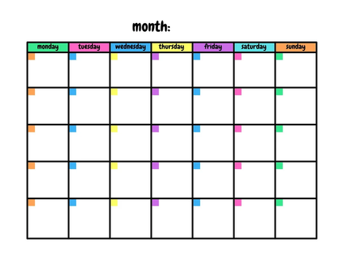

Solution Workflow
Extract Payment Data from ERP as a JSON file
Analyse due dates and filter the customers to be reminded
Automatically send personalized email reminders
Additionally, An interactive dashboard has been provided for tracking
JSON extraction is possible on almost all database systems, so the legacy ERP should be capable of this task, using APIs like requests or pandas, or even erp export tools that may be present in the legacy system.
This solution will filter according to the days till payment is due, 1 or 3 or 7 days till payment has to be made, which is also customisable.
Customers will get an email on their associated email address automatically, with days left to make payment and the amount, which eliminates the major issue faced by the company
this is for usage by the sales employees to track which payments are pending, allowing manual communication in case of overdue payments
Page 6

Slide 7





Technical Details
Solution
Implementation Highlights
Pandas
APScheduler
We use pandas to convert the json file to a dataframe, making it possible to interact with the data entered and convert it into the required format, along with filtering and analysing the dates.
ApScheduler is used to automate the job process, making it repeat at a fixed interval to make sure that reminders are sent on time and no customer is missed during communication.
Considering that the ERP system in use was not revealed, this solution uses a json file, that can be extracted from most erp systems easily. This process can also be automated, making the entire solution easy to implement.
Flask API
Flask enables data modifications, such as retrieving, adding, updating and deleting data, completely contained in a single python script. Here, we use flask to handle JSON interaction, and it can also be used to handle database integration. It acts as the backbone of our code, providing the framework to create and manage our web app, and also provides expansion capabilitees.
SMTP
StreamLit
Handles email automation; I used a dummy gmail account created specifically for this task using gmails smtp server. We can also customise the messages that we send to the customer
Provides a simple dashboard that can be used to monitor the payment dates and amounts, with filters for days till payment, id and name. Also shows all this data in tabular form.
Page 7
*This is a github repo with the entire code and test data, it has been added to every page of the solution.

Slide 8

Flow Diagram
Solution
Input
Flask (Backend)
ERP System
Hosts APIs and the backend logic
Pandas
SMTP
Extract,Process,
Filter and Analyse
Send emails using a mail account
APScheduler
Streamlit Dashboard
Automate job execution and schedule reminder
Track and search with filter options
Page 8

Slide 9
Page 09
Code(Solution)
All codes have been uploaded to a github repo for easier evaluation. The link has been added to the github logo at the bottom.
from flask import Flask, request
import pandas as pd
import datetime
import smtplib
from email.mime.text import MIMEText
from email.mime.multipart import MIMEMultipart
from apscheduler.schedulers.background import BackgroundScheduler
app = Flask(__name__)
scheduler = BackgroundScheduler()
def get_erp_data():
"""Function to get data from ERP System"""
try:
file_path = 'MockERPTestData.json'
with open(file_path, 'r') as file:
data = pd.read_json(file)
return data
except Exception as e:
print(f"Error reading ERP data: {e}")
return None
def check_due_dates(data):
"""Function to check payment due dates and filter reminders"""
try:
data['due_date'] = pd.to_datetime(data['due_date'], format='%m/%d/%Y')
today = pd.Timestamp(datetime.date.today())
data['days_until_payment'] = (data['due_date'] - today).dt.days
reminders = data[data['days_until_payment'].isin([1, 3, 7])]
return reminders
except Exception as e:
print(f"Error processing due dates: {e}")
return None
def send_reminders(data):
"""Function to send reminders via email"""
try:
smtp_server = "smtp.gmail.com"
smtp_port = 465
sender_email = "sample.erp123@gmail.com"
sender_password = "hloj drqo soxs oile"
server = smtplib.SMTP_SSL(smtp_server, smtp_port)
server.login(sender_email, sender_password)

Slide 10
Page 10
Code(Solution)
email_templates = {
1: "Dear {first_name} {last_name},\n\nYour payment of ${amount} is due tomorrow ({due_date}). Please ensure payment is made promptly.\n\nThank you.",
3: "Dear {first_name} {last_name},\n\nYour payment of ${amount} is due in 3 days ({due_date}). Please make arrangements to pay before the due date.\n\nThank you.",
7: "Dear {first_name} {last_name},\n\nYour payment of ${amount} is due in a week ({due_date}). Kindly make the payment soon.\n\nThank you."
}
for _, row in data.iterrows():
recipient_email = row['email']
category = row['days_until_payment']
body = email_templates.get(category, "").format(
first_name=row['first_name'],
last_name=row['last_name'],
amount=row['due_amount'],
due_date=row['due_date'].strftime('%m/%d/%Y')
)
server.sendmail(sender_email, recipient_email, message.as_string())
server.quit()
print("Reminders sent successfully!")
except Exception as e:
print(f"Error sending reminders: {e}")
def job():
print("Fetching ERP data...")
data = get_erp_data()
if data is None or data.empty:
print("No data available to process.")
return
message = MIMEMultipart()
message['From'] = sender_email
message['To'] = recipient_email
message['Subject'] = f"Payment Reminder - {category} day(s) left"
message.attach(MIMEText(body, 'plain'))

Slide 11
Page 11
Code(Solution)
print("Sending reminders...")
send_reminders(reminders)
if __name__ == '__main__':
job()
scheduler.add_job(job, 'interval', days=1, start_date=datetime.datetime.now())
scheduler.start()
try:
app.run('0.0.0.0', port=9000, debug=False)
except (KeyboardInterrupt, SystemExit):
scheduler.shutdown()
All these codes have been uploaded to a github repo for easier evaluation.
https://github.com/KushOfAgra/ABinBevCaseStudy/tree/main

Slide 12
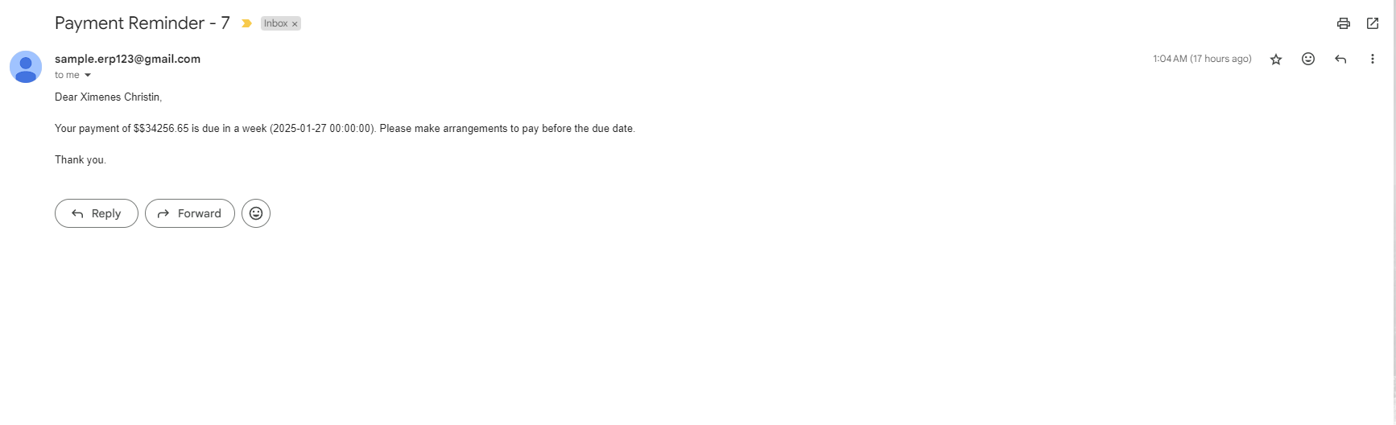
Screenshots Of Functionality
Functionality
Email

Slide 13
Page 12
All codes have been uploaded to a github repo for easier evaluation.The link has been added to the github logo at the bottom.
Code(Dashboard)
import streamlit as st
import pandas as pd
from datetime import datetime, timedelta
# Load data from the JSON file
def load_data():
file_path = 'MockERPTestData.json' # Path to the uploaded JSON file
data = pd.read_json(file_path)
data['due_date'] = pd.to_datetime(data['due_date'], format='%m/%d/%Y')
data['due_amount'] = data['due_amount'].astype(str).str.replace('$', '').astype(float)
data['days_until_due'] = (data['due_date'] - datetime.now()).dt.days
return data
def filter_data(data, days_filter):
return data[data['days_until_due'] <= days_filter]
def filter_exact_days(data, days_filter):
return data[data['days_until_due'] == days_filter]
def search_by_id(data, search_id):
return data[data['id'] == search_id]
def search_by_name(data, search_name):
return data[data['first_name'].str.contains(search_name, case=False, na=False) | data['last_name'].str.contains(search_name, case=False, na=False)]

Slide 14
Page 13
All codes have been uploaded to a github repo for easier evaluation.The link has been added to the github logo at the bottom.
Code(Dashboard)
# Streamlit app
st.title("Payment Reminder Dashboard")
# Load the data
data = load_data()
# Sidebar filters
st.sidebar.header("Filter Options")
selected_days = st.sidebar.number_input(
"Enter the number of days left",
min_value=0,
value=7,
step=1
)
# Checkbox for showing exact reminders
show_exact_reminders = st.sidebar.checkbox("Show specific Reminder for these days")
# Search options
st.sidebar.header("Search Options")
search_id = st.sidebar.text_input("Search by ID")
search_name = st.sidebar.text_input("Search by Name")
if not filtered_data.empty:
st.dataframe(
filtered_data[['id', 'first_name', 'last_name', 'email', 'due_date', 'due_amount', 'days_until_due']]
.rename(columns={
'id': 'ID',
'first_name': 'First Name',
'last_name': 'Last Name',
'email': 'Email',
'due_date': 'Due Date',
'due_amount': 'Due Amount',
'days_until_due': 'Days Until Due'
})
)
else:
st.write("No reminders match the selected filters.")
# Summary statistics
st.sidebar.header("Summary Statistics")
if not data.empty:
total_due = filtered_data['due_amount'].sum()
st.sidebar.metric("Total Amount Due", f"${round(total_due, 2)}")
reminders_count = len(filtered_data)
st.sidebar.metric("Reminders Count", reminders_count)
st.sidebar.markdown("---")
st.sidebar.text("Developed by Kushagra Gupta")

Slide 15
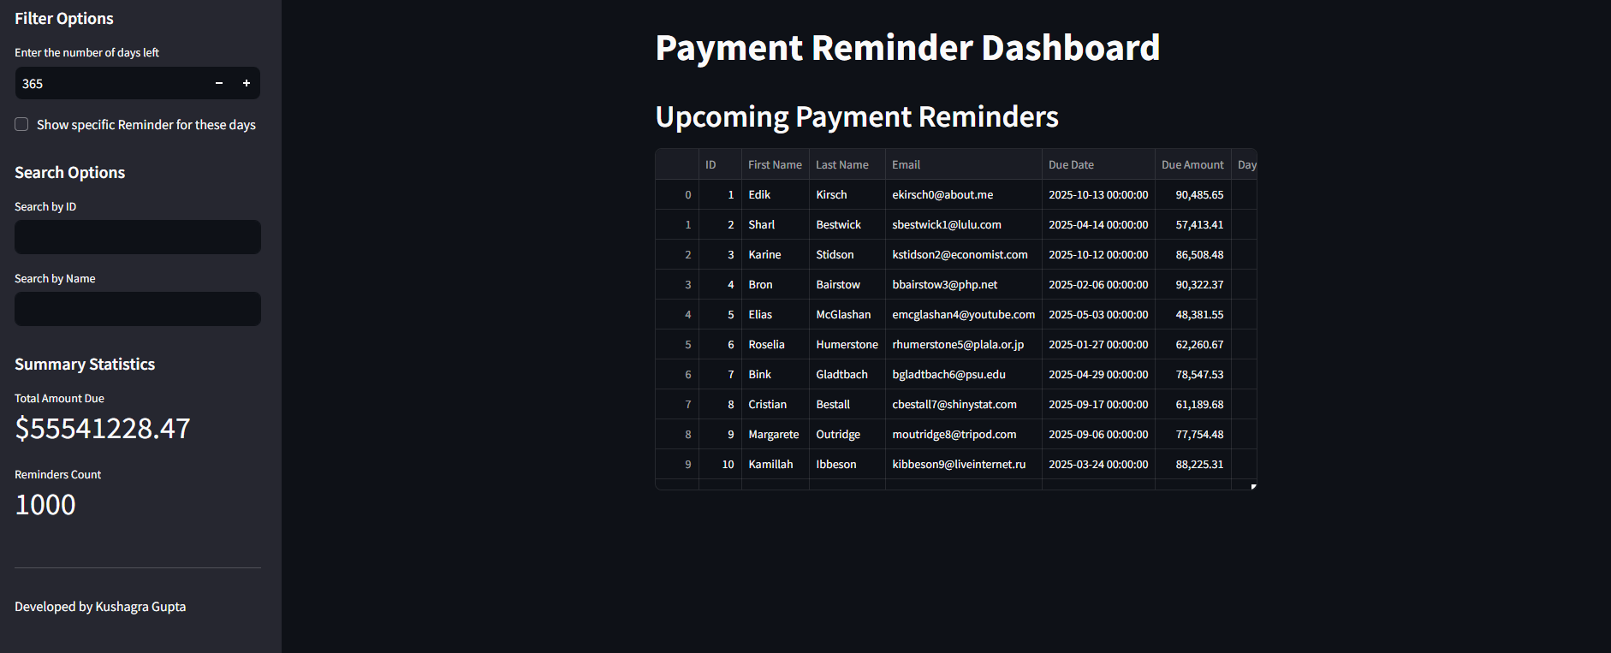
Screenshots Of Functionality
Functionality
Dashboard

Slide 16
Value Addition
Outcome
Impact of the Solution
Timely reminders eliminate the main issue of communication to the clients.
Sales team doesn’t have to perform manual follow ups, and can perform other tasks.
This solution is extremely cost effective, and can be scaled to whatever size is required.
This has the potential to reduce the losses caused by this issue and can also improve customer relations immensely.
Page 14

Slide 17
Takeaway
Conclusion
Conclusion
We have addressed the major issue, and resolved it with a hyperautomation solution.This system combines this automation with an interactive dashboard to streamline the whole operation.It is also scalable, and can be integrated with SMS/Whatsapp messaging easily to further increase reach. Integrating ML for customer predictive analysis is also possible. It should lead revenue recovery, reduced manual efforts, and future growth.
Page 15

Slide 18





Thank You
www.github.com/KushOfAgra
guptakush86@gmail.com
+91 7455037704
https://www.linkedin.com/in/kushagra86/
Kushagra Gupta

