Slide 1
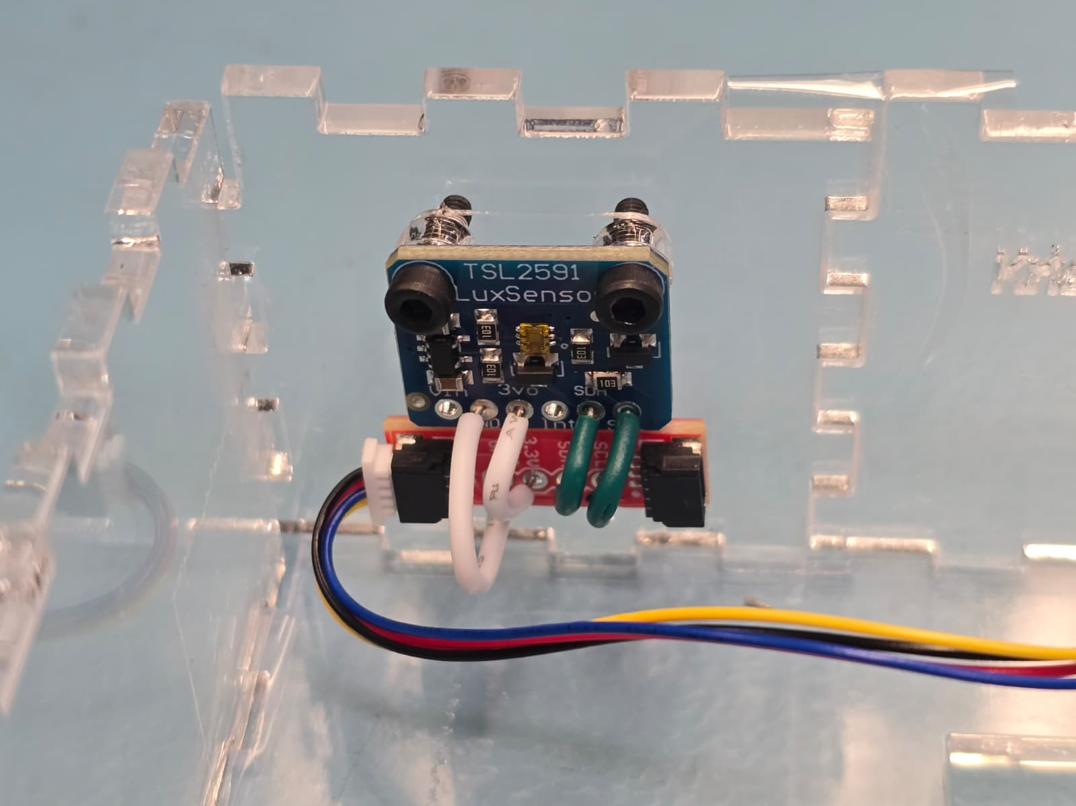
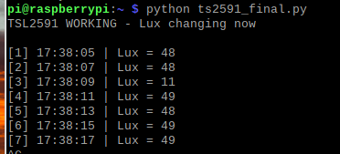
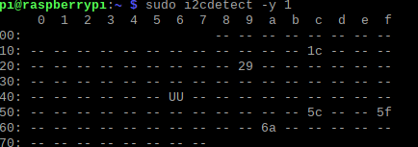
Krish Patel Hardware production technology:- TSL2591(LIGHT SENSOR)
Mounted sensor
Readings
The default i2c address of TSL2591 is 0x29
I2C ADDRESS
Measures light intensity (lux)
Uses I²C communication
I²C Address: 0x29
Provides accurate light readings using full-spectrum and infrared sensing

