Slide 1
Smart Assistive System
Kush Patel- n01657387
Krish Patel- n01666556
Daksh Rana- n01664095
Sarang Prajapati- n01662036

Slide 2
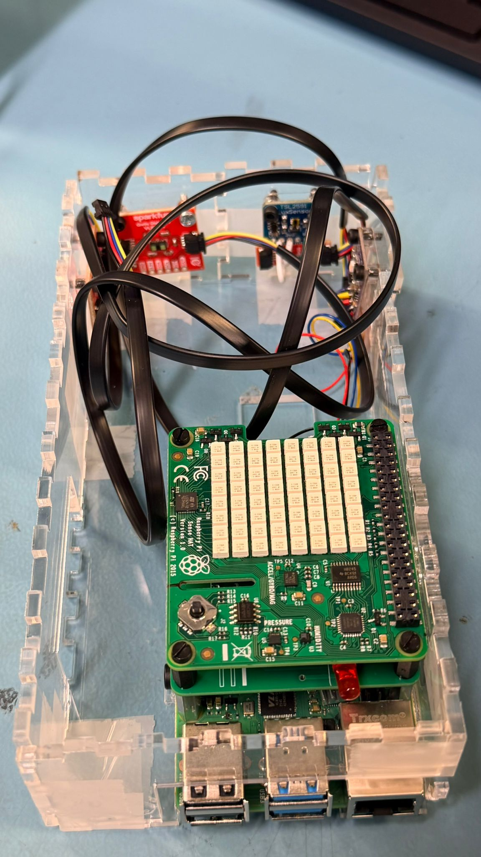
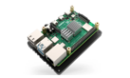
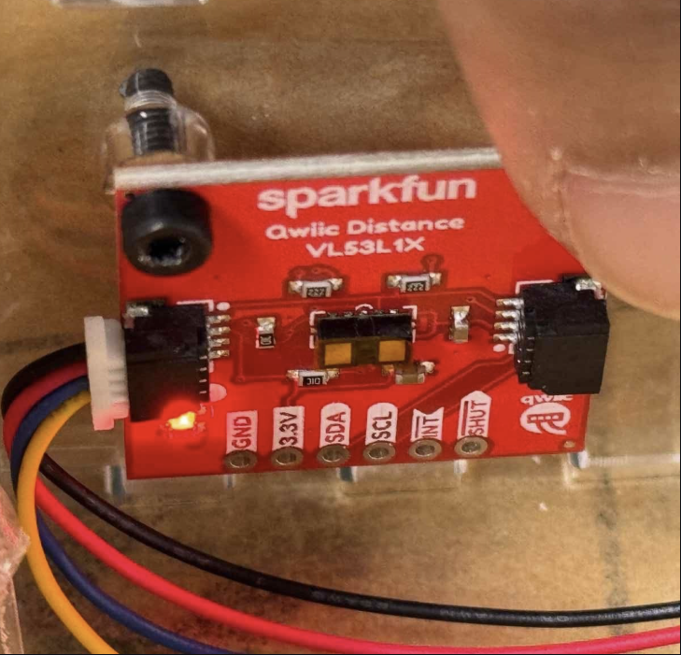
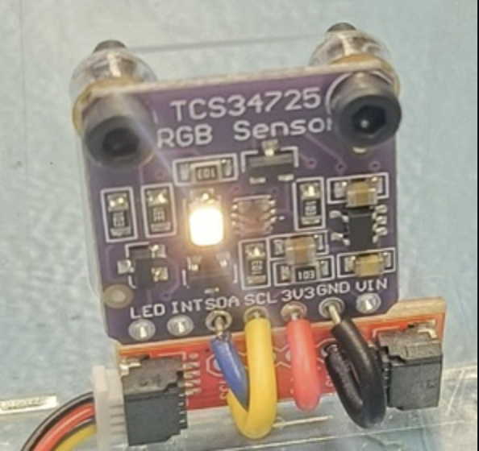
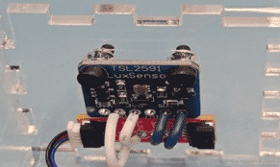
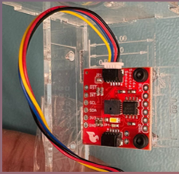
Hardware System Overview
Smart Assistive System
Member | Hardware | Use | Image
 | Raspberry Pi | Central processing unit
Kush | VL53L1X Sensor | measures distance and proximity
Daksh | TCS34725 Sensor | detects RGB color
Krish | TSL2591 Sensor | measures light levels
Sarang | AS7262 Sensor | measures spectral data
Kush Patel | Krish Patel | Daksh Rana | Sarang Prajapati

Slide 3
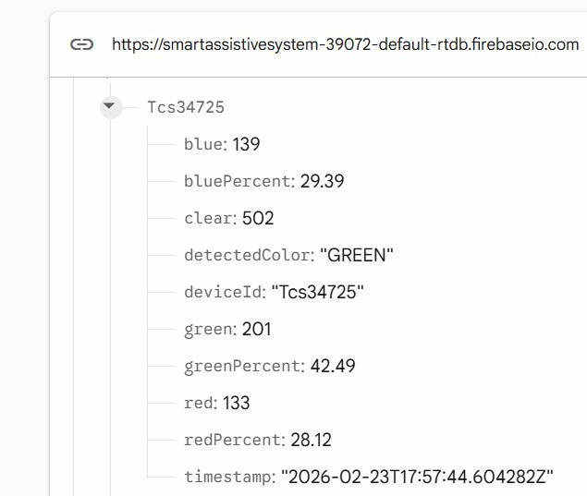
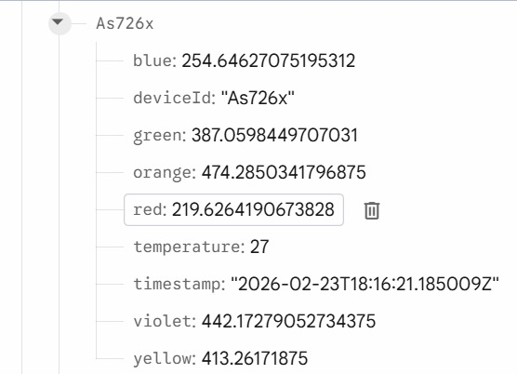
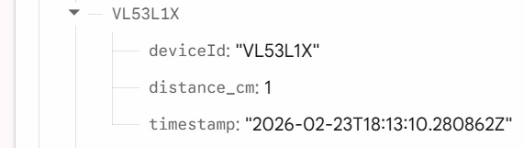
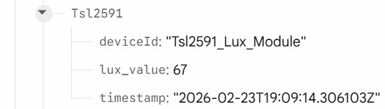
Smart Assistive System
Firebase Database
Kush Patel | Krish Patel | Daksh Rana | Sarang Prajapati

Slide 4
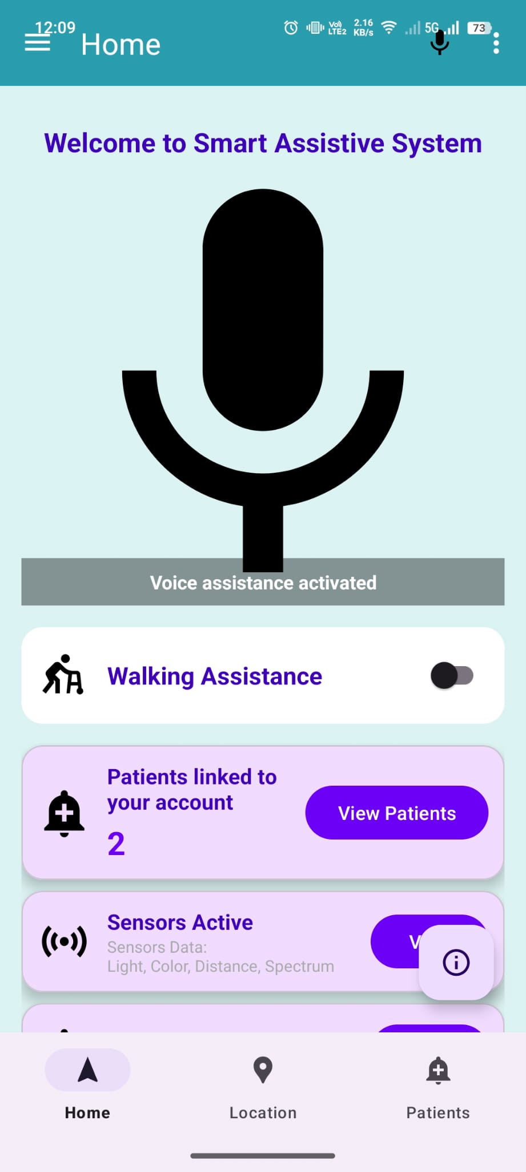
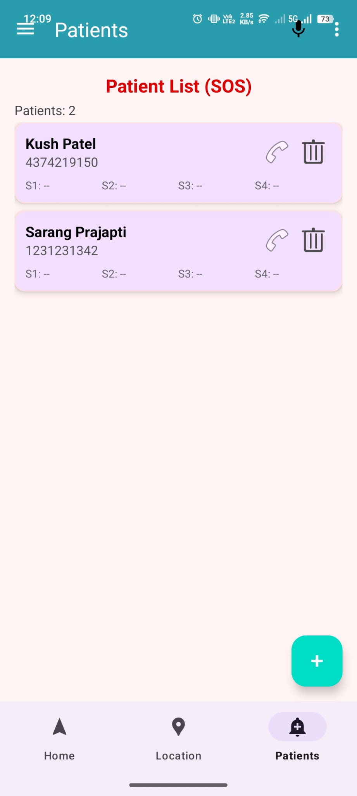
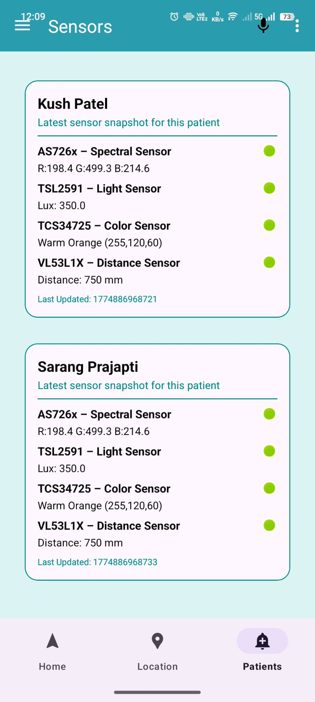
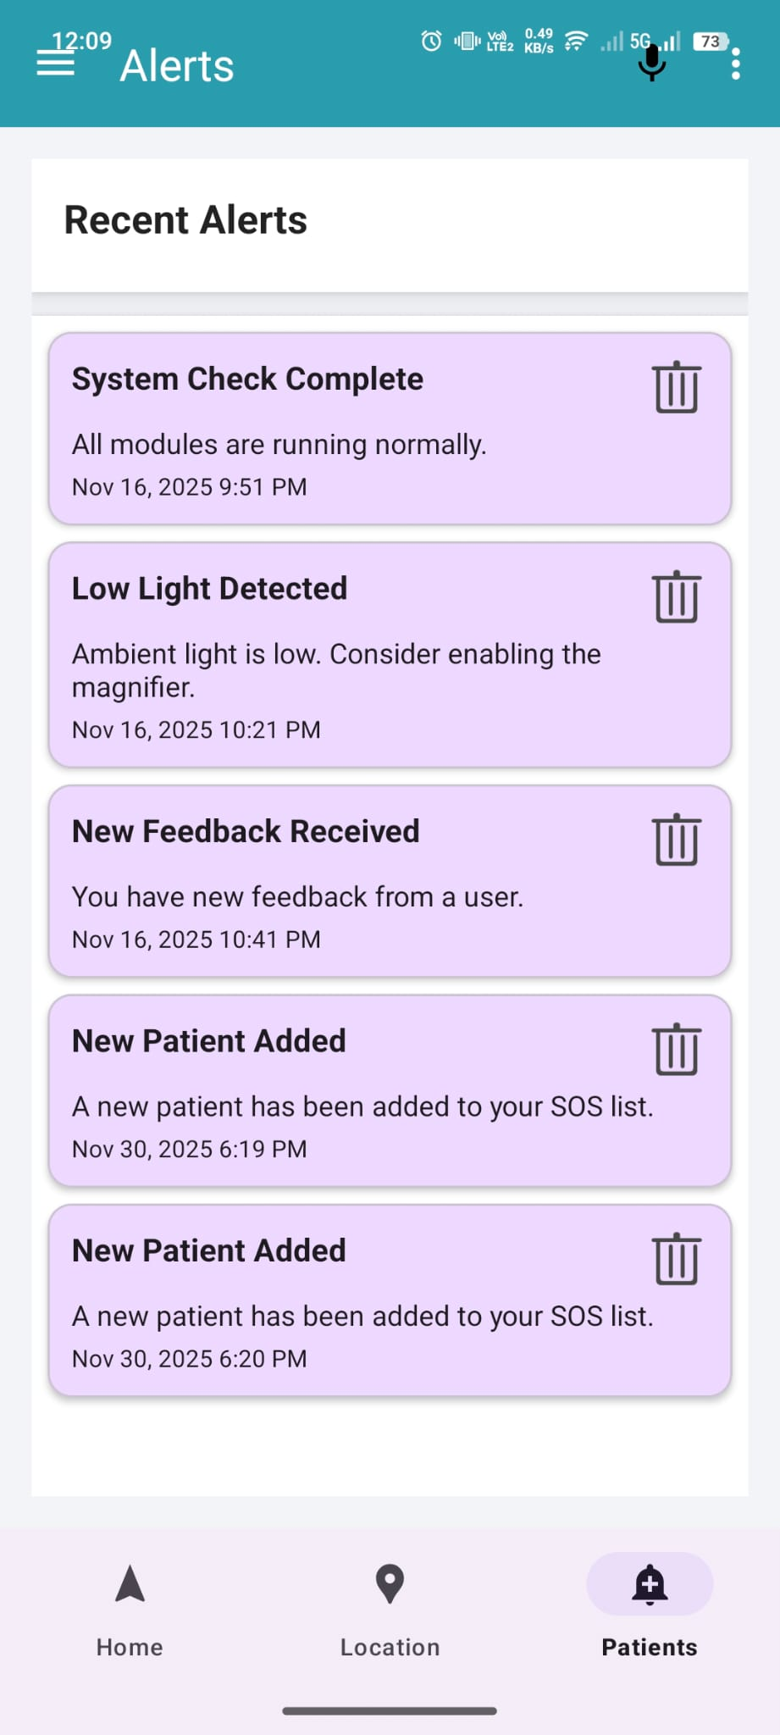
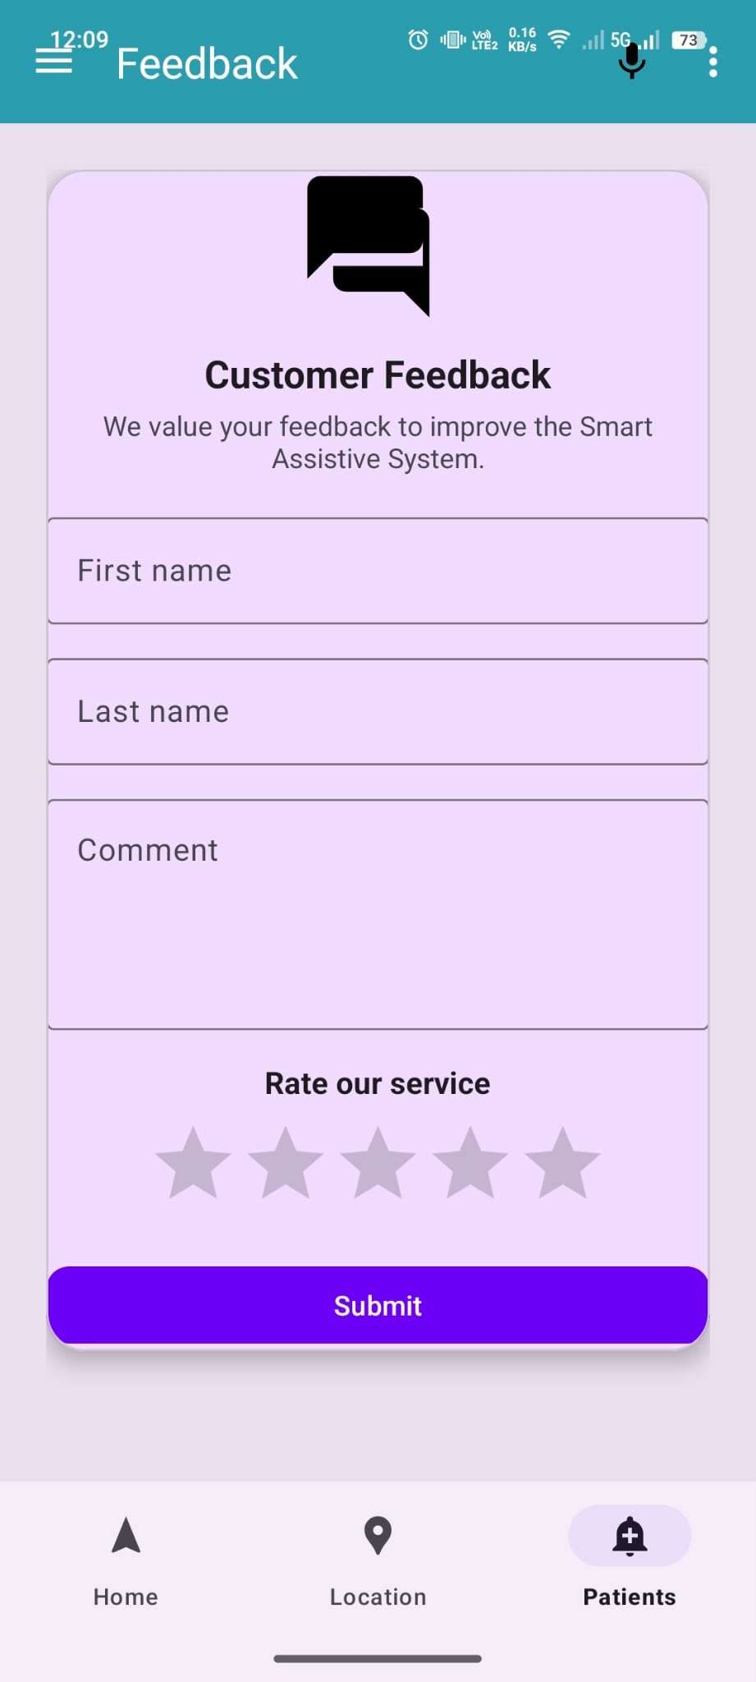
Smart Assistive System
Android Mobile Application
Kush Patel | Krish Patel | Daksh Rana | Sarang Prajapati

Slide 5
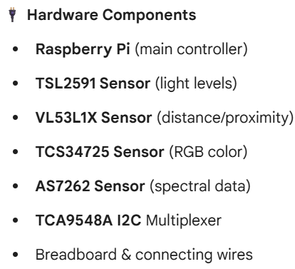
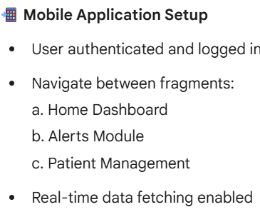
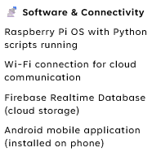
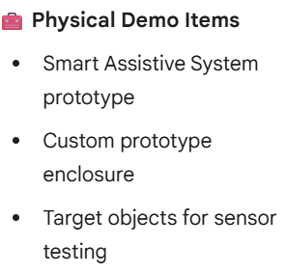
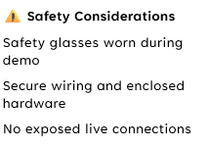
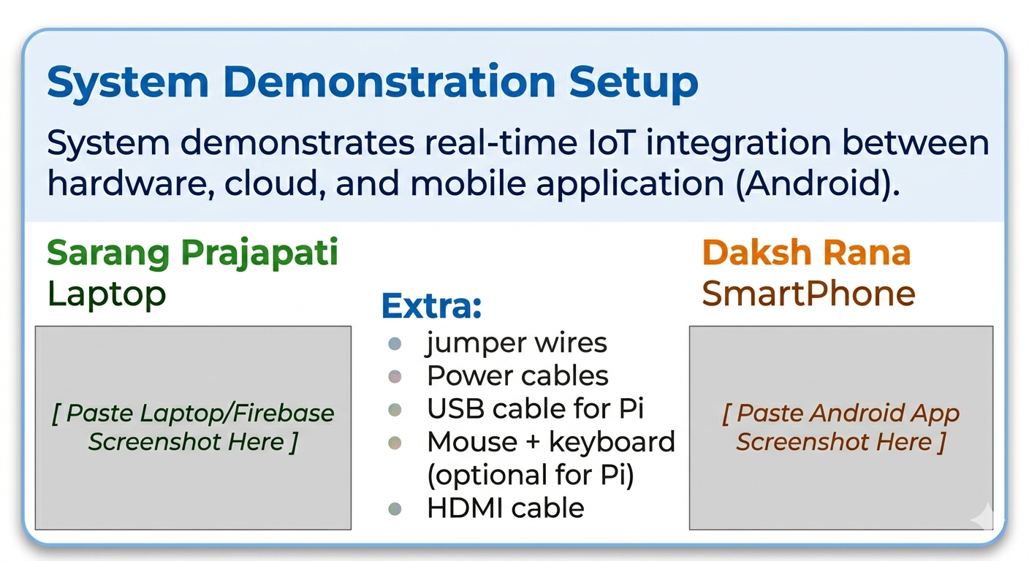


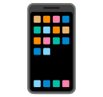
Smart Assistive System
System Demonstration Setup
Extra :
jumper wires
Power cables
USB cable for Pi
Mouse + keyboard (optional for Pi)
HDMI cable

Slide 6
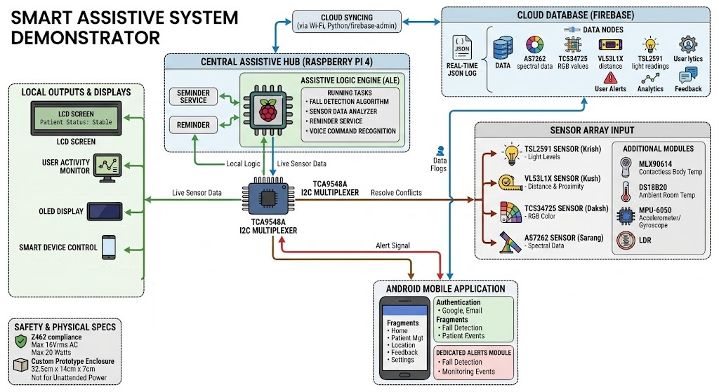
Smart Assistive System
System Demonstration
Kush Patel | Krish Patel | Daksh Rana | Sarang Prajapati

Slide 7
Thank You
Any Questions..?

