Slide 1
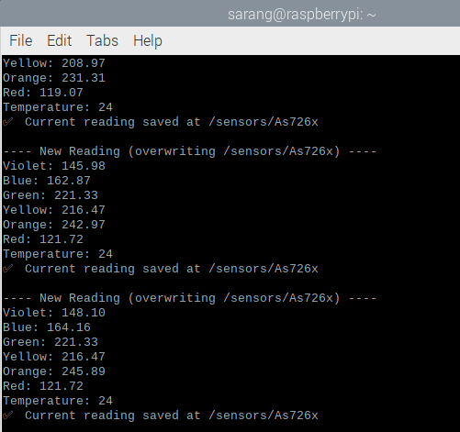
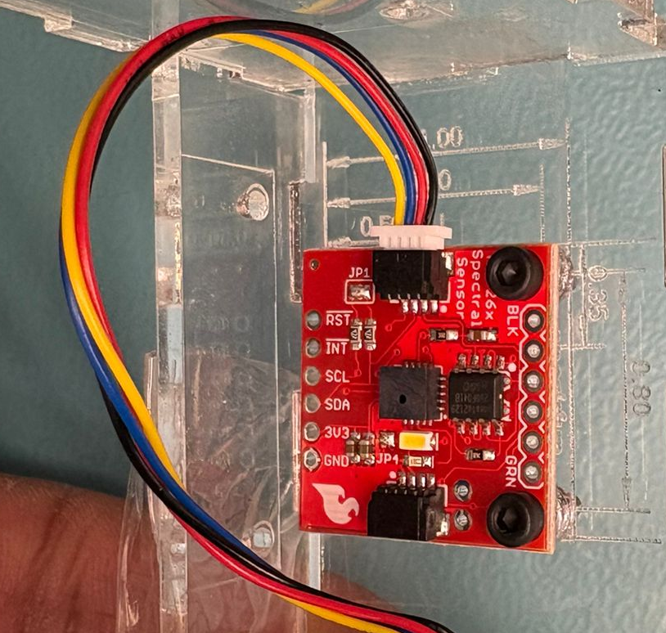
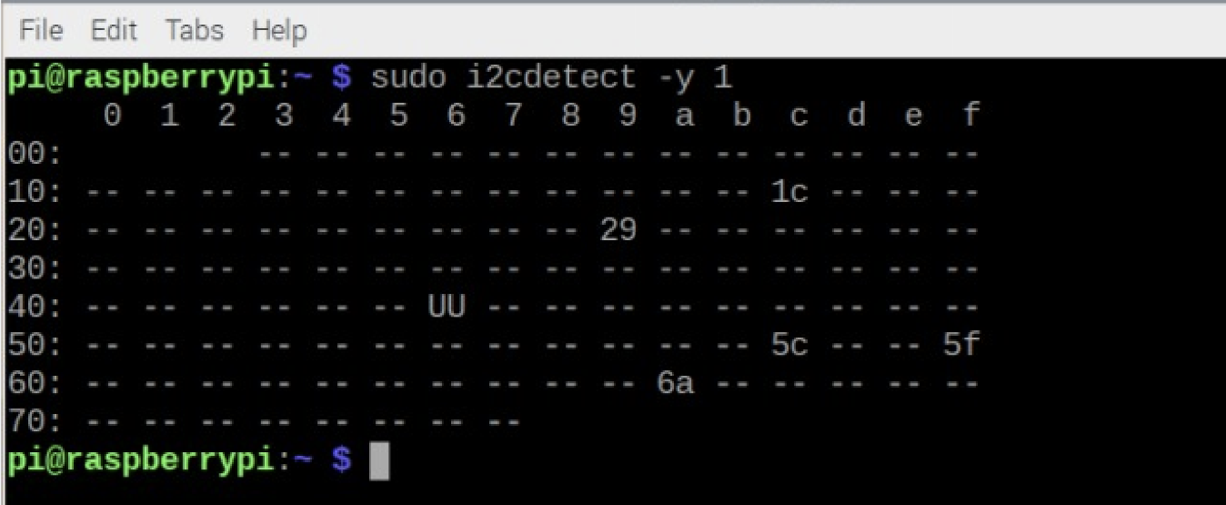
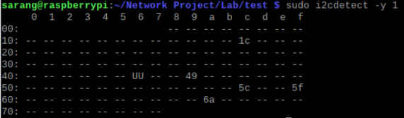
Name: Sarang Prajapati Sensor: AS726x Spectral Sensor I²C Address: 0x49
What the sensor Does : Measures light intensity at multiple wavelengths

