Slide 1
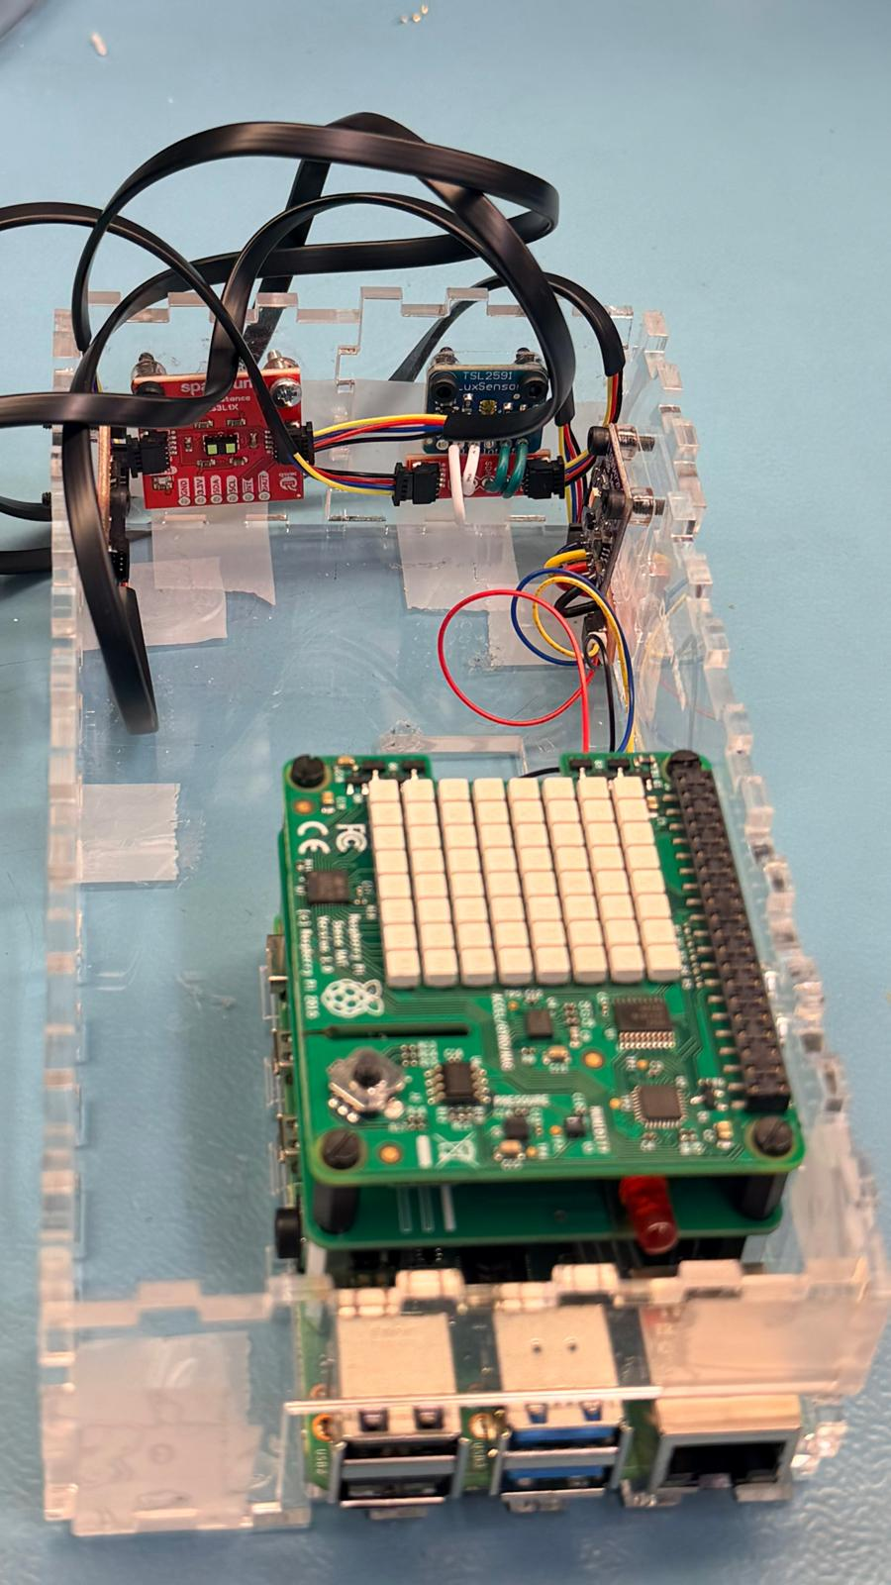
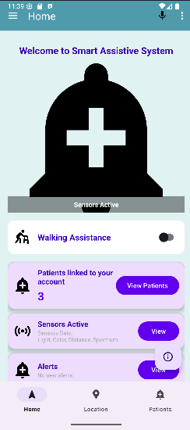
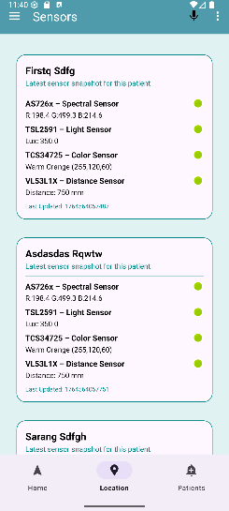
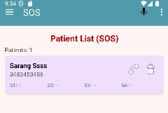
The Smart Assistive System is a portable sensor-based device that monitors environmental and user-specific parameters.
The system collects data from load cells, motion/proximity sensors, and other effectors.
Data is sent in real-time to an Android app for continuous monitoring, alerts, and limited remote control of actuators.
A Raspberry Pi serves as the main controller, while Arduino microcontrollers handle sensor interfacing.
The goal is to support safety and independence for users while providing caregivers with actionable insights.
The prototype is housed within a compact and safe enclosure.
Maximum overall project dimensions are strictly limited to 32.5cm x 14cm x 7cm.
Maximum power consumption is capped at 20 Watts to ensure safe operation.
The highest AC voltage utilized is 16Vrms via a wall adapter.
Smart Assistive System
Krish Patel, Kush Patel, Daksh Rana, Sarang Prajapati
INTRODUCTION
Context: Individuals needing care or monitoring require systems that support both safety and independence, while caregivers need actionable, real-time insights to respond to events.
Engineering Objective: Design and implement a portable sensor-based device that combines real-time sensing, cloud data management, and an Android monitoring app.
Multi-Sensor Architecture:TSL2591 measures ambient light conditions.VL53L1X measures distance and proximity.TCS34725 senses color (RGB).AS7262 provides spectral sensing (red, orange, yellow, green, blue, violet).
Embedded Processing: A Broadcom single-board computer (Raspberry Pi) performs I²C communication, handles multiplexing, and securely transmits data to the cloud.
Cloud Integration: Sensor data is stored in Firebase Realtime Database, with minimal latency (<1 second) synchronization.
Mobile System: An Android app provides a dashboard, patient management, fall detection, and location tracking.
System Value: Enhances user safety and independence while keeping caregivers informed through automatic alerts and remote monitoring.
PCB ASSEMBLY
From Hardware Reports
Development Platform: Broadcom single-board computer (Raspberry Pi) used as the central controller.
Sensor Integration (I²C Bus):
TSL2591 (0x29) – Light sensor
VL53L1X (0x29) – Distance sensor
TCS34725 (0x29) – Color sensor
AS7262 (0x49) – Spectral sensor
TCA9548A – I²C multiplexer utilized to resolve the 0x29 address conflict.
Electrical Interface: Built-in pull-up resistors on SDA/SCL lines are utilized for stable communication.
Testing Status: All sensors successfully demonstrated. Raspberry Pi Wi-Fi auto-connect and Python scripting verified.
MOBILE APP RESULTS
From Mobile Deliverables.
Modular Design: Android app built with clear separation between UI components, business logic, and utility modules.
Feature Modules: Includes Login (Email/Google Auth), a Home dashboard, an Alerts module, and a Patient management interface.
Advanced Capabilities: Integrated Fall detection module, Location tracking service, Feedback screen, and a Voice command routing framework.
Cloud Sync: Firebase services and notification handling are functioning correctly, providing seamless database updates.
Stability & Optimization: Fragment transitions are tested and stable; actively optimizing Android foreground services to ensure reliable location tracking against OS background execution limits.
DATABASE
This poster is 48” x 36”
Cloud Platform: Firebase Realtime Database (RTDB) enables stable, real-time sync between the Raspberry Pi and Android app.
Structured Data: JSON tree divided into four main nodes: Feedback, analytics/events, sensors, and users.
Live Updates: Python scripts push sensor logs (RGB, distance, light, spectral data, and timestamps) instantly to the console.
Analytics & Logging: Stores screen views, user IDs, event types, and user feedback (ratings, comments).
Security & Performance: Actively updating open read/write rules to auth-based rules to prevent privacy risks, and addressing large sensor logs with pagination limits.
TESTING AND NEXT STEPS
Unit Testing :-Individual sensor validation verified for TSL2591, VL53L1X, TCS34725, and AS7262.
Integration Testing : End-to-end data pipeline verified: Sensor → Raspberry Pi → Firebase → Android. Mobile workflow testing completed (Authentication, Dashboard navigation, Alert generation).
Production & Sustainability :- Database performance review planned for high-volume continuous sensor logging. Enclosure dimensions and power limits verified against initial scope.
Next Steps :- Integrate TCA9548A I²C multiplexer to fully resolve shared 0x29 address conflicts on the hardware bus. Implement Android foreground services to ensure reliable background location tracking. Secure Firebase RTDB rules to protect user privacy and standardize timestamp formats (epoch vs ISO).
ENCLOSURE DESIGN
The prototype is designed for active monitoring and is not to be left powered unattended.
In alignment with the space below the tray in the Humber North Campus Electronics Parts kit, the overall project maximum dimensions are 32.5cm x 14cm x 7cm (12 13/16" x 5 ½" x 2 ¾").
Keeping safety and Z462 in mind, the highest AC voltage utilized is 16Vrms from a wall adapter.
Maximum power consumption is strictly capped at 20 Watts to ensure safe operation.
ACKNOWLEDGEMENTS
Special thanks to our Supervising Faculty, Kris Medri, for guidance on this project.
Notes:
Section Start Slide

