Slide 1

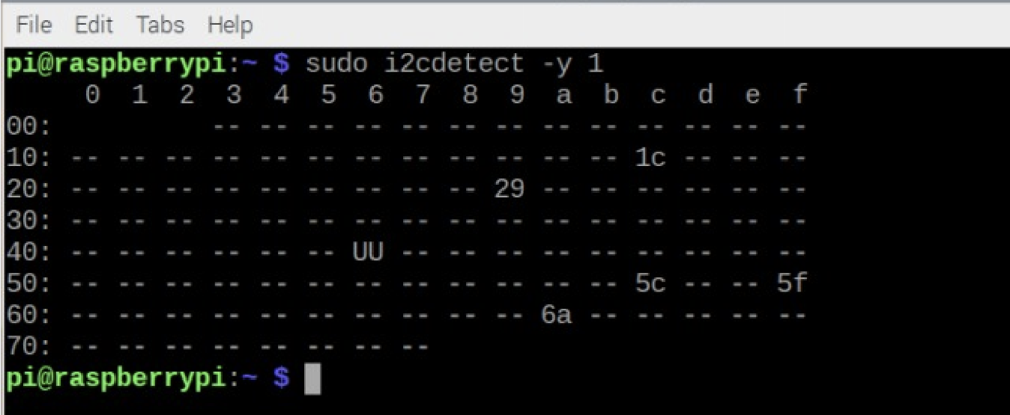
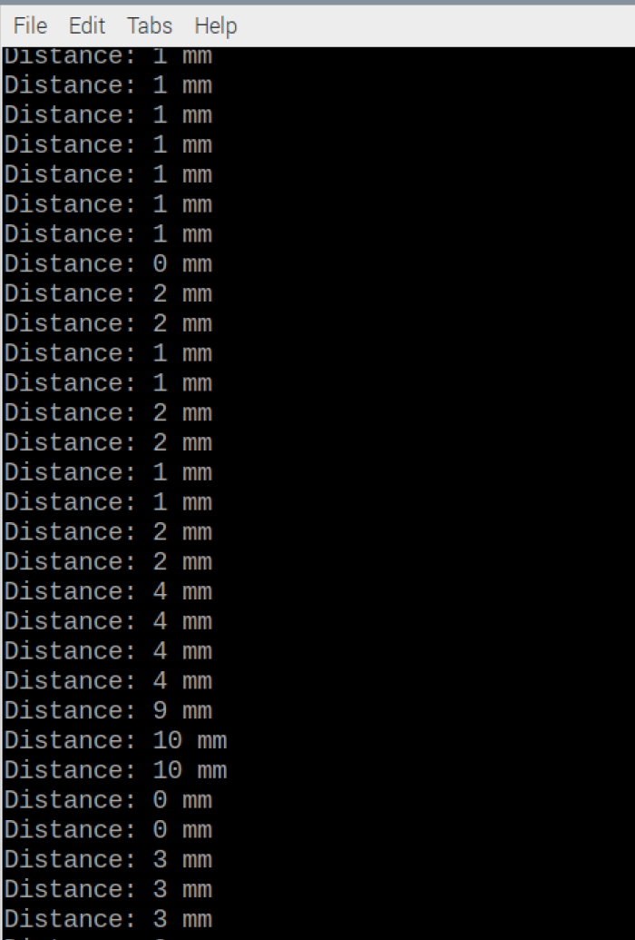
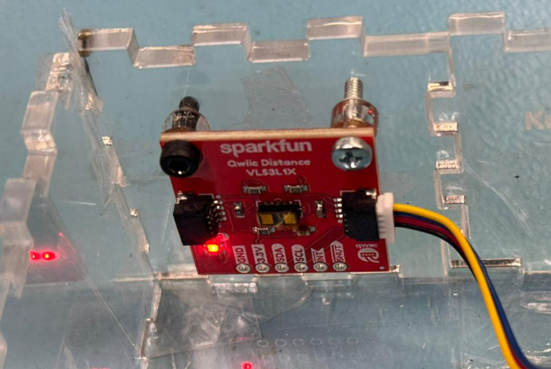
Name:-Kush Patel Sensor: VL53L1X Distance Sensor I²C Address: 0x29 VL53L1X Mounted to Hardware Case

