Slide 1
Problem Statement
Data Complexity
Scalability
Data Consistency
Security and Compliance
Data Integration

Slide 2
Unique Idea Brief (Solution)
Ensuring Data Quality and Consistency
Integrating Data from Multiple Sources
Managing Large Volumes of Data
Real-Time Data Extraction
Facilitating Data Transformation and Cleaning

Slide 3
Features Offered
Automated Feature Extraction
Wavelet scattering networks can automatically extract low-variance features from time series and image data, producing representations that minimize differences within a class while preserving discriminability across classes.
Autoencoders and deep neural networks can also be used for automated feature extraction and dimensionality reduction.

Slide 4
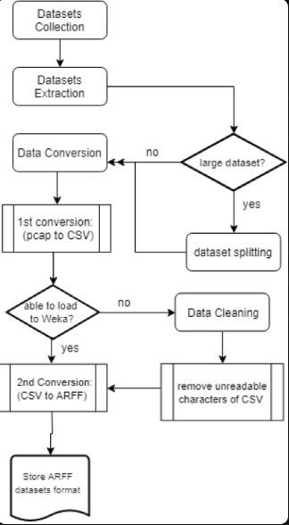
Process flow

Slide 5
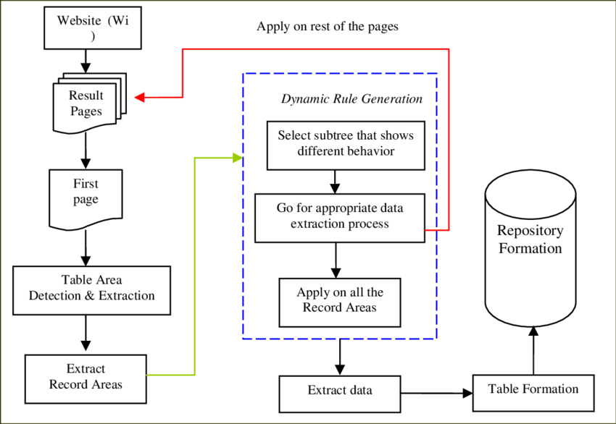
Architecture Diagram

Slide 6
Technologies used
Python: Python is a popular choice for data extraction and processing tasks.
Java: Java is another widely-used language for data extraction, with frameworks like Apache Tika and Apache Camel providing functionality for parsing and extracting.
JavaScript: For web-based data extraction, JavaScript can be leveraged, especially with tools like Puppeteer and Cheerio.
SQL: Structured Query Language (SQL) is essential for extracting data from relational databases, which often contain highly structured data sets.
C# and .NET: The .NET framework provides libraries like Html Agility Pack that enable structured data extraction, particularly from web sources.

Slide 7
Conclusion
Supporting a variety of extraction techniques like association, classification, clustering, and regression to handle different data extraction purposes Enabling extraction from multiple data sources such as databases, websites, APIs, logs, and files.
Providing methods for establishing connections to each data source for retrieving the data, using approaches like database drivers, APIs, and web scraping.
Implementing data transformation capabilities for cleaning, validating, converting, joining, and standardizing the extracted data.
Offering both incremental extraction to account for dataset shifts and full extraction to gather data from sources without variables.

