Slide 1
NIELIT Chandigarh
Dr. Sarwan Singh

Slide 2
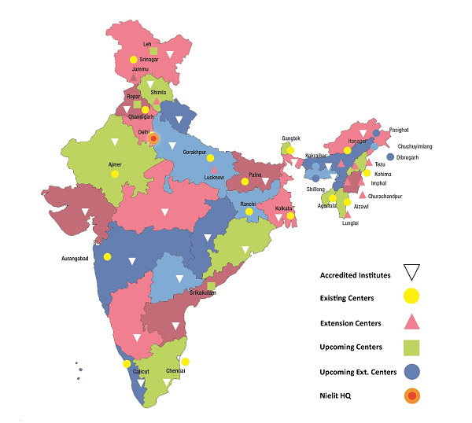

about NIELIT Chandigarh
erstwhile
Since 1978 known as
Regional computer center
and then DOEACC
ISO: 9001:2008 institute
One of the oldest renowned premier institute of Chandigarh known for excellence in education and quality services in fields of Electronics and Information Technology.

Slide 3
NIELIT Chandigarh
Our Vision
Our Mission
To be a centre of Excellence for quality assurance in education and services in the field of Information and Communication Technology through continuous improvement and upgradation.
To develop professional manpower and provide quality services in the field of Information and Communication Technology by using State-of-the-Art infrastructure.

Slide 4
NIELIT Chandigarh
Education & Training
Training & Projects
ESDM Scheme of GoI
Corporate trainings to various Govt.
departments
Training under DGE&T scheme
Training employment exchange
officers National Career Service Portal
Training to Panchayati Raj Functionaries
Training for more than 500 CSC VLEs
Data Digitization of NPR
Utility Billing projects for various states
Software Development and total IT
solutions for various Govt. departments
Examination and Certification
Facility Management
Projects
Software Development
NCPUL
Data Processing
Examination Processing
Facility Management
Online Services

Slide 5
Learning at NIELIT
The Courses here are distinctive for their unique characteristics of being Industry Oriented and practice base.
It helps in developing the professional capabilities for meeting requirements of Industry as well as reorient and update the knowledge skills.
The programs are modular and flexible.
Personal attention to every student is given during the development of project.
Technically sound and experienced faculty provides the best education and full guidance and support during project work.
Trained more than One Lakh students in non-formal sector

Slide 6

Education & Training
Long Term Course
Short Term Course
NIELIT ‘O’ Level Computer Course
NIELIT ‘A’ Level Computer Course
NIELIT ‘B’ Level Computer Course
NIELIT ‘O’ Level on Hardware Maintenance
NIELIT ‘A’ Level on Hardware Maintenance
Post Graduate Diploma in Computer Applications
Diploma in Computer Hardware
Cloud Computing and Virtualization
JAVA 2 Enterprise Edition
ASP.Net with C# / VB.Net
PHP with MY SQL and CMS
Multimedia & Animation
CCNA V 5.0 Routing & Switching
Big Data
Electronic Product Design (EPD)
Internet of Things (IoT)
Raspberry pi with Python
Embedded System Design

Slide 7
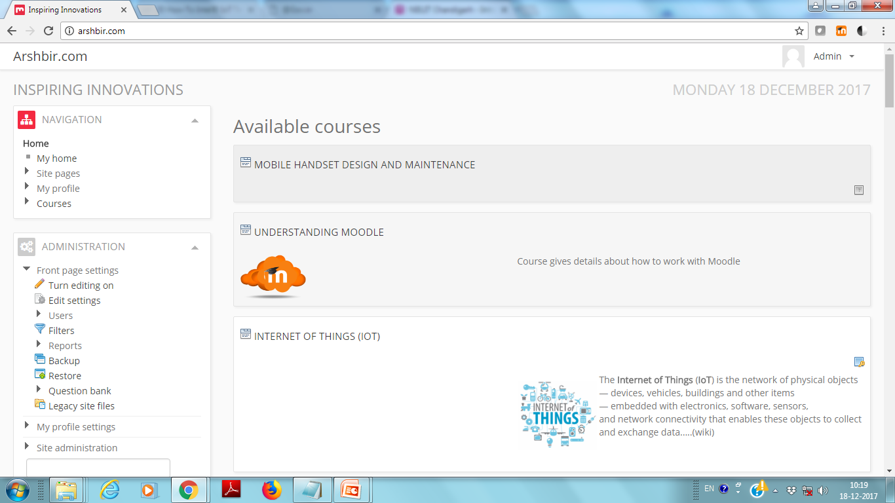
Online Learning Management System

Slide 8
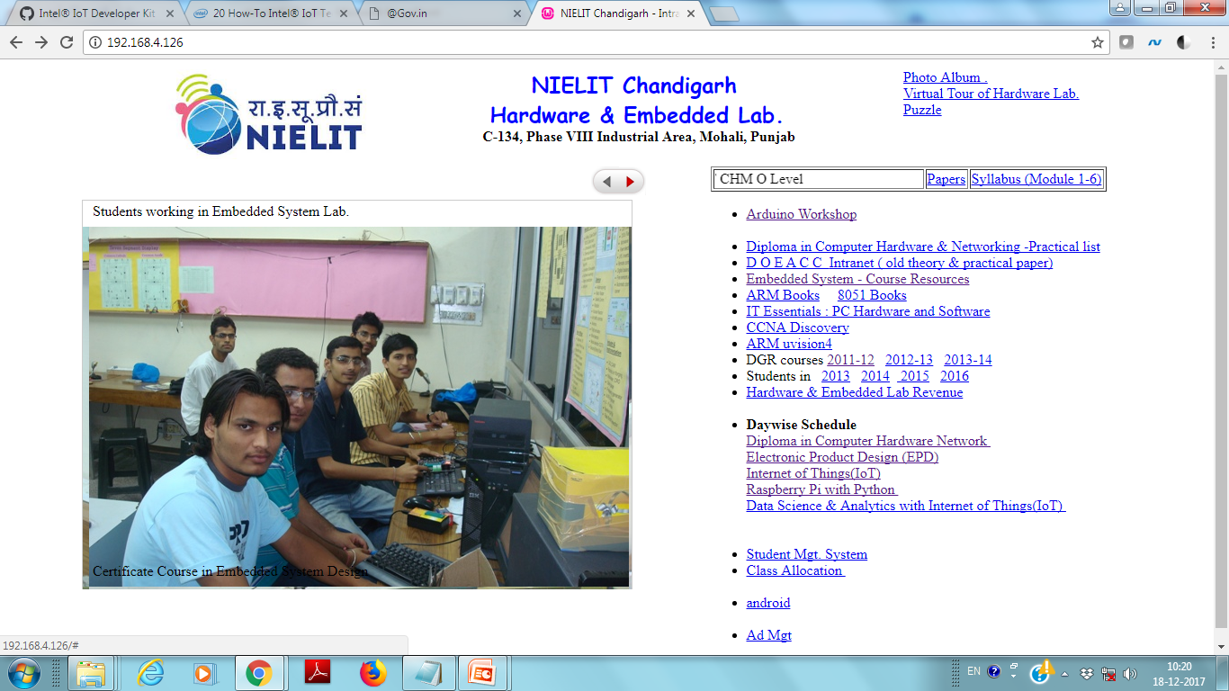
Intranet for Resource Sharing

