Slide 1
AIRBNB
DATABASE SYSTEM

Slide 2
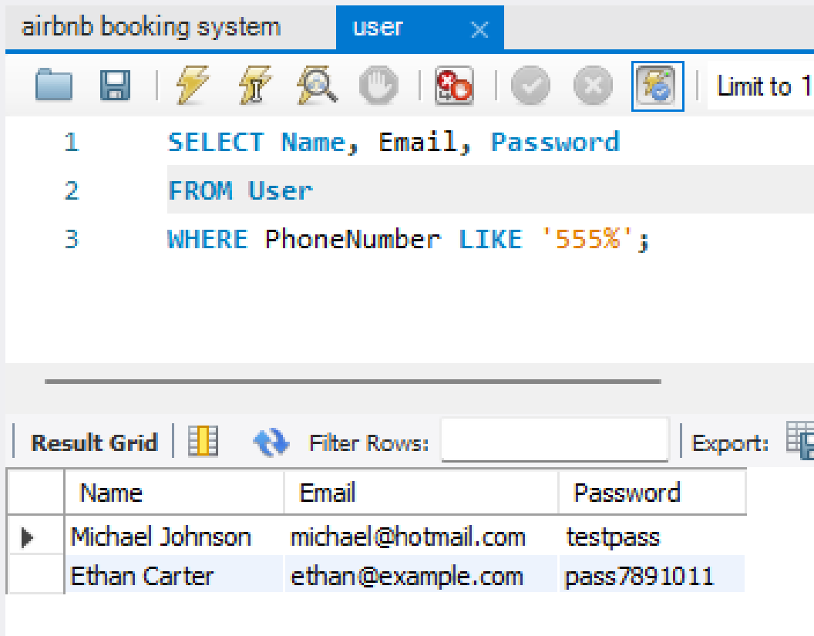
Entity one: USER
CREATE TABLE User ( UserID INT PRIMARY KEY, Name VARCHAR(255), Email VARCHAR(255), Password VARCHAR(255), PhoneNumber VARCHAR(20));
INSERT INTO User (UserID, Name, Email, Password, PhoneNumber) VALUES
(1, 'John Doe', 'johndoe@gmail.com', 'password123', '1234567890'),
(2, 'Jane Smith', 'janesmith@gmail.com', 'pass123', '9876543210'),
(3, 'Michael Johnson', 'michael@hotmail.com', 'testpass', '5555555555'),
(4, 'Emily Davis', 'emily@yahoo.com', 'pass456', '8888888888'),
(5, 'David Wilson', 'david@gmail.com', 'test123', '1111111111'),
(6, 'Sophia Lee', 'sophia@gmail.com', 'pass789', '2222222222'),
(7, 'Matthew Thompson', 'matthew@gmail.com', 'password456', '3333333333'),
(8, 'Olivia Garcia', 'olivia@gmail.com', 'testpass789', '4444444444'),
(9, 'Daniel Hernandez', 'daniel@gmail.com', 'pass999', '6666666666'),
(10, 'Isabella Clark', 'isabella@gmail.com', 'password789', '7777777777'),
(11, 'Alexander Hall', 'alexander@gmail.com', 'pass123456', '9999999999'),
(12, 'Ava Young', 'ava@gmail.com', 'testpass123', '3334445555'),
(13, 'William Turner', 'william@gmail.com', 'pass234', '1112223333'),
(14, 'Mia Baker', 'mia@gmail.com', 'password987', '4445556666'),
(15, 'James Walker', 'james@gmail.com', 'pass567', '7778889999'),
(16, 'Sophia Hill', 'sophia@gmail.com', 'testpass123456', '2221113333'),
(17, 'Ethan Carter', 'ethan@gmail.com', 'pass7891011', '5554443333'),
(18, 'Charlotte Mitchell', 'charlotte@gmail.com', 'password456789’, '8887776666'),
(19, 'Benjamin Green', 'benjamin@gmail.com', 'testpass234', '9998887777'),
(20, 'Amelia Adams', 'amelia@gmail.com', 'pass345', '1110002222');

Slide 3
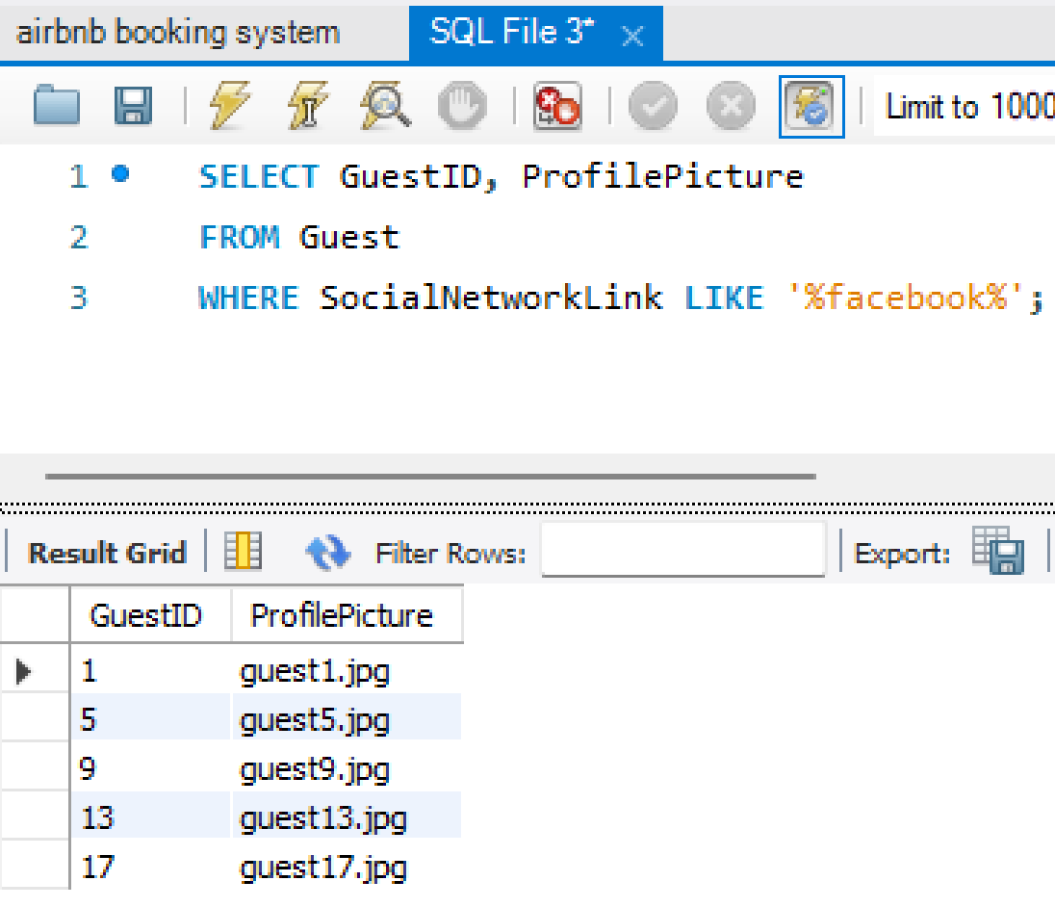
Entity two: GUEST
CREATE TABLE Guest ( GuestID INT PRIMARY KEY, ProfilePicture VARCHAR(255), SocialNetworkLink VARCHAR(255), UserID INT, FOREIGN KEY (UserID) REFERENCES User(UserID));
INSERT INTO Guest (GuestID, ProfilePicture, SocialNetworkLink)
VALUES
(1, 'guest1.jpg', 'https://www.facebook.com/johndoe'),
(2, 'guest2.jpg', 'https://www.instagram.com/janesmith'),
(3, 'guest3.jpg', 'https://twitter.com/michael'),
(4, 'guest4.jpg', 'https://www.linkedin.com/emily'),
(5, 'guest5.jpg', 'https://www.facebook.com/davidwilson'),
(6, 'guest6.jpg', 'https://www.instagram.com/sophialee'),
(7, 'guest7.jpg', 'https://twitter.com/matthew'),
(8, 'guest8.jpg', 'https://www.linkedin.com/oliviagarcia'),
(9, 'guest9.jpg', 'https://www.facebook.com/danielhernandez'),
(10, 'guest10.jpg', 'https://www.instagram.com/isabellaclark'),
(11, 'guest11.jpg', 'https://twitter.com/alexander'),
(12, 'guest12.jpg', 'https://www.linkedin.com/avayoung'),
(13, 'guest13.jpg', 'https://www.facebook.com/williamturner'),
(14, 'guest14.jpg', 'https://www.instagram.com/miabaker'),
(15, 'guest15.jpg', 'https://twitter.com/james'),
(16, 'guest16.jpg', 'https://www.linkedin.com/sophiahill'),
(17, 'guest17.jpg', 'https://www.facebook.com/ethancarter'),
(18, 'guest18.jpg', 'https://www.instagram.com/charlottemitchell'),
(19, 'guest19.jpg', 'https://twitter.com/benjamin'),
(20, 'guest20.jpg', 'https://www.linkedin.com/ameliaadams');

Slide 4
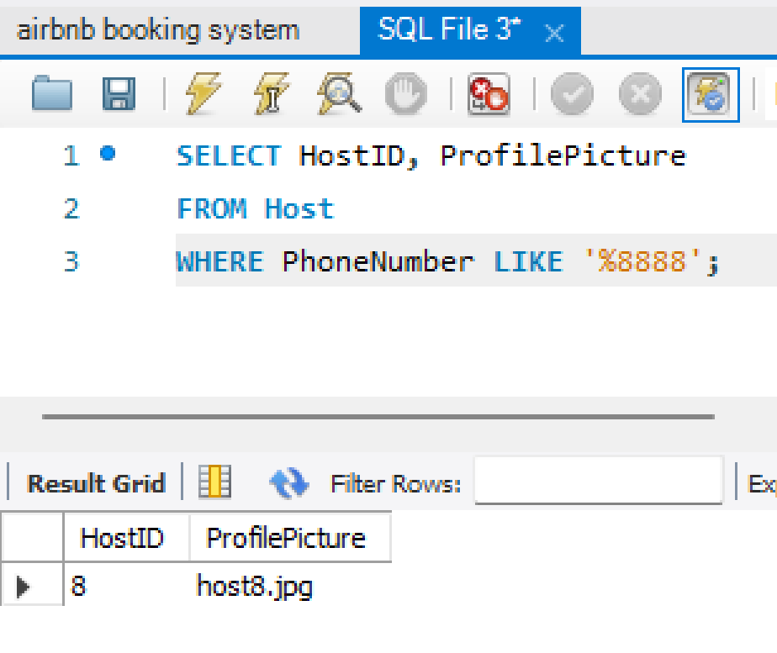
Entity three: HOST
CREATE TABLE Host ( HostID INT PRIMARY KEY, ProfilePicture VARCHAR(255), PhoneNumber VARCHAR(20), UserID INT, FOREIGN KEY (UserID) REFERENCES User(UserID));
INSERT INTO Host (HostID, ProfilePicture, PhoneNumber)
VALUES
(1, 'host1.jpg', '1111111111'),
(2, 'host2.jpg', '2222222222'),
(3, 'host3.jpg', '3333333333'),
(4, 'host4.jpg', '4444444444'),
(5, 'host5.jpg', '5555555555'),
(6, 'host6.jpg', '6666666666'),
(7, 'host7.jpg', '7777777777'),
(8, 'host8.jpg', '8888888888'),
(9, 'host9.jpg', '9999999999'),
(10, 'host10.jpg', '0000000000'),
(11, 'host11.jpg', '1234567890'),
(12, 'host12.jpg', '2345678901'),
(13, 'host13.jpg', '3456789012'),
(14, 'host14.jpg', '4567890123'),
(15, 'host15.jpg', '5678901234'),
(16, 'host16.jpg', '6789012345'),
(17, 'host17.jpg', '7890123456'),
(18, 'host18.jpg', '8901234567'),
(19, 'host19.jpg', '9012345678'),
(20, 'host20.jpg', '0123456789');

Slide 5
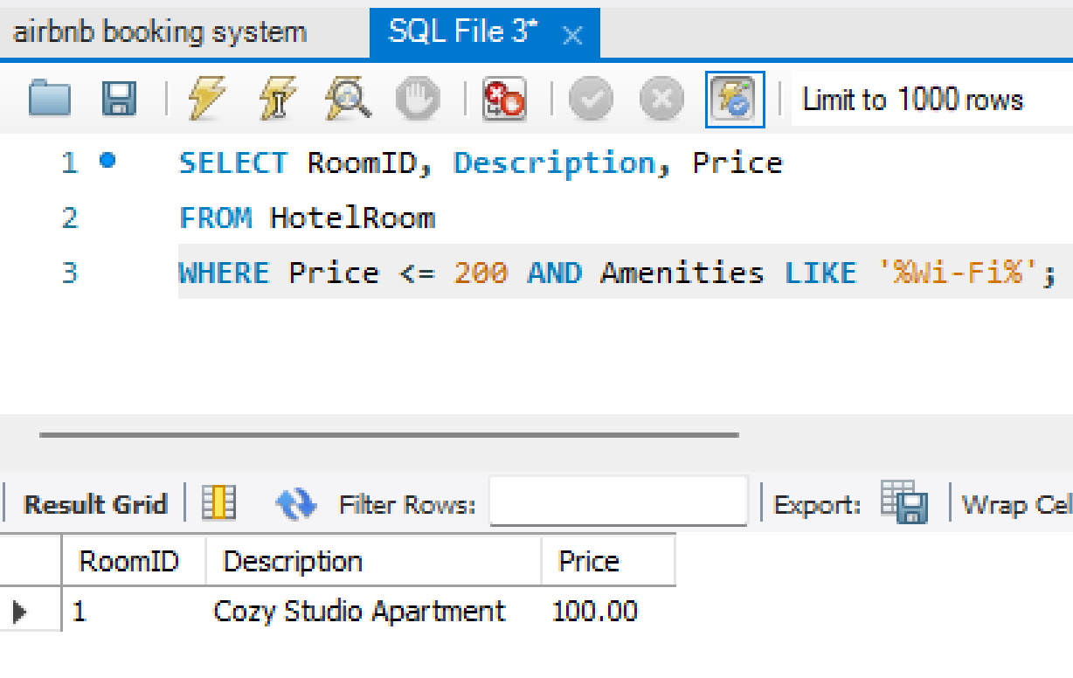
Entity five: HOTELROOM
CREATE TABLE HotelRoom (
RoomID INT PRIMARY KEY,
Description VARCHAR(255),
Amenities VARCHAR(255),
Price DECIMAL(10, 2),
LocationID INT,
FOREIGN KEY (LocationID) REFERENCES Location(LocationID));
INSERT INTO HotelRoom (RoomID, Description, Amenities, Price)
VALUES
(1, 'Cozy Studio Apartment', 'Wi-Fi, TV, Kitchenette', 100),
(2, 'Luxury Beachfront Villa', 'Private Pool, Ocean View', 500),
(3, 'Modern City Center Loft', 'Gym, Parking', 150),
(4, 'Charming Countryside Cottage', 'Fireplace, Garden', 200),
(5, 'Spacious Family House', 'Backyard, BBQ Grill', 300),
(6, 'Sleek Urban Penthouse', 'City View, Rooftop Terrace', 400),
(7, 'Rustic Mountain Cabin', 'Hot Tub, Hiking Trails', 250),
(8, 'Seaside Bungalow', 'Beach Access, Patio', 180),
(9, 'Elegant Historic Mansion', 'Grand Ballroom, Garden', 1000),
(10, 'Quaint Lakeside Chalet', 'Canoe Rental, Fishing', 220),
(11, 'Contemporary Loft Apartment', 'City View, Gym', 160),
(12, 'Cosy Log Cabin', 'Fireplace, Forest View', 190),
(13, 'Sunny Beach House', 'Ocean View, BBQ Grill', 280),
(14, 'Traditional 2BHK apartment', 'Garden, Farm Animals', 240),
(15, 'Urban Chic apartment', 'Central Location, Free Parking', 120),
(16, 'Himalayan Retreat', 'Hot Tub, Scenic Views', 350),
(17, 'Beachfront Condo', 'Swimming Pool, Balcony', 320),
(18, 'Historic clubhouse', 'Antique Furnishings, Courtyard', 180),
(19, 'Cottage by the sea', 'Riverside Deck, Canoe Rental', 200),
(20, 'Stylish Boutique lounge', 'Restaurant, Spa', 400);

Slide 6
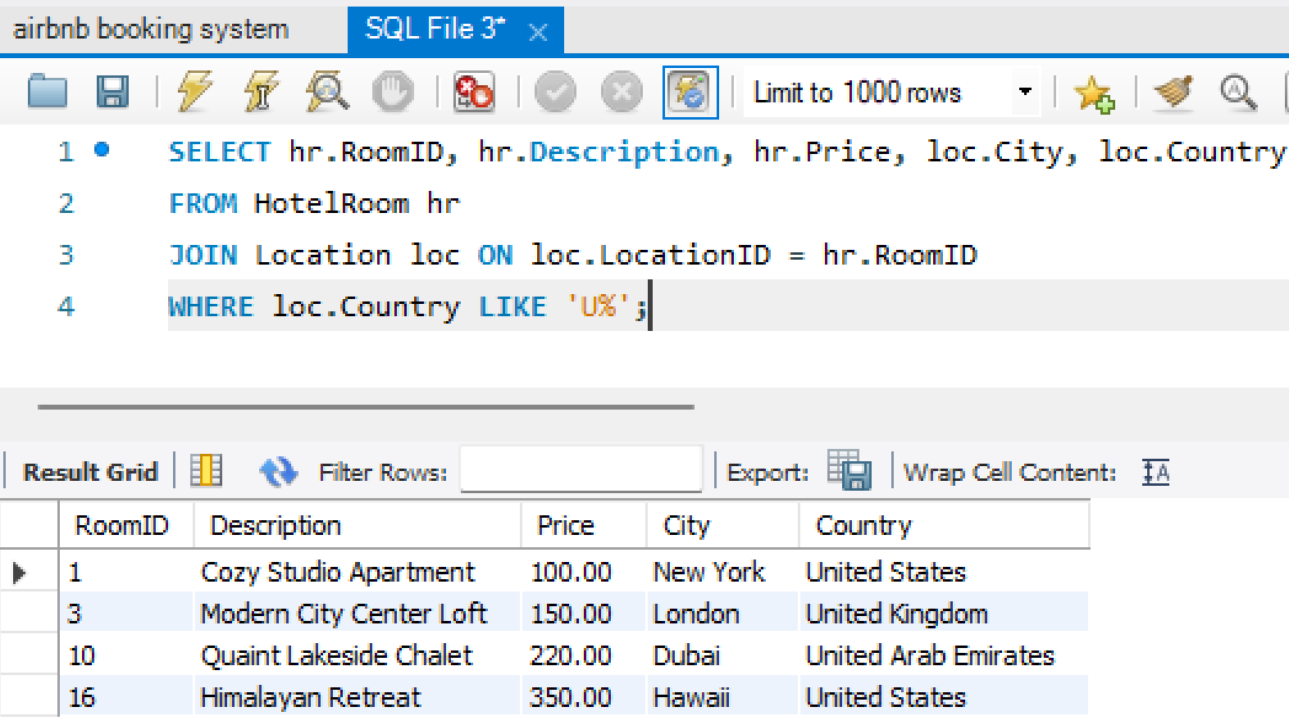
Entity four: LOCATION
CREATE TABLE Location ( LocationID INT PRIMARY KEY, City VARCHAR(100), Country VARCHAR(100));
INSERT INTO Location (LocationID, City, Country)
VALUES
(1, 'New York', 'United States'),
(2, 'Paris', 'France'),
(3, 'London', 'United Kingdom'),
(4, 'Tokyo', 'Japan'),
(5, 'Rome', 'Italy'),
(6, 'Sydney', 'Australia'),
(7, 'Cape Town', 'South Africa'),
(8, 'Rio de Janeiro', 'Brazil'),
(9, 'Barcelona', 'Spain'),
(10, 'Dubai', 'United Arab Emirates'),
(11, 'Berlin', 'Germany'),
(12, 'Amsterdam', 'Netherlands'),
(13, 'Bangkok', 'Thailand'),
(14, 'Toronto', 'Canada'),
(15, 'Mumbai', 'India'),
(16, 'Hawaii', 'United States'),
(17, 'Kathmandu', 'Nepal'),
(18, 'Pokhara', 'Nepal'),
(19, 'Ottawa', 'Canada'),
(20, 'wellington', 'Austrailia');

Slide 7
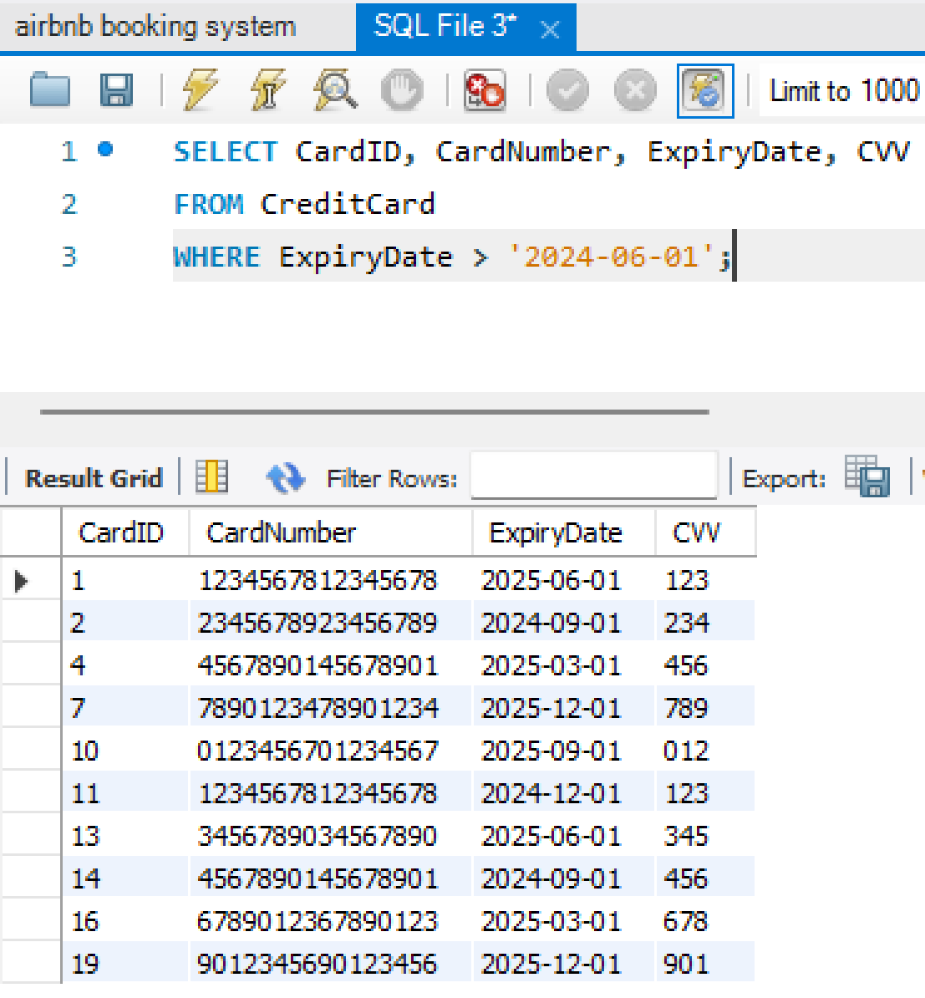
Entity six: CREDITCARD
CREATE TABLE CreditCard (
CardID INT PRIMARY KEY,
CardNumber VARCHAR(16),
ExpiryDate DATE,
CVV VARCHAR(3));
INSERT INTO CreditCard (CardID, CardNumber, ExpiryDate, CVV)
VALUES
(1, '1234567812345678', '2025-06-01', '123'),
(2, '2345678923456789', '2024-09-01', '234'),
(3, '3456789034567890', '2023-12-01', '345'),
(4, '4567890145678901', '2025-03-01', '456'),
(5, '5678901256789012', '2024-06-01', '567'),
(6, '6789012367890123', '2023-09-01', '678'),
(7, '7890123478901234', '2025-12-01', '789'),
(8, '8901234589012345', '2024-03-01', '890'),
(9, '9012345690123456', '2023-06-01', '901'),
(10, '0123456701234567', '2025-09-01', '012'),
(11, '1234567812345678', '2024-12-01', '123'),
(12, '2345678923456789', '2023-03-01', '234'),
(13, '3456789034567890', '2025-06-01', '345'),
(14, '4567890145678901', '2024-09-01', '456'),
(15, '5678901256789012', '2023-12-01', '567'),
(16, '6789012367890123', '2025-03-01', '678'),
(17, '7890123478901234', '2024-06-01', '789'),
(18, '8901234589012345', '2023-09-01', '890'),
(19, '9012345690123456', '2025-12-01', '901'),
(20, '0123456701234567', '2024-03-01', '012');

Slide 8
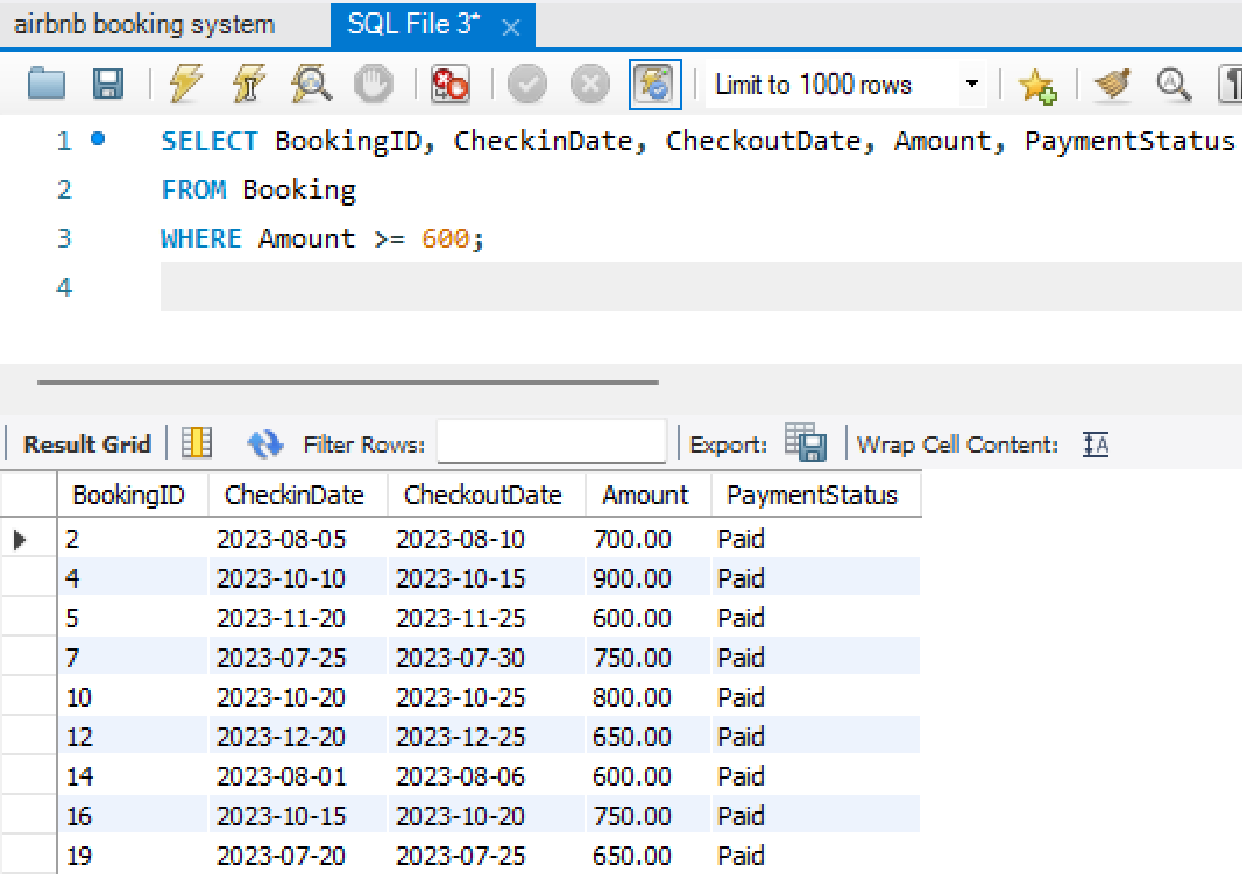
Entity seven: BOOKING
CREATE TABLE Booking (
BookingID INT PRIMARY KEY,
CheckInDate DATE,
CheckOutDate DATE,
Amount DECIMAL(10, 2),
PaymentStatus VARCHAR(20),
GuestID INT, HostID INT, RoomID INT, CardID INT,
FOREIGN KEY (GuestID) REFERENCES Guest(GuestID),
FOREIGN KEY (HostID) REFERENCES Host(HostID),
FOREIGN KEY (RoomID) REFERENCES HotelRoom(RoomID),
FOREIGN KEY (CardID) REFERENCES CreditCard(CardID)
);
INSERT INTO Booking (BookingID, CheckinDate, CheckoutDate, Amount, PaymentStatus)VALUES
(1, '2023-07-15', '2023-07-20', 500, 'Paid'),
(2, '2023-08-05', '2023-08-10', 700, 'Paid'),
(3, '2023-09-01', '2023-09-05', 300, 'Paid'),
(4, '2023-10-10', '2023-10-15', 900, 'Paid'),
(5, '2023-11-20', '2023-11-25', 600, 'Paid'),
(6, '2023-12-03', '2023-12-08', 400, 'Paid'),
(7, '2023-07-25', '2023-07-30', 750, 'Paid'),
(8, '2023-08-15', '2023-08-20', 350, 'Paid'),
(9, '2023-09-10', '2023-09-15', 550, 'Paid'),
(10, '2023-10-20', '2023-10-25', 800, 'Paid'),
(11, '2023-11-30', '2023-12-05', 500, 'Paid'),
(12, '2023-12-20', '2023-12-25', 650, 'Paid'),
(13, '2023-07-10', '2023-07-15', 400, 'Paid'),
(14, '2023-08-01', '2023-08-06', 600, 'Paid'),
(15, '2023-09-05', '2023-09-10', 350, 'Paid'),
(16, '2023-10-15', '2023-10-20', 750, 'Paid'),
(17, '2023-11-25', '2023-11-30', 550, 'Paid'),
(18, '2023-12-10', '2023-12-15', 450, 'Paid'),
(19, '2023-07-20', '2023-07-25', 650, 'Paid'),
(20, '2023-08-10', '2023-08-15', 500, 'Paid');

Slide 9
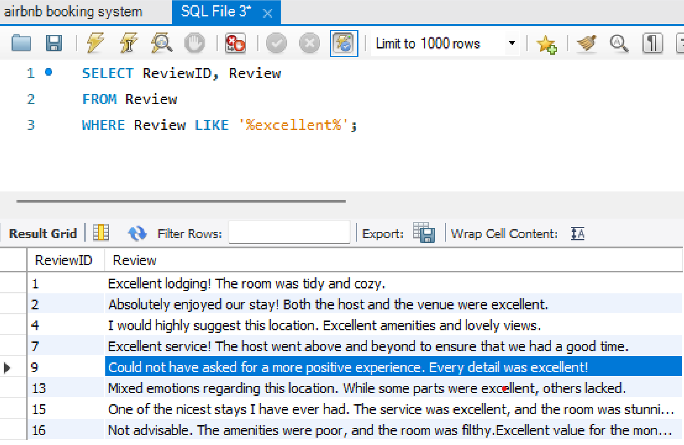
Entity eight: REVIEW
CREATE TABLE Review (
ReviewID INT PRIMARY KEY,
Review VARCHAR(500),
GuestID INT,
RoomID INT,
FOREIGN KEY (GuestID) REFERENCES Guest(GuestID), FOREIGN KEY (RoomID) REFERENCES
HotelRoom(RoomID));
INSERT INTO Review (ReviewID, Review)
VALUES
(1, "Excellent lodging! The room was tidy and cozy. "),
(2, "Absolutely enjoyed our stay! Both the host and the venue were excellent."),
(3, "Typical experience. The space might have been more tidy."),
(4, "I would highly suggest this location. Excellent amenities and lovely views."),
(5, "I had a great experience at this hotel. The staff was welcoming and accommodating."),
(6, "Unsatisfactory stay. It wasn't the advertised room."),
(7, "Excellent service! The host went above and beyond to ensure that we had a good time."),
(8, "Fair price given the quality. The space was large and well-kept"),
(9, "Could not have asked for a more positive experience. Every detail was excellent!"),
(10, "An adequate but unremarkable place to stay."),
(11, "We had a good time. The location and room were both handy.made me feel at ease."),
(12, "Outstanding accomodation! Would undoubtedly return to this hotel."),
(13, "Mixed emotions regarding this location. While some parts were excellent, others lacked."),
(14, "Overall, a pleasant visit. The host was cordial, and the view from the room was lovely."),
(15, "One of the nicest stays I have ever had. The service was excellent, and the room was stunning."),
(16, "Not advisable. The amenities were poor, and the room was filthy.Excellent value for the money."),
(17, "Our expectations were exceeded by the room.Absolutely great! "),
(18, "Everything we required was provided for at the hotel.Mixed experience. "),
(19, "While some elements were positive, others needed work.Lovely hotel with helpful personnel,"),
(20, " we thoroughly enjoyed our stay.");

Slide 10
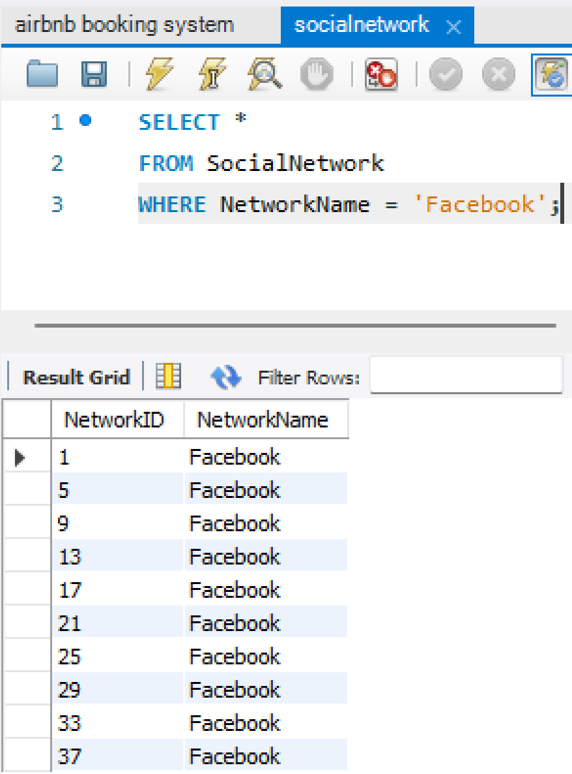
Entity nine: SOCIALNETWORK
CREATE TABLE SocialNetwork (
NetworkID INT AUTO_INCREMENT PRIMARY KEY,
NetworkName VARCHAR(255)
);
INSERT INTO SocialNetwork (NetworkID, NetworkName)
VALUES
(1, 'Facebook'),
(2, 'Instagram'),
(3, 'Twitter'),
(4, 'LinkedIn'),
(5, 'Facebook'),
(6, 'Instagram'),
(7, 'Twitter'),
(8, 'Linkedin'),
(9, 'Facebook'),
(10, 'Instagram'),
(11, 'Twitter'),
(12, 'Linkedin'),
(13, 'Facebook'),
(14, 'Instagram'),
(15, 'Twitter'),
(16, 'Linkedin'),
(17, 'Facebook'),
(18, 'Instagram'),
(19, 'Twitter'),
(20, 'Linkedin');

Slide 11
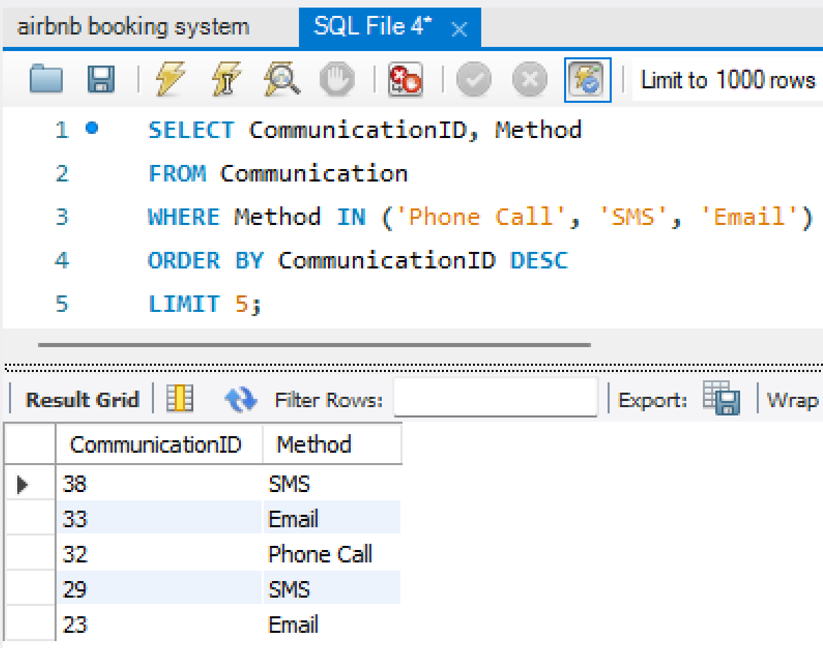
Entity ten: COMMUNICATION
CREATE TABLE Communication (
CommunicationID INT AUTO_INCREMENT PRIMARY KEY,
Method VARCHAR(255),
BookingID INT,
FOREIGN KEY (BookingID) REFERENCES Booking(BookingID)
);
INSERT INTO Communication (CommunicationID, Method)
VALUES
(1, 'Phone Call'),
(2, 'Email'),
(3, 'SMS'),
(4, 'WhatsApp'),
(5, 'Video Call'),
(6, 'In-person Meeting'),
(7, 'SMS'),
(8, 'Messenger'),
(9, 'Fax'),
(10, 'Postal Mail'),
(11, 'Voice Message'),
(12, 'Messenger'),
(13, 'Conference Call'),
(14, 'Voice over IP'),
(15, 'Vi'),
(16, 'Phone call'),
(17, 'Whatsapp'),
(18, 'Email'),
(19, 'Phone call'),
(20, 'SMS');

Slide 12
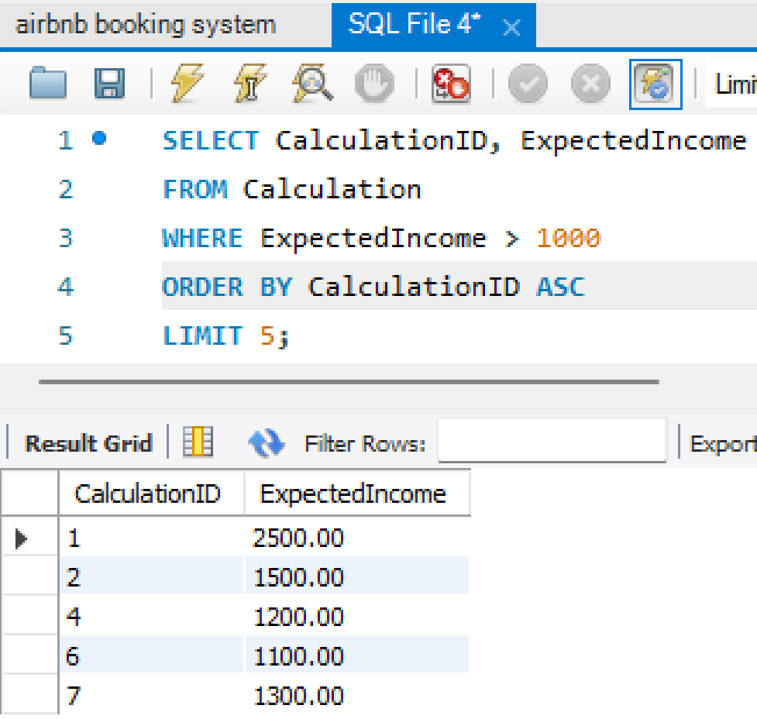
Entity eleven: CALCULATION
CREATE TABLE Calculation (
CalculationID INT PRIMARY KEY,
ExpectedIncome DECIMAL(10, 2),
HostID INT,
FOREIGN KEY (HostID) REFERENCES Host(HostID)
);
INSERT INTO Calculation (CalculationID, ExpectedIncome)
VALUES
(1, 2500),
(2, 1500),
(3, 800),
(4, 1200),
(5, 900),
(6, 1100),
(7, 1300),
(8, 700),
(9, 1000),
(10, 1400),
(11, 750),
(12, 950),
(13, 1050),
(14, 1600),
(15, 850),
(16, 1250),
(17, 1800),
(18, 600),
(19, 950),
(20, 1350);

Slide 13
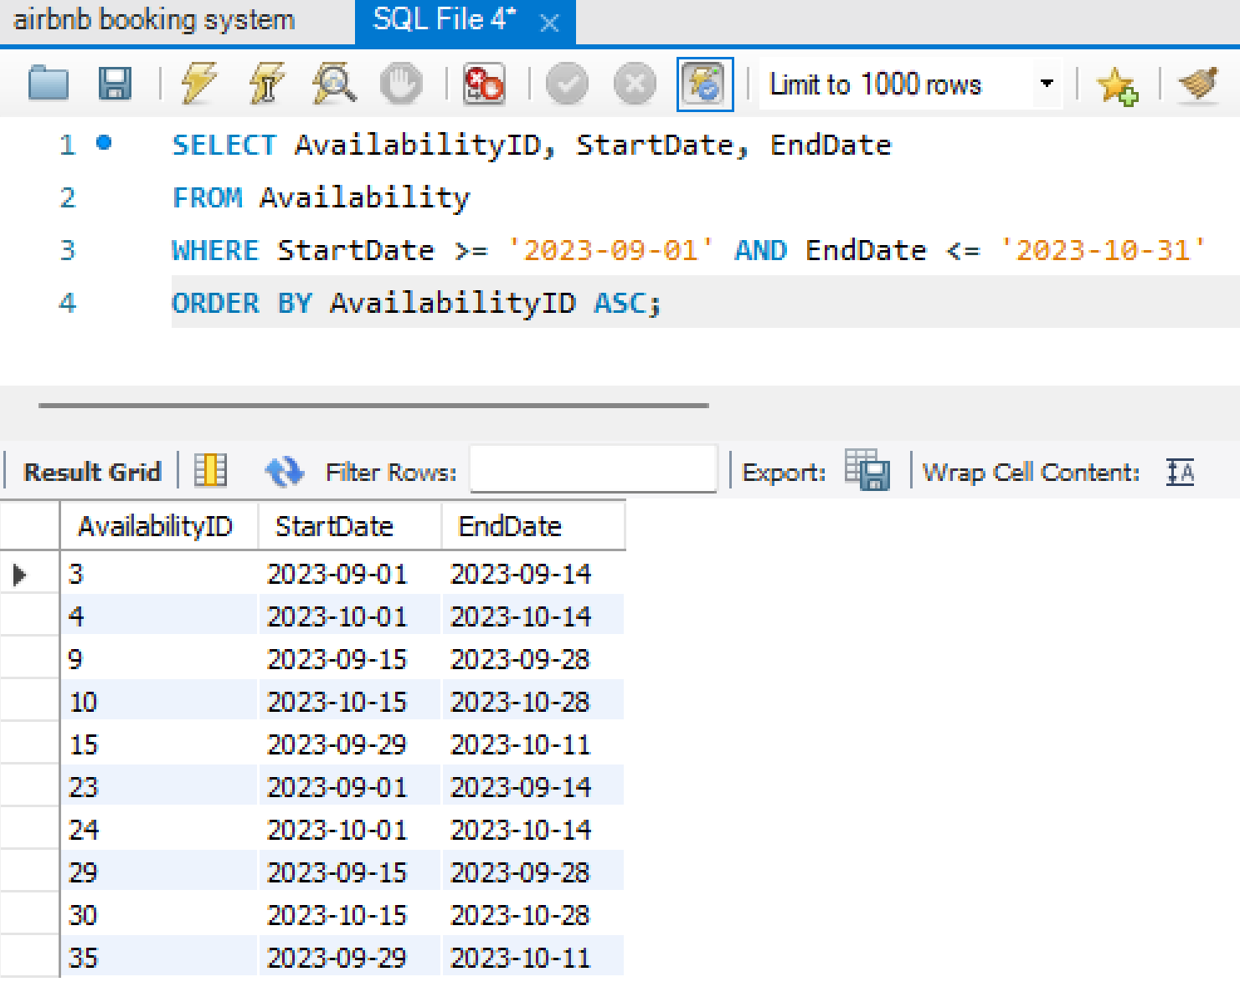
Entity twelve: AVAILABILITY
CREATE TABLE Availability (
AvailabilityID INT PRIMARY KEY,
StartDate DATE,
EndDate DATE,
RoomID INT,
FOREIGN KEY (RoomID) REFERENCES HotelRoom(RoomID));
INSERT INTO Availability (AvailabilityID, StartDate, EndDate)
VALUES
(1, '2023-07-01', '2023-07-14'),
(2, '2023-08-01', '2023-08-14'),
(3, '2023-09-01', '2023-09-14'),
(4, '2023-10-01', '2023-10-14'),
(5, '2023-11-01', '2023-11-14'),
(6, '2023-12-01', '2023-12-14'),
(7, '2023-07-15', '2023-07-28'),
(8, '2023-08-15', '2023-08-28'),
(9, '2023-09-15', '2023-09-28'),
(10, '2023-10-15', '2023-10-28'),
(11, '2023-11-15', '2023-11-28'),
(12, '2023-12-15', '2023-12-28'),
(13, '2023-07-29', '2023-08-11'),
(14, '2023-08-29', '2023-09-11'),
(15, '2023-09-29', '2023-10-11'),
(16, '2023-10-29', '2023-11-11'),
(17, '2023-11-29', '2023-12-11'),
(18, '2023-12-29', '2024-01-11'),
(19, '2023-07-12', '2023-07-25'),
(20, '2023-08-12', '2023-08-25');

Slide 14
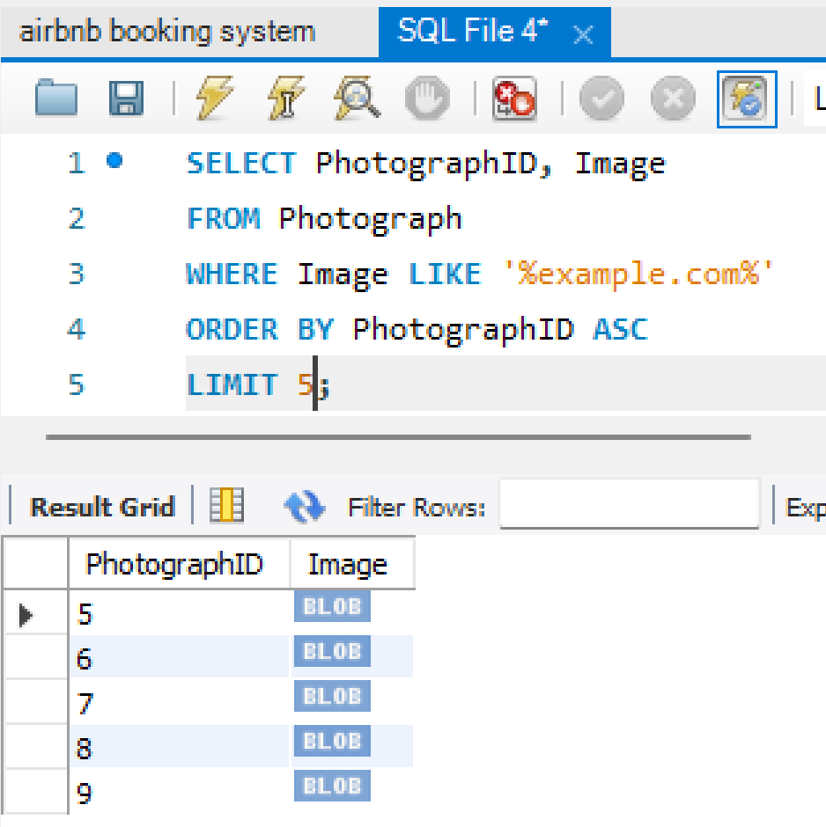
Entity thirteen: PHOTOGRAPH
CREATE TABLE Photograph (
PhotographID INT PRIMARY KEY,
Image BLOB,
RoomID INT,
FOREIGN KEY (RoomID) REFERENCES HotelRoom(RoomID)
);
INSERT INTO Photograph (PhotographID, Image)
VALUES
(1, 'https://hoteladmire.com/image1.jpg'),
(2, 'https://Hotelmoon.com/image2.jpg'),
(3, 'https://Sunnylodge.com/image3.jpg'),
(4, 'https://Hotelfunland.com/image4.jpg'),
(5, 'https://example.com/image5.jpg'),
(6, 'https://example.com/image6.jpg'),
(7, 'https://example.com/image7.jpg'),
(8, 'https://example.com/image8.jpg'),
(9, 'https://example.com/image9.jpg'),
(10, 'https://example.com/image10.jpg'),
(11, 'https://example.com/image11.jpg'),
(12, 'https://example.com/image12.jpg'),
(13, 'https://example.com/image13.jpg'),
(14, 'https://example.com/image14.jpg'),
(15, 'https://example.com/image15.jpg'),
(16, 'https://example.com/image16.jpg'),
(17, 'https://example.com/image17.jpg'),
(18, 'https://example.com/image18.jpg'),
(19, 'https://example.com/image19.jpg'),
(20, 'https://example.com/image20.jpg');

Slide 15
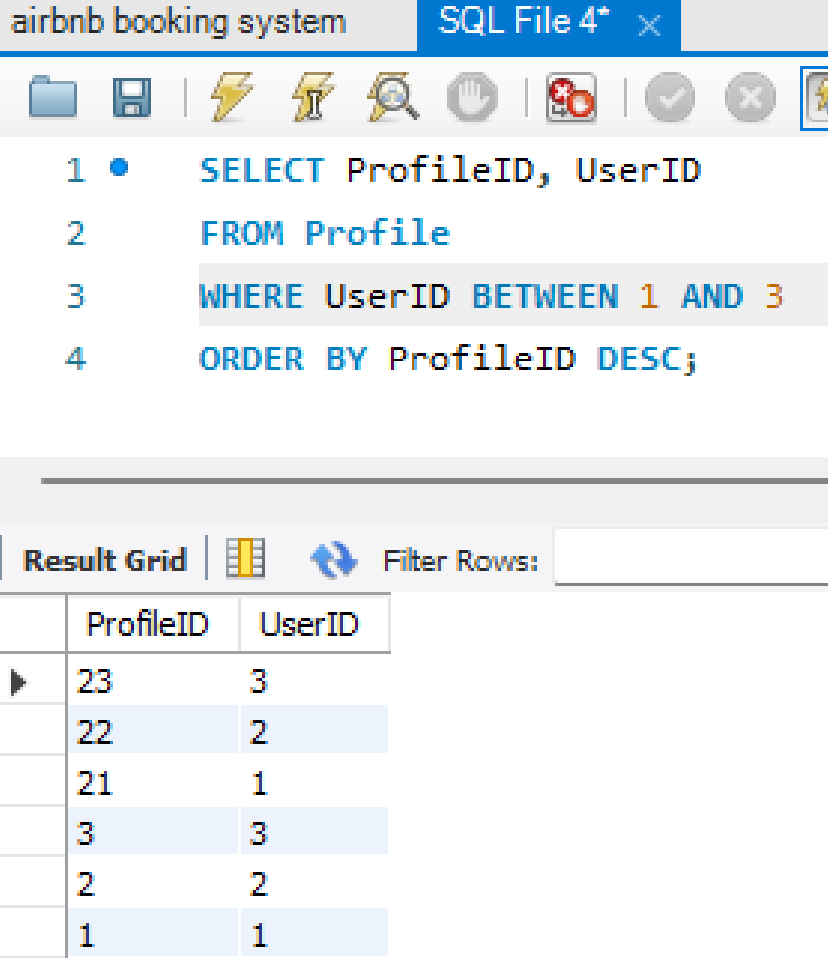
Entity fourteen: PROFILE
CREATE TABLE Profile (
ProfileID INT PRIMARY KEY,
UserID INT,
FOREIGN KEY (UserID) REFERENCES User(UserID)
);
INSERT INTO Profile (ProfileID, UserID)
VALUES
(1, 1),
(2, 2),
(3, 3),
(4, 4),
(5, 5),
(6, 6),
(7, 7),
(8, 8),
(9, 9),
(10, 10),
(11, 11),
(12, 12),
(13, 13),
(14, 14),
(15, 15),
(16, 16),
(17, 17),
(18, 18),
(19, 19),
(20, 20);

Slide 16
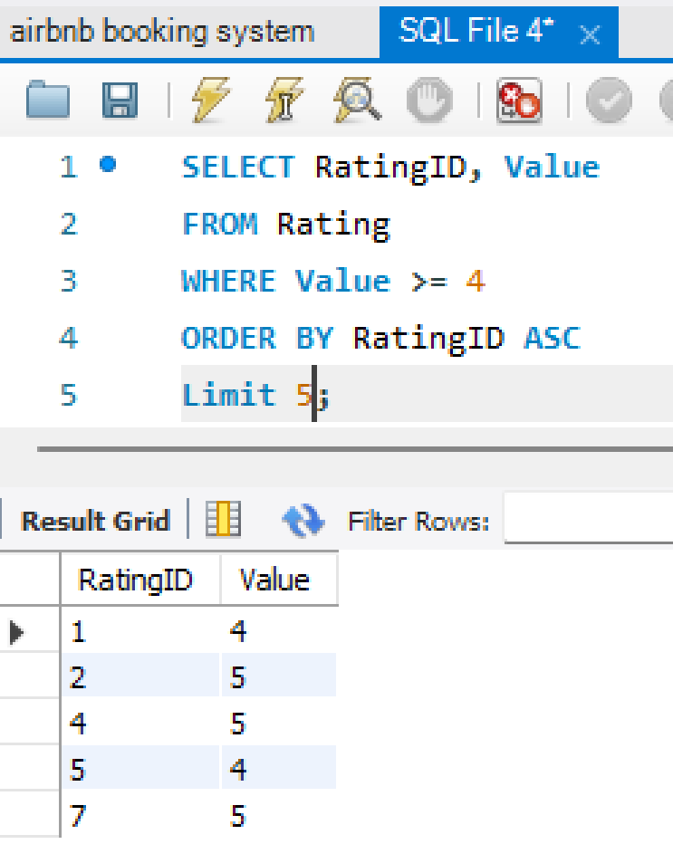
Entity fifteen: RATING
CREATE TABLE Rating (
RatingID INT PRIMARY KEY,
Value INT,
GuestID INT,
FOREIGN KEY (GuestID) REFERENCES Guest(GuestID));
INSERT INTO Rating (RatingID, Value)
VALUES
(1, 4),
(2, 5),
(3, 3),
(4, 5),
(5, 4),
(6, 2),
(7, 5),
(8, 4),
(9, 5),
(10, 3),
(11, 4),
(12, 5),
(13, 3),
(14, 4),
(15, 5),
(16, 2),
(17, 4),
(18, 5),
(19, 3),
(20, 4);

Slide 17
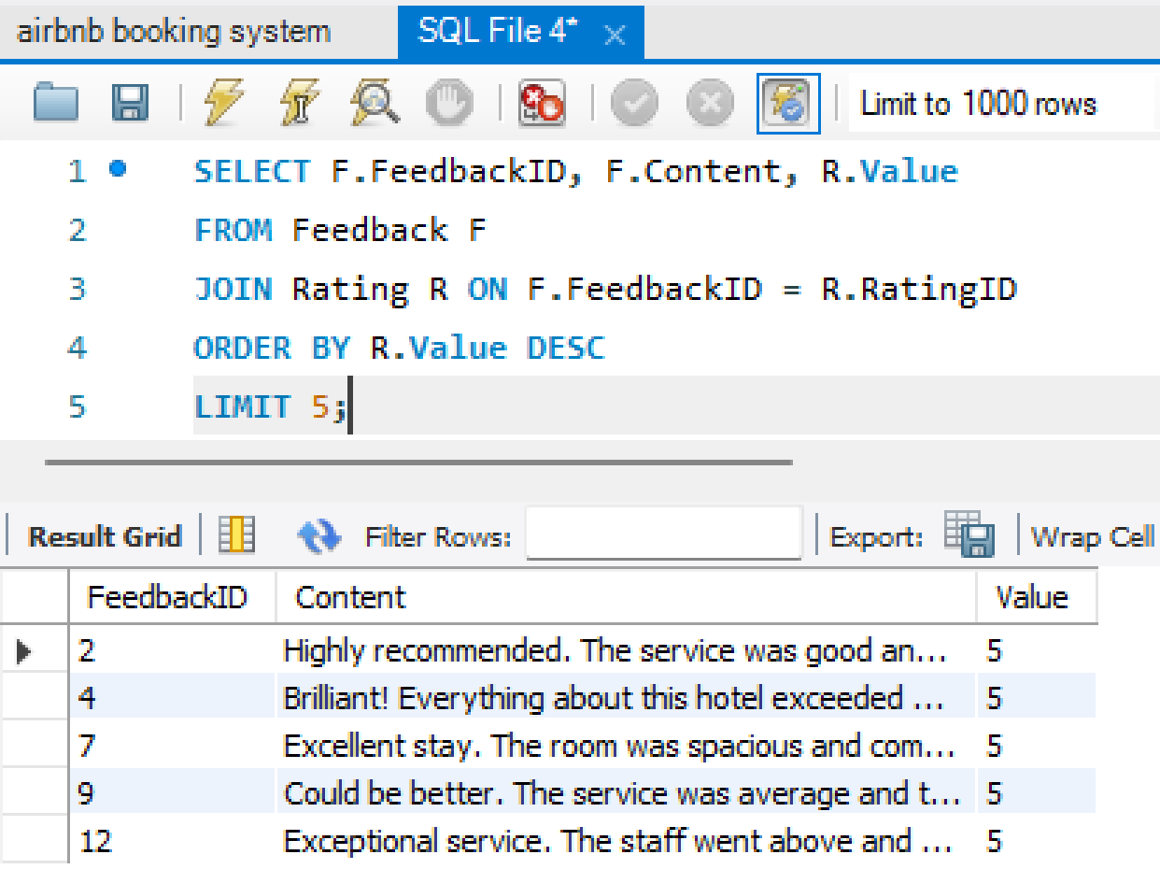
Entity sixteen: FEEDBACK
CREATE TABLE Feedback (
FeedbackID INT PRIMARY KEY,
Content TEXT,
GuestID INT,
FOREIGN KEY (GuestID) REFERENCES Guest(GuestID)
);
INSERT INTO Feedback (FeedbackID, Content)
VALUES
(1, 'Great experience overall. The hotel staff was Caring and the room was clean.'),
(2, 'Highly recommended. The service was good and the location was convenient.'),
(3, 'Average stay. The room was okay, but nothing special.'),
(4, 'Brilliant! Everything about this hotel exceeded my expectations.'),
(5, 'Not satisfied with the stay. The room was small and the amenities were lacking.'),
(6, 'Disappointing experience. The hotel did not meet my expectations.'),
(7, 'Excellent stay. The room was spacious and comfortable.'),
(8, 'Good value for money. The hotel provided all the necessary amenities.'),
(9, 'Could be better. The service was average and the room cleanliness could be improved.'),
(10, 'Wonderful stay. The hotel had a great ambiance and the staff was helpful.'),
(11, 'No complaints. The hotel provided a pleasant and comfortable stay.'),
(12, 'Exceptional service. The staff went above and beyond to ensure a great experience.'),
(13, 'Mixed feelings about this hotel. Some aspects were great, while others were lacking.'),
(14, 'Pleasant stay overall. The hotel had a nice ambiance and the staff was friendly.'),
(15, 'One of the best hotels I''ve stayed in. The room was luxurious and the service was top-notch.'),
(16, 'Not recommended. The hotel was not up to par with its advertised amenities.'),
(17, 'Great value for money. The hotel exceeded our expectations.'),
(18, 'Absolutely fantastic! The hotel had everything we needed and more.'),
(19, 'Mixed experience. Some aspects were good, but others could be improved.'),
(20, 'Lovely hotel with a friendly staff. Enjoyed our stay immensely.');

Slide 18
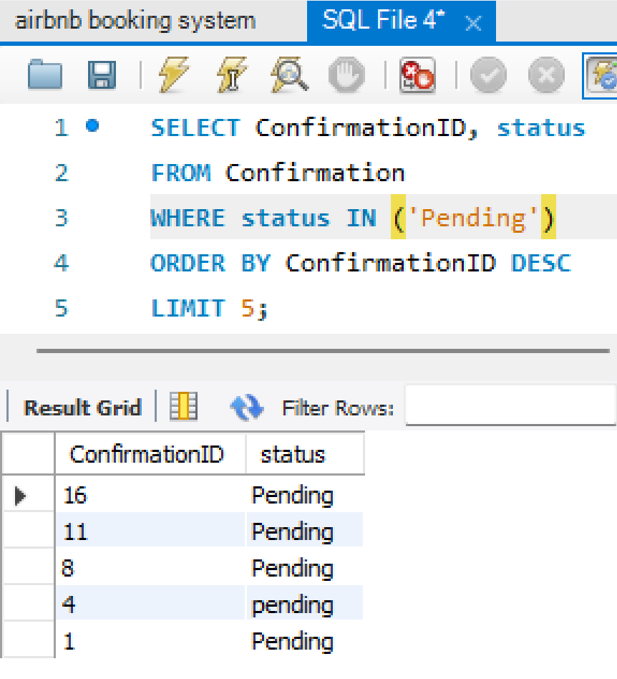
Entity seventeen: CONFIRMATION
CREATE TABLE Confirmation (
ConfirmationID INT PRIMARY KEY,
status VARCHAR(20),
BookingID INT,
FOREIGN KEY (BookingID) REFERENCES Booking(BookingID) );
INSERT INTO Confirmation (ConfirmationID, Status)
VALUES (1, 'Pending'), (2, 'Confirmed'), (3, 'confirmed'), (4, 'pending'),
(5, 'Confirmed'),
(6, 'Confirmed'),
(7, 'Confirmed'),
(8, 'Pending'),
(9, 'Confirmed'),
(10, 'Confirmed'),
(11, 'Pending'),
(12, 'Confirmed'),
(13, 'Confirmed'),
(14, 'Confirmed'),
(15, 'Confirmed'),
(16, 'Pending'),
(17, 'Confirmed'),
(18, 'Confirmed'),
(19, 'Confirmed'),
(20, 'Confirmed');

Slide 19
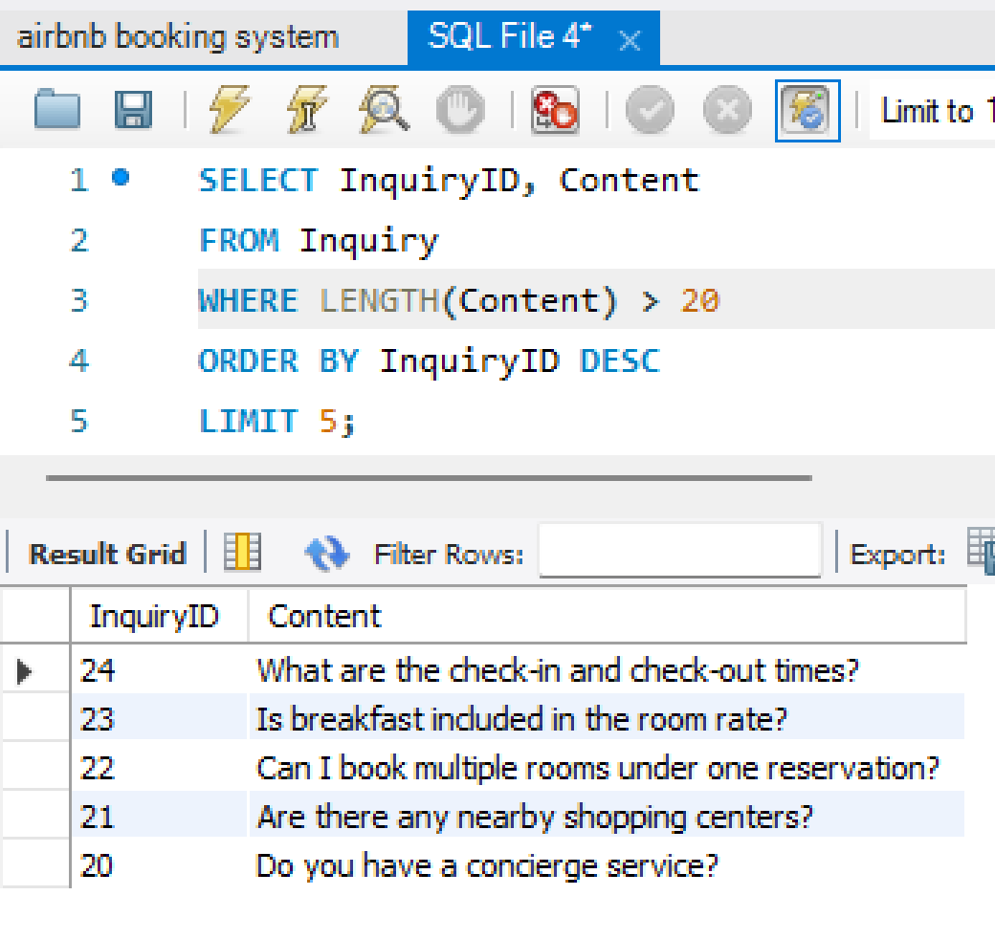
Entity eighteen: INQUIRY
CREATE TABLE Inquiry (
InquiryID INT PRIMARY KEY,
Content TEXT,
BookingID INT,
FOREIGN KEY (BookingID) REFERENCES Booking(BookingID));
INSERT INTO Inquiry (InquiryID, Content)
VALUES
(5, 'What are the nearby attractions to the hotel?'),
(6, 'Do you provide airport shuttle services?'),
(7, 'Are pets allowed in the hotel?'),
(8, 'Can I request an early check-in?'),
(9, 'Are there any restaurants within walking distance?'),
(10, 'Is there a gym or fitness center available?'),
(11, 'Can I make changes to my booking?'),
(12, 'Is there a cancellation policy?'),
(13, 'Are there any special discounts for group bookings?'),
(14, 'Can I request a late check-out?'),
(15, 'Is parking available at the hotel?'),
(16, 'Do you provide room service?'),
(17, 'Are there any additional fees or taxes?'),
(18, 'What is the Wi-Fi policy of the hotel?'),
(19, 'Is there a swimming pool on-site?'),
(20, 'Do you have a concierge service?'),
(21, 'Are there any nearby shopping centers?'),
(22, 'Can I book multiple rooms under one reservation?'),
(23, 'Is breakfast included in the room rate?'),
(24, 'What are the check-in and check-out times?');

Slide 20
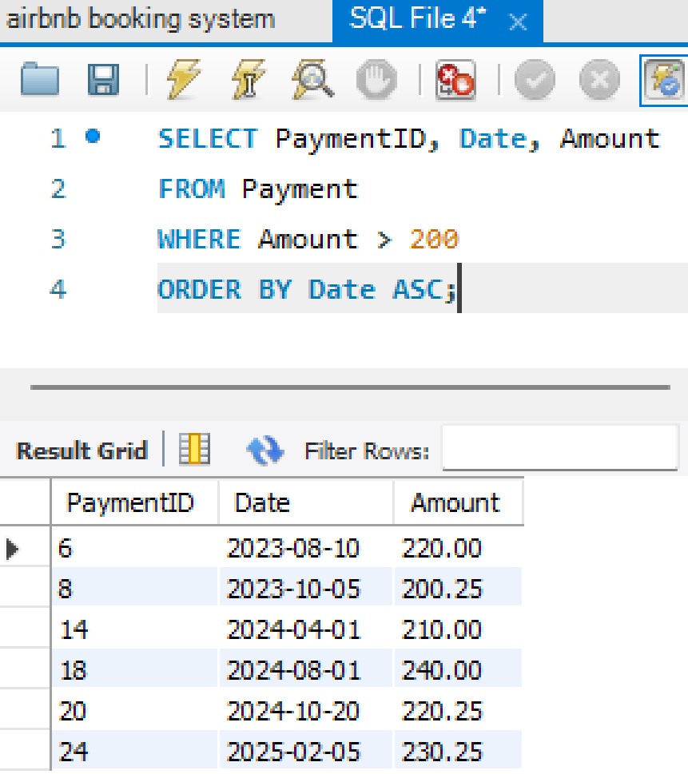
Entity nineteen: PAYMENT
CREATE TABLE Payment (
PaymentID INT PRIMARY KEY,
Date DATE,
Amount DECIMAL(10, 2),
BookingID INT,
FOREIGN KEY (BookingID) REFERENCES Booking(BookingID));
INSERT INTO Payment (PaymentID, Date, Amount)
VALUES
(5, '2023-07-25', 180.50),
(6, '2023-08-10', 220.00),
(7, '2023-09-20', 140.75),
(8, '2023-10-05', 200.25),
(9, '2023-11-15', 160.50),
(10, '2023-12-01', 180.00),
(11, '2024-01-10', 120.75),
(12, '2024-02-05', 190.25),
(13, '2024-03-15', 150.50),
(14, '2024-04-01', 210.00),
(15, '2024-05-10', 130.75),
(16, '2024-06-05', 180.25),
(17, '2024-07-15', 170.50),
(18, '2024-08-01', 240.00),
(19, '2024-09-10', 160.75),
(20, '2024-10-20', 220.25),
(21, '2024-11-25', 190.50),
(22, '2024-12-10', 200.00),
(23, '2025-01-20', 150.75),
(24, '2025-02-05', 230.25);

Slide 21
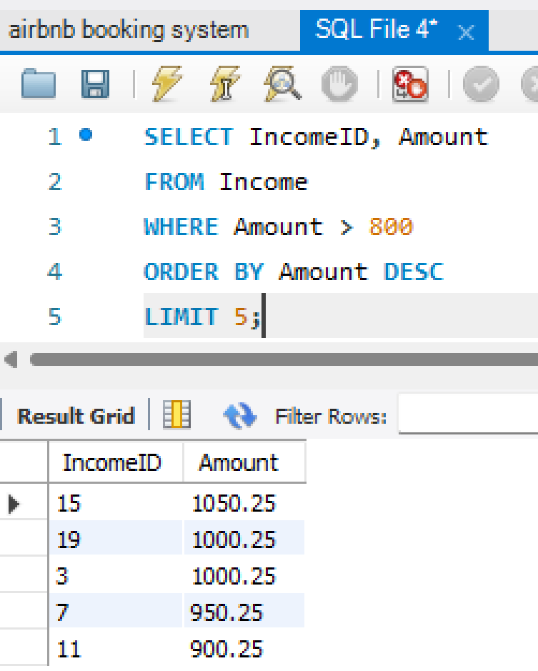
Entity twenty: INCOME
CREATE TABLE Income (
IncomeID INT PRIMARY KEY,
Amount DECIMAL(10, 2),
HostID INT,
FOREIGN KEY (HostID) REFERENCES Host(HostID) );
INSERT INTO Income (IncomeID, Amount)
VALUES
(1, 600.00),
(2, 800.50),
(3, 1000.25),
(4, 700.75),
(5, 550.00),
(6, 750.50),
(7, 950.25),
(8, 650.75),
(9, 500.00),
(10, 700.50),
(11, 900.25),
(12, 600.75),
(13, 650.00),
(14, 850.50),
(15, 1050.25),
(16, 750.75),
(17, 600.00),
(18, 800.50),
(19, 1000.25),
(20, 700.75);

Slide 22
Query using multiple join
USE airbnb_booking_system;
SELECT Booking.BookingID, Host.HostID, Host.
ProfilePicture AS HostProfilePicture, Host.PhoneNumber AS HostPhoneNumber, HotelRoom.RoomID,
HotelRoom.Description AS RoomDescription, HotelRoom.Amenities AS RoomAmenities, Payment.PaymentID, Payment.Date, Payment.Amount AS PaymentAmount, Guest.GuestID,
Guest.ProfilePicture AS GuestProfilePicture, Guest.SocialNetworkLink AS GuestSocialNetworkLink
FROM Booking
JOIN Host ON Booking.HostID = Host.HostID
JOIN HotelRoom ON Booking.RoomID = HotelRoom.RoomID
JOIN Payment ON Booking.BookingID = Payment.PaymentID
JOIN Guest ON Booking.GuestID = Guest.GuestID;

Slide 23
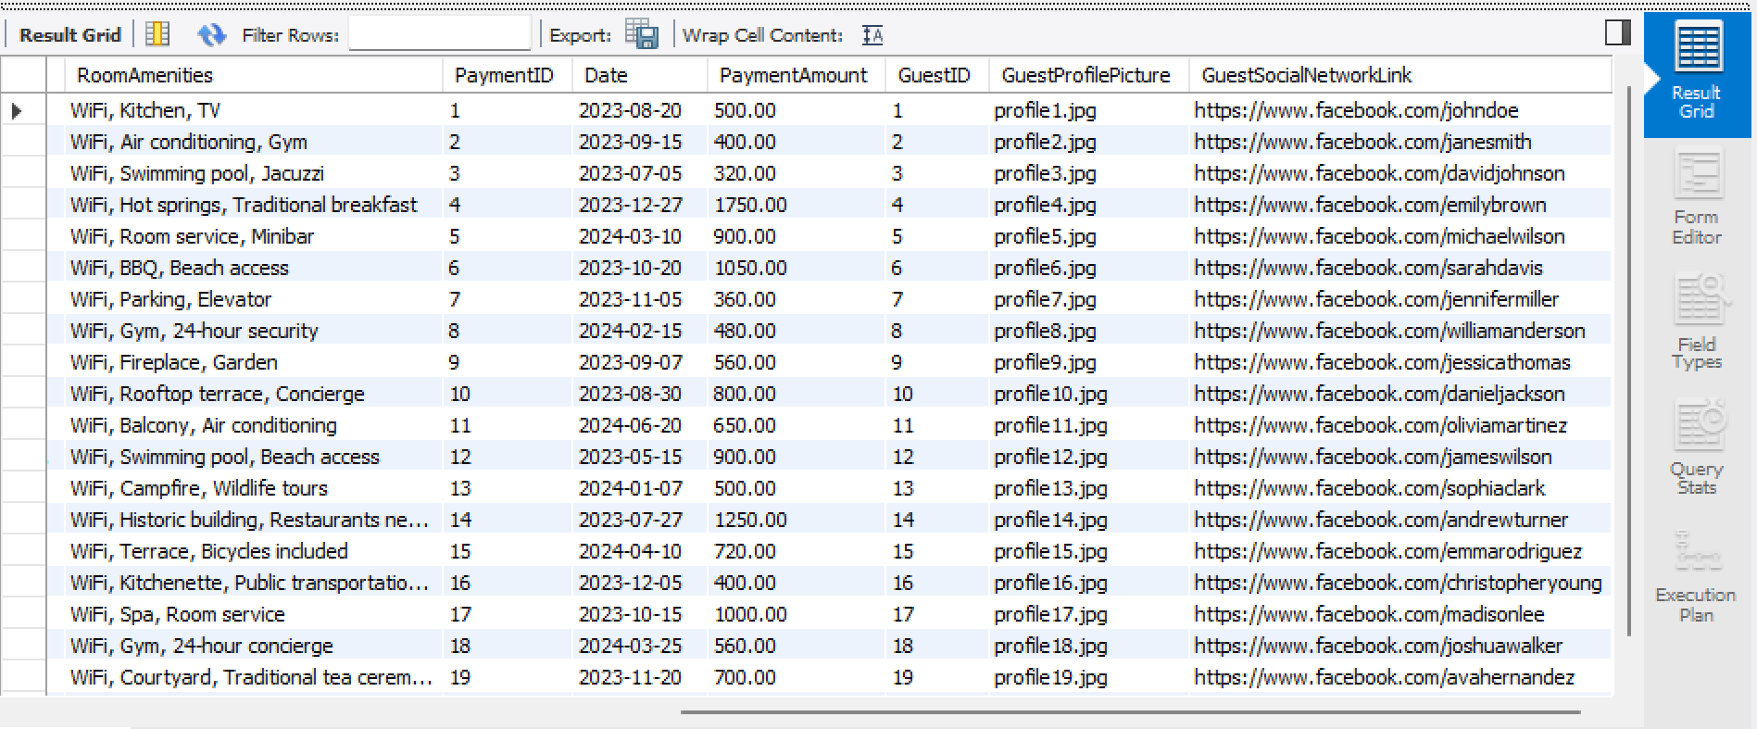
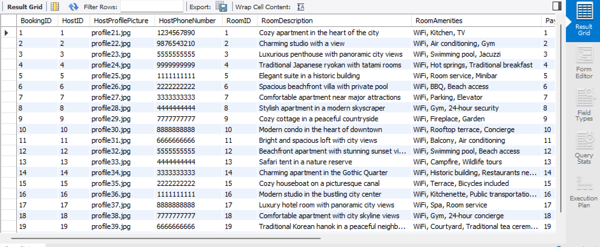
Query using multiple join

Slide 24
THANK YOU!
THE END

