Slide 1

SYNTAX HACKATHON
-KUSHAGR ITTAN

Slide 2
INSTRUCTIONS
1.OPEN THE HTML FILE
2.NOW YOU CAN GO THROUGH THE LIST OF THE SONGS IN PLAYLIST
3.CLICK ON PLAY BUTTON AFTER ANY SONG YOU WANT TO PLAY
4.ENJOY THE MUSIC IN ITS TRUE FORM!!

Slide 3
QUALITIES/SPECIALITIES
NOT VIBRANT AT ALL AND BEST SUITS WITH DARK MODE IN OS.
USER FRIENDLY AND DOES NOT ASK FOR LOGIN
FREE OF COST
ATTRACTIVE WITH A POSITIVE AND DARK EFFECT
CONTAINS ALL HITS OF 2010-2020
TRUE NON-STOP EXPERIENCE
CUSTOMIZABLE ,JUST CONTACT kushagrpc@gmail.com FOR THE SAME.

Slide 4
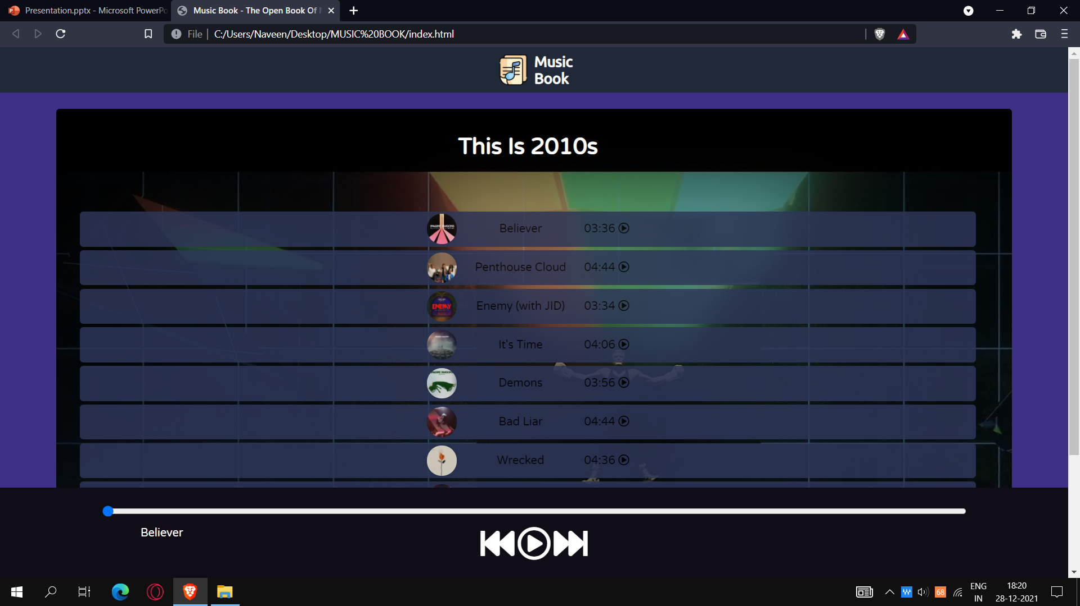
SCREENSHOTS

Slide 5
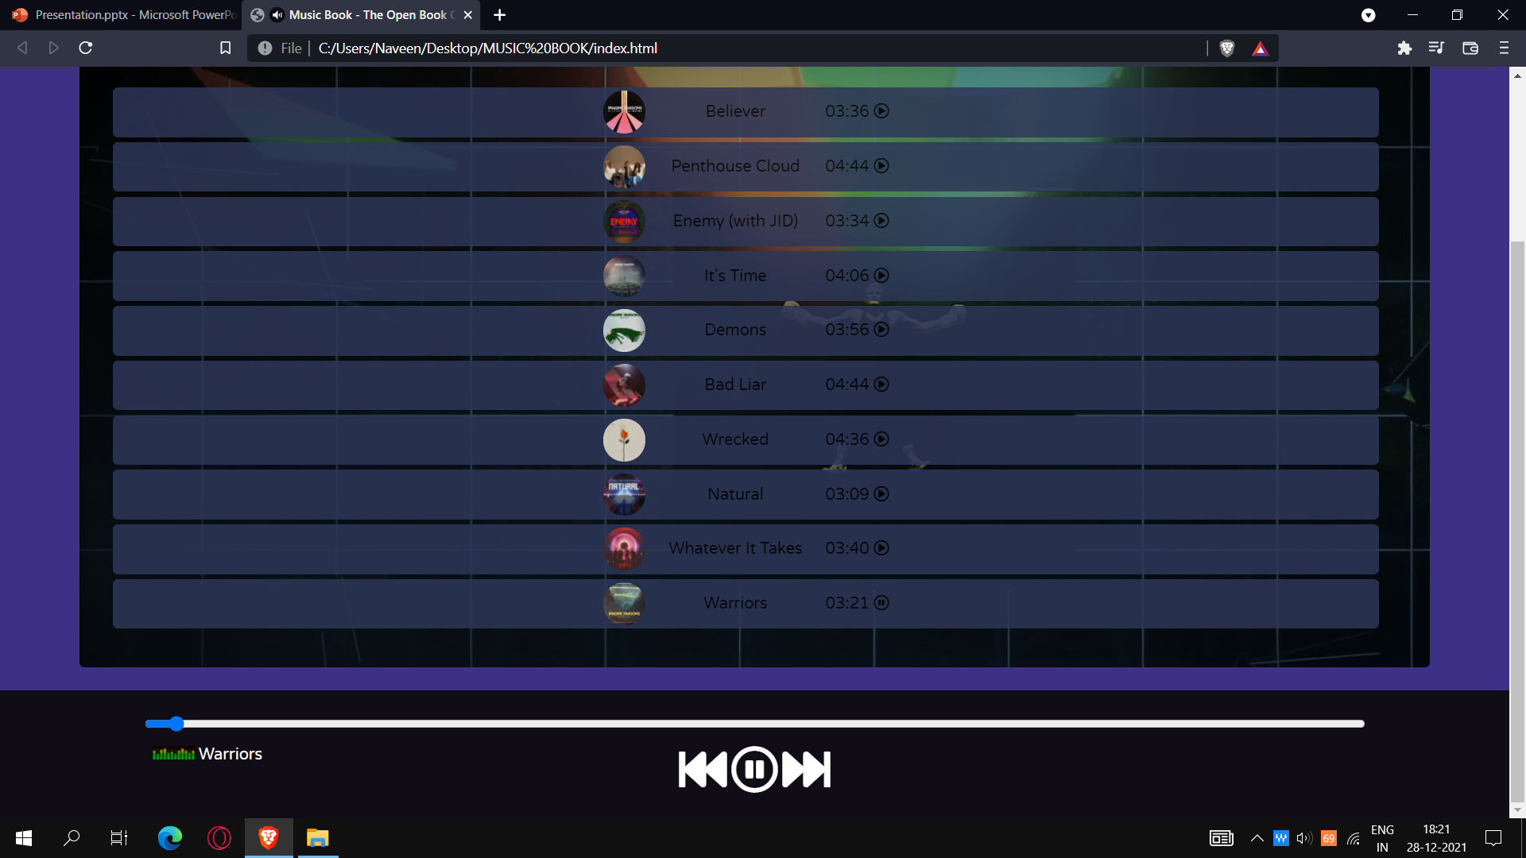
SONGS WITH TRUE BASS

Slide 6


