Slide 1

SYNTAX HACKATHON
-KUSHAGR ITTAN

Slide 2
INSTRUCTIONS
1.OPEN THE HTML FILE
2.NOW YOU CAN GO THROUGH THE LIST OF THE SONGS IN PLAYLIST
3.CLICK ON PLAY BUTTON AFTER ANY SONG YOU WANT TO PLAY
4.ENJOY THE MUSIC IN ITS TRUE FORM!!

Slide 3
UNIQUE ASPECT
You can click on the song name to open the lyrics if you don’t understand or are not good at English hearing .
GIF is played while you are listening to the songs.
Contrast and Opacity has been specially taken care so that users do not feel vibrant while looking at it .
The Design is a bit of Nostalagic for some people and reminds them of something or the other.
It is not a complex audio player and according to what most of our fellow customers need while listening to songs
It has a Bluetooth song BACKWARD ,FORWARD and PAUSE/PLAY support for users using BT headset or wireless devices like speakers ,TWS earphones ,Neckband

Slide 4
QUALITIES/SPECIALITIES
NOT VIBRANT AT ALL AND BEST SUITS WITH DARK MODE IN OS.
USER FRIENDLY AND DOES NOT ASK FOR LOGIN
FREE OF COST
ATTRACTIVE WITH A POSITIVE AND DARK EFFECT
CONTAINS ALL HITS OF 2010-2020
TRUE NON-STOP EXPERIENCE
CUSTOMIZABLE ,JUST CONTACT kushagrpc@gmail.com FOR THE SAME.

Slide 5
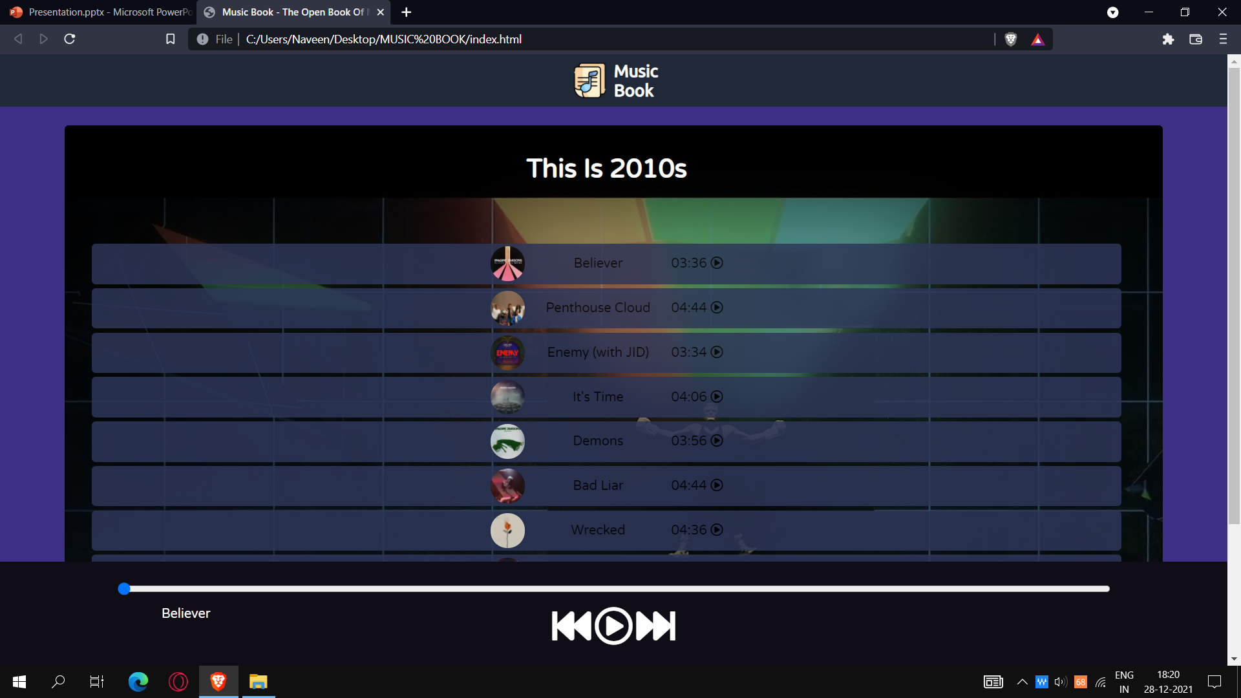
SCREENSHOTS

Slide 6
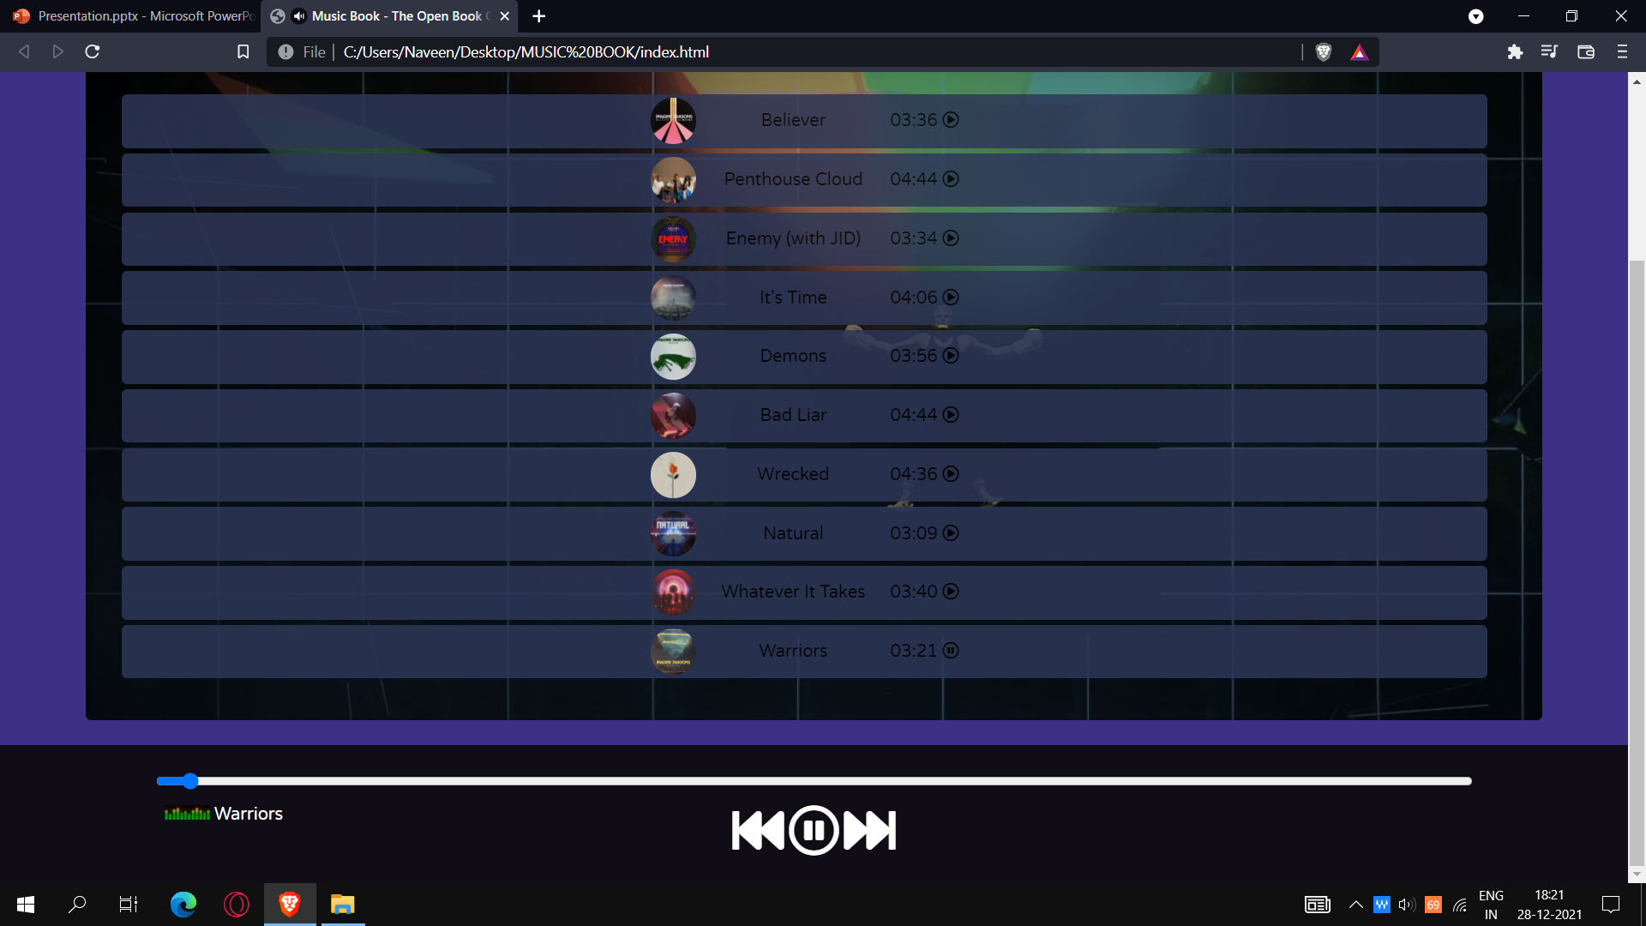
SONGS WITH TRUE BASS

Slide 7


