Slide 1

Zomato Unit Economics & Risk Simulator (FY24)
Monte Carlo Based Profitability Model
Kushagra Bansal

Slide 2
Why Model Unit Economics?
Food delivery profitability is highly sensitive to small fluctuations in AOV, CAC, refunds, and rider payouts
Static Excel models hide risk because they assume fixed averages
Real-world costs behave like distributions, not constants
Monte Carlo helps quantify risk of loss per order (vs. point estimates)
Goal: simulate volatility, identify failure points, and test strategy levers

Slide 3
FY24 Operating Inputs Used in the Simulator (Zomato Actuals + Industry Ranges)
Driver | Value Used | Source / Logic
AOV (Mean) | ₹428 | Zomato FY24 AOV
AOV (Std Dev) | ₹50 | Basket size volatility
Commission Rate | 22.5% | Typical take rate
Delivery Fee | ₹33 | FY24 average per order
Rider Cost (Mean) | ₹32 | Industry avg payout
Rider Cost (Std Dev) | ₹10 | Traffic/rain variability
Packaging Cost | ₹12 | Restaurant reimbursement
CAC/Marketing Cost | ₹20 (SD 10) | FY24 marketing allocation
Refund Probability | 2% | Cancellations/refunds
Refund Loss Amount | = AOV | Full order value lost
Payment Gateway Fee | 2.4% of AOV | Standard MDR
Monthly Orders (FY24) | ~66 million | GOV ÷ AOV
This simulator is built on Zomato’s FY24 food-delivery metrics and realistic industry cost distributions. These assumptions form the baseline for the Monte Carlo model.
These parameters define the statistical “shape” of unit economics and allow us to simulate 10,000 realistic profit outcomes instead of a single static estimate.

Slide 4
The “Golden Equation” of Profit per Order (Unit Economics Framework)
Zomato’s profitability fundamentally depends on how revenue and variable costs behave at the order level.
This equation defines how every assumption in the model flows into profit:
Net Profit per Order = Revenue - Cost
per Order per Order
Revenue Components
Revenue = (AOV × Commission Rate) + Delivery Fee
Commission = Platform take rate from restaurant
Delivery Fee = Paid by customer
Cost Components
Costs = Rider Cost + Packaging Cost + CAC/Marketing + Payment Gateway Fee + Refund Loss
Rider Cost: Payout to delivery partner (varies with traffic, rain → modeled as Normal dist.)
Packaging Cost: Reimbursement/charge per order
CAC / Marketing Cost: Spread across acquired users
Gateway Fee: % of AOV (typically 2–3%)
Refund Loss: = AOV × (refund probability)
Example: FY24 Average Order (Illustration)
AOV = ₹428
Commission (22.5%) = ₹96.3
Delivery Fee = ₹33 → Revenue ≈ ₹129.3
Rider Cost ≈ ₹32
CAC ≈ ₹20
Packaging ≈ ₹12
Gateway Fee ≈ ₹10.3
Refund Cost (2% × AOV) ≈ ₹8.5 → Total Cost ≈ ₹82.8
Net Profit ≈ ₹46.5 per order
(This matches the baseline simulation output)
This equation converts Zomato’s operating model into a simulation-ready financial structure, enabling risk and profitability modeling across thousands of scenarios.

Slide 5
Monte Carlo Simulation: Measuring Profitability & Risk Under Real World Uncertainty
Traditional unit economics assume fixed costs. But in reality, rider payouts, CAC, refunds, packaging, and AOV fluctuate daily.
Monte Carlo simulation introduces probability into the equation — generating thousands of possible outcomes instead of just one number.
This allows Zomato to measure profit volatility, downside risk, and sensitivity to operational changes.
How the Simulator Runs (Step-by-Step):
Randomly generates 10,000 “virtual orders” Each order has:
AOV drawn from a Normal distribution
Rider cost drawn from a Normal distribution
CAC drawn from a Normal distribution
Refund occurrence drawn from a Bernoulli distribution (0 or 1)
Applies the Golden Equation to every order Net Profit = Revenue – Costs (using that order’s random variables)
Creates a Profit Distribution Instead of one number, you get a curve of outcomes (your bell-shaped graph).
Calculates Key Risk Metrics:
Average profit per order
Probability of loss (profit < 0)
Range of best-case and worst-case outcomes
Scales this to Monthly Profit using FY24 volumes (~66M orders per month)
Why Monte Carlo Is Valuable for Food Delivery:
Captures real operational uncertainty Rider with rain, traffic, peak costs vary ours.
Models edge cases High refund days, spikes in CAC, festival demand.
Shows the downside risk of decisions Example: Increasing delivery fee lowers loss risk but reduces order volume.
Helps design pricing, commissions, and incentives By seeing which variables matter most.
Transforms unit economics from static to probabilistic
Monte Carlo simulation converts Zomato’s unit economics into a predictive risk engine — enabling smarter decisions on pricing, incentives, and profitability levers.

Slide 6
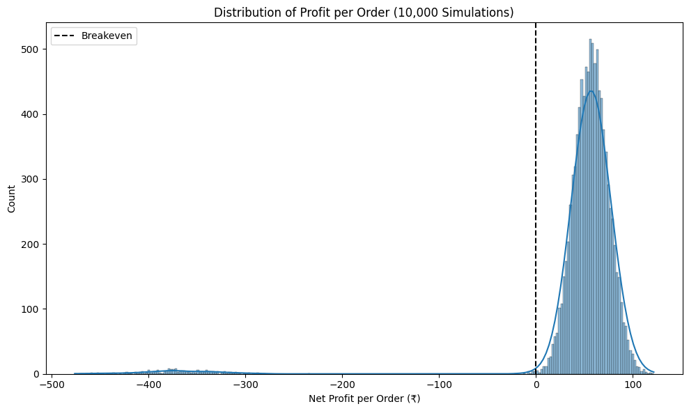
Baseline Simulation Results (10,000 Orders)
Baseline Profit Curve (10,000 Orders)
Baseline (FY24 Inputs):
Avg Profit/order: ₹48.26
Loss Risk: 2.20%
5th–95th Percentile Range: ₹10 → ₹100
Monthly Orders: ~66M
Monthly Profit: ₹318.5 Cr
Interpretation:
Unit economics are solidly profitable.
Loss-making orders are rare (~2%).
Profit distribution is stable + predictable.
What the Curve Shows:
Most orders cluster at ₹45– ₹60 profit.
Upside driven by efficient delivery days.
Implications:
Strong baseline before optimization.
Rider volatility, refunds, and CAC are the biggest levers.
Baseline FY24 economics show strong profitability with limited downside risk.

Slide 7
Scenario Testing: Evaluating Profit & Risk Impact Across Five Strategic Levers
Using Monte Carlo, we test how changes to pricing, refunds, rider costs, CAC, and commissions shift profitability and downside risk.
Lever A — Delivery Fee (+₹5)
Goal: Increase per-order revenue Risk: Slight customer churn
Lever B — Refund Probability (2% → 1%)
Goal: Reduce refund-related losses Risk: Lower new-user trust if refund policies tighten
Lever C — Rider Cost Variance (SD 10 → 6)
Goal: Stabilize delivery payouts Risk: Potential rider dissatisfaction / slower supply response
Lever D — Reduce CAC (₹20 → ₹10)
Goal: Lower marketing spend per order Risk: Slower user growth
Lever E — Increase Commission (22.5% → 25%)
Goal: Increase take rate from restaurants Risk: Possible restaurant churn to competitors
Why These 5?
These five variables create 90% of Zomato’s profit volatility:
Delivery fee → revenue driver
Refunds → pure downside loss
Rider variance → operational unpredictability
CAC → marketing efficiency
Commission → platform monetization
Together, they represent the core levers Zomato can realistically adjust.
These scenarios quantify how operational changes translate into profit shifts and risk reductions.

Slide 8
Scenario Results: Profitability & Risk Comparison
Scenario | Avg Profit / Order (₹) | Loss Risk (%) | Monthly Profit (₹ Cr)
Baseline (FY24) | 48.26 | 2.20% | 318.5
A. +₹5 Delivery Fee | 51.31 | 1.82% | 328.5
B. Refund ↓ (2% → 1%) | 52.70 | 1.02% | 337.4
C. Rider Cost Variance ↓ | 47.49 | 2.24% | 310.3
D. CAC ↓ (₹20 → ₹10) | 59.27 | 1.82% | 371.6
E. Commission ↑ (22.5% → 25%) | 58.24 | 2.20% | 376.7
Key Takeaways
Biggest profit upside: Reducing CAC and increasing commission
Lowest downside risk: Reducing refund probability
Most stable economics: Lower rider cost variance
Trade-offs exist: Higher profits often come with churn or growth risk
(All scenarios simulated using 10,000 Monte Carlo runs and scaled to FY24 monthly volumes)
Not all profit levers are equal — CAC efficiency and refunds deliver the best risk-adjusted gains.

Slide 9
Key Insights & Strategic Recommendations
KEY INSIGHTS
Zomato’s FY24 unit economics are structurally profitable Baseline profit of ~₹48/order with low downside risk (~2%).
Not all levers deliver equal risk-adjusted returns Some increase profit but introduce churn or growth risk.
Refund probability is the most effective risk reducer Cutting refunds from 2% → 1% halves loss risk with minimal volume impact.
CAC efficiency unlocks the largest profit upside Reducing CAC delivers the highest improvement in monthly profit.
Commission increases boost profit but carry ecosystem risk Higher take rates risk restaurant churn over time.
STRATEGIC RECOMMENDATIONS
1. Prioritize Refund Reduction (Low Risk, High Stability)
Improve order accuracy, packaging standards, and customer communication.
Delivers the lowest loss risk (≈1%) with limited demand impact.
2. Focus on CAC Efficiency, Not Absolute Cuts
Shift from blanket discounts to targeted, cohort-based incentives.
Preserves growth while capturing ₹50+ Cr monthly upside.
3. Use Delivery Fee Increases Selectively
Apply dynamic pricing during peak demand and high congestion periods.
Increases profitability without broad-based churn.
4. Treat Commission Increases as a Secondary Lever
Pair higher commissions with restaurant value-adds (ads, analytics).
Avoid long-term platform disintermediation risk.
5. Improve Rider Cost Predictability, Not Suppression
Use surge pricing and routing optimization instead of hard cost caps.
Stabilizes operations without triggering supply shocks.
The optimal strategy combines refund reduction and CAC efficiency first, with pricing and commission levers used selectively.

Slide 10
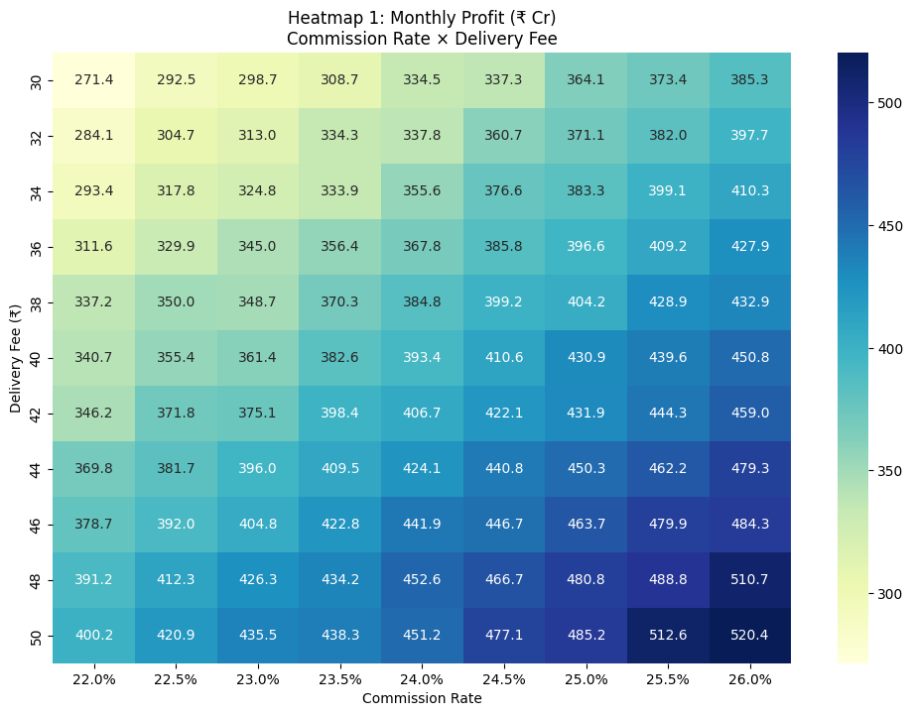
Sensitivity Analysis: Monthly Profit Impact of Pricing Levers
Monthly Profit Sensitivity (₹ Cr)
Commission Rate × Delivery Fee
What this shows:
Profit increases monotonically with higher commission and delivery fees
Delivery fee increases have a linear impact
Commission increases have a compounding impact at scale
Insight:
Pricing levers are powerful
Should be applied selectively to avoid customer or restaurant churn
Pricing decisions materially impact profitability, but scale effects amplify commission changes.

Slide 11
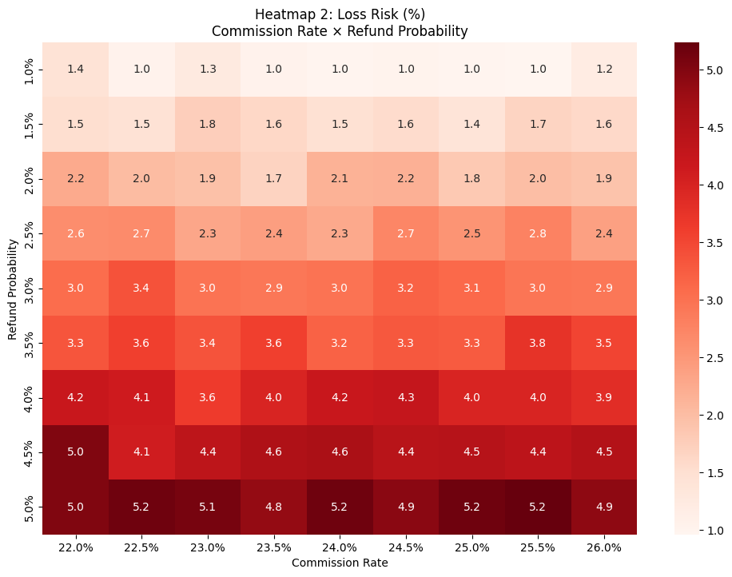
Sensitivity Analysis: Loss Risk Response to Refund Probability
Loss Risk Sensitivity (%)
Commission Rate × Refund Probability
What this shows:
Refund probability is the dominant driver of downside risk
Higher commission cannot offset high refund rates
Loss risk rises sharply beyond ~3–4% refund probability
Insight:
Operational quality and order accuracy matter more than monetization for risk control
Refund control is the single most effective lever for reducing loss-making orders.

Slide 12
Limitations, Assumptions & Next Steps
KEY ASSUMPTIONS
FY24 averages used for AOV, commissions, and order volumes
Cost drivers modeled as independent probability distributions
Order volume elasticity applied conservatively at scenario level
Competitive landscape assumed stable in the short term
LIMITATIONS
Does not model long-term customer or restaurant churn dynamics
Cross-effects between levers (e.g., higher fees → refunds) not fully captured
City-level, time-of-day, and cohort-level variations not modeled
Results indicate directional strategy impact, not exact forecasts
NEXT STEPS
Add cohort-based demand and churn modeling
Extend simulator to city-level and peak/off-peak analysis
Integrate real-time operational data for live decision support
Use simulator as a pricing & policy experimentation tool
Code & Simulation Notebooks:
https://github.com/Kushagra-1210/Zomato-Unit-Economics-Simulator.git
This simulator is a strategic decision-support tool — not a static forecasting model.

