Slide 1
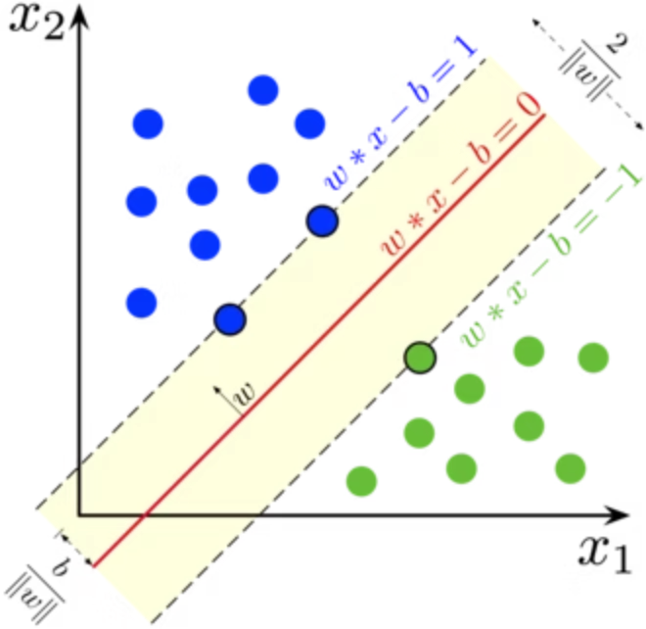
Unveiling Support Vector Machines (SVMs)
Support Vector Machines (SVMs) are powerful supervised machine learning algorithms. They are versatile, capable of handling classification, regression, and even outlier detection tasks. At their core, SVMs aim to find the optimal separating boundary, known as a hyperplane, that maximizes the distance between different classes of data. This "maximum margin" approach is what gives SVMs their robustness and effectiveness.

Slide 2

Understanding the Core Concepts of SVM
Hyperplane
Margin
Support Vectors
This is the decision boundary that distinctly separates different classes within the dataset. In a 2D space, it's a line; in 3D, it's a plane; and in higher dimensions, it's a hyperplane.
The margin represents the distance between the hyperplane and the closest data points from each class. The goal of an SVM is to maximize this margin, leading to better generalization.
These are the critical data points that lie closest to the hyperplane. They are the most influential points, as they directly determine the position and orientation of the optimal hyperplane.

Slide 3
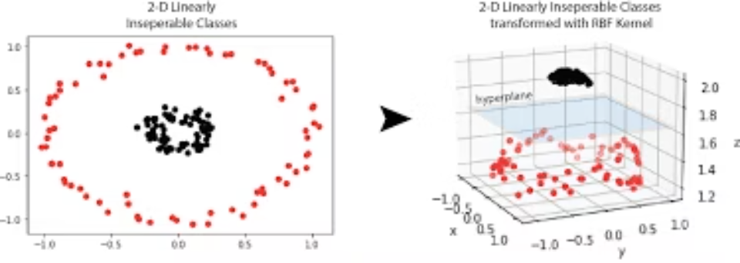
Why Choose SVMs? Key Advantages & Applications
Why SVMs Excel:
Real-World Applications:
High-Dimensional Effectiveness: SVMs perform exceptionally well even in spaces with a large number of features, making them suitable for complex datasets.
Image Classification: Identifying objects or patterns within images, such as facial recognition.
Spam Detection: Classifying emails as legitimate or spam based on their content and features.
Clear Margin Separation: They are particularly effective when there's a discernible margin of separation between classes, leading to robust classification.
Bioinformatics: Used for tasks like gene classification and protein structure prediction.
Robust Against Overfitting: With appropriate regularization techniques, SVMs can mitigate the risk of overfitting, ensuring better performance on unseen data.
Text Categorization: Sorting documents or articles into predefined categories based on their textual content.

Slide 4

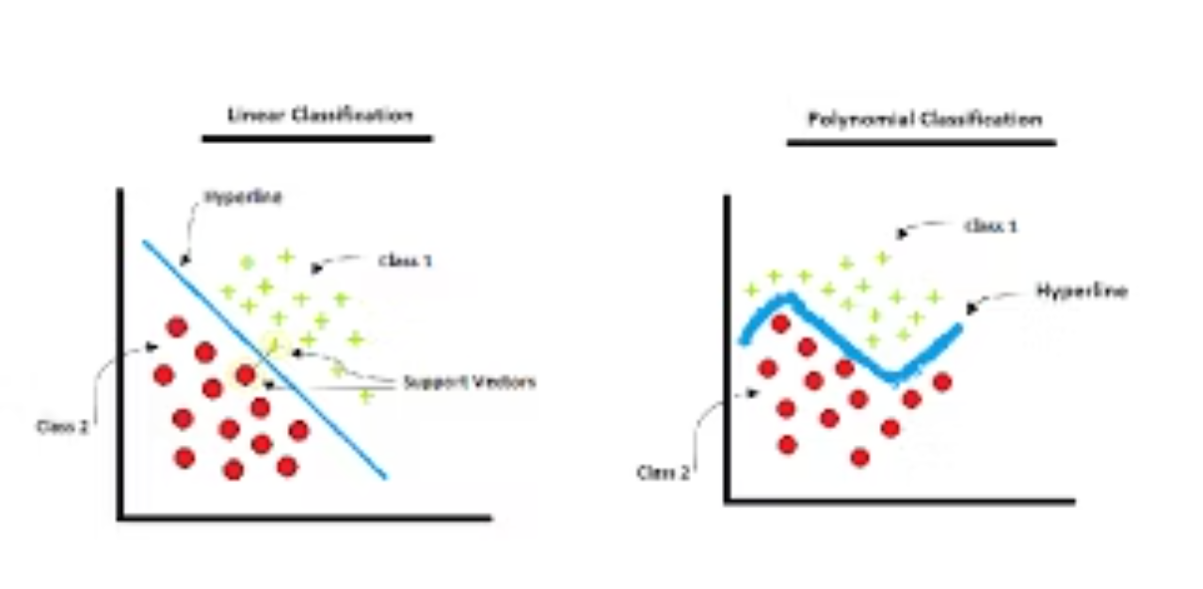
Exploring SVM Types & Kernel Functions
1
2
Linear SVM
Non-linear SVM
Applicable when data points can be separated by a single straight line (or hyperplane) in their original feature space. It seeks to find this linear decision boundary.
When data is not linearly separable, non-linear SVMs employ kernel functions to transform the data into a higher-dimensional space where a linear separation becomes possible.
Kernel functions are crucial for non-linear SVMs, allowing them to model complex relationships between data points without explicitly calculating the coordinates in the higher-dimensional space—a technique known as the "kernel trick."

Slide 5





The Power of Kernel Functions
Linear Kernel
Polynomial Kernel
Ideal for datasets that are inherently linearly separable, where a straight line or plane suffices to distinguish classes.
Suitable for capturing curved decision boundaries, allowing for more flexible separation of classes based on polynomial combinations of features.
RBF (Gaussian) Kernel
Sigmoid Kernel
The most widely used kernel, excellent for modeling complex, non-linear relationships and capturing intricate patterns in the data.
Often behaves similarly to neural networks, useful in scenarios where the data exhibits characteristics amenable to activation function-like transformations.
These kernel functions are what allow SVMs to tackle a wide variety of classification problems, transforming data into a space where even complex separations become manageable.

Slide 6
Introducing Support Vector Classification (SVC)
Support Vector Classification (SVC) is the specific implementation of the SVM algorithm tailored for classification tasks. Its primary objective is to construct an optimal decision boundary based on the margin maximization principle, effectively separating different categories of data.
SVC aims to minimize classification error by maximizing the margin of separation, ensuring robust and generalizable models.
The Hinge Loss Function
SVC employs the Hinge Loss function to quantify the error. This loss function penalizes misclassified points and points that are within the margin, driving the algorithm to find the widest possible margin.
Here, y_i is the true label, w^T x_i + b is the decision function output, and the loss is zero if the point is correctly classified outside the margin.

Slide 7
How SVC Works: A Step-by-Step Approach
01
02
03
Labeled Data Input
Kernel Selection
Margin Maximization
SVC begins by taking a dataset where each data point is associated with a known class label.
A suitable kernel (e.g., linear, RBF, polynomial) is chosen based on the anticipated complexity of the decision boundary needed.
The algorithm then works to identify the hyperplane that maximizes the margin between the different classes, using support vectors as guiding points.
04
05
Classifier Creation
Prediction on New Data
Once the optimal hyperplane is found, an SVC classifier is created, effectively defining the separation boundary.
Finally, the trained classifier is used to predict the class labels for new, unseen data points, placing them on one side or the other of the learned boundary.

Slide 8
Key Hyperparameters for SVC Model Tuning
Effective tuning of SVC hyperparameters is crucial for achieving optimal model performance, balancing bias and variance.
C (Regularization Parameter)
Kernel
Gamma (γ)
This parameter dictates the trade-off between maximizing the margin and minimizing classification errors on the training data.
The choice of kernel function fundamentally determines the shape of the decision boundary.
Used specifically in the RBF and polynomial kernels, Gamma influences the reach of a single training example.
"linear": Creates a straight decision boundary.
High Gamma: Decision boundary becomes tight, sensitive to individual data points (overfitting).
High C: Smaller margin, aims for perfect classification (risk of overfitting).
"rbf": Generates flexible, curved boundaries.
Low Gamma: Produces a smoother, broader decision boundary (potential for underfitting).
Low C: Larger margin, allows more misclassifications (better generalization).
"poly": Forms polynomial curves for separation.

Slide 9
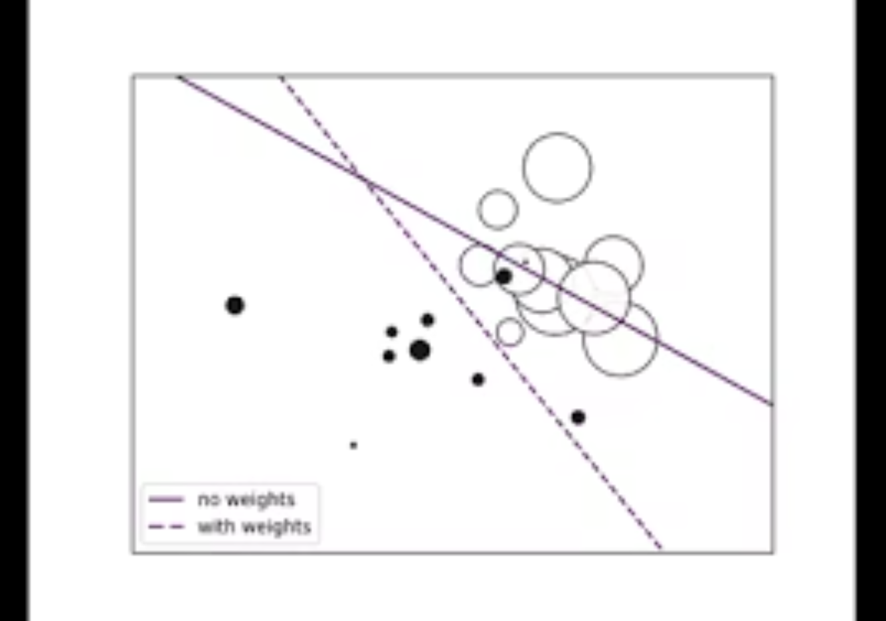
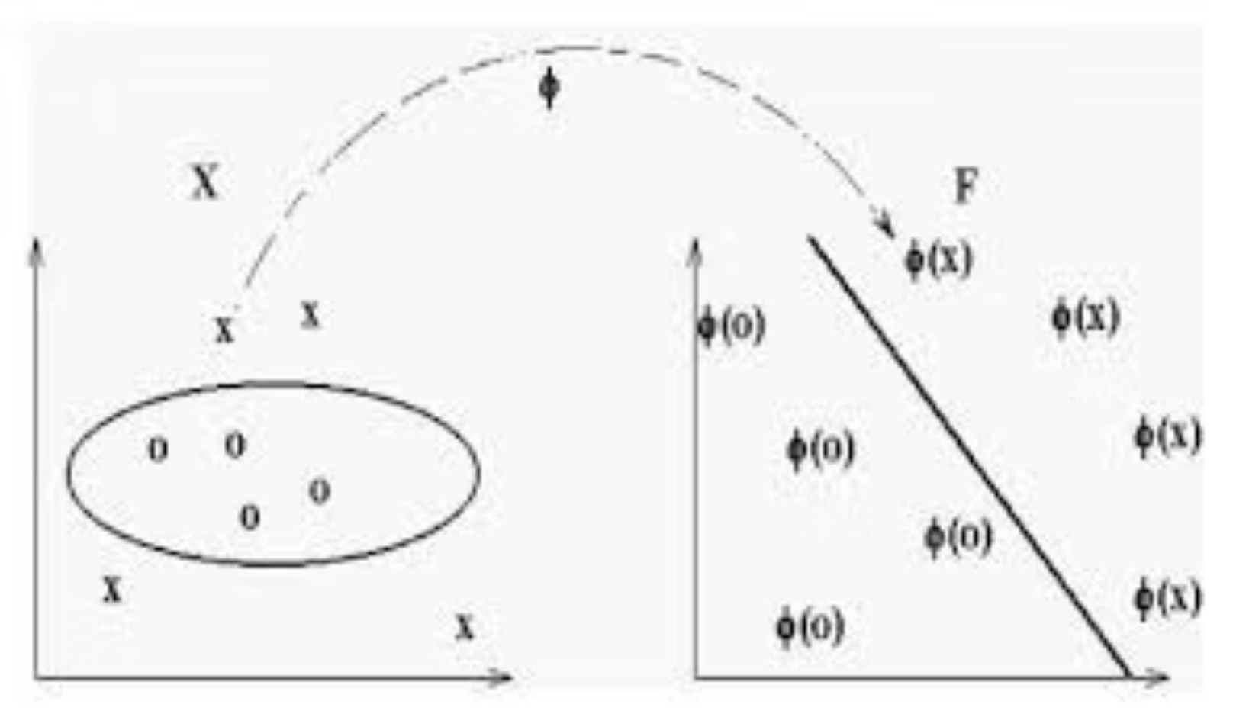

Advanced Hyperparameters for Refined Control
Beyond the primary parameters, several others provide granular control over SVC behavior.
Degree
Class Weight
(For Polynomial Kernel only)
Crucial for addressing imbalanced datasets.
Specifies the degree of the polynomial function.
Assigns higher penalties to misclassifying the minority class.
Higher degrees create more complex, curved decision boundaries.
Helps prevent the model from becoming biased towards the majority class.
Default value is typically 3.
Other Useful Parameters:
probability=True: Enables probability estimates for predictions.
shrinking=True: Can improve training speed for larger datasets.
max_iter: Sets a limit on the number of iterations for training, preventing excessive runtimes.

Slide 10

SVC Classification Workflow: From Data to Evaluation
Implementing SVC involves a systematic workflow, from initial data preparation to model evaluation and hyperparameter optimization.
Import Dataset
Load your labeled dataset, ensuring data quality and readiness for processing.
Split Data
Divide the dataset into training and testing sets to evaluate model performance objectively.
Standardize Features
Apply standardization or normalization to features, which often improves SVM performance, especially for kernels like RBF.
Choose Kernel
Select an appropriate kernel function (e.g., RBF is a common starting point) based on the data's characteristics.
Train SVC Model
Fit the SVC model to your training data using the chosen kernel and initial hyperparameters.
Tune Hyperparameters
Optimize model performance using techniques like GridSearchCV to systematically search for the best combination of hyperparameters.
Evaluate Performance
Assess the model's effectiveness using metrics such as accuracy, confusion matrix, precision, recall, and F1-score on the test set.

