Slide 1
Embedding Java Classes with code2vec: Improvements from Variable Obfuscation
A paper by Rhys Compton, Eibe Frank, Panos Patros and Abigail Koay
Presentation By Kushagra Chaturvedy

Slide 2
Code2vec
Code2vec is a recently released embedding approach that uses the proxy task of method name prediction to map Java methods to feature vectors using neural networks.
Code2vec converts Java code into a set of paths from the code’s Abstract Syntax Tree (AST) and learns to combine these paths using an attention mechanism.
Embeddings capture information about code semantics
Can be useful for a variety of tasks such as author attribution, bug detection etc.

Slide 3
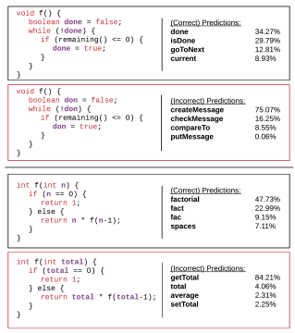
Problems and shortcomings
However, since the AST contains variable names as leaves, experimentation with code2vec shows that it overfits on variable names for prediction.
Does not allow the model to generalize and affects the model’s classification accuracy if the variables are typos.
Moreover, it can only create embeddings for individual functions and methods and cannot summarize an entire Java class in a single vector
Notes:
Overfits on variable name because the model is trained on projects from Github where conventional variable names are used which are predictive in nature.

Slide 4
Solutions
Dependency on variable names: Obfuscation to help the model focus more on code structure.
Class level embeddings: Aggregation of method level vectors to obtain class level embeddings.
Does obfuscation of variable names yield an improved model of code semantics?
How should we aggregate embeddings for methods?
Notes:
Limit the information that the model gets from variables by obfuscating them, forcing the model to analyze the code structure leading to better generalization in prediction. Multiple ways of obfuscation that we will see in a moment.
As for aggregations, how to do aggregations of method vectors in a Java class to accurately describe the class as a single entity?

Slide 5
Learning code embeddings
Code2vec extracts information from code using AST.
Contains the code’s syntactic structure
Model objective is to create similar embeddings for similar methods
To do so, it is trained by optimizing the accuracy of predicting method names
Notes:
The syntactic structure of the code defines the code’s functionality.

Slide 6
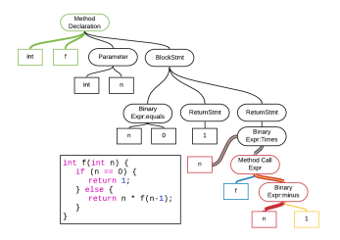
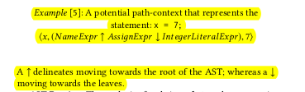
Learning code embeddings - Terminology
AST Path: Path between 2 leaves
Path Context: It is a triplet (X_s, p, X_t)
Model learns an embedding of each and concatenates them into a single path context vector
Notes:
X_s= starting point of the path
p=path itself
X_t=ending node of the path

Slide 7
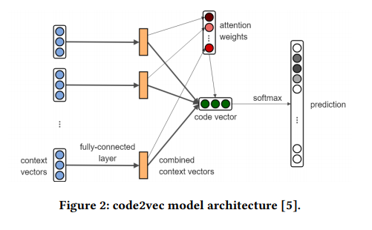
Learning code embeddings – PCV selection
The embeddings of X_s, path p and X_t are learnt in training. Concatenated into a PCV.
Attention mechanism learns how to combine the PCVs
Puts focus on certain PCVs
However, makes it too dependent on variable names.
Notes:
3rd point: Thus it allows the model to identify the parts of the AST that are more predictive in nature and ignore those that are not.
4th Point: Loss of accuracy is seen when test sample has typos or obfuscation in variable names

Slide 8
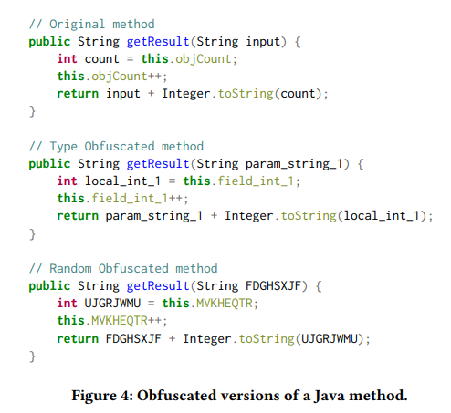
Obfuscating variable names
Using conventional variable names made the model generalize poorly. Hence, we limit that information by obfuscating variable names
Two obfuscation methods were used:
Type obfuscation: variable name indicates scope and type. Some info is given to aid learning.
Random Obfuscation: variable name replaced with random string. No dependence on variable name
Utilize obfuscation for training AND testing.
Implemented using a command line tool called Spoon.
Notes:
Initially the code2vec authors did a study in which they removed the variable name info only at test time Hence they trained on full path contexts and tested on limited path contexts which led to bad results. Here we do both training and testing on obfuscated data.

Slide 9
Code2vec training and embedding models
Java-large dataset was used for training(~15.3m examples)
Four embedding models were used based on obfuscation techniques:
Standard Baseline: No obfuscation(15.3m examples)
Type obfuscated: Type obfuscation(13.7m examples)
Random obfuscated: Random obfuscation(13.7m examples)
Reduced: has less amount of data points to account for smaller size of obfuscated datasets. No obfuscation(13.7m examples)

Slide 10
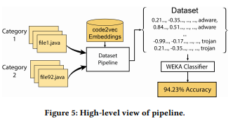
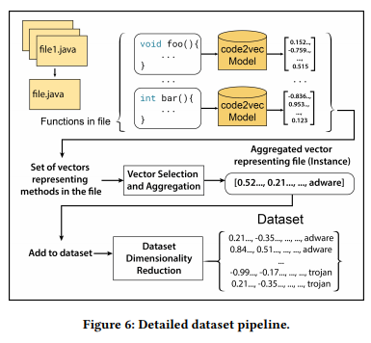
Dataset Pipeline
To make class level embeddings, method level embeddings were combined using different aggregation functions
To compare performance with different embedding models and aggregation methods, a dataset pipeline was made.
Quality of the embeddings judged by accuracy given by the WEKA classifier

Slide 11
Selection Method and Dimensionality Reduction
Experiment with different methods of selecting method embeddings for aggregation:
All: All methods selected for aggregation
Top K: Select top K methods based on method’s LOC
Random K: Randomly select K methods
Dimensionality reduction applied to reduce features of resulting class vectors/embeddings to improve accuracy. Done using UMAP.

Slide 12
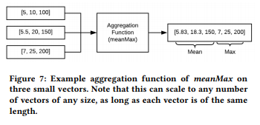
Aggregation Methods
Aggregation methods are applied column-wise across method vectors to make the class vectors.
Max, min, median, mean, and standard deviation were used.
Aggregation functions combined in pairs by concatenating results(meanMax).
Another function made by combining all aggregation functions(minMaxMeanMedianStddevSum).
Leaves us with 23 aggregation functions

Slide 13
Evaluation datasets
Seven evaluation datasets were used to test the quality of the models:
OpenCV/Spring: 2 types of java files with contrasting workflows. Check contrast in embeddings. Taken from files on Github
Algorithm classification: Java files of various algorithms hosted on “Java Algorithms and Clients” by Princeton University
Code author attribution: Predict author of code given set of predefined authors. Useful for cybersecurity and plagiarism. Solutions of Leetcode questions hosted on Github were used.

Slide 14
Evaluation Datasets
Bug Detection: Classify a java file as having at least one bug or no bugs at all. The Public Unified Bug Dataset(~43k files) was used as a source.
Duplicate Detection: Dataset of pairs of duplicate methods and duplicate files curated by Source{d}. The datasets for pairs of files and pairs of methods was made into 2 separate datasets.
Malware Classification: Classifying code into various classes of malware. Android Malware dataset containing 24k samples of APKs with 10 malware classes was used as source. APKs decompiled using JADX. 3 classes of malware used: adware, ransomware, and trojan
Notes:
Mention that the files were originally hand labelled as having with the number of bugs, dataset was altered to be a 2 class obfuscation problem.
The duplicate dataset had 3 labels for duplication: Yes, No, Maybe. “Maybe” categories were removed. Aggregated Embeddings for each pair were made and subtracted if ~0 values were obtained, classify it as duplicate.

Slide 15
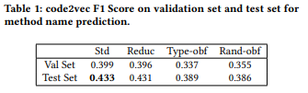
Experimental Results – Method Prediction
Compare the performance of all 4 embedding models using F score:
Notes:
Baseline model performed best with similar accuracy by reduced model. Obfuscated models performed worse in method prediction which was to be expected given the previous study by the code2vec authors.

Slide 16
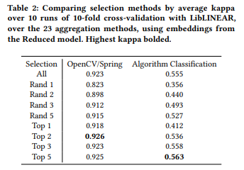
Selection Method
Kappa statistic used to compare accuracy. Better than % accuracy.
Selection methods tested on OpenCV/Spring Dataset and Algorithms Dataset
3 Selection methods: All, Top K and Random K
Difference in Algorithm dataset due to large number of methods per class.
Selecting longest methods more informative
All, Top K with K=[2,5]
Notes:
Best selection methods were found to be All, and Top K with in [2,5]

Slide 17
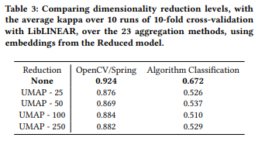
Dimensionality Reduction
UMAP was used for dimensionality reduction
Size reduced from 384 to 25, 50, 100 and 250 dimensions
Doing so in every case reduced the accuracy by a large amount
Hence dimensionality reduction deemed unnecessary.

Slide 18
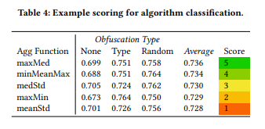
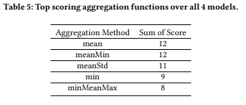
Aggregation methods
All 23 methods were used with all 4 embedding models and evaluated on all 7 datasets.
For each evaluation dataset and each embedding model, the average kappa for each aggregation method was calculated over the embedding models and the aggregation methods were ranked based on the average kappa.
The top 5 aggregation methods were given a score based on their rank.
This score was summed up for each aggregation method over all datasets
Mean, meanMin had overall best accuracy
Notes:
T

Slide 19
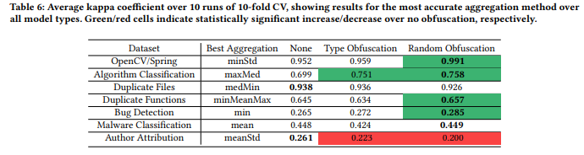
Obfuscation Comparison over evaluation datasets
Embeddings compared using all 7 datasets
Random obfuscation performed better than type obfuscation in many cases.
Model learns code structure
Notes:
Better performance of obfuscated dataset in algo classification shows that the model is learning the structure of the code which is giving it better predictions.
Java files with bugs were semantically similar to files without bugs. Since model was using the semantic structure to make the embeddings and not analyzing the bug prone areas, the accuracy is low here.
Since every author has their own way of naming their variables, variable names are a important feature for predicting authors from code. However since that is obfuscated in the models, we get a lower accuracy.

Slide 20
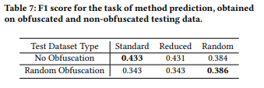
Training on complete information
Model was trained and tested on limited AST information
Study by authors featured training on full information and testing on limited information, giving poor results in method prediction.
Hence model trained on non obfuscated data and evaluated on non obfuscated data to illustrate results.
Notes:
Since a model trained on no obfuscation leverages variable names for method name prediction instead of the code structure, the accuracy of the baseline decreases when tested on a obfuscated test set. The accuracy of the obfuscated dataset remains similar regardless of the test set as it learns the code structure and uses that to make the embeddings.

Slide 21
Conclusion
Obfuscation of variable names may give less accuracy on proxy task but the generated embeddings capture the structure and semantics of the code.
Best selection method for aggregation was to select all methods
Dimensionality reduction using UMAP was not useful
A combination of min/max and mean/median/stddev is the best aggregation function
Training on random obfuscation makes model generalize more and does not overfit on variable names. Hence variable name obfuscation can be used as a regularization.
However for tasks that rely on variable naming such as author attribution, the model should be trained on non-obfuscated variable names as they contain information for classifying.

Slide 22
Future Work
Class name predictions can also be used for determining embeddings instead of method name predictions
Instead of using aggregation functions for combining method embeddings to make class embeddings, neural networks can be utilized.
Obfuscation of method names can also be done along with the variable names.
Inlining the method calls in the code can be done to better understand code behavior instead of analyzing the name of the called method.

Slide 23
Thank You

