Slide 1
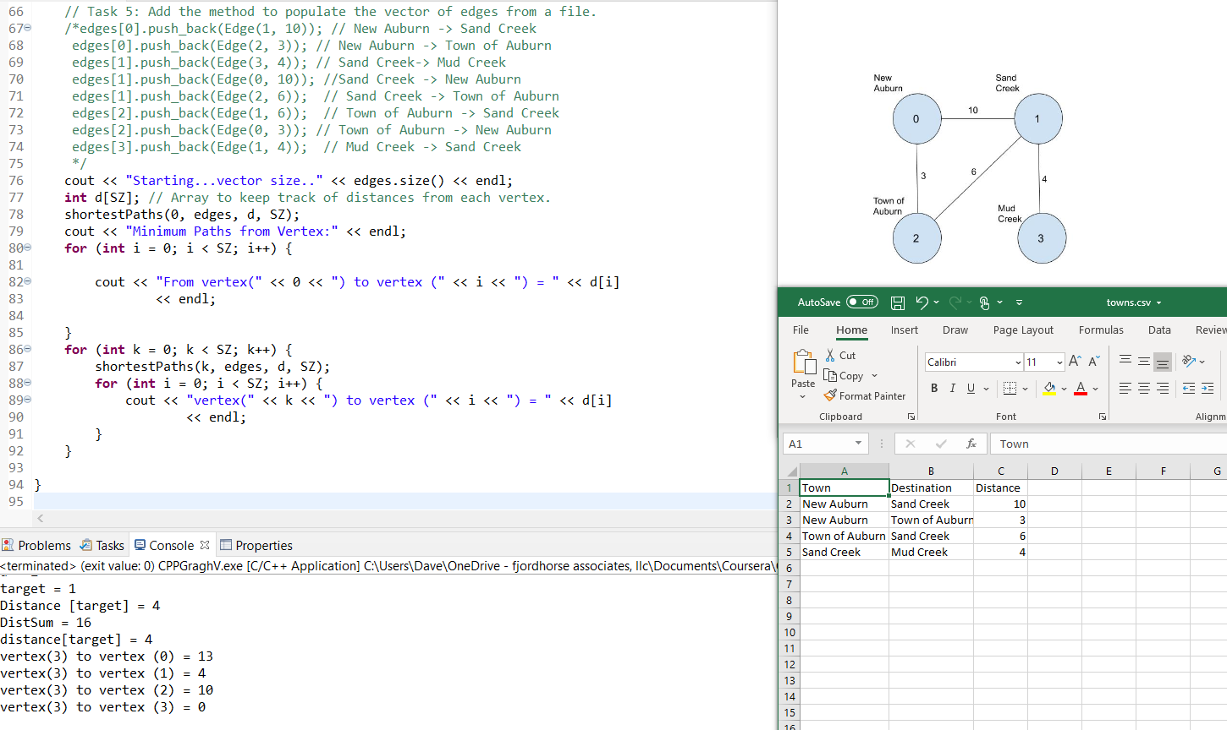

Process Map Data using C++ Adjacency List Shortest Path
Dave Dalsveen

Slide 2
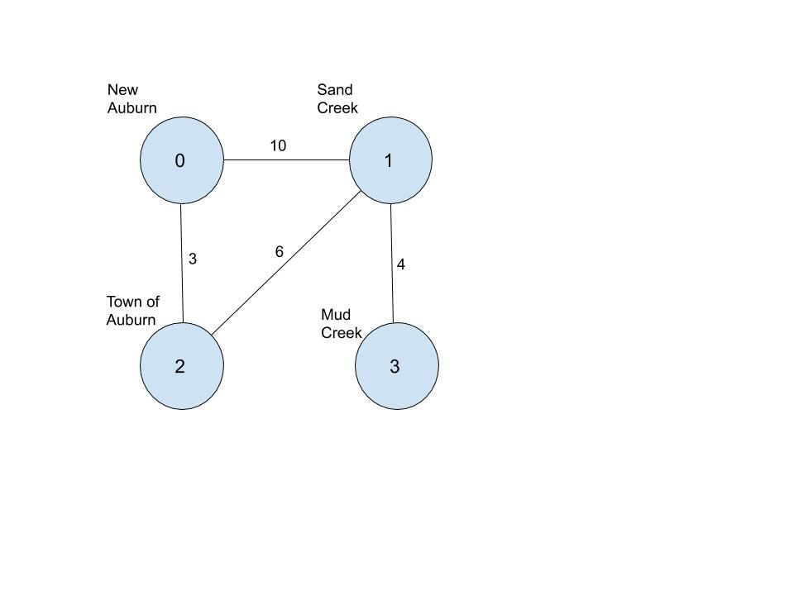
Task1: Analyze the shortest distance problem and Create the C++ Edge Class.
Discuss the meaning of the Graph and how it relates to the shortest path problem.
Generate an Edge class to represent an edge with a target vertex and weight.
Generate constructor and getters in the Edge class.

Slide 3
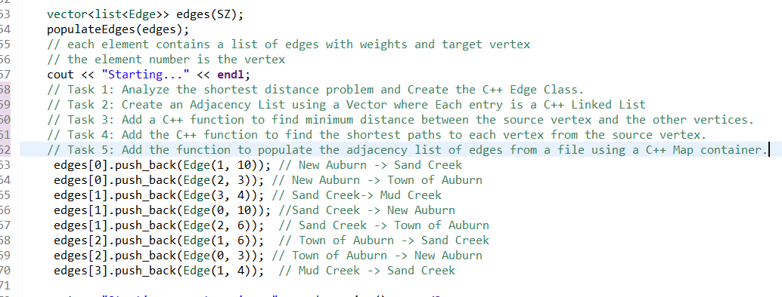
Task2: Create an Adjacency List using a Vector where Each entry is a C++ Linked List.
Define a size for the Vector container.
Create the Vector of Linked Lists called the Adjacency List.
Populate the Vector elements with Linked Lists using the Graph.
Print the Linked lists associated with one element of the Vector.

Slide 4
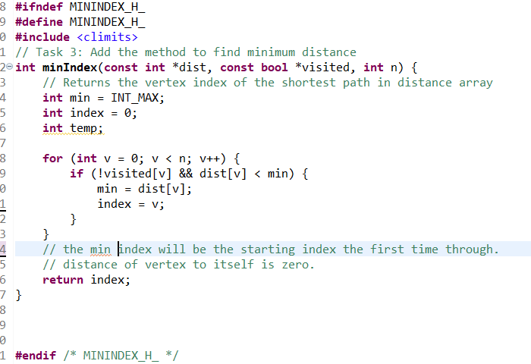
Task3: Add a C++ function to find minimum distance between the source vertex and the other vertices.
Initialize min index to MAX size of integer.
Use a Boolean array to check if index (vertex) has already been visited.
Implement for loop to iterate through the distance array to check for minimum distance.

Slide 5
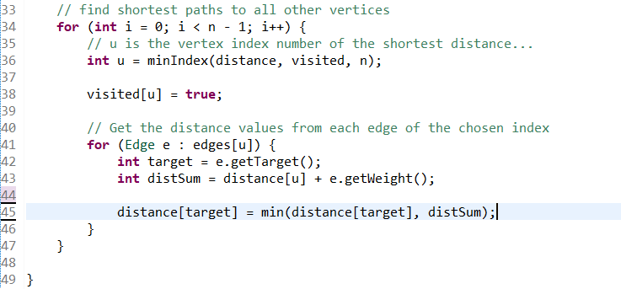
Task4: Add the C++ function to find the shortest paths to each vertex from the source vertex.
Initialize visited array and distance array.
Get the minimum distance vertex.
Use the minimum distance vertex to get each edge from its linked list.
Update the target distance for each edge and update the target distance with a new distance (current distance + weight) if it is smaller.

Slide 6
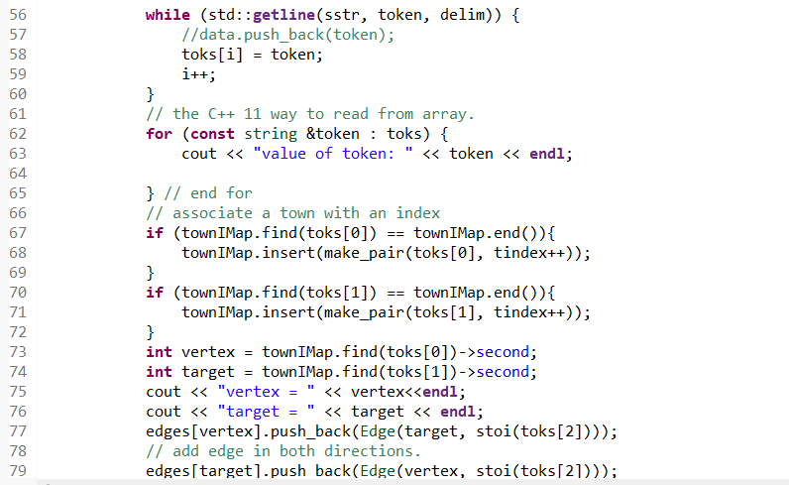
Task5: Add the function to populate the adjacency list of edges from a file using a C++ Map container.
Create a Map Container to associate a town name with integer vertex.
Use the Token process to extract Source Town, Target, and Distance.
Create the Entries for the C++ Adjacency List.

