Slide 1

Multiprocessor Synchronization
CSCI 176
Introduction
Lecture 1
9 September 2021
Maurice Herlihy
Brown University

Slide 2
Staff
Maurice Herlihy (instructor)
Casey Nelson (HTA)
Daniel Engel (GTA)

Slide 3
Grading
8 Homeworks (40%)
5 programming assignments (20%)
2 Midterms (40%)

Slide 4
Collaboration
Permitted
talking about the homework problems with other students; using other textbooks; using the Internet.
NOT Permitted
obtaining the answer directly from anyone or anything else in any form.

Slide 5
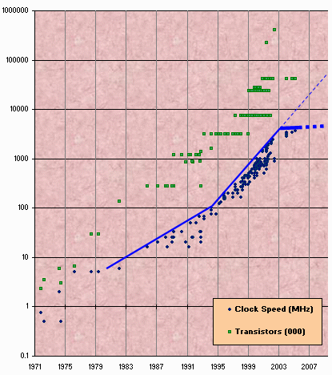
Moore’s Law
Transistor count still rising
Clock speed flattening sharply
5
Notes:
5
Most of you have probably heard of Moore’s law, which states that the number of transistors on a chip tends to double about every two years. Moore’s law has been the engine of growth for our field, and the reason you can buy a laptop for a few thousand dollars that would have cost millions a decade earlier. The green dots on this graph show

Slide 6
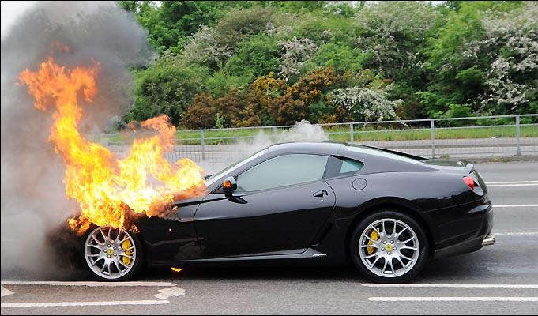
Moore’s Law (in practice)

Slide 7

Extinct: the Uniprocesor
cpu
memory
7
Notes:
7
Traditionally, we have had inexpensive single processor with an associated memory on a chip, which we call a uniprocessor.

Slide 8
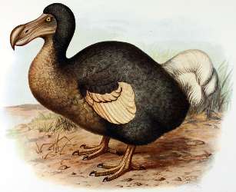
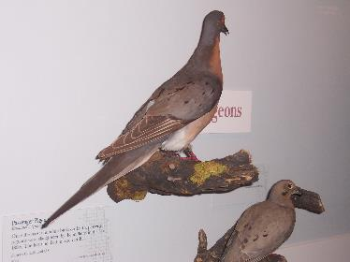
Extinct: The Shared Memory Multiprocessor (SMP)
cache
cache
cache
Bus
Bus
shared memory
8
Notes:
8
And we had expensive multiprocessor chips in the enterprise, that is, in server farms, high performance computing centers and so on. The
Shared memory multiprocessor (SMP) consists of multiple CPUs connected by a bus or interconnect network to a shared memory.

Slide 9
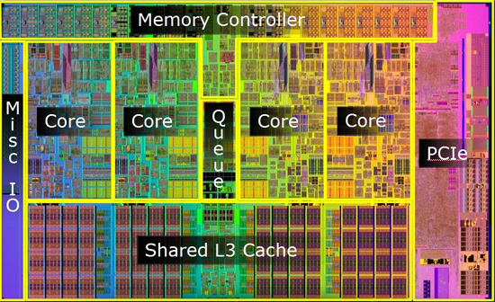
Meet The New Boss: The Multicore Processor (CMP)
cache
cache
cache
Bus
Bus
shared memory
9
Notes:
9
The revolution we are going through is that the desktop is now becoming a multiprocessor also. We call this type of processor a system-on-a-chip or a multicore machine or a chip multiprocessor (CMP). The chip you see here is the Sun T2000 Niagara CMP that has 8 cores and shared cache and memory. We will learn about the Niagara in more detail later. It is the machine you will be using for your homework assignments.

Slide 10
Why do we care?
Time no longer cures software bloat
The “free ride” is over
Double your program’s path length?
You can’t just wait 6 months …
Your software must somehow exploit twice as much concurrency

Slide 11
Traditional Scaling Process
7x
Speedup
3.6x
1.8x
User code
Traditional
Uniprocessor
Time: Moore’s law
11
Notes:
11
Recall the traditional scaling process for software: write it once, trust Intel to make the CPU faster to improve performance.

Slide 12
Ideal Scaling Process
7x
3.6x
Speedup
1.8x
User code
Multicore
Unfortunately, not so simple…
12
Notes:
12
With multicores, we will have to parallelize the code to make software faster, and we cannot do this automatically (except in a limited way on the level of individual instructions).

Slide 13
Actual Scaling Process
Speedup
2x
2.9x
1.8x
User code
Multicore
Parallelization and Synchronization require care…
13
Notes:
13
This is because splitting the application up to utilize the cores is not simple, and coordination among the various code parts requires care.

Slide 14
Course Overview
Fundamentals
Models, Algorithms, Impossibility, Reasoning
Real-World Programming
Architectures
Techniques

Slide 15
Sequential Computation
thread
memory
object
object
15
Notes:
15

Slide 16
Concurrent Computation
threads
memory
object
object
16
Notes:
16

Slide 17
Asynchrony
Sudden unpredictable delays
Cache misses (short)
Page faults (long)
Scheduling quantum used up (really long)
17
Notes:
17

Slide 18
Model Summary
Multiple threads
Sometimes called processes
Single shared memory
Objects live in memory
Unpredictable asynchronous delays
18
Notes:
18

Slide 19
Road Map
We are going to focus on principles first, then practice
Start with idealized models
Look at simplistic problems
Emphasize correctness over pragmatism
“Correctness may be theoretical, but incorrectness has practical impact”
19
Notes:
19

Slide 20
Concurrency Jargon
Hardware
Processors
Software
Threads, processes
Sometimes OK to lump them together, sometimes not.
20
Notes:
20
We will use the terms above, even though there are also terms like strands, CPUs, chips etc also…

Slide 21
Parallel Primality Testing
Challenge
Print primes from 1 to 10¹⁰
Given
10-processor multiprocessor
One thread per processor
Goal
Get 10-fold speedup (or close)
21
Notes:
21
We want to look at the problem of printing the primes from 1 to 10^10 in some arbitrary order.

Slide 22
Load Balancing
1
10⁹
2·10⁹
…
10¹⁰
P₀
P₁
…
P₉
Split the work evenly?
Each thread tests range of 10⁹
22
Notes:
22
Split the range ahead of time

Slide 23
Procedure for Thread i
void primePrint {
int i = ThreadID.get(); // IDs in {0..9}
for (j = i*10⁹+1, j<(i+1)*10⁹; j++) {
if (isPrime(j))
print(j);
}
}
23
Notes:
23
Code matches code in Chapter 1 of book.

Slide 24
Issues
Higher ranges have fewer primes
Yet larger numbers harder to test
Thread workloads
Uneven
Hard to predict
24
Notes:
24
You can mention that the use of prime() is a bit artificial since it makes sense to use earlier numbers detected as prime in testing whether a later number is prime.
Jean-Paul Rigault of the University of Nice Sophia Antipolis in France tells us that there are
Overall 454 millions Primes between 1 and 10¹⁰, 51 million of them between 0x10⁹ and 1x10⁹ and 43 million of them between 9x10⁹ and 10x10⁹. The primes seem rather uniformly distributed in the given range, although there are indeed fewer between 9x10⁹ and 10¹⁰ than between 1 and 10⁹ (about 20% less).
He obtained these numbers using a Python program implementing Legendre's approximation for pi(n), the number of primes less than n: pi(n) = n/(log n - 1).

Slide 25
Issues
Higher ranges have fewer primes
Yet larger numbers harder to test
Thread workloads
rejected
Uneven
Hard to predict
25
Notes:
25
You can mention that the use of prime() is a bit artificial since it makes sense to use earlier numbers detected as prime in testing whether a later number is prime.
Jean-Paul Rigault of the University of Nice Sophia Antipolis in France tells us that there are
Overall 454 millions Primes between 1 and 10¹⁰, 51 million of them between 0x10⁹ and 1x10⁹ and 43 million of them between 9x10⁹ and 10x10⁹. The primes seem rather uniformly distributed in the given range, although there are indeed fewer between 9x10⁹ and 10¹⁰ than between 1 and 10⁹ (about 20% less).
He obtained these numbers using a Python program implementing Legendre's approximation for pi(n), the number of primes less than n: pi(n) = n/(log n - 1).

Slide 26
Shared Counter
19
each thread takes a number
18
17
26
Notes:
26

Slide 27
Procedure for Thread i
int counter = new Counter(1);
void primePrint {
long j = 0;
while (j < 10¹⁰) {
j = counter.getAndIncrement();
if (isPrime(j))
print(j);
}
}
27
Notes:
27

Slide 28
Procedure for Thread i
int counter = new Counter(1);
void primePrint {
long j = 0;
while (j < 10¹⁰) {
j = counter.getAndIncrement();
if (isPrime(j))
print(j);
}
}
Shared counter
object
28
Notes:
28

Slide 29
Where Things Reside
void primePrint {
int i = ThreadID.get(); // IDs in {0..9}
for (j = i*10⁹+1, j<(i+1)*10⁹; j++) {
if (isPrime(j))
print(j);
}
}
Local
variables
code
cache
cache
cache
Bus
Bus
shared
memory
1
shared counter
29
Notes:
29
Need this slide since some students do not understand where the counter resides, where the shared variables reside, and where the code resides etc. This is our opportunity to explain.

Slide 30
Procedure for Thread i
Counter counter = new Counter(1);
void primePrint {
long j = 0;
while (j < 10¹⁰) {
j = counter.getAndIncrement();
if (isPrime(j))
print(j);
}
}
Stop when every value taken
30
Notes:
30

Slide 31
Procedure for Thread i
Counter counter = new Counter(1);
void primePrint {
long j = 0;
while (j < 10¹⁰) {
j = counter.getAndIncrement();
if (isPrime(j))
print(j);
}
}
Increment & return
each new value
31
Notes:
31

Slide 32
Counter Implementation
public class Counter {
private long value;
public long getAndIncrement() {
return value++;
}
}
32
Notes:
32

Slide 33
Counter Implementation
int counter = new Counter(1);
void primePrint {
long j = 0;
while (j < 10¹⁰) {
j = counter.getAndIncrement();
if (isPrime(j))
print(j);
}
}
OK for single thread,
not for concurrent threads
33
Notes:
33

Slide 34
What It Means
public class Counter {
private long value;
public long getAndIncrement() {
return value++;
}
}
34
Notes:
34

Slide 35
What It Means
public class Counter {
private long value;
public long getAndIncrement() {
return value++;
}
}
temp = value;
value = temp + 1;
return temp;
35
Notes:
35

Slide 36
Not so good…
Value… 1
2
3
2
read
1
write
2
read
2
write
3
read
1
write
2
time
36
Notes:
36
Time goes from left to right. The Blue thread might read 1 from \fValue{}, but before
it sets \fValue{} to 2, the Red thread would go through the
increment loop several times, reading 1 and setting to 2, reading
2 and setting to 3. When the Blue thread finally completes its
operation and sets \fValue{} to 2, it will actually be setting
the counter back from 3 to 2.

Slide 37
Is this problem inherent?
!!
!!
write
read
read
write
If there were some way to glue reads and writes together…
37
Notes:
37
Is this phenomena inherent or is there a better implementation we are missing?
To understand why such bad interleavings can always happen, consider
the following situation that all of us run into every once in a while.
You are walking down the street, and
suddenly someone is coming straight at you. You move to the right, and they
move to the right, so you move to the left, and they happen to do the
same, now you try and make a final break to either left or right, many
times you manage not to bump, but sometimes you do. Are these
collisions avoidable? Can we think of a protocol to follow in order to
prevent people from ever colliding?
The answer is NO! \footnote{One might think that you
can agree to always move to the right, to which you can answer ``but
what if the other person is British?'' Alternately,
think of Atlantis and Mir flying one towards the other in space, where
the is no predefined ``right side.''} It can be mathematically shown
that there is always a sequence of moves that will result in people
bumping (this is the famous result of Fischer, Lynch, and Paterson we will
Study later in the course).
The problem arises from the fact that ``looking'' at the other person
and ``moving'' aside to avoid him are two separate operations. If one
could ``look-and-jump'' instantaneously the problem could be avoided.
In the same way that people compete for the right to pass, computers
compete to gain access to shared locations in memory. In the case of
our {\tt shared-counter}, processors are in a competition where the
winner gets the lower counter value and the looser gets the higher
one. The moral of the ``people in the street'' example is that we need
to ``glue together'' the {\tt get} and {\tt increment} operations to
get an ``instantaneous'' {\tt get-and-increment}. This operation
would execute the {\tt get} and the {\tt increment} instructions
like one indivisible operation with no other operation taking place
between the start of the {\tt get} and the end of the {\tt
increment}. If we have such an operation then the following is a
correct and efficient solution to the prime printing problem.

Slide 38
Challenge
public class Counter {
private long value;
public long getAndIncrement() {
temp = value;
value = temp + 1;
return temp;
}
}
38
Notes:
38

Slide 39
Challenge
public class Counter {
private long value;
public long getAndIncrement() {
temp = value;
value = temp + 1;
return temp;
}
}
make these steps atomic (indivisible)
39
Notes:
39

Slide 40
Hardware Solution
public class Counter {
private long value;
public long getAndIncrement() {
temp = value;
value = temp + 1;
return temp;
}
}
ReadModifyWrite()
instruction
40
Notes:
40
We will see later that modern multiprcessors provide special types of readModiftWrite() instructions to allow us to overcome the
problem at hand. But how do we solve this problem in software?

Slide 41
An Aside: Java™
public class Counter {
private long value;
public long getAndIncrement() {
synchronized {
temp = value;
value = temp + 1;
}
return temp;
}
}
41
Notes:
41

Slide 42
An Aside: Java™
public class Counter {
private long value;
public long getAndIncrement() {
synchronized {
temp = value;
value = temp + 1;
}
return temp;
}
}
Synchronized block
42
Notes:
42

Slide 43
An Aside: Java™
public class Counter {
private long value;
public long getAndIncrement() {
synchronized {
temp = value;
value = temp + 1;
}
return temp;
}
}
Mutual Exclusion
43
Notes:
43
Java provides us with a solution: mutual exclusion in software…lets try and understand how this is done

Slide 44
Mutual Exclusion, or “Alice & Bob share a pond”
A
B
44
Notes:
44
We now present a sequence of fables, illustrating some of the basic problems.
Like most authors of fables, we retell stories mostly invented by others. The following story was told by a famous
Multiprocessing pioneer, Leslie Lamport.
See story outline in the Introduction Chapter of the Book.

Slide 45
Alice has a pet
A
B
45
Notes:
45

Slide 46
Bob has a pet
A
B
46
Notes:
46

Slide 47
The Problem
A
B
The pets don’t
get along
47
Notes:
47

Slide 48
Formalizing the Problem
Two kinds of correctness properties:
Safety
Nothing bad happens ever
Liveness
Something good happens eventually
48
Notes:
48

Slide 49
Formalizing the Problem
Mutual Exclusion
Both pets never in pond simultaneously
Safety property!
No deadlock
if one wants in, it gets in
if both want in, one gets in
Liveness property!
49
Notes:
49
Notice that we use the term deadlock and not livelock though some people would use both to describe the
Requirement. They are not the same thing. Deadlock is used to denote that Alice and Bob are stuck and no amount of retry (backoff) will help, while livelock means backoff can help. In any case both are different from “no starvation” which is the stronger requirement that means that every request always succeeds.

Slide 50
Simple Protocol
Idea
Just look at the pond
Gotcha
Not atomic
Trees obscure the view
50
Notes:
50
In the following versions of the protocol, we try and show the students which solutions will not work.
Can ask students for help in the solution by showing the first part of the slide (the Idea part) and then show the
Gotcha part once they have suggested solutions. This is true for all the next set of suggested solutions.

Slide 51
Interpretation
Threads can’t “see” what other threads are doing
Explicit communication required for coordination
51
Notes:
51

Slide 52
Cell Phone Protocol
Idea
Bob calls Alice (or vice-versa)
Gotcha
Bob takes shower
Alice recharging battery
Bob out shopping for pet food
52
Notes:
52
In the following versions of the protocol, we try and show the students which solutions will not work.
Can ask students for help in the solution by showing the first part of the slide (the Idea part) and then show the
Gotcha part once they have suggested solutions. This is true for all the next set of suggested solutions.

Slide 53
Interpretation
Message-passing doesn’t work
Recipient might not be
listening
There at all
Communication must be
Persistent (like writing)
Not transient (like speaking)
53
Notes:
53

Slide 54
Can Protocol
cola
cola
54
Notes:
54

Slide 55
Bob conveys a bit
A
B
cola
55
Notes:
55

Slide 56
Bob conveys a bit
A
B
cola
56
Notes:
56

Slide 57
Can Protocol
Idea
Cans on Alice’s windowsill
Strings lead to Bob’s house
Strings lead to Bob’s house
Gotcha
Cans cannot be reused
Bob runs out of cans
57
Notes:
57

Slide 58
Interpretation
Cannot solve mutual exclusion with interrupts
Sender sets fixed bit in receiver’s space
Receiver resets bit when ready
Potentially unbounded number of interrupt bits
58
Notes:
58
Notice that the point here is that it can be used as a solution but takes an unbounded number of inturrupt bits. This is not the case with the next solution…

Slide 59
Flag Protocol
A
B
59
Notes:
59
Here is a solution that does not suffer from the problems of the former ones…

Slide 60
Alice’s Protocol (sort of)
A
B
60
Notes:
60

Slide 61
Bob’s Protocol (sort of)
A
B
61
Notes:
61

Slide 62
Alice’s Protocol
Raise Flag
Wait until Bob’s flag is down
Unleash pet
Lower flag when pet returns
62
Notes:
62

Slide 63
Bob’s Protocol
Raise Flag
Wait until Alice’s flag is down
Unleash pet
Lower flag when pet returns
danger!
63
Notes:
63

Slide 64
Bob’s Protocol (2nd try)
Raise Flag
While Alice’s flag is up …
Lower flag
Wait for Alice’s flag to go down
Raise flag
Unleash pet
Lower flag when pet returns
64
Notes:
64

Slide 65
Bob’s Protocol (2nd try)
Raise Flag
While Alice’s flag is up …
Lower flag
Wait for Alice’s flag to go down
Raise flag
Unleash pet
Bob defers to Alice
Lower flag when pet returns
65
Notes:
65

Slide 66
The Flag Principle
Raise Flag
Look at other’s flag
Flag Principle:
If each raises and looks, then
Last to look must see both flags up
66
Notes:
66
This intuitively explains implies why at least one of them will not
enter the critical section if both are trying at the same time. Many coordination protocols use falg raising and
The flag principle to guarantee that threads notice each other.
The following proof of mutual exclusion will not be
presented in class, but we provide it just to give you some intuition
about how one reasons about concurrent programs. Lets prove that if
they follow the algorithm the dogs will never be together in the yard.
Assume by way contradiction that this is not the case. We are assuming
that both dogs are in the yard. Therefore both Alice and Bob had a
last ``looking'' action before they let their dog enter the yard. Lets
take a look at the one who finished this looking action first. When he
(she) looked, he (she) saw that the other one's flag was down. Without
loss of generality let's assume it was Bob, so he had {\tt (=
Alice-flag 'down)} as true, otherwise he couldn't have entered the
critical section. So it follows that Alice's flag was up {\em after}
Bob finished his looking action. Therefore, Alice's looking was {\em
completely after} the end of Bob's raising of his flag, so Alice must
have seen this flag up and could not have entered the critical
section, a contradiction.

Slide 67
Proof of Mutual Exclusion
Assume both pets in pond somehow
Derive a contradiction
By reasoning backwards …
Consider the last time Alice and Bob each looked before letting the pets in
Without loss of generality assume Alice was the last to look…
67
Notes:
67
If both look at the same time, then its OK to assume that Alice looked last. They both have different protocols but the part of the protocols that raises the flag for the last time and looks if the other’s flag is raised is the same.

Slide 68
Proof
Bob last raised flag
Alice last raised her flag
Alice’s last look
Bob’s last look
QED
time
Alice must have seen Bob’s Flag. A Contradiction
68
Notes:
68
Explanation: assume without loss of generality that Alice was the last to look in the last look each performed before they both let their animals in the pond concurrently. Then Bob’s last look must have been
before Alice’s last flag raising since Bob let his pet into the pond. But since Bob raised his flag before he looked, it follows that Alice must have seen Bob’s flag raised, a contradiction.

Slide 69
Proof of No Deadlock
Claim: If only one pet wants in, it gets in
Deadlock requires both continually trying to get in.
If Bob sees Alice’s flag, he backs off, gives her priority (Alice’s lexicographic privilege)
QED
69
Notes:
69

Slide 70
Remarks
Protocol is unfair
Bob’s pet might never get in
Protocol uses waiting
If Bob is eaten by his pet, Alice’s pet might never get in
70
Notes:
70
The protocol is unfair. Another property of compelling interest above no-deadlock is no-starvation:
if a pet wants to enter the yard, will it eventually succeed?
Here, Alice and Bob's protocol performs poorly. Whenever Alice and
Bob conflict, Bob defers to Alice, so it is possible that Alice's
pet can use the pond over and over again, while Bob's pet becomes
increasing uncomfortable. Later on, we will see how to make
protocols prevent starvation.
Waiting is problematic in terms of performance as we will explain in more detail later in the lecture

Slide 71
Moral of Story
Mutual Exclusion cannot be solved by
transient communication (cell phones)
interrupts (cans)
It can be solved by
one-bit shared variables
that can be read or written
71
Notes:
71
During the course we will devote quite a bit of effort to understanding the tradeoffs that have to do with the use of mutual exclusion.

Slide 72
The Arbiter Problem (an aside)
Pick a point
Pick a point
72
Notes:
72
Notice that when Alice or Bob look at the otehrs flag, it might be in the process of being raised, which
Means we need to decide from what point on the flag is up or down. We essentially want to turn a continuous process of raising the flag into a discrete process in which it only has two states and we never have an intermediate “undefined” state. The same issue arises in memory. Bits of memory are in many cases electrical units called flip-flops. If a current representing a bit of either 0 or 1 is entered into a flip-flops input wires, we would like to think of the output as either 0 or 1. But this process takes time, and the current coming out of the
flip-flop is not discrete, if we measure it at different times, especially if we measure it before the output current has stabilized, we will not get a guaranteed correct behaviour. In other words, as with the flags, we might be catching it while the bit is being raised or lowered. What hardware manufacturers do is decide on a time when they believe the current on the output will be stable. However, as the lower figure shows, picking such a point is a probabilistic event, that is, if we test the gate after 5 nano-seconds, there is always a probability that it will not give us the correct corresponding output given the inputs because the gate is unstable. However, this time is chosen so that the probability is small enough that other failure probabilities (like the probability that a spec of dust will neutralize a flip-flop) are higher.

Slide 73
The Fable Continues
Alice and Bob fall in love & marry
Then they fall out of love & divorce
She gets the pets
He has to feed them
Leading to a new coordination problem: Producer-Consumer
73
Notes:
73
Joke: say that with a probability of 50% they divorce.

Slide 74
Bob Puts Food in the Pond
A
74
Notes:
74

Slide 75
Alice releases her pets to Feed
mmm…
B
mmm…
75
Notes:
75

Slide 76
Producer/Consumer
Alice and Bob can’t meet
Each has restraining order on other
So he puts food in the pond
And later, she releases the pets
avoid
Releasing pets when there’s no food
Putting out food if uneaten food remains
76
Notes:
76
Many coordination problems are producer consumer problems, in fact, whenever an algorith involves the word “buffer” chances are high that we are talking about a producer consumer algorithm.

Slide 77
Producer/Consumer
Need a mechanism so that
Bob lets Alice know when food has been put out
Alice lets Bob know when to put out more food
77
Notes:
77

Slide 78
Surprise Solution
A
B
cola
78
Notes:
78

Slide 79
Bob puts food in Pond
A
B
cola
79
Notes:
79

Slide 80
Bob knocks over Can
A
B
cola
80
Notes:
80

Slide 81
Alice Releases Pets
yum…
A
B
B
yum…
cola
81
Notes:
81

Slide 82
Alice Resets Can when Pets are Fed
A
B
cola
82
Notes:
82

Slide 83
Pseudocode
while (true) {
while (can.isUp()){};
pet.release();
pet.recapture();
can.reset();
}
Alice’s code
83
Notes:
83

Slide 84
Pseudocode
while (true) {
while (can.isUp()){};
pet.release();
pet.recapture();
can.reset();
}
Bob’s code
while (true) {
while (can.isDown()){};
pond.stockWithFood();
can.knockOver();
}
Alice’s code
84
Notes:
84

Slide 85
Correctness
safety
Mutual Exclusion
Pets and Bob never together in pond
liveness
No Starvation
if Bob always willing to feed, and pets always famished, then pets eat infinitely often
safety
Producer/Consumer
The pets never enter pond unless there is food, and Bob never provides food if there is unconsumed food
85
Notes:
85
Producer/Consumer:
The pets will not enter the yard unless there is food, and Bob
will never provide more food if there is unconsumed food.
Let the students guess which property is a safety property and which is a liveness property.

Slide 86
Waiting
Both solutions use waiting
while(mumble){}
In some cases waiting is problematic
If one participant is delayed
So is everyone else
But delays are common & unpredictable
86
Notes:
86
Again, waiting si problematic as one delays all causing the computation to proceed in a sequential manner.

Slide 87
Could Also Solve Using Flags
A
B
87
Notes:
87

Slide 88
The Fable drags on …
Bob and Alice still have issues
So they need to communicate
They agree to use billboards …
88
Notes:
88

Slide 89
Billboards are Large
B
D
Letter
Tiles
From Scrabble™ box
A
C
2
3
E
1
3
1
89
Notes:
89
One tile at a time.

Slide 90
Write One Letter at a Time …
W
A
S
4
1
1
H
4
B
D
A
C
2
3
E
1
3
1
90
Notes:
90

Slide 91
To post a message
W
A
S
H
T
H
E
C
A
R
4
1
1
4
1
4
1
3
1
1
whew
91
Notes:
91

Slide 92
Let’s send another message
L
A
S
E
L
L
L
A
V
A
1
1
S
1
1
1
1
1
1
4
1
M
P
3
3
1
92
Notes:
92

Slide 93
Uh-Oh
S
E
L
L
T
H
E
C
A
R
1
1
1
1
1
4
1
3
1
1
L
1
OK
93
Notes:
93

Slide 94
Readers/Writers
Devise a protocol so that
Writer writes one letter at a time
Reader reads one letter at a time
Reader sees “snapshot”
Old message or new message
No mixed messages
94
Notes:
94
This is a classical problem that captures how our machines memory really behaves. Memory consists of individual words that can be read or written one at a time, want if we read what is being written one word at a time while others are writing memory one word at a time, how can we guarantee to see correct values.

Slide 95
Readers/Writers (continued)
Easy with mutual exclusion
But mutual exclusion requires waiting
One waits for the other
Everyone executes sequentially
Remarkably
We can solve readers-writes without mutual exclusion
95
Notes:
95
Its also easy with producer-consumer interrupt bit based solution if we have one producer and one consumer.
Using Mutex for large chunks of memory introduces performance problems. The surprising thing is that we can actually provide a “snapshot” of memory by reading memory locations one at a time, and while others are continuously writing it, all this WITHOUT mutual exclusion. Stay tuned to see how we do this.

Slide 96

Ten Processors
60% concurrent, 40% sequential
How close to 10-fold speedup?
This eliminates the bottleneck
Threads wait for access to shared counter
We can solve readers-writes without mutual exclusion

Slide 97
Esoteric?
Java container size() method
Single shared counter?
incremented with each add() and
decremented with each remove()
performance
bottleneck
Threads wait for access to shared counter
97
Notes:
97

Slide 98
Readers/Writers Solution
Each thread i has size[i] counter
only it increments or decrements
To get object’s size, a thread reads a “snapshot” of all counters
This eliminates the bottleneck
98
Notes:
98

Slide 99
Why do we care?
We want as much of the code as possible to execute concurrently (in parallel)
A larger sequential part implies lower performance
Amdahl’s law: this relation is not linear…
99
Notes:
99
Mutual exclusion and waiting imply that code is essentially executed sequentially, while one is executing it others spin doing nothing useful. The larger these sequential parts, the worst our utilization of the multiple processors on our machine. Moreover, this relation is not linear: if 25% of the code is sequential, it does not mean that on a ten processor machine we will see a 25% loss of speedup…to understand the real realation, we need to understand
Amdahl’s law. Gene Amdahl was a computer science pioneer.

Slide 100
Amdahl’s Law
1-thread execution time
Speedup=
n-thread execution time
100
Notes:
100
This kind of analysis is very important for concurrent computation.
The formula we need is called \emph{Amdahl's Law}.
It captures the notion that the extent to
which we can speed up any complex job (not just painting)
is limited by how much of the job must be executed sequentially.
Define the \emph{speedup} $S$ of a job to be the ratio between the
time it takes one processor to complete the job (as measured by a wall clock)
versus the time it takes $n$ concurrent processors to complete the same job.
\emph{Amdahl's Law} characterizes the maximum speedup $S$ that can be achieved by $n$
processors collaborating on an application where $p$ is the fraction of
the job that can be executed in parallel.
Assume, for simplicity,
that it takes (normalized) time 1 for a single processor to complete the job.
With $n$ concurrent processors, the parallel part takes time $p/n$ and the sequential part takes time $1-p$.
Overall, the parallelized computation takes time:
$$
1 - p + \frac{p}{n}
$$
Amdahl's Law says that the speedup, that is,
the ratio between the sequential (single-processor) time and the parallel time,
is:
$$
S = \frac{1}{1 - p + \frac{p}{n}}
$$
We show this in the next set of slides

Slide 101
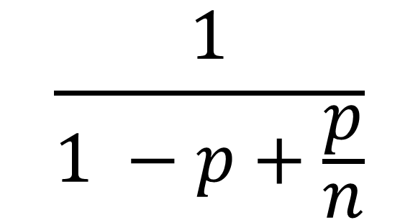
Amdahl’s Law
$$\frac{1}{1 −p+\frac{p}{n}}$$
Speedup =
101
Notes:
101
AVOID USING THE WORD “CODE”, P is not a fraction of the code but if the execution time of the solution algorithm. It could be that 5% of the code are executed in a loop and account for 90% of the execution time.

Slide 102
Amdahl’s Law
Parallel fraction
$$\frac{1}{1 −p+\frac{p}{n}}$$
Speedup =
102
Notes:
102

Slide 103
Amdahl’s Law
Sequential fraction
Parallel fraction
$$\frac{1}{1 −p+\frac{p}{n}}$$
Speedup =
103
Notes:
103

Slide 104
Amdahl’s Law
Sequential fraction
Parallel fraction
$$\frac{1}{1 −p+\frac{p}{n}}$$
Speedup =
Number of threads
104
Notes:
104

Slide 105
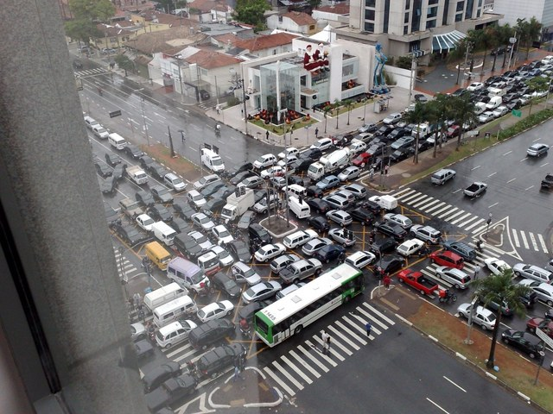
Amdal’s Law
Bad synchronization ruins everything

Slide 106
Example
Ten Processors
How close to 10-fold speedup?
60% concurrent, 40% sequential
Speedup = 2.17=
106
Notes:
106
Explain to students that you work really hard and parallelize 60% of the applications execution (NOT ITS CODE, its EXECUTION)
and get little for your money

Slide 107
Example
Ten Processors
How close to 10-fold speedup?
80% concurrent, 20% sequential
Speedup = 3.57=
107
Notes:
107
Explain to students that you work really hard and parallelize 60% of the applications execution (NOT ITS CODE, its EXECUTION)
and get little for your money

Slide 108
Example
Ten Processors
How close to 10-fold speedup?
90% concurrent, 10% sequential
Speedup = 5.26=
108
Notes:
108
Explain to students that you work really hard and parallelize 60% of the applications execution (NOT ITS CODE, its EXECUTION)
and get little for your money

Slide 109
Example
Ten Processors
How close to 10-fold speedup?
99% concurrent, 1% sequential
Speedup = 9.17=
109
Notes:
109
Explain to students that you work really hard and parallelize 60% of the applications execution (NOT ITS CODE, its EXECUTION)
and get little for your money

Slide 110
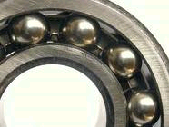
Diminishing Returns
This course is about the parts that
are hard to make concurrent …
but still have a big influence on speedup!
Notes:
With 25% sequential, cannot do more than

