Slide 1

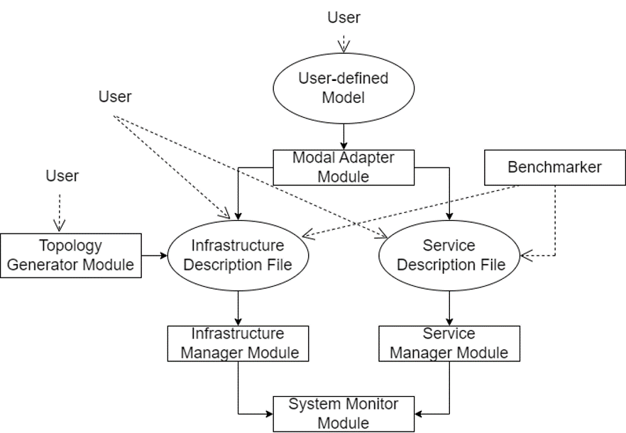
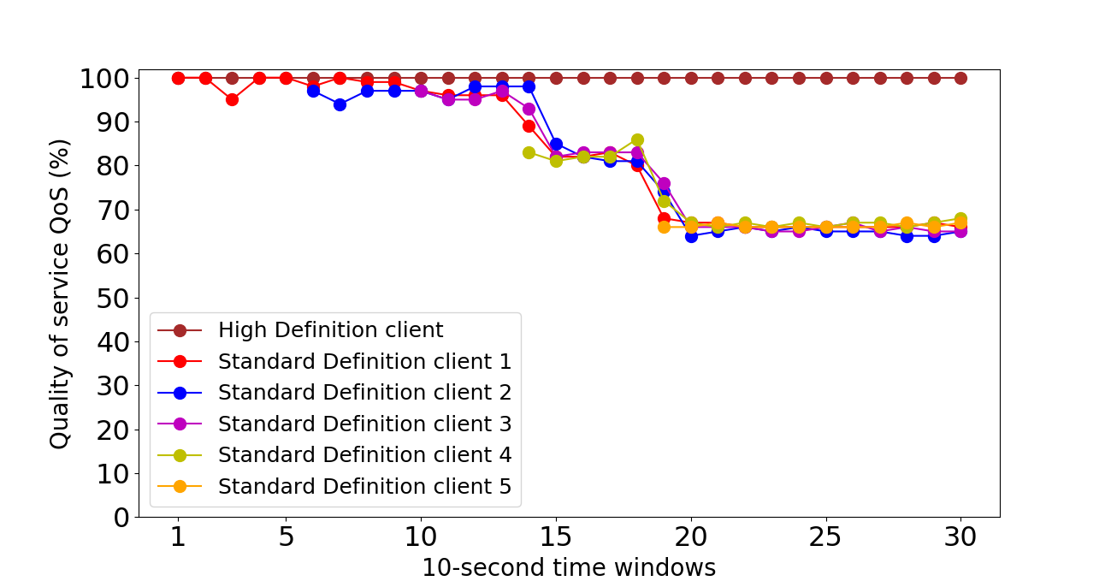
Performance Evaluation of varied KPI’s in Dynamic Radio Access Network(RAN) Slicing of 5G Networks
Team: Lavanya Shahapur, Ajay Kushal, Pragathi Pujari, Kushagra Tomar, Ashwini Jannu
Guided by : Mr. Parikshit P Hegde
Mini-Project, 5th Sem, 2022-23
School of Computer Science and Technology
TM
Problem Domain :
The second method of interaction is by using the Topology Generator that generates random network topologies. The third method of interaction is by the user providing its own infrastructure and services.
Quality of service (QoS) ensures stable performance of applications which allows clients to modify network traffic by prioritizing high-performance applications which is computed every 10 seconds.
..
Problem Definition :
To support multiple logical networks over common infrastructure and to evaluate KPI’s with respect to the video streaming use case. To design and customize the network slices to meet the demands of all use cases dynamically
Conclusion :
When workload starts to increase, QoS of video streaming service of the users belonging to ''High Definition'' remains unchanged, whereas for the users belonging to 'Standard Definition', the QoS starts to decrease. Therefore, the created slices are able to meet their expected results.
Objectives :
To simulate the dynamic slicing of 5G RAN
To simulate resource allocation with tailored solutions to separate slices.
To evaluate the performance of services running on 5G RAN slicing
Results :
Methodology :
The proposed system allows multiple networks to be created on top of common physical infrastructure. It enables service providers to build virtual end-to-end networks. The system supports three ways of user interactions. The first method is that user can provide the output of an optimization model to the model adapter.
Publication status :
Paper is accepted in ICSSIT 2023 conference.
Paper submitted in ERCICA 2023 conference.
The horizontal axis depicts the time window and vertical axis depicts the QoS received by each user.

