Slide 1

“Improving Energy Efficiency through Massive MIMO and Small-Cells in 5G Networks”
Team No: N4
Name | USN
Pragathi Pujari | 01FE20BCS189
B Ajay Kushal | 01FE20BCS289
Lavanya Shahapur | 01FE20BCS185
Kushagra Tomar | 01FE20BCS063
Ashwini Jannu | 01FE20BCS208
Guided by
Mr.Parikshit P Hegde

Slide 2

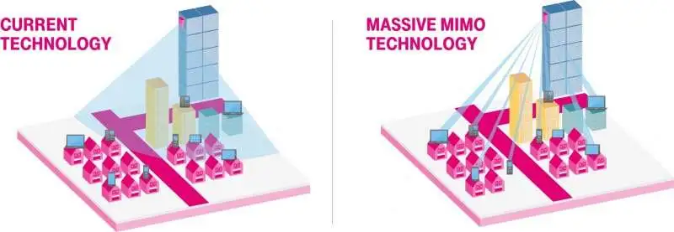
Introduction: Massive MIMO
Massive MIMO can increase the capacity 10 times or more and simultaneously improve the radiated energy-efficiency in the order of 100 times.
Massive MIMO can be built with inexpensive, low-power consumption.
Massive MIMO enables a significant reduction of latency on the air interface (due to robustness against fading).

Slide 3
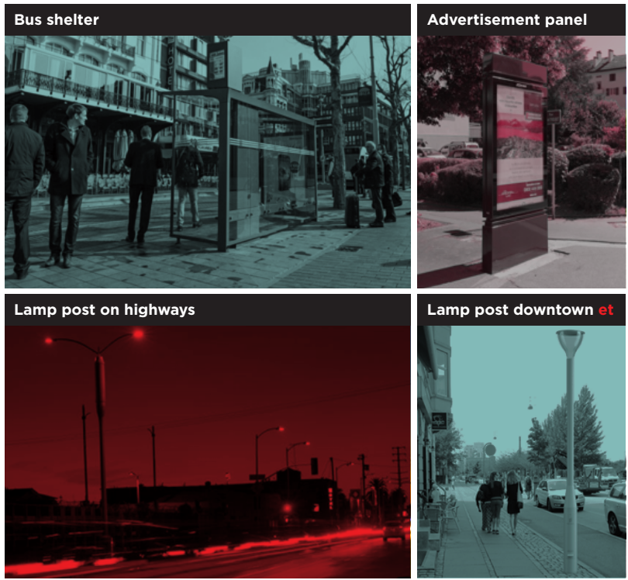
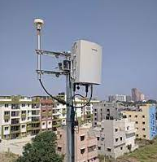
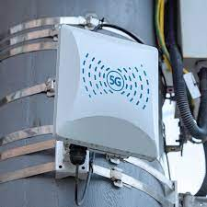
Introduction: Small cells
5G small cells are base stations that cater to a small segment of a macro site. They are usually deployed in dense urban areas such as downtown, stadiums, train stations, malls, and areas with high data capacity requirements and coverage.
Macro base stations have penetration issues indoors, significantly when metallic structures obstruct the network signals. Thus the need for coverage indoors and in large venues like stadiums is prevalent, where capacity is a significant issue – that’s where small cell systems play as the leading solution.

Slide 4
Motivation
Energy consumption becomes a critical concern for 5G networks because the ICT sector already contributes significantly toward the global carbon footprint.
The design of current wireless networks based on Long-Term Evolution (LTE) are characterized by poor energy efficiency (EE) and large disparity between peak and average rates.
The macro-cell network topology is well-suited for providing wide-area coverage, but cannot handle the rapidly increasing user numbers and QoS expectations.
To meet up the strict demands of next-generation wireless platforms and 5G networks, maximising energy efficiency becomes the need of the hour.

Slide 5
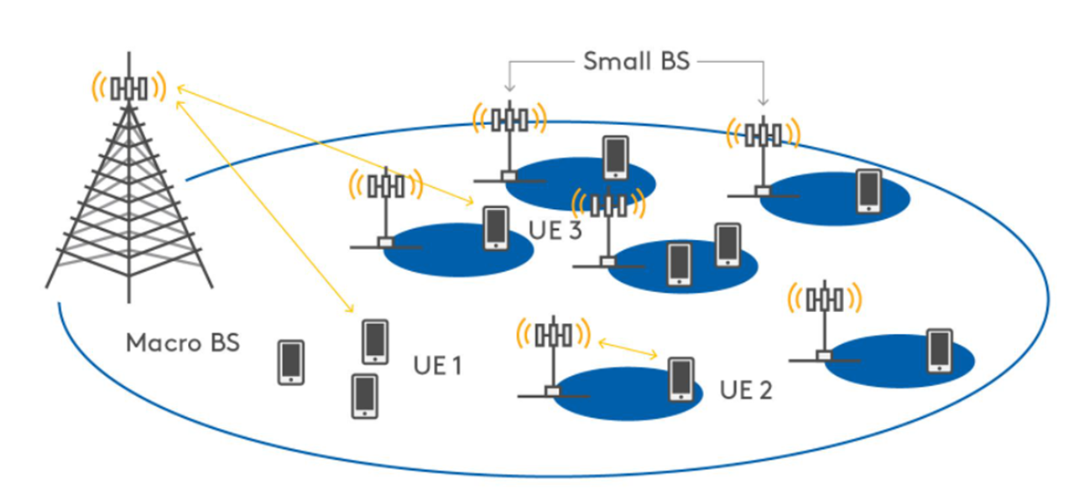
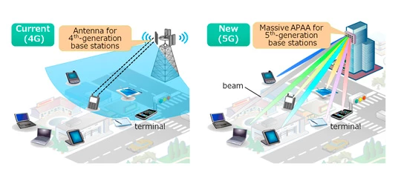
Problem Formulation
Present day macro-cell network topology is well-suited for providing wide-area coverage, but cannot handle the rapidly increasing user numbers and QoS expectations of modern society.
MU MIMO systems uses intensive signal processing and user scheduling algorithms, while Massive MIMO system uses simple user scheduling algorithms at BS, providing high energy efficiency and low power consumption.
The high traffic demands expected in 5G is meet by decreasing the cell size and increasing the number of small cells (SCs) per unit area.
Massive MIMO System can meet the Quality of Service (QoS) Expectations of the modern society while increasing number of users.

Slide 6
Problem Statement
“Improving Cellular Energy Efficiency by Combined Simulation of Massive MIMO and Small-Cells in 5G Networks”

Slide 7
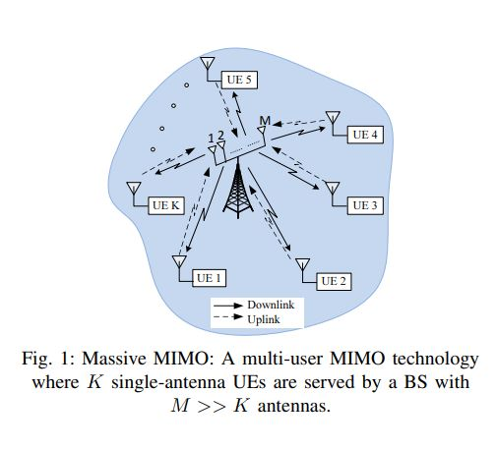
Problem Analysis
An important design criterion for 5G networks is bit-per-joule energy efficiency (EE) defined as EE = R/P, Energy Efficiency = Throughput (R)/Power Consumption (P)
The sum power consumption P, aggregated over UpLink(UL) and DownLink(DL) transmissions in an Massive MIMO system, can be modelled as P = P_{PA} + P_{C} + P_{sys} where
P_{PA}- total UL and DL power consumed by the power amplifiers (PAs) at the Base Station and the User Equipments,
P_{C} - total UL and DL circuit power expenditure
P_{sys} - the remaining system-dependant component in P
The main benefit of small cells is the reduced propagation losses, while the main benefit of massive MIMO is the interference suppression among the User Equipments that share the energy costs associated with the serving Base Stations.

Slide 8
Objectives / Goals
To improve the cellular energy efficiency, without sacrificing Quality-of-Service (QoS).
To densify ‘Network Topology’ to enable higher spatial reuse.
1. MIMO base stations
2. Small-cell access points.
To minimize the total power consumption while satisfying QoS constraints at the users and power constraints at the Base Station and Small cells.

Slide 9
Massive MIMO and small cells
Two main approaches that we are currently investigating:
Massive MIMO: Deploy large-scale antenna arrays at existing macro base stations (BSs). This enables precise focusing of emitted energy on the intended users, resulting in a much higher energy efficiency.
Small-cell Access Points: Deploy an overlaid layer of small-cell access points (SCAs) to offload traffic from BSs, thus exploiting the fact that most data traffic is localized and requested by low-mobility users. This approach reduces the average distance between users and transmitters, which translates into lower propagation losses and higher energy efficiency.

Slide 10
Literature Survey
Energy Efficiency in 5G Massive MIMO for Mobile Wireless Network
Ali Hameed Ahmed, Ahmed Thair Al-Heety , Belal Al-Khateeb,Alaa Hamid Mohammed
5G Massive MIMO
A new direction for wireless networks has emerged due to the evaluation of mobile devices and applications in the current decade. This paper concentrates on three of objective proposed method that starts from, to investigate energy efficiency concepts, features, and design constraints of UDNs, to examine hardware impairments and their impact on massive MIMO. And to analyze and discuss the network capacity and energy efficiency for UDNs and how the network density affects the EE.
Energy Efficiency in new Techniques and Deployment
The introduction of D2D communications, massive MIMO, and small cells for 3GPP LTE Advanced networks has been proposed as a way of handling the tremendous growth in mobile data traffic and reducing the huge infrastructural cost. In the D2D communications, near-by cellular network users can directly share data without passing the BS. Being physical close to each other, D2D communications can assure proximity benefits, hop gain, and reuse gain. Thus, device EE can be improved by D2D communications.
Random Waypoint Mobility Model
The massive MIMO technology is the major driver for 5G, where the BSs are designed with several antennas to achieve multiple spectral and EE gains over the existing LTE networks. Random Waypoint Mobility Model is used in which each node is meant to select a random destination. The node travels towards the selected position in a straight line at a randomly selected uniform speed. Upon reaching the destination, the node stops for a specified period known as pause time and then continues to repeat its movement. Each node is executed within a fixed area, where it selects its destination and move randomly within the selected area.
Energy Efficiency
The performance metric used is energy efficiency (EE) which plays a very important role in identifying the gain achieved by implementing energy efficient strategies in wireless cellular networks. It is used to measure the energy consumption per information bit that is successfully transmitted over the network. It is measured in joules per bit. Energy Efficiency= (Energy of successfully transmitted bit/Total Energy)

Slide 11
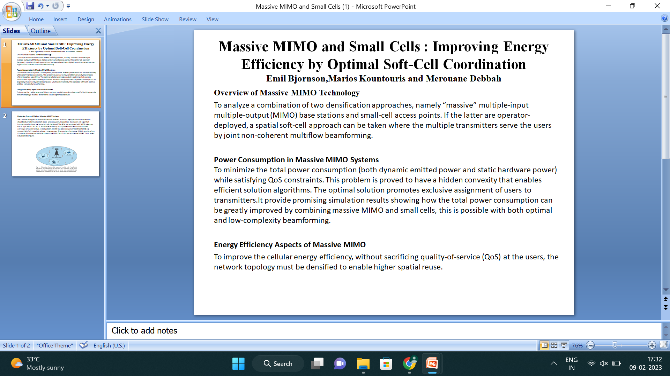
Literature Survey

Slide 12
Literature Survey
Energy-efficient future wireless networks: A marriage between massive MIMO and small cells
Emil Björnson, Luca Sanguinetti, Marios Kountouris
Cellular Network
Cellular networks are modeled by using stochastic geometry and optimize the energy efficiency with respect to the density of base stations, the number of antennas and users per cell, the transmit power levels, and the pilot reuse.
Massive MIMO and small cells
Smaller cells are obtained by densifying the base station (BS) deployment. This has a positive effect on the EE in terms of increasing the SE and reducing the transmit power (due to lower propagation losses). Massive MIMO evolves the conventional BS technology by replacing the bulky high-gain vertical antennas with arrays comprising hundreds of small dipole antennas.
System Model
A cellular network that is designed to serve users from a heterogeneous user distribution. Each BS has M antennas and serves K single-antenna user equipments (UEs). Each UE connects to its closest BS. The UEs are assumed to be uniformly distributed in the cells. Since there are K UEs per cell, small cells have higher user density (per km2 ) than larger cells, giving a judicious deployment based on a heterogenous user distribution.
Energy Efficiency Maximization
A. Optimal Pilot Reuse Factor β: Both ρ and M amplify the desired signal, which as consequence improves channel estimation and makes the system operate in a less noise limited regime.
B. Optimal BS Density and Radiated Power: An EE perspective it is preferable to have as high BS density as possible. This might sound counterintuitive at first, since the inter-cell interference typically grows as the cells become smaller.
C. Optimal Number of Antennas and UEs per BS: For analytical tractability, we first fix the number of BS antennas per UE, and find the EE-maximizing value of K. K increases with the static energy consumption. More hardware should be turned on (i.e., BS antennas and UEs per cell) only if the increase in circuit power has a marginal effect.

Slide 13
Literature Survey
Energy-efficient Design for MIMO Two-Way AF Multiple Relay Networks
Ahmad Alsharoa, Hakim Ghazzai, Mohamed-Slim Alouini
Two Way Relay Communication
In Two Way Relay Networks equipped with multi-input multi output antennas where each relay employs an amplify-and-forward strategy.So, the power consumption is more. The algorithm set up by in the paper tries to minimise the total power consumption without degrading the quality of service of the terminals.
System Model
A cellular network is formed in which two MIMO TWRN’s with two Terminals T1 and T2 exchanging data via half duplex relays using AF strategy in the absence of direct T1-T2 link .
Simulation and Results
The challenge is to find the optimal amplification factors at the relays. The idea is to adjust the terminal and relay powers simultaneously and iteratively until reaching an optimal solution.
Algorithm : Particle swarm optimization Technique
This algorithm helps to compute the total optimal power values for the random particles present in an initial population.
The graphical results show that the interpretation obtained when power consumed by T1> T2 , has a similar behaviour due to the symmetry of the TWRN’s. Thus it is clear that the total power consumed in the relays follows the behaviour of the total sum power consumed in the terminals.

Slide 14
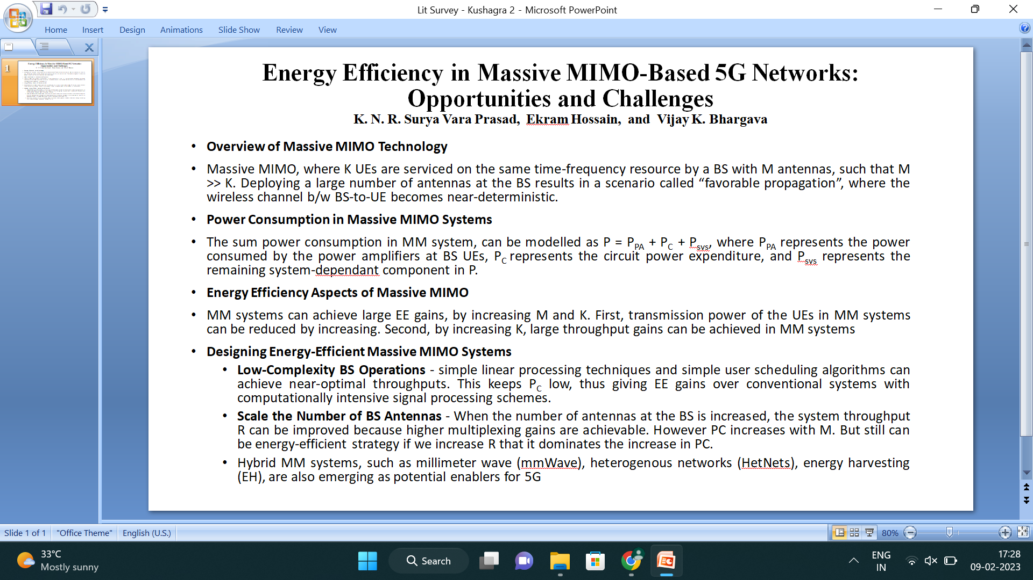
Literature Survey

Slide 15
THANK YOU

