Slide 1

“Reducing Power Consumption by Combined Simulation of Massive MIMO and Small-Cells”
Team No: N4
Name | USN
Pragathi Pujari | 01FE20BCS189
B Ajay Kushal | 01FE20BCS289
Lavanya Shahapur | 01FE20BCS185
Kushagra Tomar | 01FE20BCS063
Ashwini Jannu | 01FE20BCS208
Guided by
Mr.Parikshit P Hegde

Slide 2

Problem Statement
“Reducing the Cellular Power Consumption by Combined Simulation of Massive MIMO and Small-Cells”

Slide 3
Objectives / Goals
To minimize the total power consumption while satisfying Quality-of-Service (QoS) constraints at the users and power constraints at the Base Station and Small cells.
To provide promising simulation results showing total power consumption can be improved by combining massive MIMO and small cells.
To compare and analyse the results of the proposed algorithm with other beamforming algorithms.

Slide 4
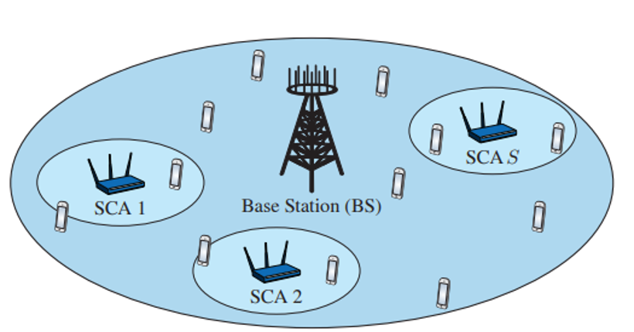
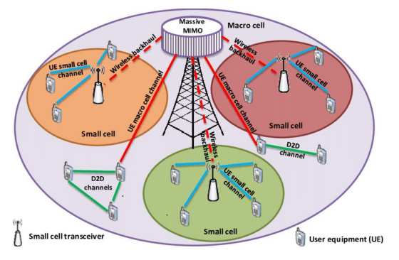
Suggestions from Review 1
How to reduce Power Consumption ?
Dealing with SINR problem
Which problem is to be solved ?

Slide 5
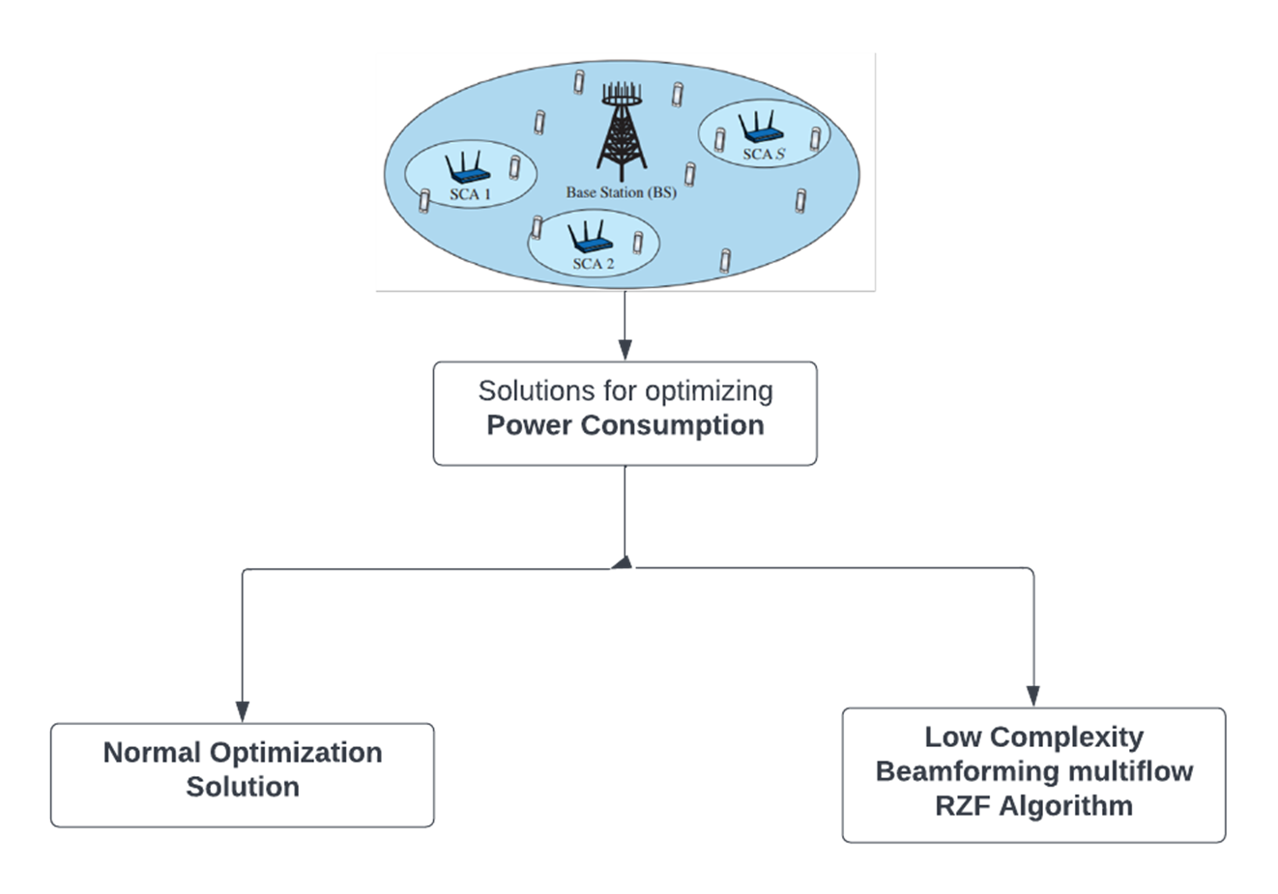
Flow Chart

Slide 6
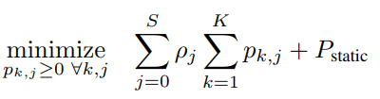
Algorithm Design
Low-complexity Non-iterative Multiflow-RZF Beamforming Algorithm :
Step1 : Each SCA computes the energy required for serving the user. Additionally, each SCA sends the scalar values channel coefficients and weighting matrices, to the BS.
Step2 : The BS then optimizes the power allocation across all transmitters by minimizing the both dynamic and static power. This is done by solving a convex optimization problem
Where ρj accounts for the inefficiency of the power amplifier at the jth transmitter. The objective is to minimize the total transmit power while satisfying the power constraint and QoS constraint.
Step3 : Once the optimal power allocation is determined, the BS sends the optimal power allocation, back to the jth SCA. The SCA then uses these values to compute the transmit signal.

Slide 7
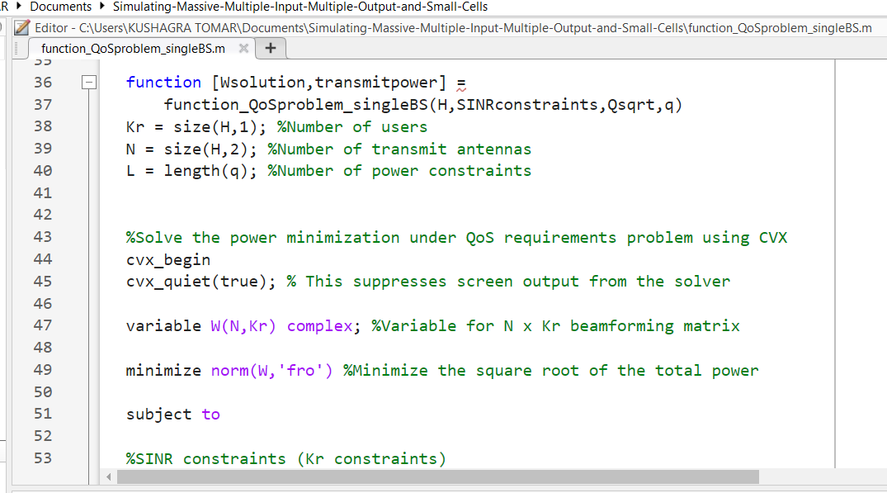
Implementation of Modules
Consider N_{BS} = 50 and N_{SCA} = 2 for different QoS constraints. Three beamforming algorithms are compared:
1) Optimal beamforming using only the BS
2) Optimal spatial soft-cell coordination
3) Multiflow-RZF Beamforming proposed
Fig. Optimal beamforming using only the BS

Slide 8
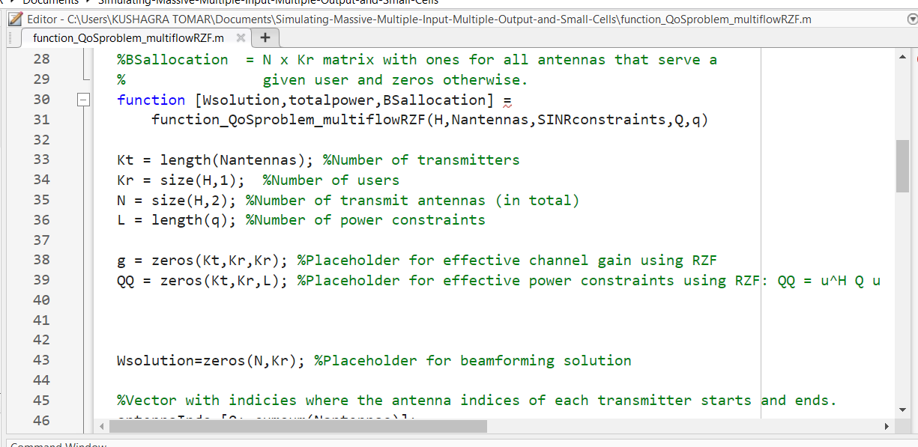
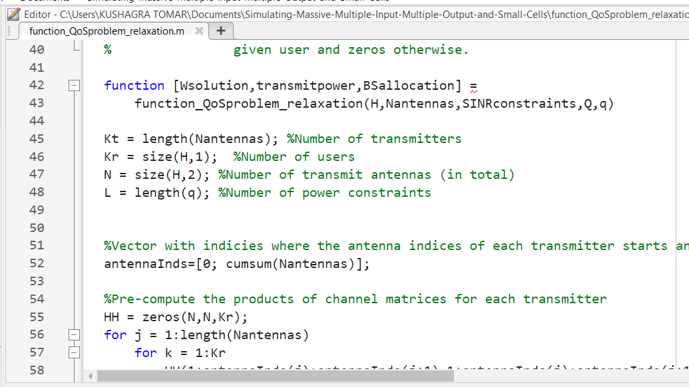
Implementation of Modules
Fig.Multiflow-RZF proposed
Fig.Optimal spatial soft-cell coordination

Slide 9
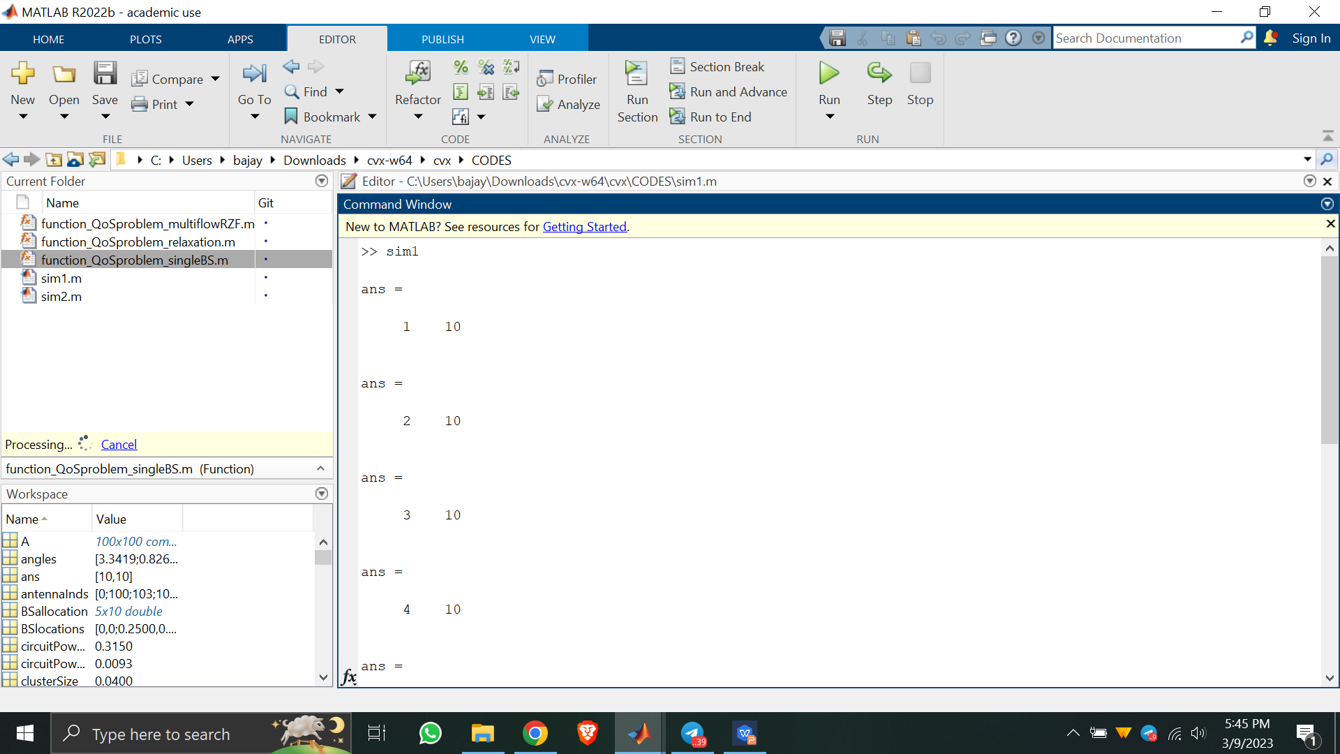
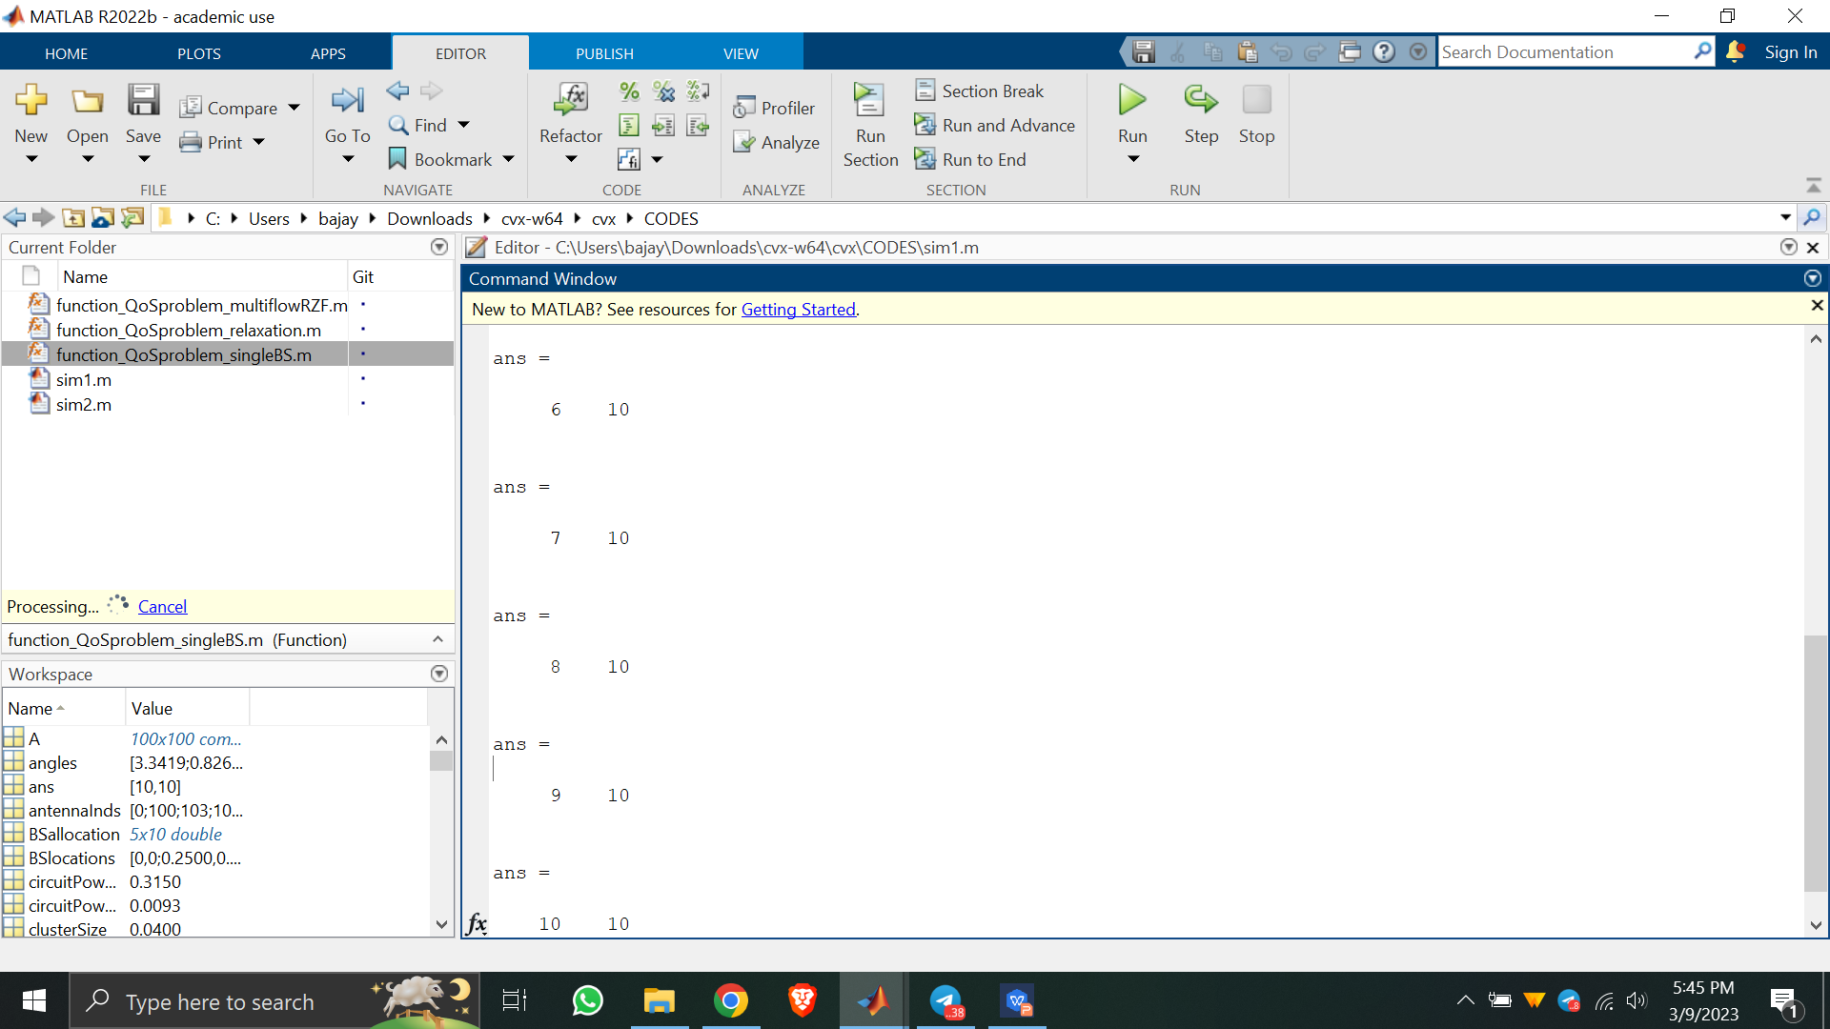
Intermediate Result Analysis
Fig. This figure depicts the completion of simulation for all 10 users.

Slide 10
THANK YOU

