Slide 1

“Reducing Power Consumption by Combined Simulation of Massive MIMO and Small-Cells”
Team No: N4
Name | USN
Pragathi Pujari | 01FE20BCS189
B Ajay Kushal | 01FE20BCS289
Lavanya Shahapur | 01FE20BCS185
Kushagra Tomar | 01FE20BCS063
Ashwini Jannu | 01FE20BCS208
Guided by
Mr.Parikshit P Hegde

Slide 2

Problem Statement
“Reducing the Cellular Power Consumption by Combined Simulation of Massive MIMO and Small-Cells”

Slide 3
Objectives / Goals
To minimize the total power consumption while satisfying Quality-of-Service (QoS) constraints at the users and power constraints at the Base Station and Small cells.
To provide promising simulation results showing total power consumption can be improved by combining massive MIMO and small cells.
To compare and analyse the results of the proposed algorithm with other beamforming algorithms.

Slide 4
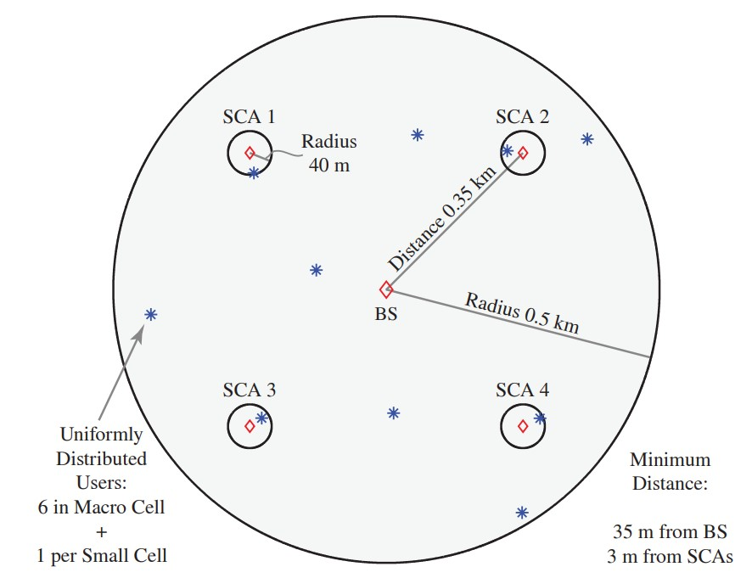
Approaches Used
1) Optimal Beamforming using only BS
2) Optimal Spatial SoftCell coordination
3) Low Complexity RZF Beamforming

Slide 5
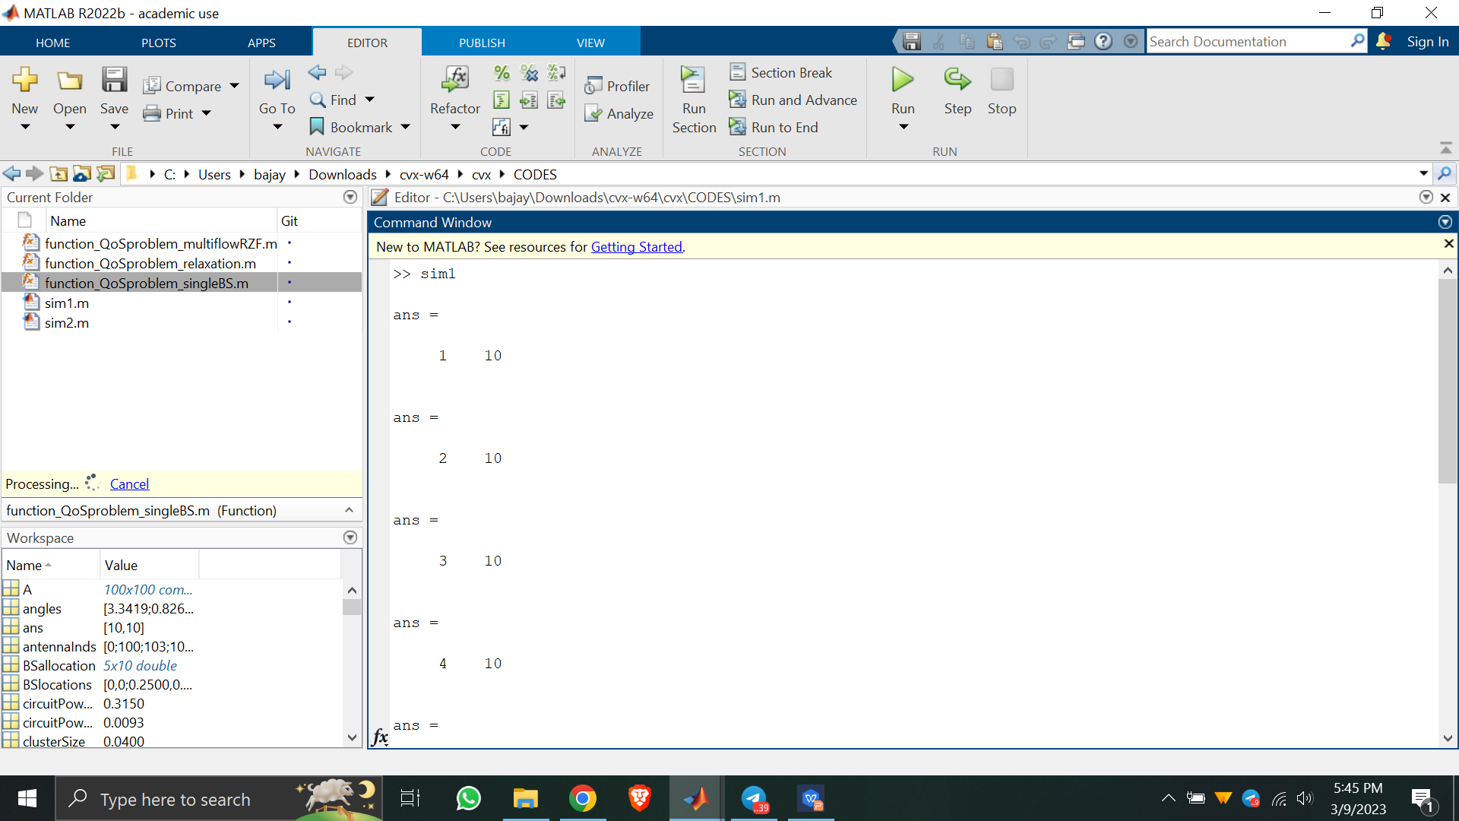
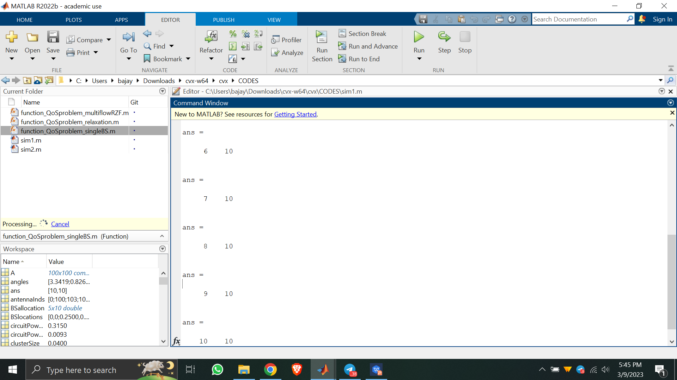
Result Analysis
Fig. This figure depicts the completion of simulation for all 10 users.

Slide 6
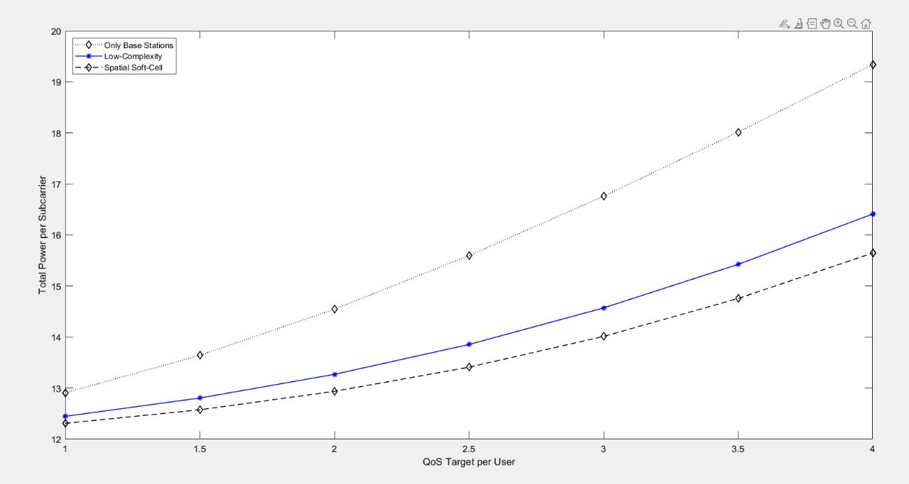
Result Analysis
 | QoS | Total Power
Only BS | 1 | 12.9
 | 2 | 14.5
 | 4 | 19.2
Low Complexity.RZF | 1 | 12.5
 | 2 | 13.1
 | 4 | 16.4
Spatial Soft cell | 1 | 12.4
 | 2 | 12.9
 | 4 | 15.6
Fig. Base Graph

Slide 7
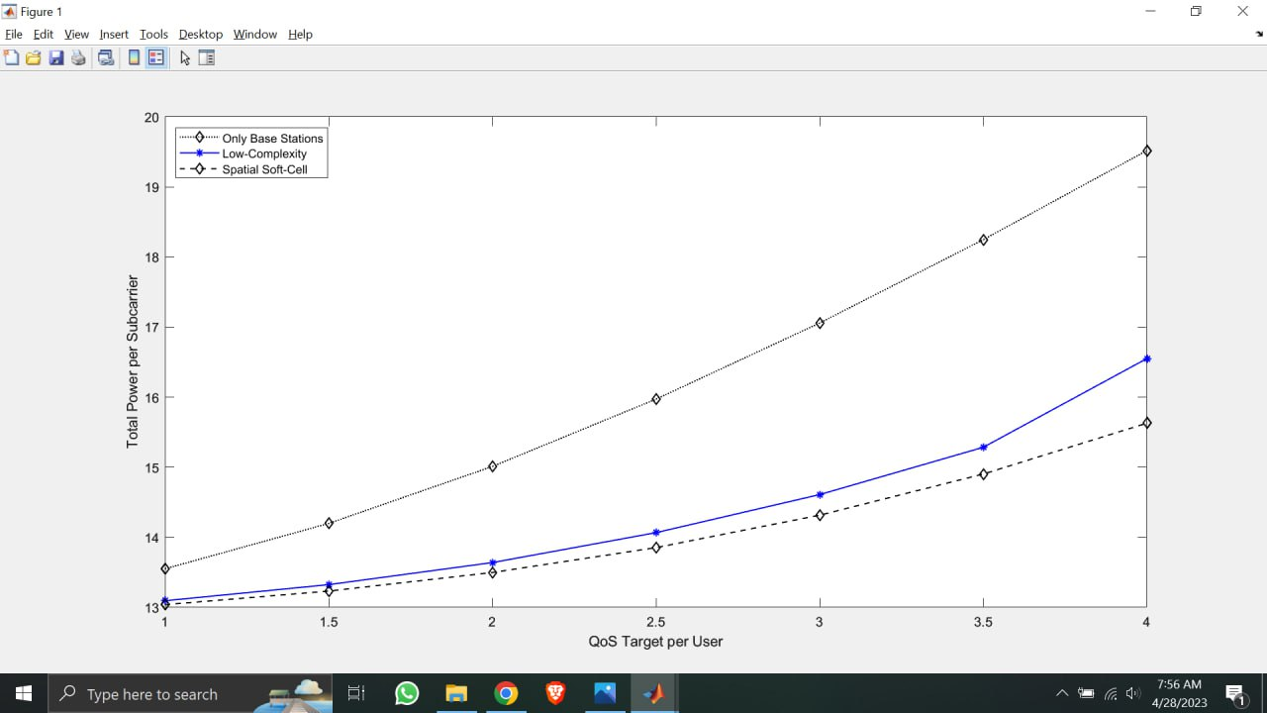
Result Analysis
 | QoS | Total Power
Only BS | 1 | 13.5
 | 2 | 15.0
 | 4 | 19.5
Low Complexity RZF | 1 | 13.1
 | 2 | 13.5
 | 4 | 16.5
Spatial Soft cell | 1 | 13.0
 | 2 | 13.4
 | 4 | 15.7
Increased Maximal transmit power per subcarrier and No. of Antennas at BS, SCA marginally.
Fig. Graph A

Slide 8
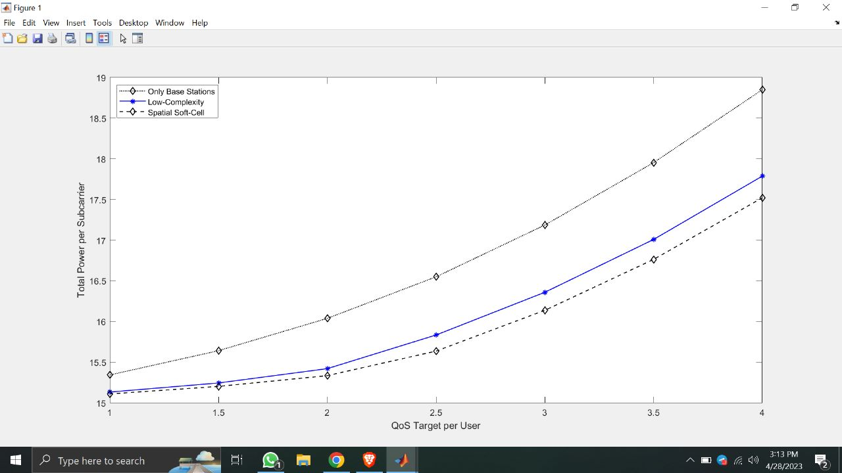
Result Analysis
 | QoS | Total Power
Only BS | 1 | 15.3
 | 2 | 16.1
 | 4 | 18.8
Low Complexity RZF | 1 | 15.1
 | 2 | 15.3
 | 4 | 17.7
Spatial Soft cell | 1 | 15.1
 | 2 | 15.2
 | 4 | 17.5
Decreased Maximal transmit power marginally, while doubled the No. of Antennas at BS, SCA.
Fig. Graph B

Slide 9
Conclusion
The total power of Only BS to achieve the required QoS is higher than the Low Complexity RZF and Spatial Soft Cell approach, due to high amount of power required to overcome the interference.
We can achieve same Quality of Service (QoS) requirements with reduced total power with both Low Complexity RZF algorithm and Spatial Soft Cell usage.
The total power of Low Complexity RZF is slightly more than the Spatial Softcell because of its high complexity and computational requirements. Still this approach is better due to its ability to mitigate user interference making it practical for real world applications.

Slide 10
THANK YOU

