Slide 1
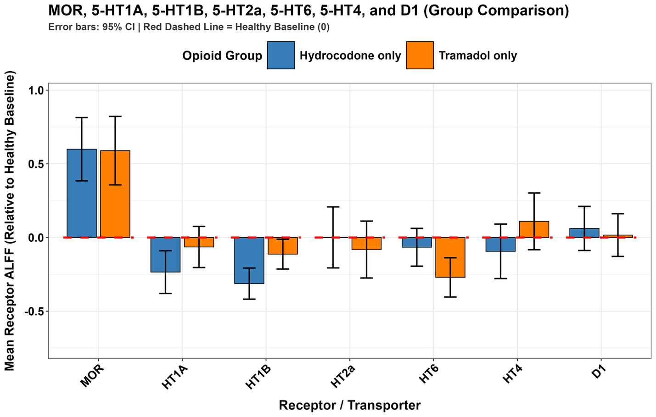
Receptor Related Brain Activity
5
5
5
5
5

